Slide 1
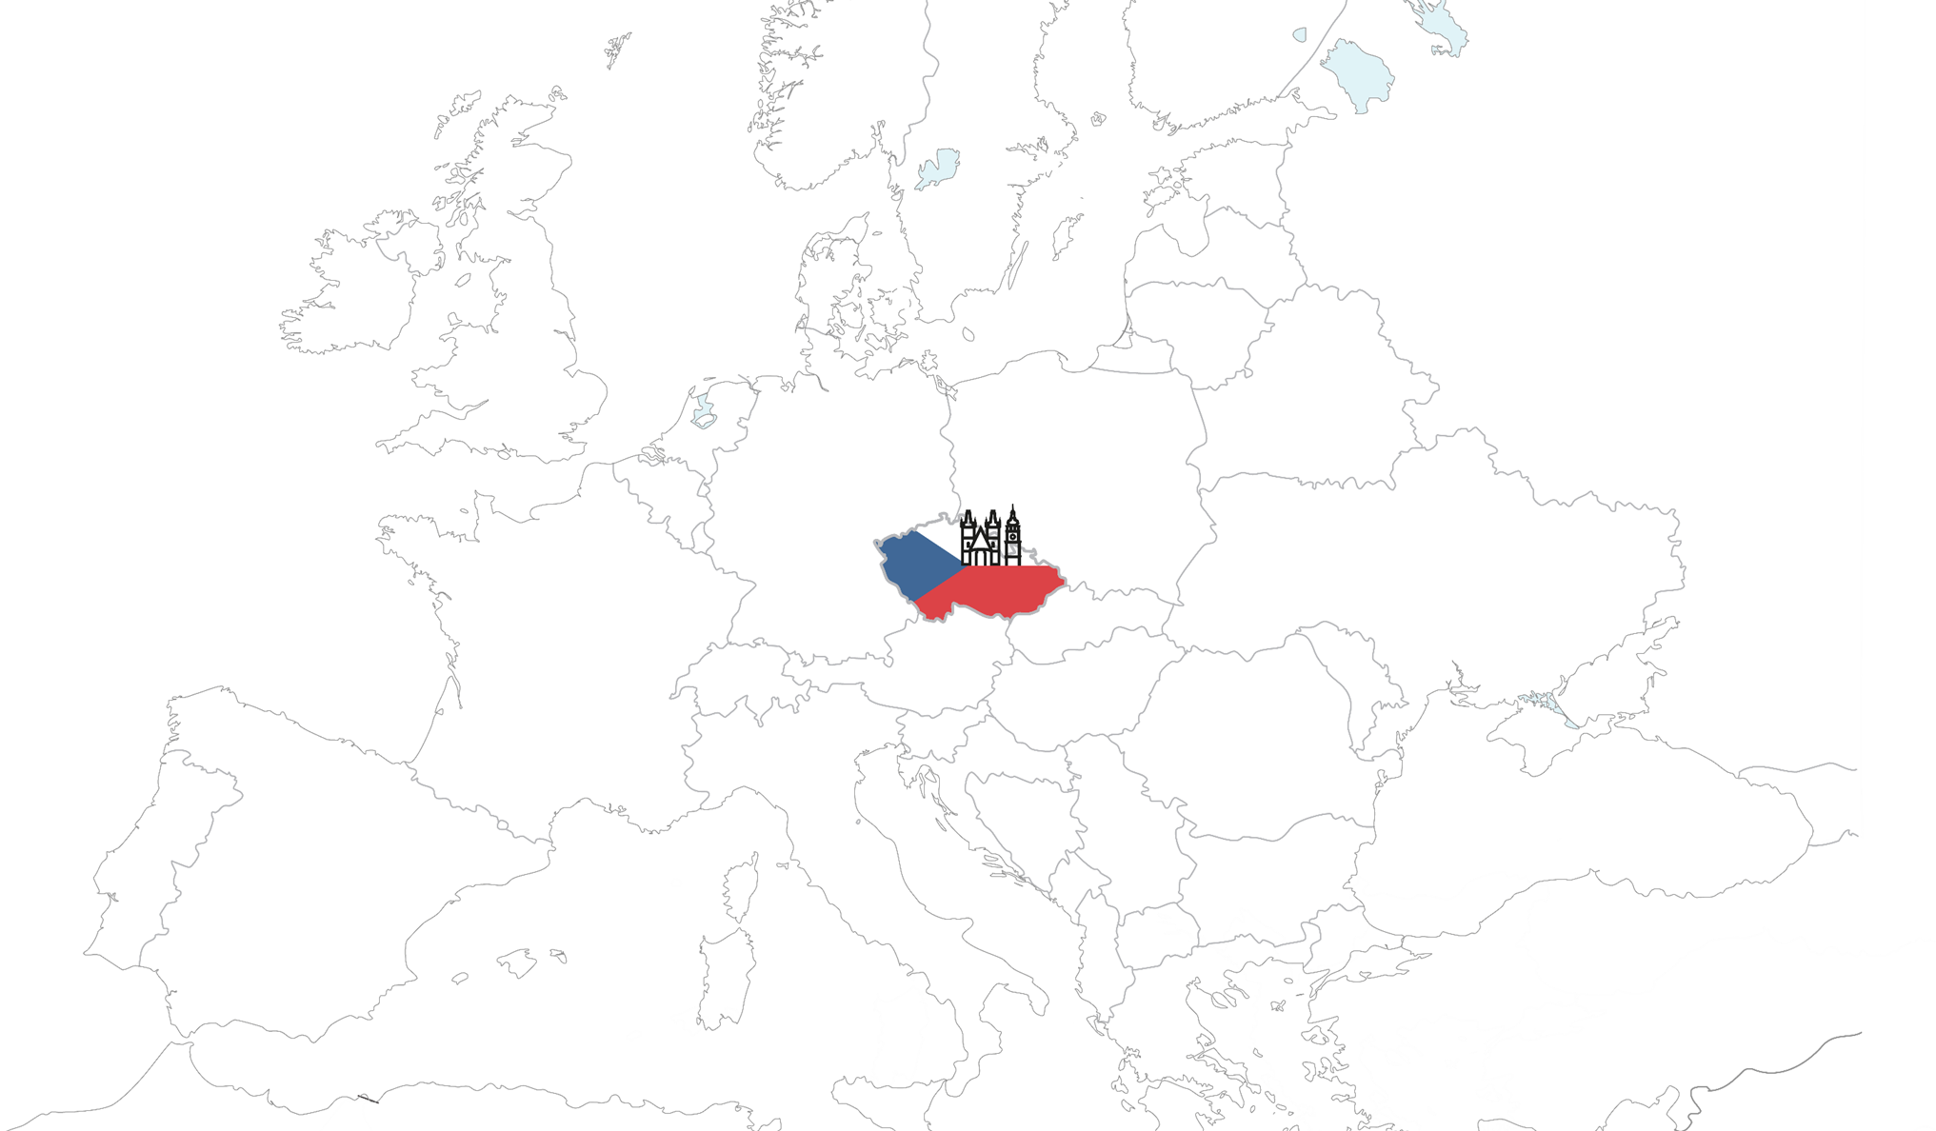


Introduction of the University of Hradec Králové

Slide 2


Location
Hradec Králové
Central Europe, Eastern Bohemia
Capital of the region, approx. 93 000 inhabitants
One of the safest cities in the Czech Republic

Slide 3


Location
Hradec Králové
Rich history
Green city
Amazing architecture
Cultural events
Easy transportation
Affordable cost of living

Slide 4
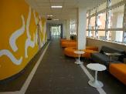
University of Hradec Králové

Slide 5




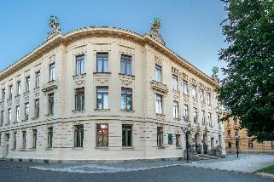

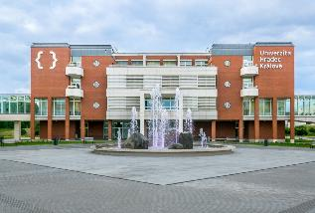
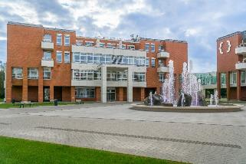
University of Hradec Králové

Slide 6

University of Hradec Králové
a public university since 1959
more than 6 000 students in full or part-time form of studies of all ages
preparing competitive graduates for the global labor market
keeping to high standards of the European education
around 90 study programmes in bachelor, masters and doctoral studies

Slide 7


Study & Students

Slide 8
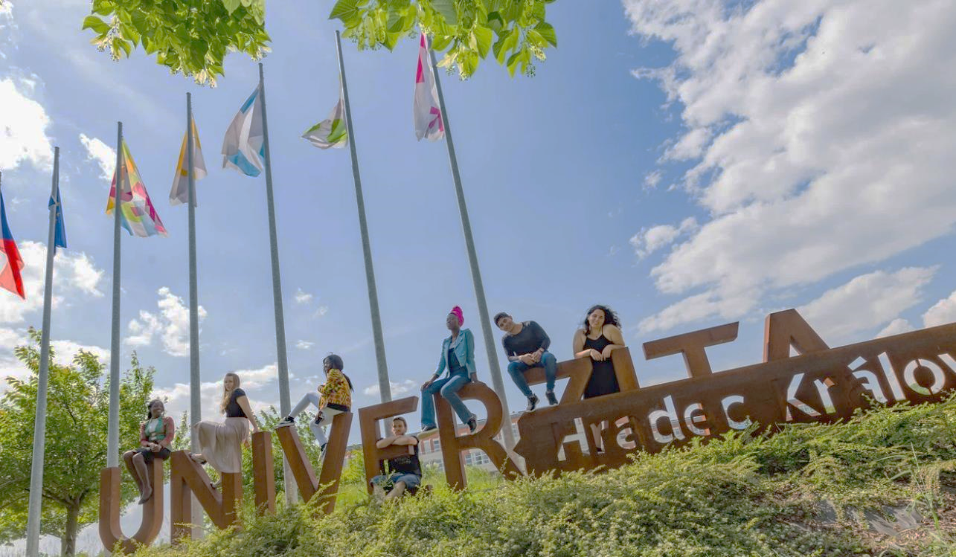
University of Hradec Králové
Degree programmes
3yrs Bachelor
2yrs Master
4yrs Doctoral
around 30 English-taught study programmes
summer schools with various focuses on IT, Czech culture and language or science, including extra leisure activities
modern campus, libraries, laboratories
vibrant student life (3 universities in town)

Slide 9




University of Hradec Králové
UHK proves its high standard by passing strict criteria of prestigious international rankings such as QS or THE, it has also successfully qualified in a ranking devoted to sustainability and ecology – the UI Green Metric.
UHK qualifying in 2023-2024 rankings
THE WUR | 1201–1500
THE BY SUBJECT: Computer Science | 601–800
THE BY SUBJECT: Physical Science | 1001+
THE BY SUBJECT: Life Sciences | 601–800
THE Young Universities | 401–500
THE Emerging Economies | 401–500
QS WUR | 1001–1200
QS Europe | 398
UI GREEN METRIC | 486

Slide 10

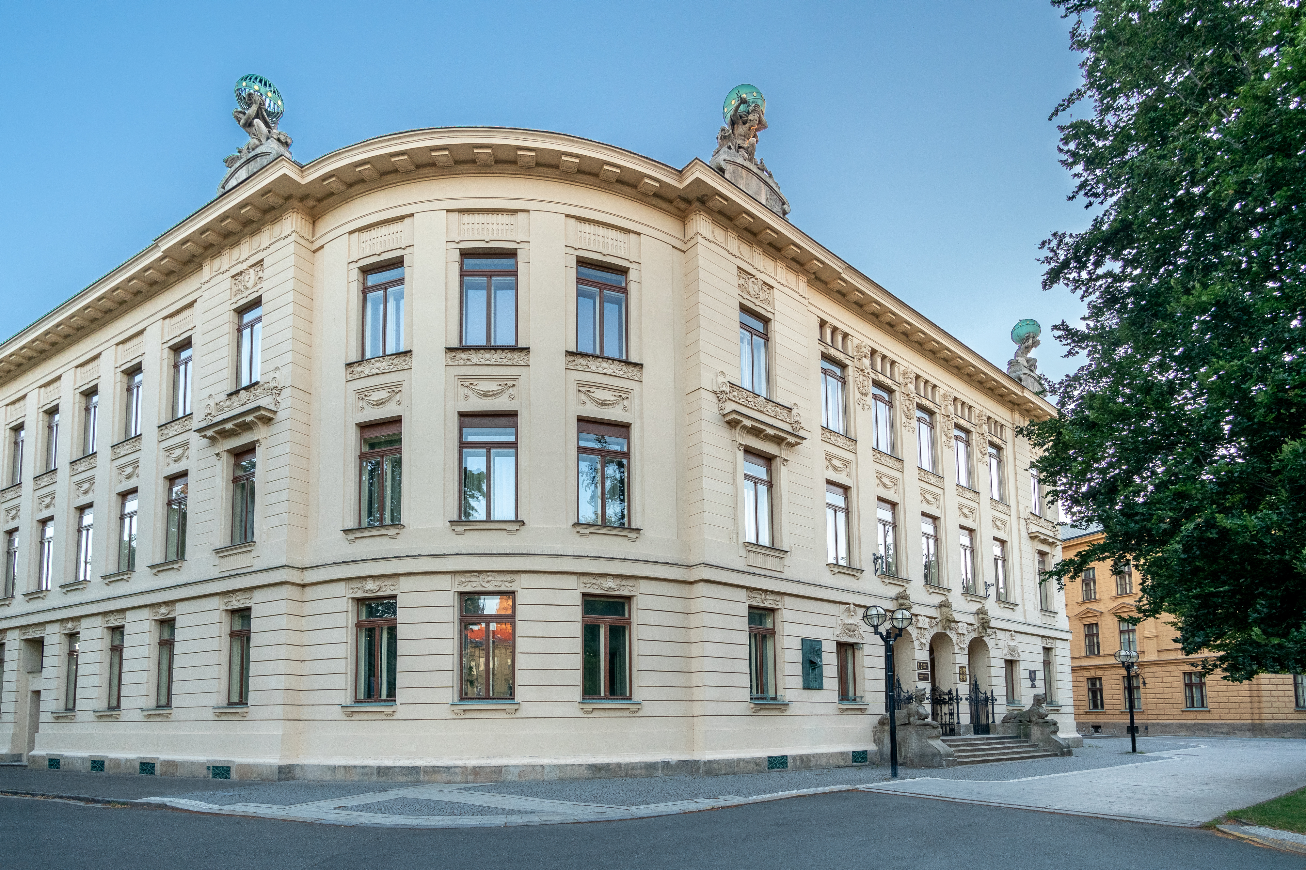
Faculty of Education
Programmes taught in English:
Undergraduate
Playing a Musical Instrument Focused
on Education
Solo Singing Focused on Education
Transcultural Communication
Graduate
Early Childhood Education with a Focus
on Children with Special Needs
Teaching at Basic Art Schools - Playing
a Musical Instrument and Solo Singing

Slide 11

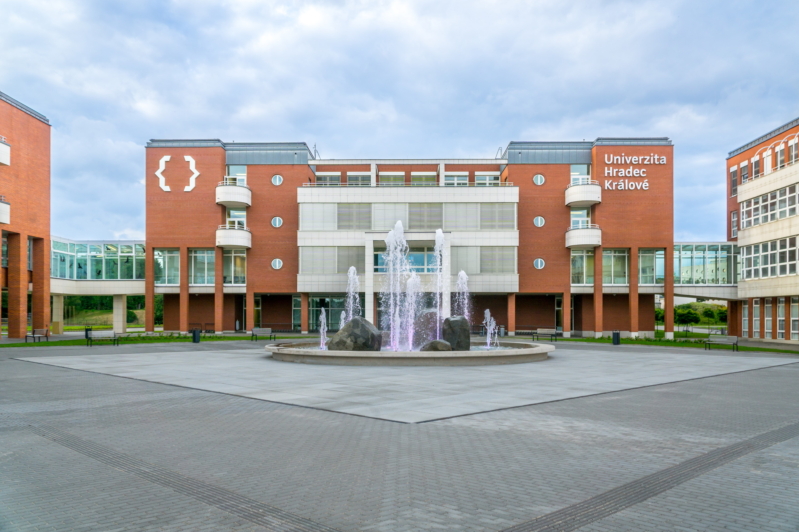
Faculty of Informatics and Management
Programmes taught in English:
Undergraduate
Information Management
Graduate
Economics and Management
Information Management
Postgraduate
Economics and Management
Applied Informatics
Information and Knowledge Management

Slide 12


Philosophical Faculty
Programmes taught in English:
Undergraduate
Political Science
Political Science - Double Degree
Graduate
Central European Studies
Philosophy
Postgraduate
Philosophy

Slide 13

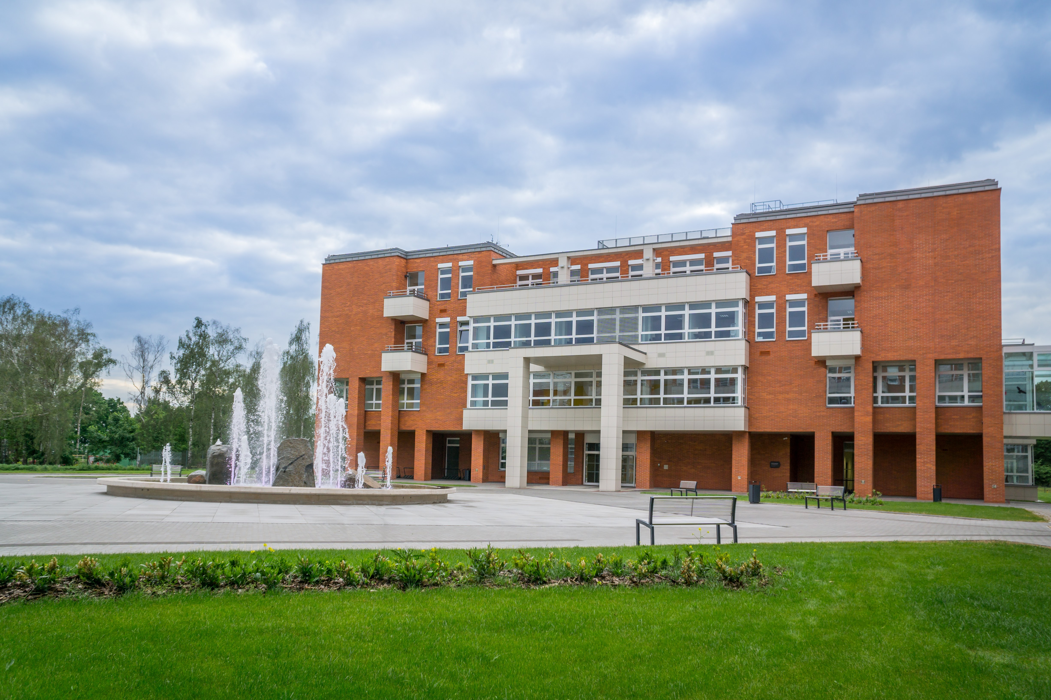
Faculty of Science
Programmes taught in English:
Undergraduate
Biology and Ecology
Chemistry – Spec. Bioorganic Chemistry; Spec. Toxicology and Analysis of Pollutants
Graduate
Biology and Ecology – Spec. Experimental Biology; Spec. Plant Biology; Spec. Animal Biology
Chemistry – Spec. Toxicology and Analysis of Pollutants; Spec. Bioorganic Chemistry; Spec. Analysis of Biomolecules
Postgraduate
Biology and Ecology
Toxicology

Slide 14


Internationalization
Internationalization as a cross-sectional activity
High importance for science and research as well as for teaching and education
Key element of many particular activities at the university

Slide 15
International Students

Slide 16
International Staff

Slide 17
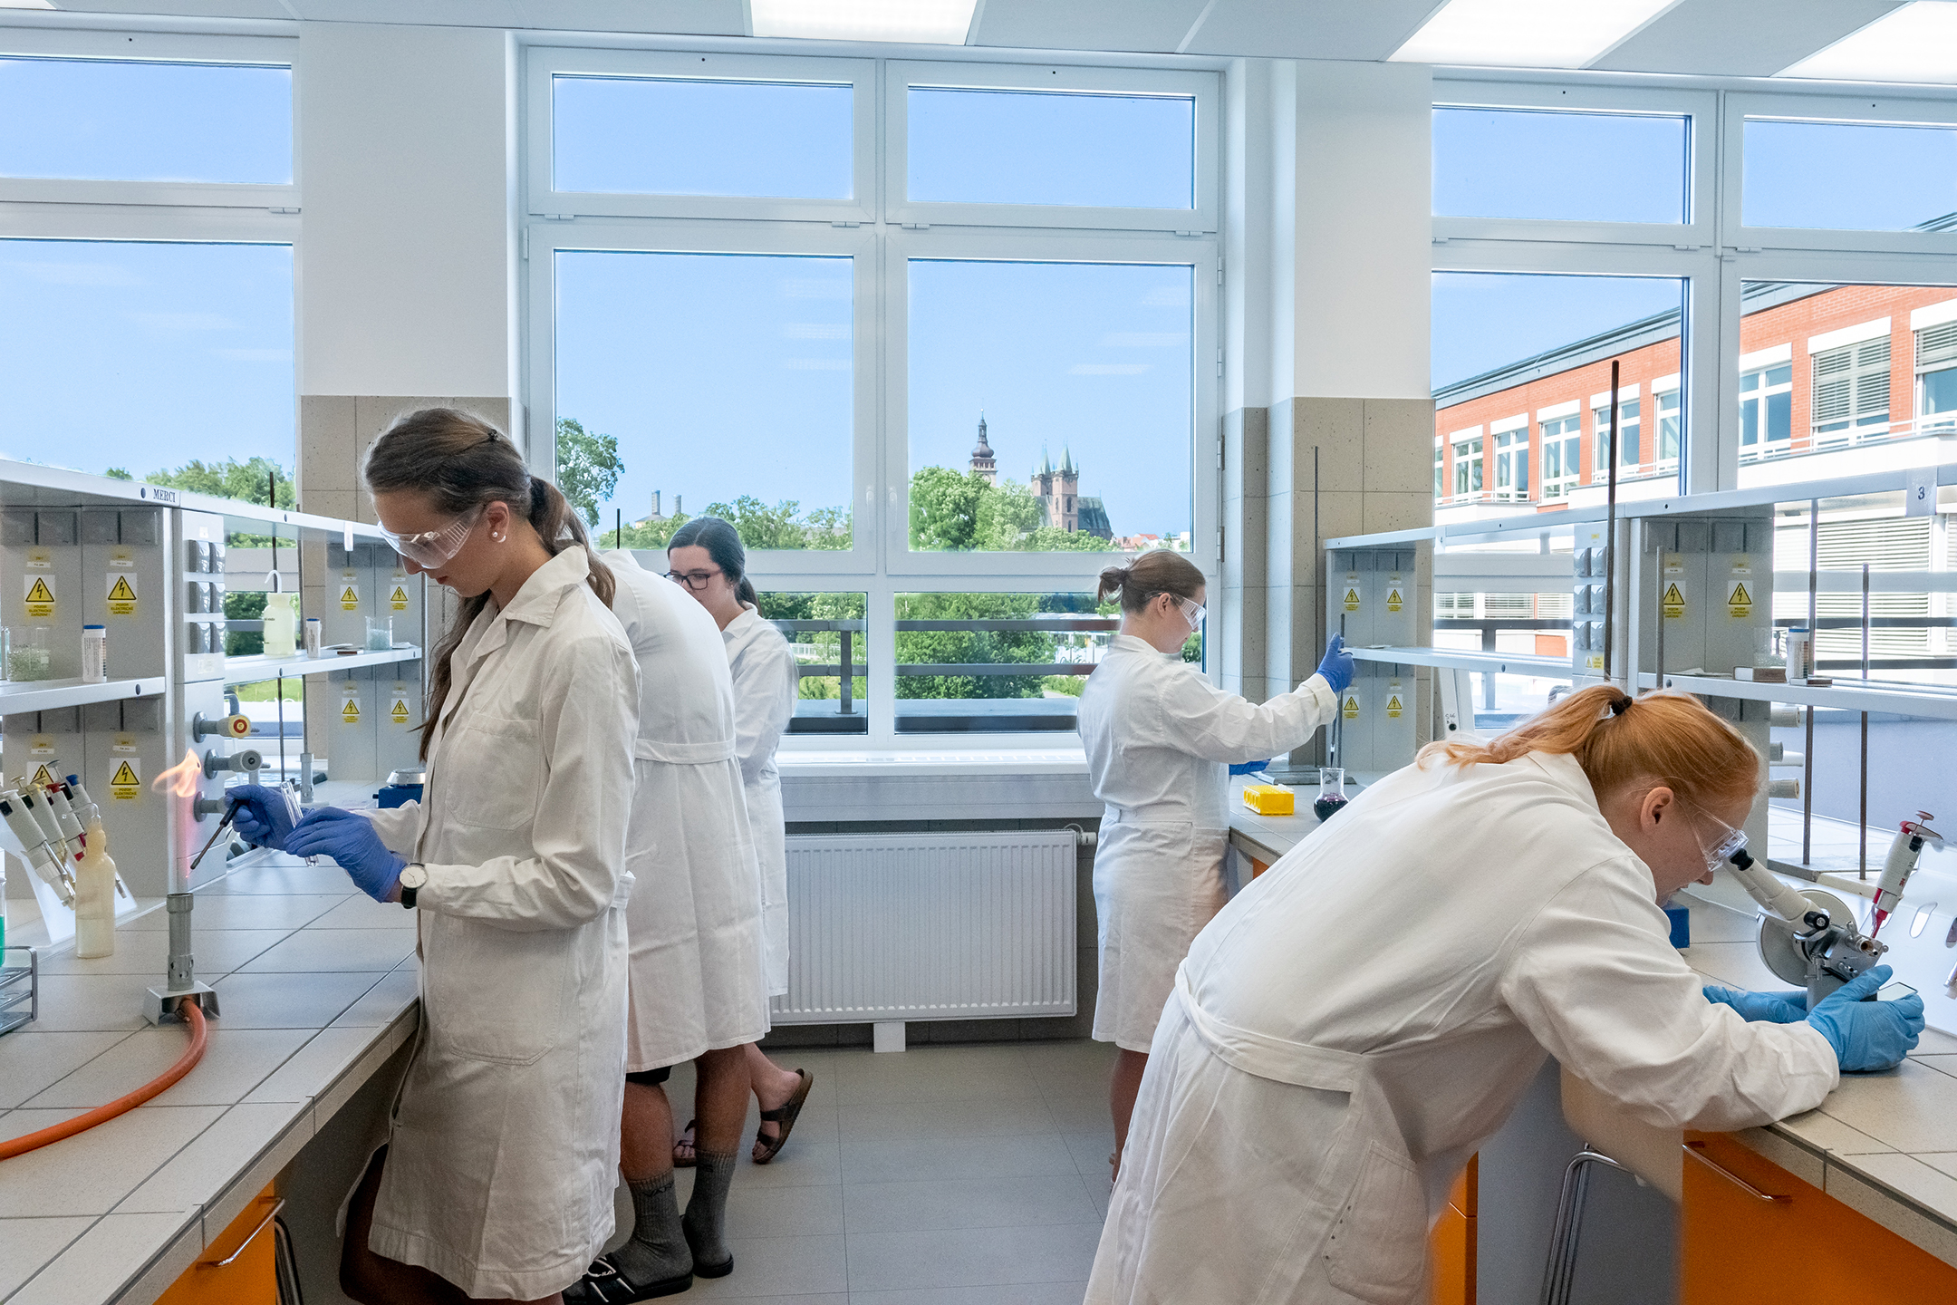
Research and Development

Slide 18

HRS4R | HR Award
Human Resources Strategy for Researchers
Guarantee of the European standard of care for employees
Quality of work environment
Transparency and openness of recruitment procedures

Slide 19



UHK Research – Topics
University-wide research topics
Healthy Ageing and Quality of Life
Security and Sustainable Development in the Digital Society
New Challenges in Education

Slide 20
UHK Research – Publications
UHK Science - Publications
All UHK publications on the Web of Science

Slide 21
UHK Research – Publications
UHK publications on the Web of Science – Journal Citation Report (Article, Review, Letter)

Slide 22
UHK Research – Publications
UHK publications on the Web of Science – Conference Proceedings Citation Index & Book Citation Index

Slide 23
UHK Research – Publication Benchmark
Web of Science – JCR (Article, Review, Letter)

Slide 24
UHK Research – Publications
Web of Science – JCR quartiles (Article, Review, Letter)

Slide 25
UHK Research – Publications
Scopus – SJR quartiles (Article, Review, Letter)

Slide 26
UHK Research – Research Area Benchmark – D1 Articles
Position at Czech Republic Module 2 Bibllio WOS-CATS 2023
WoS Category | FORD Category | Rank in CR | Articles
ART | 6.4 Arts | 2 | 1
COMPUTER SCIENCE, CYBERNETICS | 1.2 Computer and information sciences | 2 | 1
COMPUTER SCIENCE, THEORY & METHODS | 1.2 Computer and information sciences | 3 | 3
ENVIRONMENTAL STUDIES | 5.7 Social and economic geography | 5 | 1
GREEN & SUSTAINABLE SCIENCE & TECHNOLOGY | 1.4 Chemical sciences; 1.5 Earth | 6 | 2
HORTICULTURE | 4.1 Agriculture, forestry, and fisheries | 4 | 1
CHEMISTRY, MEDICINAL | 3.1 Basic medical research | 8 | 7
INTEGRATIVE & COMPLEMENTARY MEDICINE | 3.2 Clinical medicine | 3 | 1
MATHEMATICS | 1.1 Mathematics | 7 | 2
PHARMACOLOGY & PHARMACY | 3.1 Basic medical research | 8 | 11
PHILOSOPHY | 6.3 Philosophy, ethics and religion | 1 | 3
REGIONAL & URBAN PLANNING | 5.7 Social and economic geography | 3 | 3
THERMODYNAMICS | 2.3 Mechanical engineering | 8 | 2
TOXICOLOGY | 3.1 Basic medical research | 4 | 3

Slide 27
UHK Research – Research Area Benchmark – Q1 Articles
Position at Czech Republic Module 2 Bibllio WOS-CATS 2023 – part 1
WoS Category | FORD Category | Rank in CR | Articles
ART | 6.4 Arts | 1 | 3
BUSINESS | 5.2 Economics and business | 2 | 3
COMPUTER SCIENCE, ARTIFICIAL INTELLIGENCE | 1.2 Computer and information | 9 | 11
COMPUTER SCIENCE, CYBERNETICS | 1.2 Computer and information sciences | 2 | 2
COMPUTER SCIENCE, THEORY & METHODS | 1.2 Computer and information sciences | 6 | 6
EDUCATION & EDUCATIONAL RESEARCH | 5.3 Education | 6 | 1
ENGINEERING, ELECTRICAL & ELECTRONIC | 2.2 Electrical engineering, electronic | 7 | 18
ENGINEERING, GEOLOGICAL | 2.7 Environmental engineering | 10 | 3
FOOD SCIENCE & TECHNOLOGY | 2.11 Other engineering and technologies; 4.5 Other | 4 | 38
FORESTRY | 4.1 Agriculture, forestry, and fisheries | 10 | 16
GERONTOLOGY | 3.2 Clinical medicine | 5 | 1
HEALTH POLICY & SERVICES | 3.3 Health sciences | 2 | 2
HISTORY & PHILOSOPHY OF SCIENCE | 6.1 History and archaeology | 4 | 2
HORTICULTURE | 4.1 Agriculture, forestry, and fisheries | 4 | 7

Slide 28
UHK Research – Research Area Benchmark – Q1 Articles
Position at Czech Republic Module 2 Bibllio WOS-CATS 2023 – part 2
WoS Category | FORD Category | Rank in CR | Articles
CHEMISTRY, MEDICINAL | 3.1 Basic medical research | 5 | 34
INTEGRATIVE & COMPLEMENTARY MEDICINE | 3.2 Clinical medicine | 4 | 3
LANGUAGE & LINGUISTICS | 6.2 Languages and literature | 4 | 1
LINGUISTICS | 6.2 Languages and literature | 6 | 1
MATHEMATICS | 1.1 Mathematics | 6 | 24
MATHEMATICS, APPLIED | 1.1 Mathematics | 7 | 14
MATHEMATICS, INTERDISCIPLINARY APPLICATIONS | 1.1 Mathematics | 7 | 2
PHARMACOLOGY & PHARMACY | 3.1 Basic medical research | 9 | 24
PHILOSOPHY | 6.3 Philosophy, ethics and religion | 3 | 8
POLITICAL SCIENCE | 5.6 Political science | 6 | 2
PSYCHOLOGY, MULTIDISCIPLINARY | 5.1 Psychology and cognitive sciences | 9 | 2
REGIONAL & URBAN PLANNING | 5.7 Social and economic geography | 4 | 3
TELECOMMUNICATIONS | 2.2 Electrical engineering, electronic engineering, information engineering | 4 | 5
TOXICOLOGY | 3.1 Basic medical research | 2 | 28

Slide 29
UHK Research – Research Area Benchmark – Total Articles
Position at Czech Republic Module 2 Bibllio WOS-CATS 2023 – part 1
WoS Category | FORD Category | Rank in CR | Articles
ART | 6.4 Arts | 7 | 3
BIOPHYSICS | 1.6 Biological sciences | 8 | 23
BUSINESS | 5.2 Economics and business | 6 | 12
CLASSICS | 6.2 Languages and literature | 5 | 1
COMMUNICATION | 5.8 Media and communication | 3 | 5
COMPUTER SCIENCE, ARTIFICIAL INTELLIGENCE | 1.2 Computer and information | 7 | 53
COMPUTER SCIENCE, CYBERNETICS | 1.2 Computer and information sciences | 7 | 4
COMPUTER SCIENCE, HARDWARE & ARCHITECTURE | 2.2 Electrical engineering, electronic | 7 | 5
COMPUTER SCIENCE, INFORMATION SYSTEMS | 1.2 Computer and information sciences | 4 | 72
COMPUTER SCIENCE, INTERDISCIPLINARY APPLICATIONS | 1.2 Computer and information | 8 | 23
COMPUTER SCIENCE, SOFTWARE ENGINEERING | 1.2 Computer and information | 8 | 9
COMPUTER SCIENCE, THEORY & METHODS | 1.2 Computer and information sciences | 8 | 25
EDUCATION & EDUCATIONAL RESEARCH | 5.3 Education | 7 | 6
EDUCATION, SCIENTIFIC DISCIPLINES | 5.3 Education | 3 | 5
ENGINEERING, ELECTRICAL & ELECTRONIC | 2.2 Electrical engineering, electronic | 5 | 95
ERGONOMICS | 5.1 Psychology and cognitive sciences | 4 | 1

Slide 30
UHK Research – Research Area Benchmark – Total Articles
Position at Czech Republic Module 2 Bibllio WOS-CATS 2023 – part 2
WoS Category | FORD Category | Rank in CR | Articles
ETHICS | 6.3 Philosophy, ethics and religion | 4 | 4
ETHNIC STUDIES | 5.4 Sociology | 3 | 3
FOOD SCIENCE & TECHNOLOGY | 2.11 Other engineering and technologies; 4.5 Other | 9 | 58
GERONTOLOGY | 3.2 Clinical medicine | 7 | 3
HEALTH CARE SCIENCES & SERVICES | 3.3 Health sciences | 5 | 11
HEALTH POLICY & SERVICES | 3.3 Health sciences | 5 | 7
HISTORY | 6.1 History and archaeology | 6 | 8
HISTORY & PHILOSOPHY OF SCIENCE | 6.1 History and archaeology | 4 | 8
HORTICULTURE | 4.1 Agriculture, forestry, and fisheries | 8 | 9
HUMANITIES, MULTIDISCIPLINARY | 6.5 Other Humanities and the Arts | 8 | 3
CHEMISTRY, MEDICINAL | 3.1 Basic medical research | 5 | 77
INFORMATION SCIENCE & LIBRARY SCIENCE | 5.8 Media and communication | 6 | 3
INTEGRATIVE & COMPLEMENTARY MEDICINE | 3.2 Clinical medicine | 5 | 5
LANGUAGE & LINGUISTICS | 6.2 Languages and literature | 9 | 2
LINGUISTICS | 6.2 Languages and literature | 7 | 8
LITERATURE, SLAVIC | 6.2 Languages and literature | 6 | 3
MANAGEMENT | 5.2 Economics and business | 8 | 17
MATHEMATICS | 1.1 Mathematics | 6 | 108
MATHEMATICS, INTERDISCIPLINARY APPLICATIONS | 1.1 Mathematics | 4 | 28

Slide 31
UHK Research – Research Area Benchmark – Total Articles
Position at Czech Republic Module 2 Bibllio WOS-CATS 2023 – part 3
WoS Category | FORD Category | Rank in CR | Articles
OPERATIONS RESEARCH & MANAGEMENT SCIENCE | 5.2 Economics and business | 7 | 9
PHARMACOLOGY & PHARMACY | 3.1 Basic medical research | 7 | 94
PHILOSOPHY | 6.3 Philosophy, ethics and religion | 3 | 27
PHYSICS, MATHEMATICAL | 1.1 Mathematics | 6 | 36
PHYSICS, MULTIDISCIPLINARY | 1.3 Physical sciences | 6 | 76
PHYSICS, PARTICLES & FIELDS | 1.3 Physical sciences | 10 | 26
POLITICAL SCIENCE | 5.6 Political science | 6 | 21
PRIMARY HEALTH CARE | 3.3 Health sciences | 3 | 1
PSYCHOLOGY, CLINICAL | 3.1 Basic medical research | 9 | 3
PSYCHOLOGY, EXPERIMENTAL | 5.1 Psychology and cognitive sciences | 8 | 5
PSYCHOLOGY, MULTIDISCIPLINARY | 5.1 Psychology and cognitive sciences | 6 | 29
PUBLIC ADMINISTRATION | 5.6 Political science | 6 | 3
PUBLIC ADMINISTRATION | 5.6 Political science | 6 | 3
QUANTUM SCIENCE & TECHNOLOGY | 1.3 Physical sciences; 1.4 Chemical sciences; 2.2 Electrical engineering, 2.11 Other | 8 | 5
RELIGION | 6.3 Philosophy, ethics and religion | 6 | 3
SOCIAL SCIENCES, INTERDISCIPLINARY | 5.9 Other social sciences | 8 | 6
SOCIAL WORK | 5.4 Sociology | 4 | 4
SOCIOLOGY | 5.4 Sociology | 8 | 9
TELECOMMUNICATIONS | 2.2 Electrical engineering | 4 | 46
TOXICOLOGY | 3.1 Basic medical research | 2 | 100
TRANSPORTATION SCIENCE & TECHNOLOGY | 2.1 Civil engineering | 8 | 4

Slide 32
UHK Research – Articles (JCR 2015–2023)
more than 44% in Q1 Journals (2020–2023)
  32% in 2015–2019
more than 36% in Q2 Journals (2020–2023)
  32% in 2015–2019
more than 13% in the 1st decile in their category
more than 58% in cooperation with foreign partners

Slide 33



UHK Research
External Projects
Year | 2014 | 2015 | 2016 | 2017 | 2018 | 2019 | 2020 | 2021 | 2022 | 2023
Amount | 11 | 11 | 9 | 18 | 33 | 55 | 60 | 57 | 48 | 43

Slide 34
UHK – solved projects
UHK – Solved Projects

Slide 35
UHK – Other Projects

Slide 36
UHK – Technology Transfer
Applied Research
Patent application
Applied Research
Utility application

Slide 37


UHK - Technology Transfer
The Technology Agency of the Czech Republic (TA CR GAMA 2)
Proof of Concept 15 internal sub-projects
Applied Research – Spin Off
2018 Grant Detection s.r.o. (Research staff from UHK – without UHK ownership interest)
2019 ANUME s.r.o. (Research staff from UHK – without UHK ownership interest)
2023 TallWell s.r.o. (Research staff from UHK – without UHK ownership interest)

Slide 38
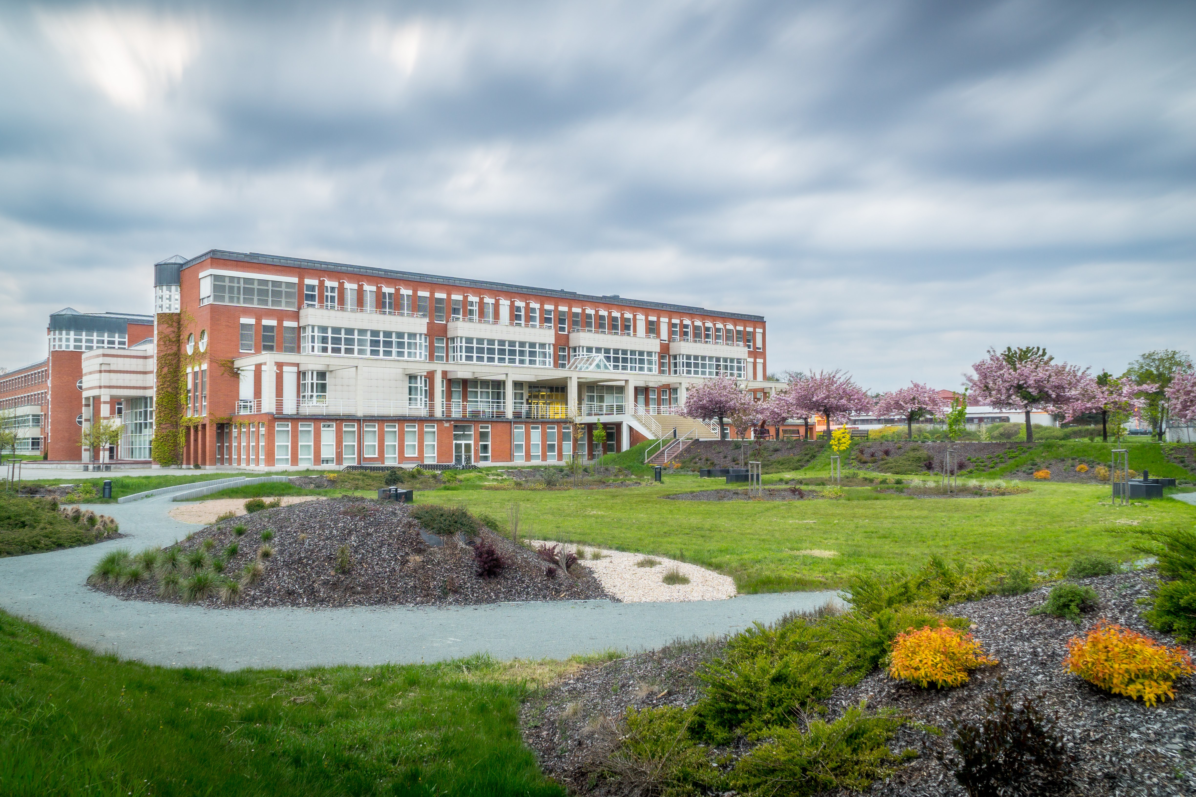
Future of University of Hradec Králové

Slide 39
UHK Future Targets
Increasing number of PhD students / PhD programmes
New postdoc positions
Strengthen university – industry partnership
Double degree programmes
International strategic partnerships
EU & international projects
International teams / Centers
Consistent positions in rankings

Slide 40





uhk.cz/en

