Slide 1
How to properly use UHK PowerPoint template
Every possible layout configuration

Slide 2
Default layout style
This layout is the easiest to use and doesn’t require any additional setup from user’s side.
Bullet point
2nd level bullet point

Slide 3
Default layout style
Title of the slide
This layout is the easiest to use and doesn’t require any additional setup from user’s side.
Bullet point
2nd level bullet point

Slide 4
Optimal title layout
Maximal length
You can move the bubble in and out of the frame to make it longer.
This layout is more complicated however, it allows for an optimal title placement.
First, you need to change title alignment to align left. Then move the “bubble”.
Bullet point
2nd level bullet point

Slide 5
Chapter titlexxxx
Optimal title layout
There should be a space of at least four lowercase “x” (in standard font size) between the edge of the slide and the text.
This layout is more complicated however, it allows for an optimal title placement.
First, you need to change title alignment to align left. Then move the “bubble”.
Bullet point
2nd level bullet point

Slide 6
Chapter title/name
Picture label

Slide 7
Section header with image background
The logo is always full black.
Try changing the template style to the faculty one.

Slide 8
Section header with solid color background
In positive version, the background is always white, and the bubble is in faculty/university color
Maximal size

Slide 9
Picture label
this bubble can also be moved

Slide 10
Negative version
In default layout style

Slide 11
Title can be here
Bullet point
2nd level bullet point

Slide 12
Chapter title
Title
Bullet point
2nd level bullet point

Slide 13
Chapter title/name
Picture label
Click here to change the image

Slide 14
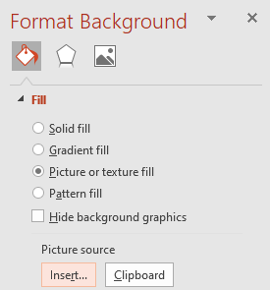
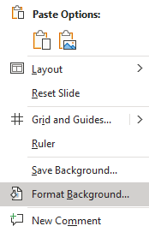
Section header with image background
To change background image right click on the background.

Slide 15
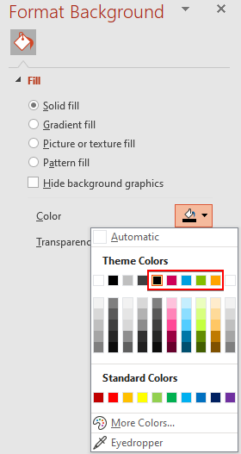
Section header with solid color background
Right click on the background.
faculty colors
To change background from image to solid color.
In negative version, the background is in faculty/university color and the bubble is always white.

Slide 16
Picture label
click here to change the image

Slide 17
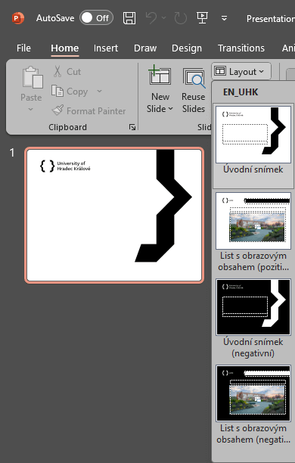
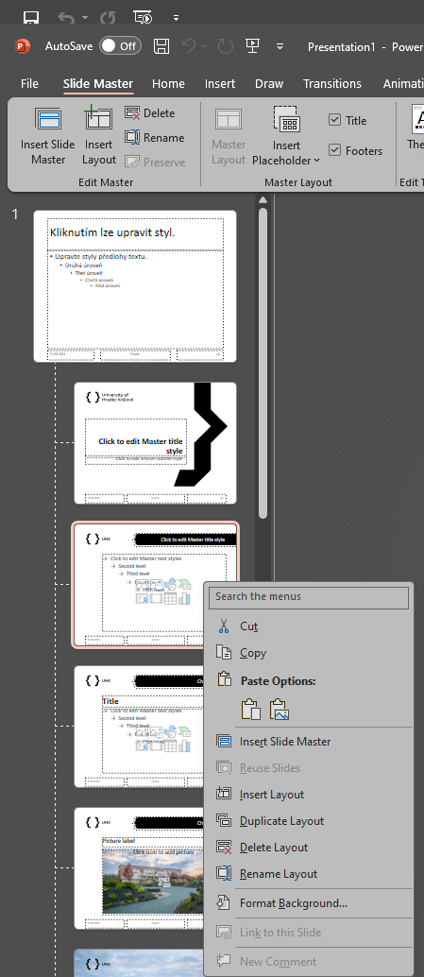
Optimizing the data size of the final presentation
Optimalizace datové velikosti výsledné prezentace
Deleting redundant layout slides
The template is prepared with several possible layout slides/page templates to cover as many types as possible. In the document, you can select the necessary layout from the Layout list (Home / Layout) and work with it.
If any of these layout slides are not needed in the presentation, they can be removed, thereby reducing the data size of the entire presentation. To delete a layout slide, go to View / Slide Master, right-click, and select delete layout.
Image compression in the presentation
If the presentation contains a large number of images, it is worth considering whether we need to have them inserted in print quality. Ideally, images should be inserted compressed, thereby saving on the data size of the entire presentation. For help with compressing images, you can contact the university graphic designer at grafik@uhk.cz.

