Slide 1
M08 Project management and management of risks
Trainer Presentation

Slide 2
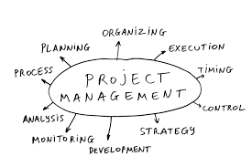
WHAT IS PROJECT?
A project is defined as a sequence of tasks that must be completed to attain a certain outcome.
A project is a combination of set objectives to be accomplished within a fixed period.
A project is an activity to meet the creation of a unique product or service.
A project is a set of tasks which must be completed in order to arrive at a deliverable.

Slide 3
Before we even go into more detailed project planning
Should the project be implemented at all?
Is the chosen implementation path correct?
Do we have the resources to implement the project?

Slide 4
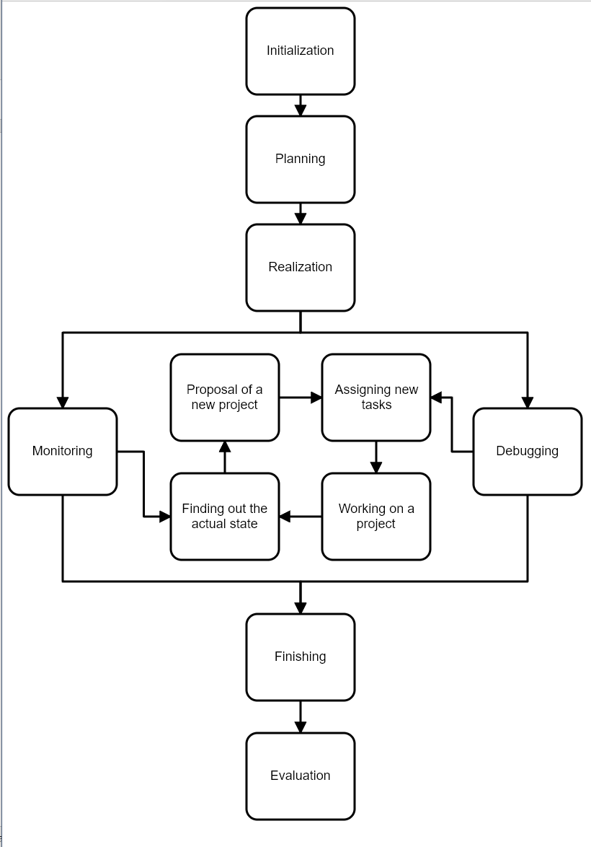
Stages of project implementation

Slide 5
W - questions
What?
Why?
For whom?
Where?
Who?
When?
With whom?
How?
For how much

Slide 6
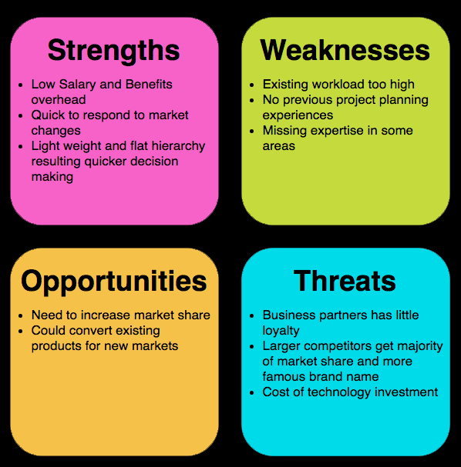
SWOT analysis
Strengths
Weaknesses
Opportunities
Threats

Slide 7
The PRINCE2 methodology extends the three-imperative to 6 aspects of project performance
costs,
time,
quality,
scope,
risk,
benefits.

Slide 8
Agile management
Quality
Functionaility
Sources
Time
Quality
Functionaility
Sources
Time
Fixed
Variable

Slide 9
Completion and evaluation of the project
submission of the final project report,
project billing,
archiving of project documents.

Slide 10
Project phase
Planning phase
Organizational phase
Implementation phase
Evaluation phase

Slide 11
Risk management

Slide 12
Relationship between basic terms in the field of risk management
Sources of threats
THREATS
Property
Strength
Event
Activity
Person
SECURITY PRECAUTIONS
ASSETS
Life
Health
Property
Environment
RESIDUAL
RISK
RISK
RISK
VULNERABILITY
RISK

Slide 14
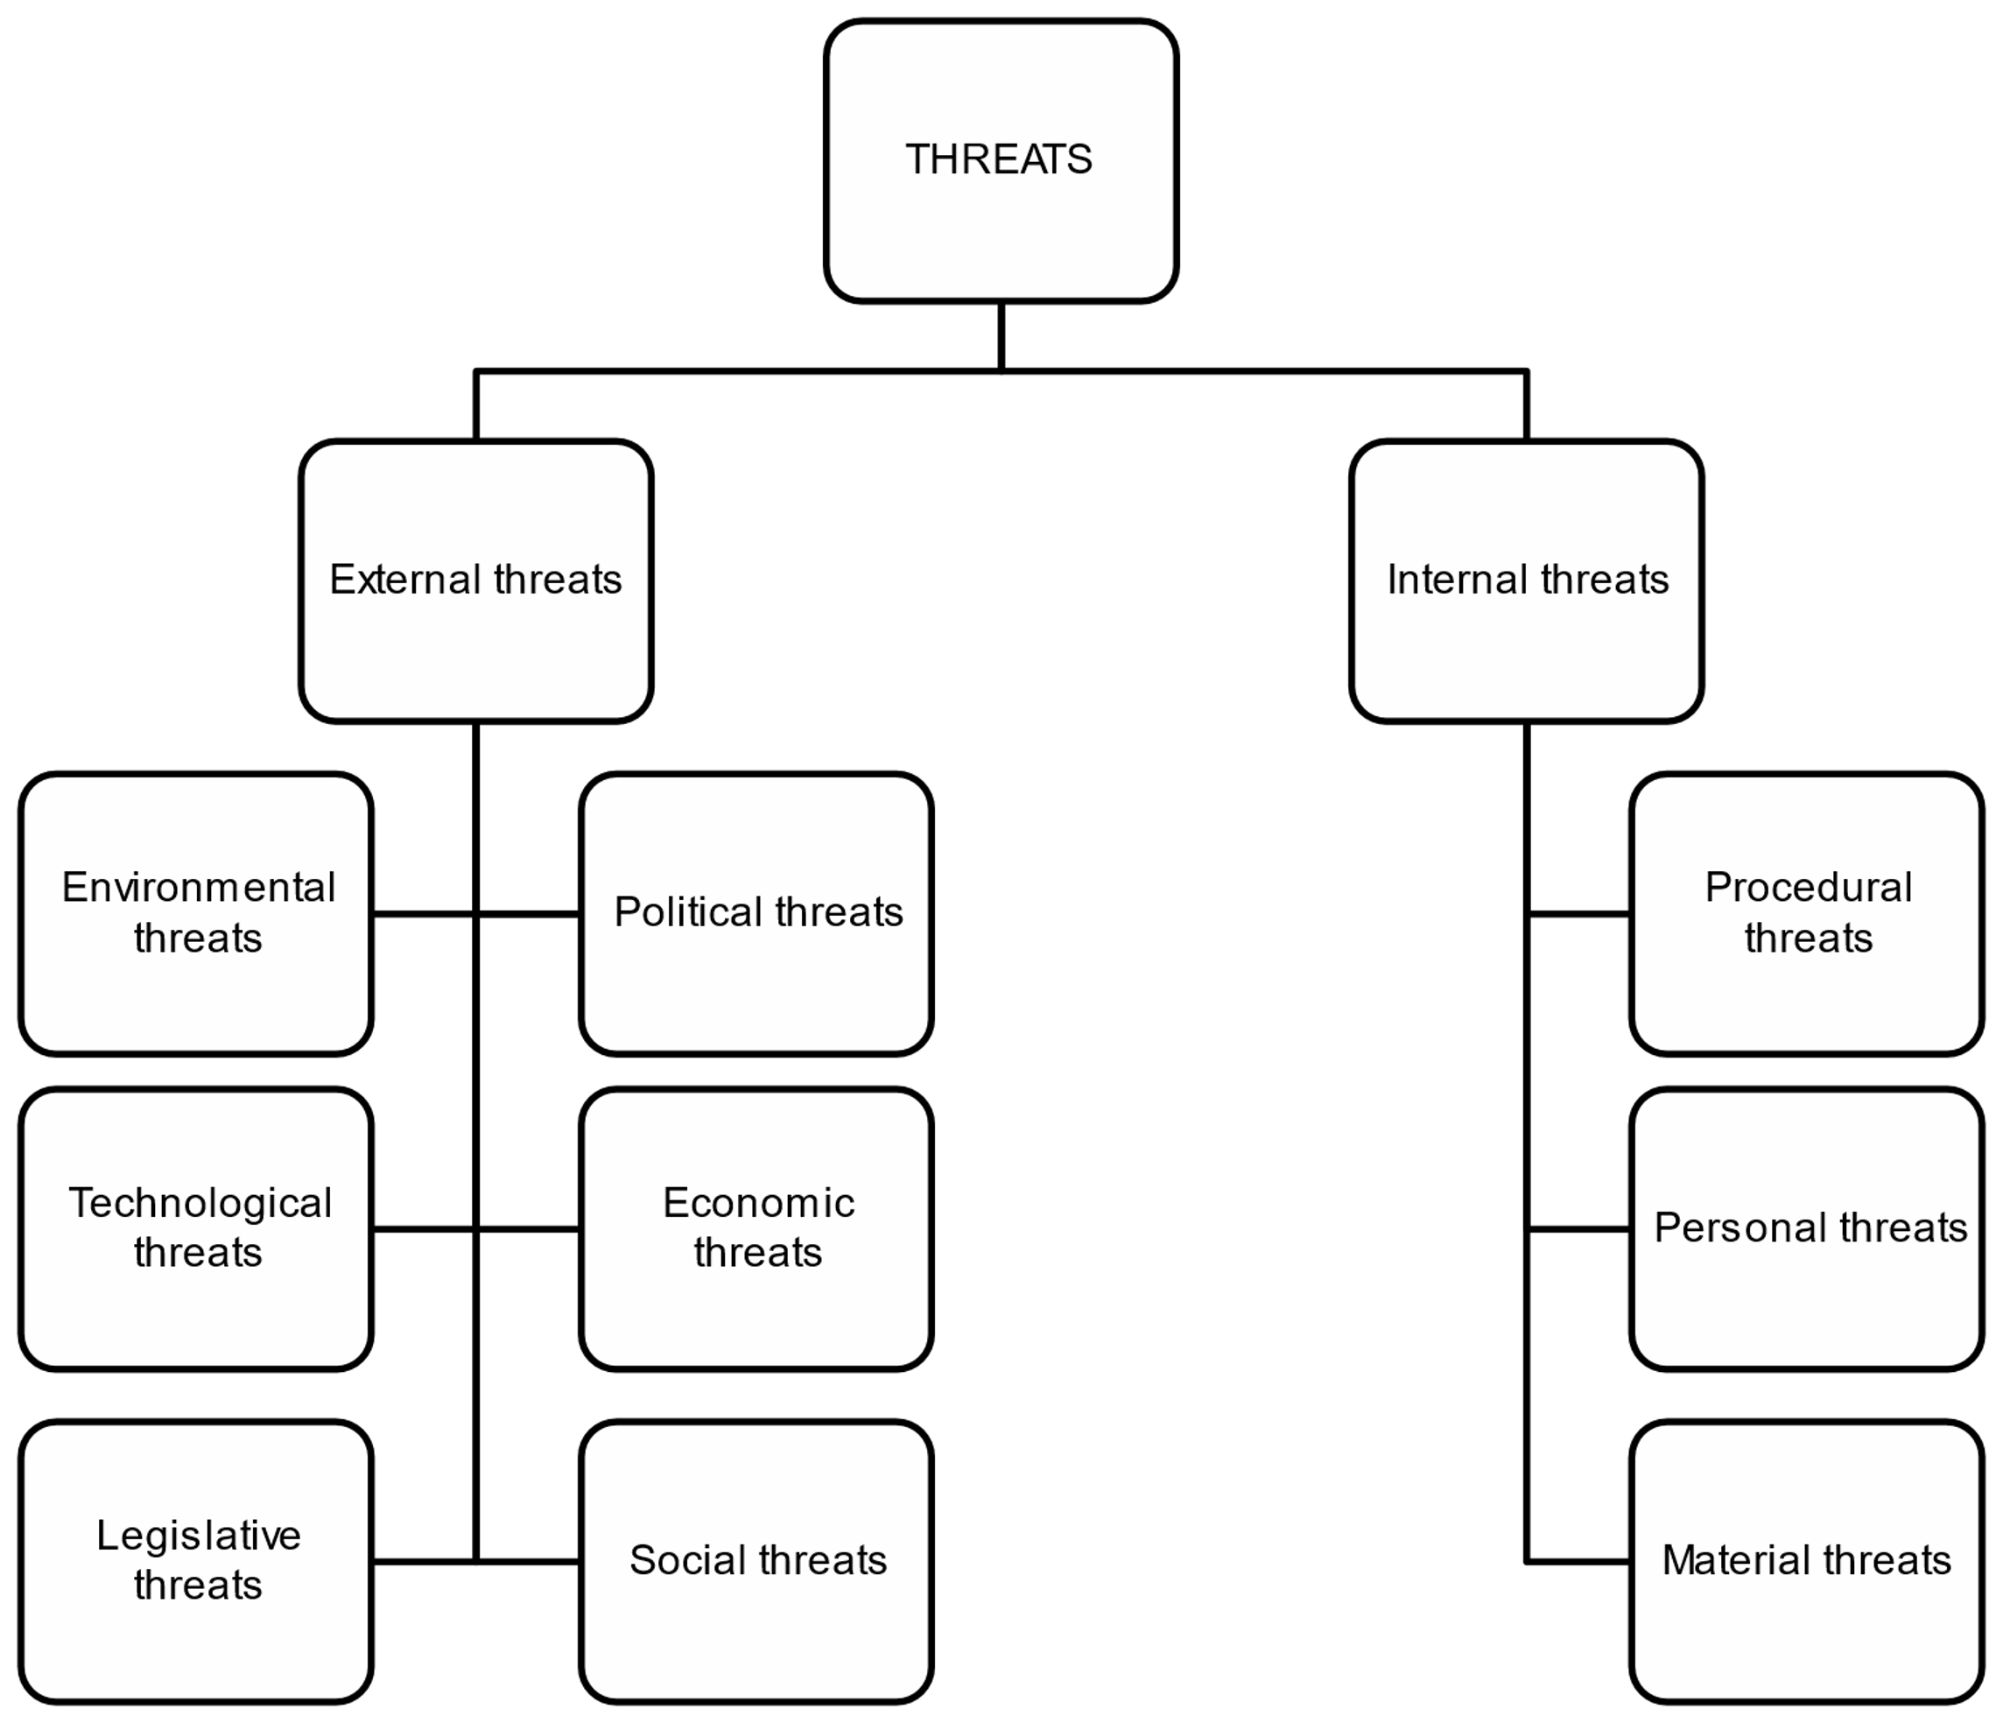
Breakdown of threats into categories and areas

Slide 15
Scheme of the effect of threats on assets
EXTERNAL THREATS
Political, Economic, Social, Technological, Legislative, Ecological
ORGANIZATION
ASSETS OF OTHER ORGANIZA-TIONS
TANGIBLE ASSETS
INTERNAL THREATS
Process (project), Personnel, Material
INTANGIBLE ASSETS

Slide 16
Risk management process (adjusted according to ČSN ISO 31000: 2010)
Communication and consultation
Definition of context
Process monitoring and review
Risk assessment
Risk identification
Risk analysis
Risk assessment
Risk management

Slide 17
Risk management options
RISKS RISKS
THREAT
ASSET
RISK TRANSFER
THREAT
ASSET
STRONGER ENTITY (e.g. insurance company)
RISK REDUCTION
THREAT
SECURITY PRECAUTIONS
ASSET
RISK AVOIDANCE
THREAT
ASSET
ASSET

Slide 18
Recommended principles for the selection of risk management options
 | High probability | Low probability
Impact severity high | risk avoidance risk reduction (D is from 3 to 5) | risk transfer
Impact severity low | risk reduction risk retention (D is from 1 to 3) | risk retention
D – severity of the impact
P – probability of occurrence

Slide 19
Subprocess activities
Monitoring the risk management process
Review of the risk management process
Processing and transmission of results

Slide 20
Summary
The general approach to risk management provides the organization with guidelines for implementing the basic elements of risk management in a clear and reliable manner in any scope and context.
Each specific branch of safety engineering or the way in which risk management is applied brings with it individual needs, individual risk perceptions and the resulting differences of opinion when defining criteria for risk assessment.
It is necessary to draw attention to the fact that through the comprehensive implementation of the risk management process, organizations will achieve a significant increase in the safety of existing processes at all levels.

Slide 21
Technology Transfer Management
Factors supporting technology transfer:
Greater rewards for involving researchers in the technology transfer process.
An environment with a concentration of high-tech companies.
The experience of technology transfer staff.
Stronger links between universities and industry, and the legislative environment.
Academic entrepreneurship, collaboration and activities carried out in an open innovation environment.

Slide 22
Conclusion
Successful technology transfer provides for great economic benefits and incentives resulting from successful commercialization of the technology, as it can accelerate the development of new technologies and the introduction of new innovative products, services and processes on the market.

