Slide 1
The Technology and Knowledge transfer in the University of Hradec Králové
prof. Ing. Ondřej Krejcar, Ph.D.
Vice-Rector for Science and Creative Activities

Slide 2
Content
Technology transfer support in University of Hradec Králové (UHK)
UHK Commercialization board for implementation
Achieved results
Achieved results in 2022
Licenses
Spin-off
GAMA 2 program
The Technology and Knowledge Transfer based on Norway - Czech Cooperation
Technology transfer together
TTO processes

Slide 3
Technology Transfer Office Support
Technology transfer office (TTO) in UHK was founded in 2020, currently has 2 employees.
The main goal is to support the transfer of new knowledge of science and research
and their successful application in practice.
TTO provides support in the protection of intellectual property and in the implementation
of research and development results into practice.
Provides project and financial management of Proof of Concept projects to verify commercial potential.
Offers mediation of analyzes and searches in cooperation with patent and marketing specialists.
In cooperation with the UHK Commercialization board, ensures the process
of commercialization of research and development results.
Mediates legal services in the field of intellectual property protection and technology
and knowledge transfer.

Slide 4
UHK Commercialization board for implementation
UHK Commercialization board for implementation is Rector's advisory body.
The board has 5 members (2 members from financial sector, 2 members
from application sphere, one member from UHK).
Recommends to the Rector the approval or disapproval of the submitted case
of commercialization.
Evaluates and approves sub-projects in GAMA 2, discusses interim and final reports, implementation plans, decides on significant changes to sub-projects
and the termination of the sub-project.

Slide 5
Achieved results in UHK

Slide 6
Achieved results in UHK
Patent applications and utility model applications
Year​ | Patent application​ | Granted​
2014​ | 2​ | 2​
2015​ | 2​ | 2​
2016​ | 2​ | 2​
2017​ | 0​ | 0​
2018​ | 3​ | 3​
2019​ | 4​ | 3
2020​ | 2​ | 2​
2021​ | 4 | 1
2022 | 5 | 0
Year​ | Utility application
2012​ | 4​
2017​ | 1​
2018​ | 1​
2019​ | 3​
2020​ | 4​
2021​ | 2​
2022 | 5

Slide 7
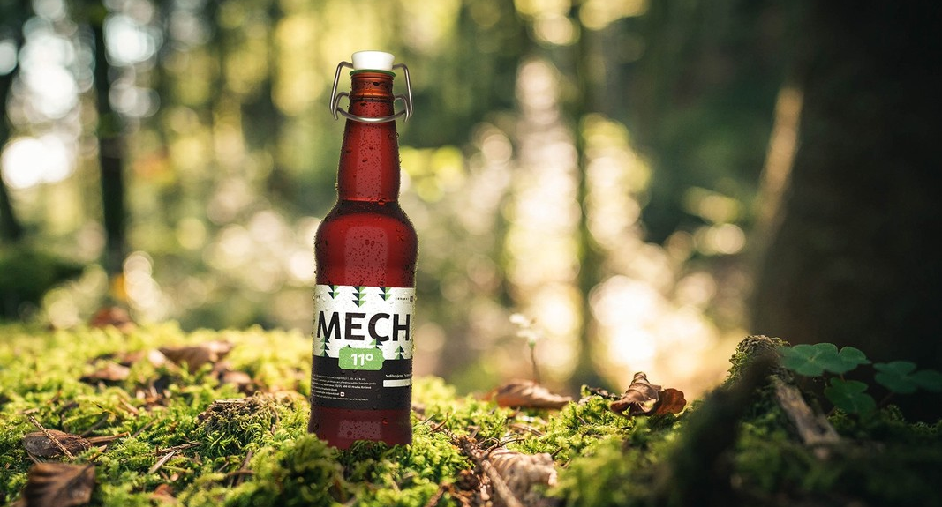




Trademarks examples

Slide 8
UHK Results in 2022

Slide 9
UHK - Licences
BV elektronik s.r.o. – Coil, capacitor, induction type current shunt - 3 patents (2017)
Grant Detection s.r.o. – Method of detecting organisms, in particular vertebrates, in enclosed and partially enclosed spaces and the equipment for this – patent (2018)
DeepLab s.r.o. – Smart Furniture – know-how (2019)
Multicore s.r.o. – A method of processing an image by a gradual brightness gradient method
of image pixels along a longitudinal axis and the apparatus for the method - patent (2019)
Technologické centrum HK z.ú. – Information system– software (2021)

Slide 10
Spin-off
GAMA 2 program
Applied Research – Spin-Off
2018 – Grant detection s. r. o., (Research staff from UHK)
2019 – Deeplab s. r. o., (Research staff from UHK)
GAMA 2
The University of Hradec Králové received financial support
from the Technology Agency of the Czech Republic for the GAMA 2 program.
The aim of this project is to support systems for the transfer
of knowledge of science and research financed from public sources
in research organizations and their successful application in practice.

Slide 11
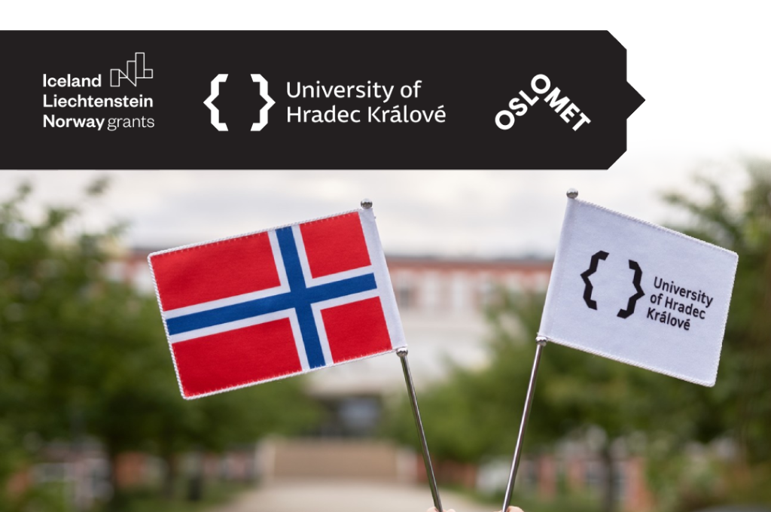
The Technology and Knowledge Transfer based on Norway - Czech Cooperation
Institutional cooperation between University of Hradec Králové and Oslo Metropolitan University.
The aim of the project focuses on the transfer of technology, intellectual property protection and support of spin-off companies.
The project is financed through EEA Grants.
Support the establishment of spin-off companies with the goal of commercialization
of intellectual property created through research at UHK.
The project should help to build know-how to develop businesses and civic involvement in economic development as it should support starting businessmen
in the region.

Slide 12
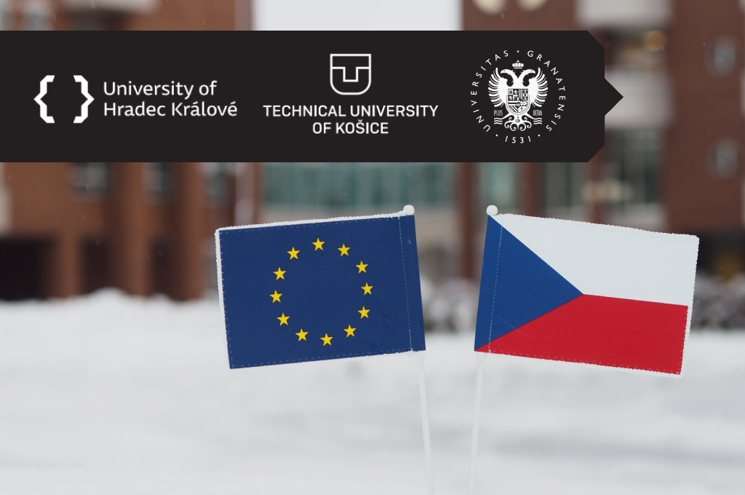
Technology transfer together
The project Technology transfer together based on partnership with the University of Granada and the Technical University of Kosice.
Is co-funded by the Erasmus+ Program of the European Union.
The aim of the project focuses on the transfer of technology, intellectual property protection and to support of spin-off companies.
Through the implementation of this project, the University of Hradec Králove will strengthen institutional cooperation with the University of Granada
and the Technical University of Košice.

Slide 13
Transfer technology office in process
Thanks to the program GAMA 2, TTO had the opportunity to set up and optimize processes within the protection of intellectual property and provide systematic support for TT and commercialization.
Through the TTO and also thanks to the involvement of the members of the board for Commercialization, the mutual cooperation between the UHK and the commercial sphere at the regional and national level is strengthened.
By strengthening cooperation with the application sphere, that's small and medium-sized enterprises, there is an increase in awareness of research results that arise
at the UHK.

Slide 14
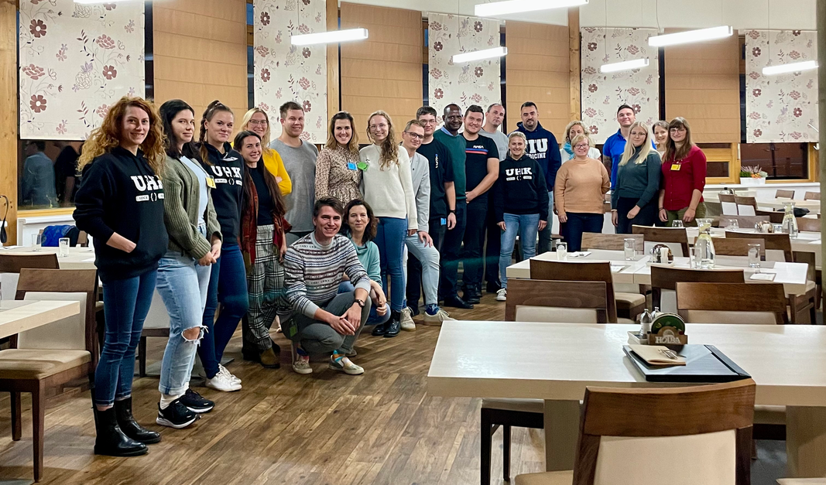
PhD summit

Slide 15
Conclusion
Thank you for your attention

