Slide 1
AI opportunities and challenges in the context of Knowledge Transfer support in Norway
Anis Yazidi
Hradec Spring Tech 4TTCAMP 2023
Notes:
OUS endredt til store bokstaver alle

Slide 2
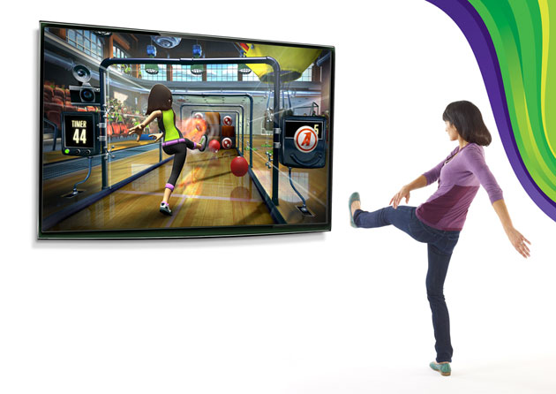
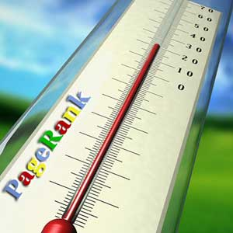
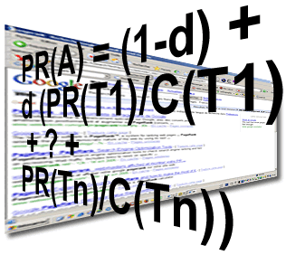
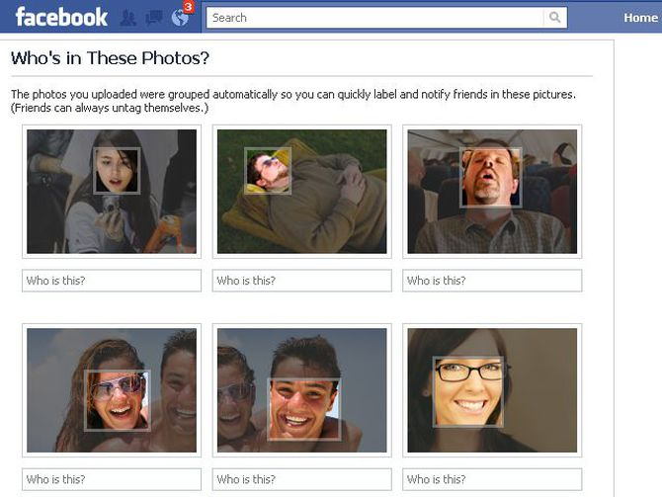

AI and ML: part of our dailylife
Notes:
Jeg har midstilt noen overskrifter her et eksemepl
Kunstig intelligens og roboter blir en stadig større del av vår hverdag

Slide 3
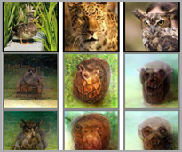
AI part of our future
‘MIND-READING’ ALGORITHM DECODES THE PICTURES IN YOUR HEAD
Researchers from ATR Computational Neuroscience Laboratories and Kyoto University in Japan developed a deep learning-based algorithm that can generate images from brain activity.
Notes:
Midtstil andre overskrifter også .

Slide 4
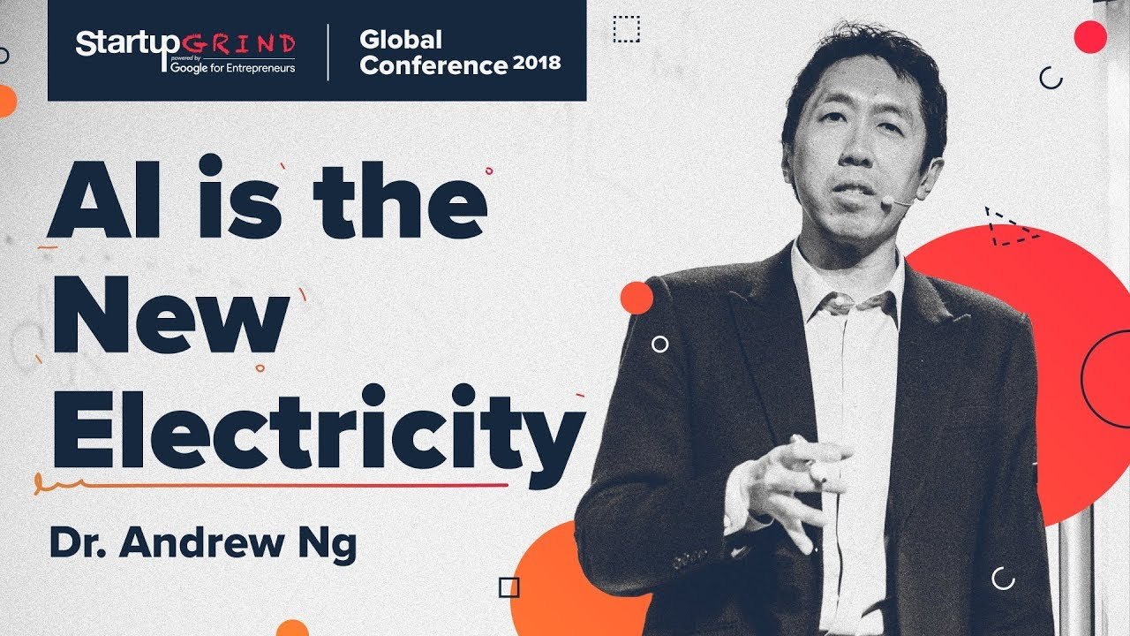

Slide 5
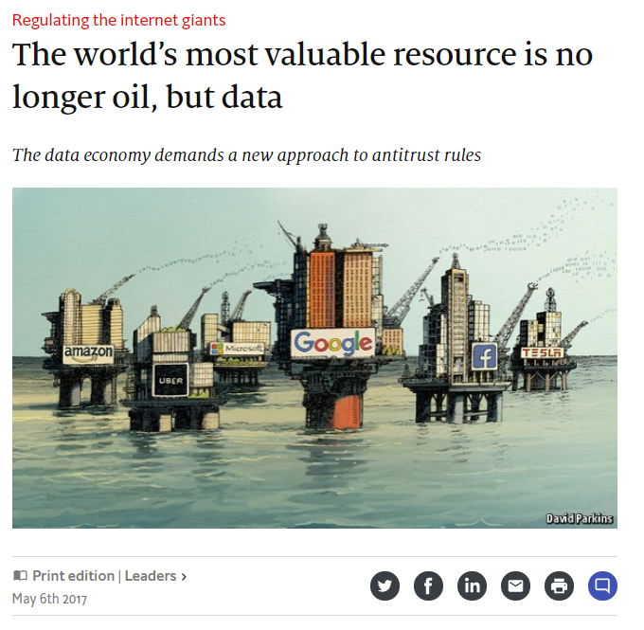
(Source: The Economist)
Notes:
Alphabet (Google’s parent company), Amazon, Apple, Facebook and Microsoft—look unstoppable. They are the five most valuable listed firms in the world.
-> 5 most valuable companies all gather and apply ML to huge amounts of data.
Uber: tons of data about traffic and transportation. Tesla: tons of traffic for training self-driving vehicles.
User data -> positive spiral -> better service - > more data, etc.
The amout of data is increasing thanks to the Internet.
The value of data is increasing thanks to machine learning. Your preferences can be analyzed and sold to advertisers, etc.
the “data-network effect”—using data to attract more users, who then generate more data, which help to improve services, which attracts more users.
-> when you make a google search, google learns about you, and is able to give you better results next time.

Slide 6
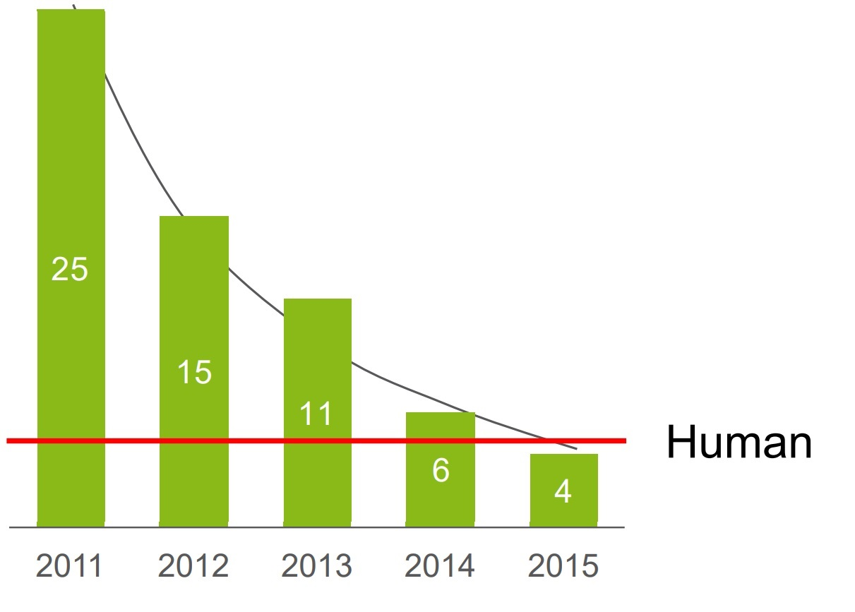
First Inflection Point
‘Deep learning’ has brought further rapid improvements, producing an accuracy of 96% in 2015, surpassing humans for the first time
Error rates on ImageNet visual challenge, %

Slide 7
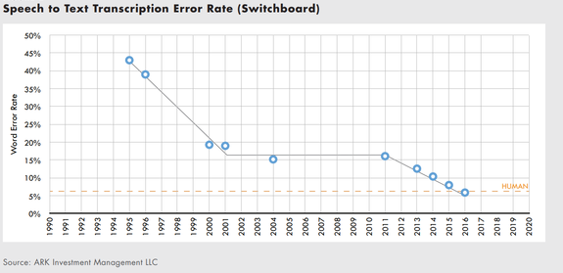
Second Inflection Point
Notes:
For the sake of comparison, Microsoft declared in October 2016 that it had reached speech recognition parity with humans. Its word error rate at the time was 5.9 percent, though it’s not clear if the two companies are following the same standards of evaluation.

Slide 8
Third Inflection point: More IoT data:
Cisco predictions:

Slide 9
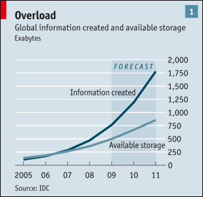
Fourth Inflection point
We live in an era of “Big Data”:
  Technology are producing increasingly large data streams every second.
We can no longer afford to store all the data produced by devices
The economist

Slide 10
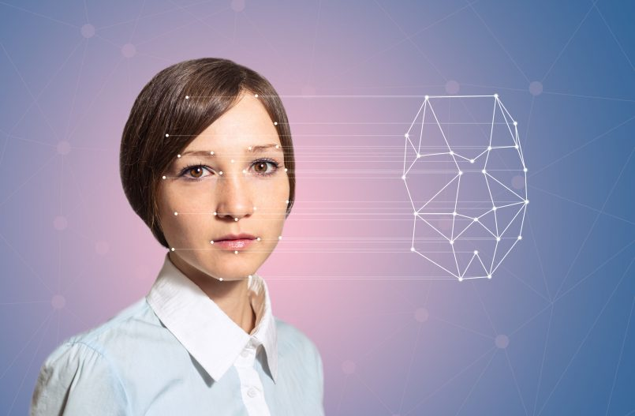
Why Machine Learning?
It is very hard to write programs that solve problems like recognizing a face.
  We don’t know what program to write because we don’t know how our brain does it.
Instead of writing a program by hand, we collect lots of examples that specify the correct output for a given input.

Slide 11
Some History of AI
Notes:
Midstilte

Slide 12
1960s: Alexey G. Ivakhnenko and multilayered neural networks
Notes:
Har du bedre bilde med høyere opplsning?
The Ukrainian mathematician A. G. Ivakhnenko, the father of deep learning himself. His team had deep multilayer perceptrons with 8 layers or so back in the 1960s
Universal approximation theorem, which demonstrates the benefit of deep learning, was not established before 1989.

Slide 13
1980s:
The age of expert systems
1980 Revival of the AI research with the narrow focus of managing knowledge
Notes:
Bra men lag mellomrom mellom de ulike utsagn har forsøkt
Private companies such as IBM and Xerox started investing in a new AI spring.
New hopes were fueled by a technology called expert systems: computer programs that encode the knowledge of a human expert in a certain field in the form of precise, if-then rules. An example will help you understand how expert systems were designed to work.
Suppose you want to build an AI system that can stand in for a gastroenterologist. This is how you do it with an expert system: you ask a doctor to describe with extreme precision how they make decisions about patients. You then ask a programmer to painstakingly transform the doctor’s knowledge and diagnosis flow to if-then rules that can be understood and executed by a computer. An extremely simplified version would look something like this:
If the patient has a stomachache and the body temperature is high, then the patient has the flu.
If the patient has a stomachache and has eaten expired food, then the patient has food poisoning.
And so on. Once the doctor’s knowledge is encoded into the software and a patient comes in, the software follows the same decision path as the doctor and (hopefully) comes up with the same diagnosis.
Expert systems were responsible for the revival of AI as managing knowledge got into the center of issue and it was profitable. Also, connectionism, influenced by systemic and cybernetic thoughts in the 70s helped a revival. AI was now back in the spotlight
1981: 500$ million in japan to develop 5th generation computer project (written in prolog) to be able to understand language, perform translation and perform some reasoning.
GAME AI is forever to be used as a good test-bed for AI. And until now it is used as a measure of progress in the field.
1989 The Carnegie Mellon lab creates the first autonomous vehicle using a neural network
Late 80s neuveau AI (true intelligence can only develop if the machine has a body) embodied reasoning/cognition. It draws from the idea that the brain evolved to support movement and problem solving in the physical world. Criticized by the community in papers written “how elephants do not play chess"
Intelligent agents (environment, percepts, sensors, agent, effectors, actions, environment)

Slide 14
1997 Deep Blue beats Garry Kasparov in Chess
Notes:
1997 Deep Blue beats Garry Kasparov in Chess
Deep blue is an example of Good and Old Fashion AI with advances in memory and parallel processing to improve the database and the search time. It is an expert system specialized in chess.

Slide 15
1999 Aibo and MIT
Emotional AI Lab
New artificial intelligence technologies are learning and recognizing human emotions, and using that knowledge to improve everything from marketing campaigns to health care.
Notes:
Har midstil tema og bilde blir penere da
1999 Sony introduces AiBo- MIT Lab emotional AI
https://www.media.mit.edu/articles/emotion-ai-explained/

Slide 16
Honda P-series continues evolving
Notes:
https://randomol420.wordpress.com/2016/07/31/asimo-the-humanoid-robot/
Har midstilt som du ser blir vel penere utrolig kult

Slide 17
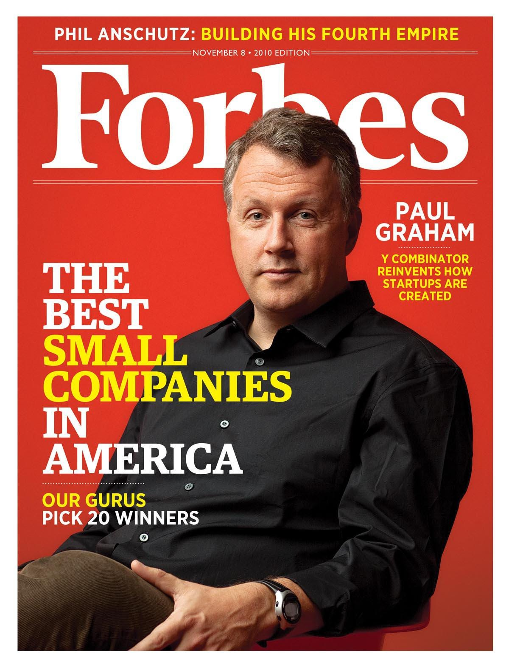
2002 First anti-spam
SPAM
HAM
Paul Graham
Notes:
In 2002, Paul Graham wrote an essay proposing a new solution to detect spam emails. Back then, email was just getting off the ground, and spam (unwanted email) was one of the most serious threats to widespread use of the internet by non-techies.
In his essay, Graham thought about a new ML-based approach that would learn to classify an email by processing thousands of “good” and spam emails. Paul’s simple software learned to recognize spam better than the complex rules concocted by engineers.

Slide 18
2004 Darpa Autonomous Vehicle Challenge
The first competition of the DARPA Grand Challenge was held on March 13, 2004 in the Mojave Desert region of the United States, along a 150-mile (240 km).
None of the robot vehicles finished the route. Carnegie Mellon University's Red Team traveled the farthest distance, completing 11.78 km (7.32 mi).
Therefore, a second DARPA Grand Challenge event was scheduled for 2005.
Just one year later 5 vehicles completed the course and almost all of the 23 competitors did better than the best entry of the 2004 competition.

Slide 19
2008 IBM Watson Jeopardy
Notes:
Penere med litt luft under tittel enig?
Watson is a question-answering computer system capable of answering questions posed in natural language, developed in IBM's DeepQA project by a research team led by principal investigator David Ferrucci. Watson was named after IBM's founder and first CEO, industrialist Thomas J. Watson.
The computer system was initially developed to answer questions on the quiz show Jeopardy! and, in 2011, the Watson computer system competed on Jeopardy! against champions Brad Rutter and Ken Jennings, winning the first place prize of $1 million.
In February 2013, IBM announced that Watson software system's first commercial application would be for utilization management decisions in lung cancer treatment at Memorial Sloan Kettering Cancer Center, New York City, in conjunction with WellPoint (now Anthem). In 2013, Manoj Saxena, IBM Watson's business chief said that 90% of nurses in the field who use Watson now follow its guidance.

Slide 20
2009 Deep Learning revolution powered by GPUs
2009
Notes:
Midstil tittel Forklar GPU – ikke bruk ord som er vanskelige og omd du gjør det vennligst forklar alt slik at dette blir aI presentasjonfor dummies.
The explosive growth in AI the last 10 years has largely been due to the use of Deep Learning, which is only possible because of the GPU revolution.
‘Large-scale Deep Unsupervised Learning using Graphics Processors’ (2009) from Ranja, Madhavan and Andrew Ng is probably the first really important paper that introduced GPUs to large neural networks. Andrew Ng has been flirting with the idea for some time, and his intuition was that larger models trained on more data will give bigger improvement than better algorithms. And to train large models, he came with the idea of using GPUs.

Slide 21
2010 Natural Language Generation: Writing reports
Notes:
2010 Narrative Science AI demonstrates the possibility of writing reports

Slide 22
2015 Open source AI projects receive massive investment
Notes:
2015 Microsoft invests 1 billion dollars in Open AI

Slide 23
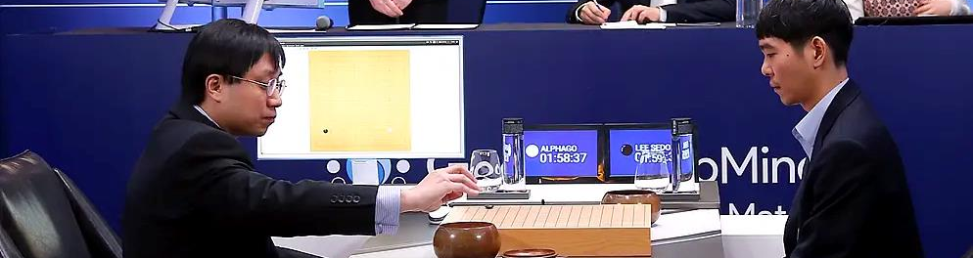
2016 Google’s Alpha Go defeats Lee Sedol in a game of Go
About an hour into the match, AlphaGo placed one of its stones in a nontraditional spot on the board that surprised those watching.
«This technology is going to cut through the global economy like a hot knife through butter. It learns fast and largely on its own. It's widely applicable. It doesn't only master what it has seen, it can innovate. For example: some of the unheard of moves made by AlphaGo were considered "beautiful" by the Grandmaster it beat.» John Robb
Notes:
"It was difficult to say at what point AlphaGo was ahead or behind, a close game throughout," commentator Michael Redmond said. "AlphaGo made what looked like a mistake with move 48, similar to the mistake in game four in the
middle of the board. After that AlphaGo played very well in the middle of the board, and the game developed into a long, very difficult end game.»
Google’s Alpha Go defeats Lee Sedol in a game of Go
Milestones in 2016: Google´s deep mind defeats alpha go champion Lee Sedol + AI 100 report + UC Berkley launches the center human compatible artificial intelligence.
About an hour into the match, AlphaGo placed one of its stones in a nontraditional spot on the board that surprised those watching.

Slide 24
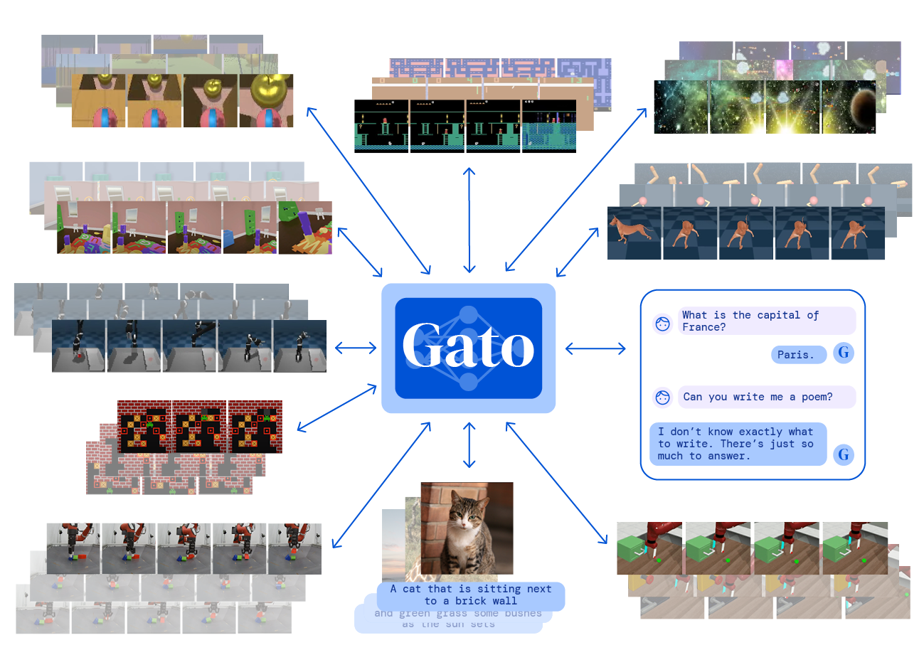
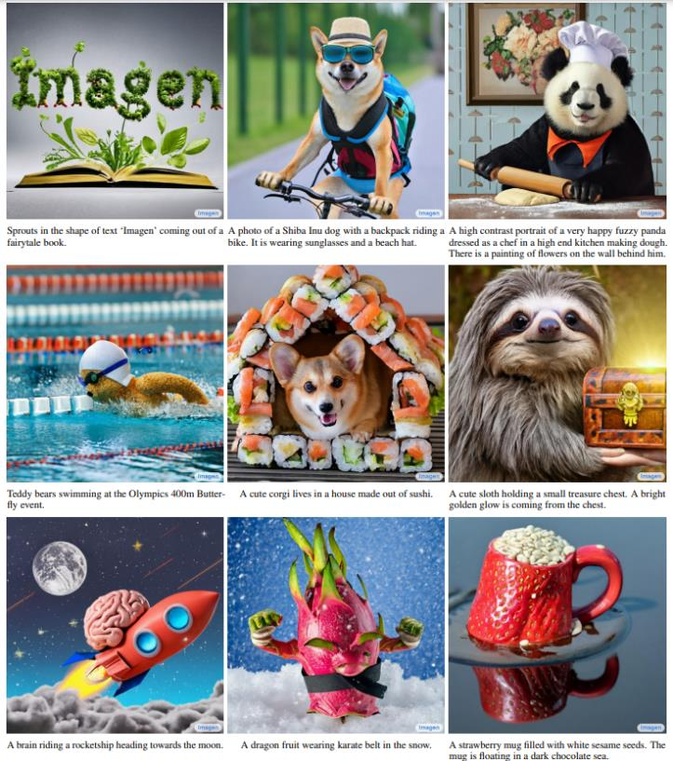
Current state of the art models
Generalist agents (Gato, GPT-3)
Digital artists (DALL-E 2, Imagen)
https://www.deepmind.com/publications/a-generalist-agent

Slide 25
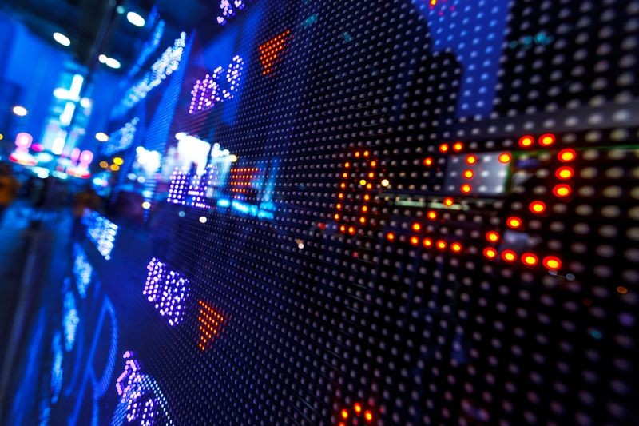
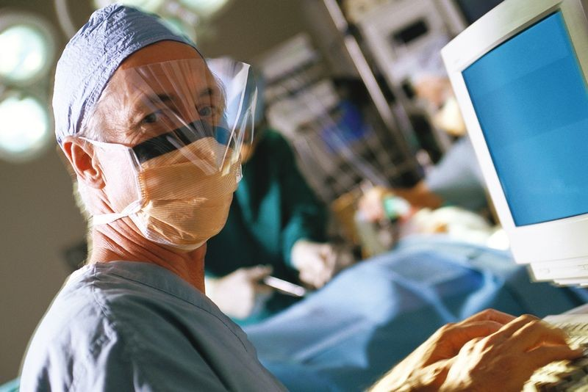

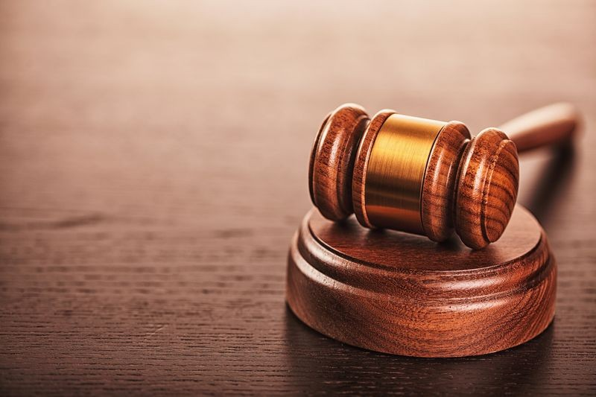
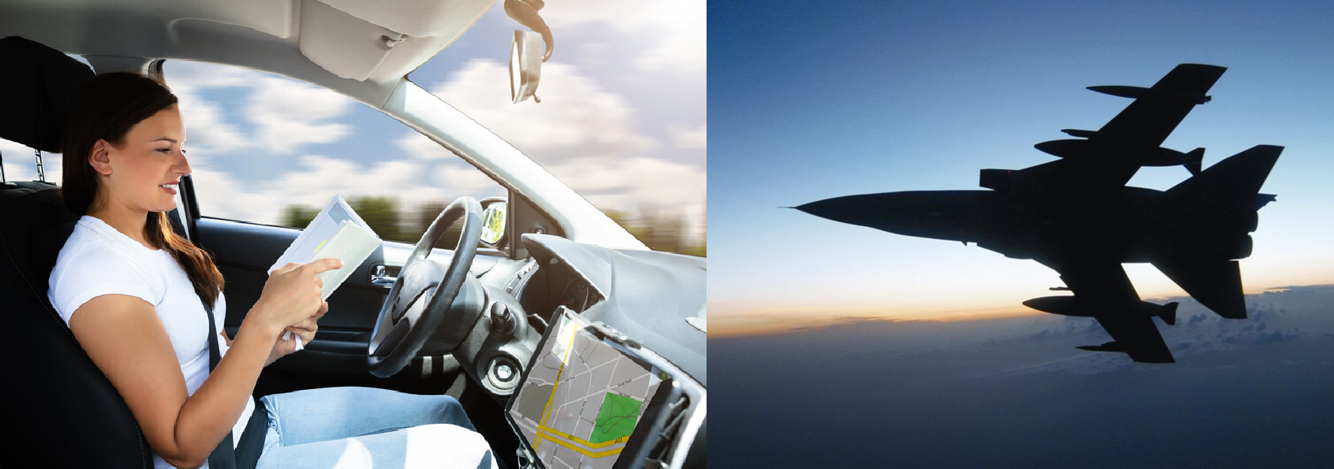
AI is increasingly used in many high-stakes tasks
Notes:
Forklar alle seks bildene

Slide 26
AI BASICS TAILORMADE
WHAT SHOULD WE ALL KNOW TO BE ABLE TO HAVE AN INTERESTING AI TALK WITH YOUR COLLEAGES?

Slide 27
Types of Machine Learning

Slide 28
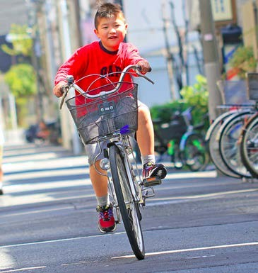
Reinforcement Learning
Familiar models of machine learning
–Learning from data.
How did you learn to cycle?
–Not from Data!
–Trial and error!
–Falling down hurts!
Walking, Talking, etc.

Slide 29
Unsupervised Learning
Notes:
Her viktig å fortelle om de to hovedformer for AI og sette unsupervised og supervised I context.

Slide 30
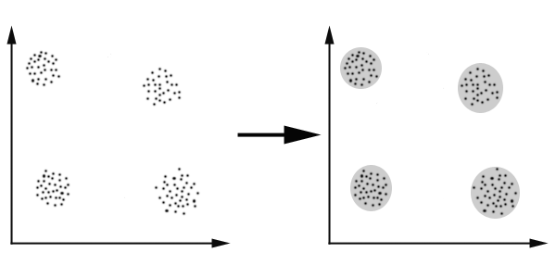
What is Clustering ?
Notes:
Kan du midstille andre de andre titelen også. Blir penere når resten er så strøkent.

Slide 31
What is Clustering?
Finding groups of objects such that the objects in a group will be similar (or related) to one another and different from (or unrelated to) the objects in other groups
Inter-cluster distances are maximized
Intra-cluster distances are minimized

Slide 32
Examples of Clustering Applications
Patient Stratification: finding groups of patients that have similar characteristics/responses
Marketing: Help marketers discover distinct groups in their customer bases, and then use this knowledge to develop targeted marketing programs
Land use: Identification of areas of similar land use in an earth observation database
Insurance: Identifying groups of motor insurance policy holders with a high average claim cost

Slide 33
K-means: Example, k = 3
Step 1:
- Make Random assignments
- Compute centroids (big dots)
Step 2: Assign points to nearest centroids
Step 3: Re-compute centroids
Notes:
Denne forstår folk derimot

Slide 34
Supervised Learning
Notes:
Forklar forskjellenen på supervised og unsupervised godt.

Slide 35
1-Nearest Neighbor
Nearest Neighbor: Non-parametric pattern classification.
One of the simplest of all machine learning classifiers
Simple idea: Label a new point the same as neighbor
Label it red.
Notes:
Remember all your data
When someone asks a question,
find the nearest old data point
return the answer associated with it

Slide 36
k-Nearest Neighbor
Generalizes 1-NN to smooth away noise in the labels
New point: Assigned to most frequent label of its k NN
Label it red, when k = 3
Label it blue, when k = 7

Slide 37
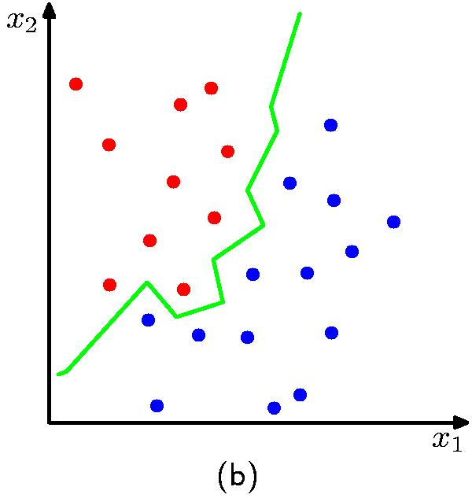
Nearest-Neighbours for Classification
K = 1

Slide 38
Deep learning: bird view

Slide 39
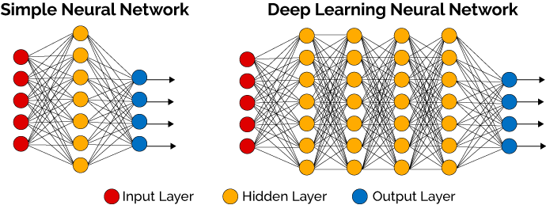
Deep Learning
• Utilizes learning algorithms that derive meaning out of data by using a hierarchy of multiple layers that mimic the neural networks of our brain.

Slide 40
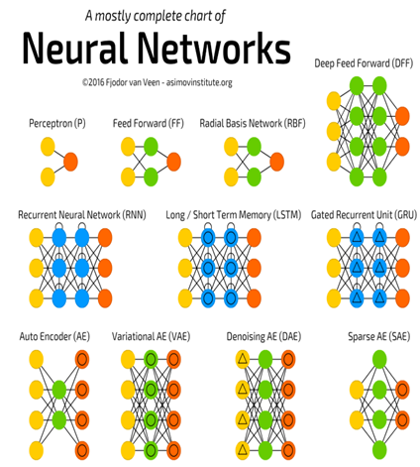
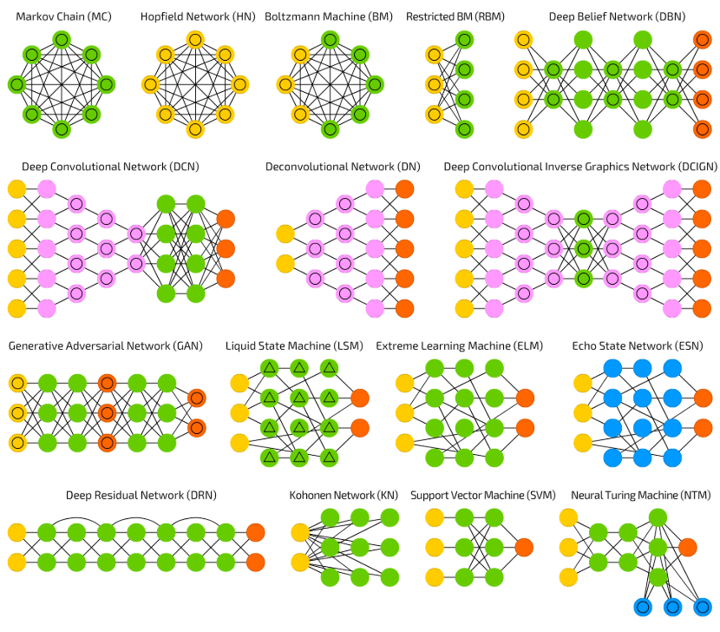
http://www.asimovinstitute.org/neural-network-zoo/

Slide 41



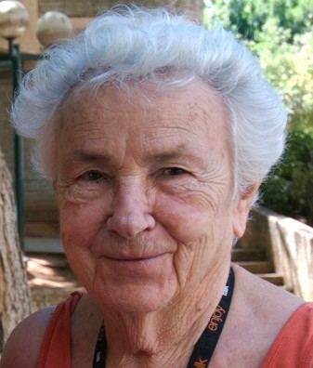












Standard Image Classifcation: Image features
Features = local detectors
  Combined to make prediction
  (in reality, features are more low-level)
Nose
Eye
Face!
Eye
Mouth

Slide 42


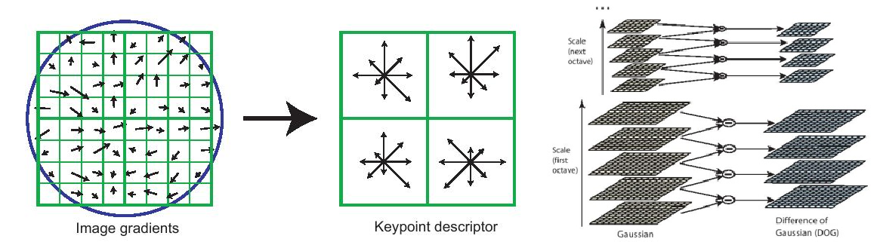
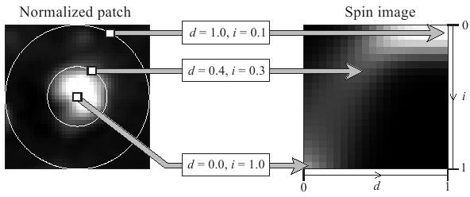
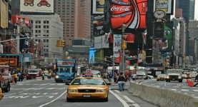



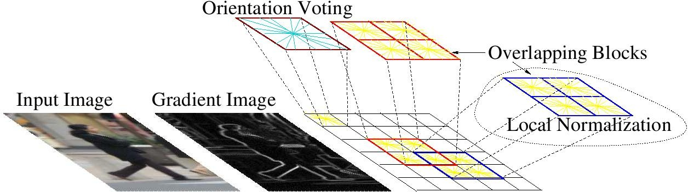
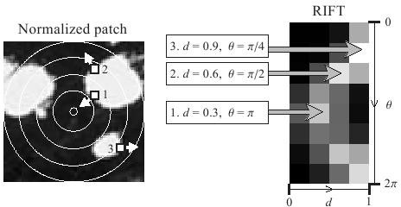
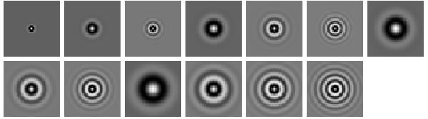
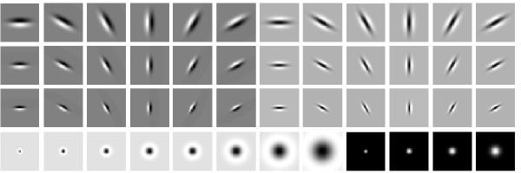
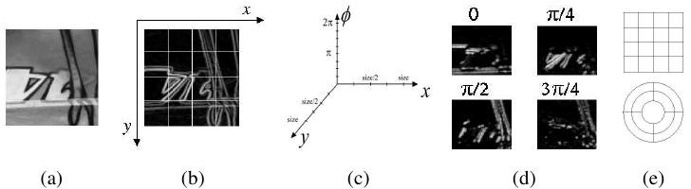
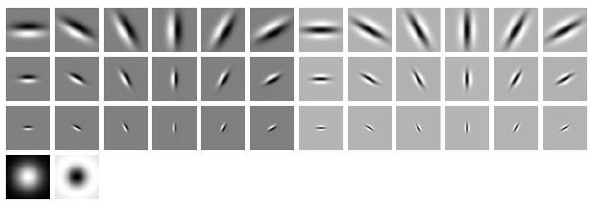
Standard image classification approach
Input Extract features
e.g., logistic regression, SVMs
SIFT
Spin image
Car?
HoG
RIFT
Use simple classifier
Textons
GLOH
Slide Credit: Honglak Lee

Slide 43
Many hand create features exist…
SIFT
Spin image
HoG
RIFT
Textons
GLOH
Slide Credit: Honglak Lee
… but very painful to design

Slide 44
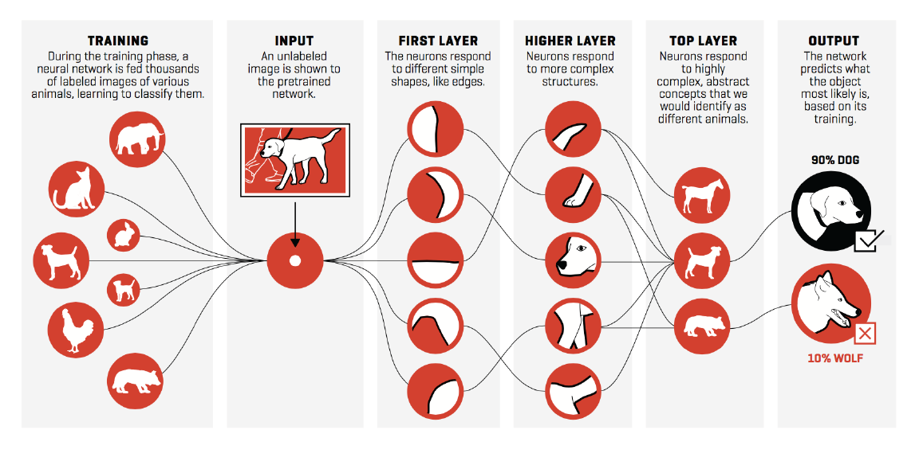
Deep Learning

Slide 45
Unethical usage/exploitation of AI

Slide 46

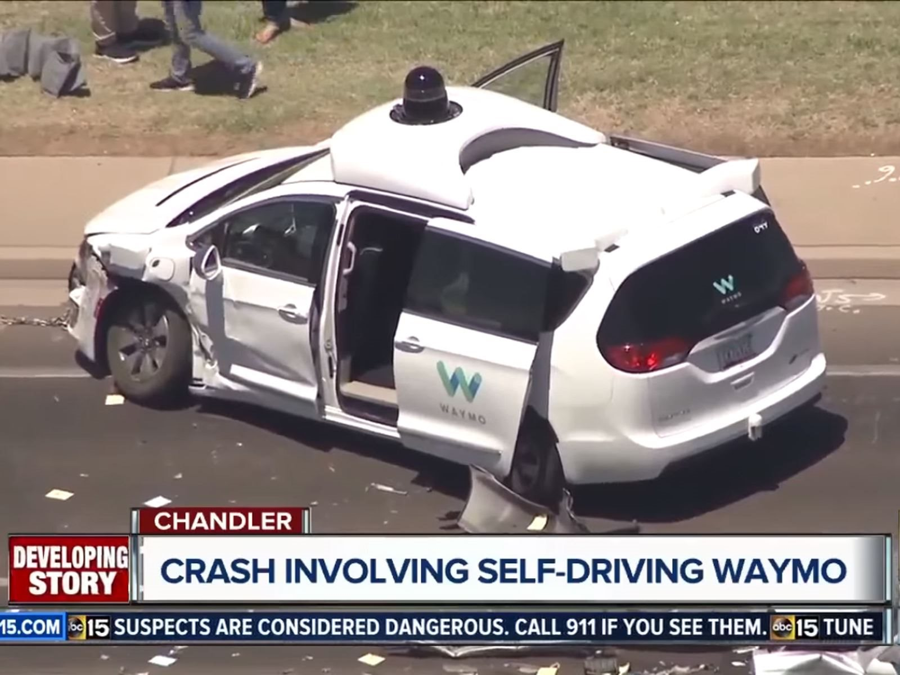
AI can be life threatening
Security in digital world=
Security in physical world

Slide 47
“Adversarial” attacks
Researchers confused a computer vision system into thinking that a stop sign was a 45 mph sign, with just a few pieces of tape.
Neural networks can be fooled in surprising ways.

Slide 48
“Adversarial” attacks
Peturbated
Proof of concept adversarial attacks on medical images. Image shown are pre- (Clean) and post-adversarial. The image perturbations are not perceptible to humans. The percentage displayed on the bottom left of each image represents the probability that the model assigns that image of being diseased. Green = Model is correct on that image. Red = Model is incorrect. Image from [Finlayson].

Slide 49
Do you recognize one of them?

Slide 50
Nvidia’s artificial intelligence can produce images of fake celebrities that look scarily real

Slide 51
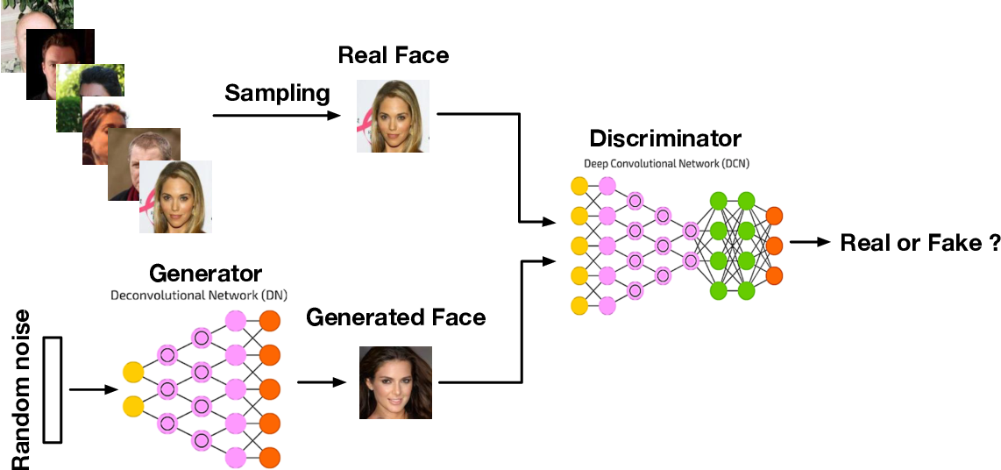
Generative adversarial Networks

Slide 52
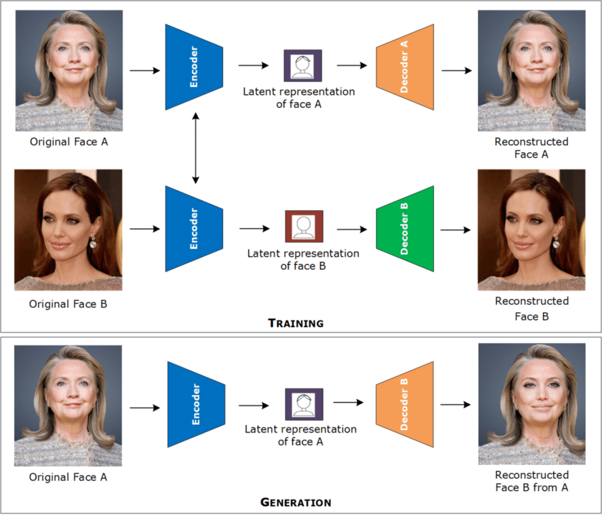
Deepfake

Slide 53
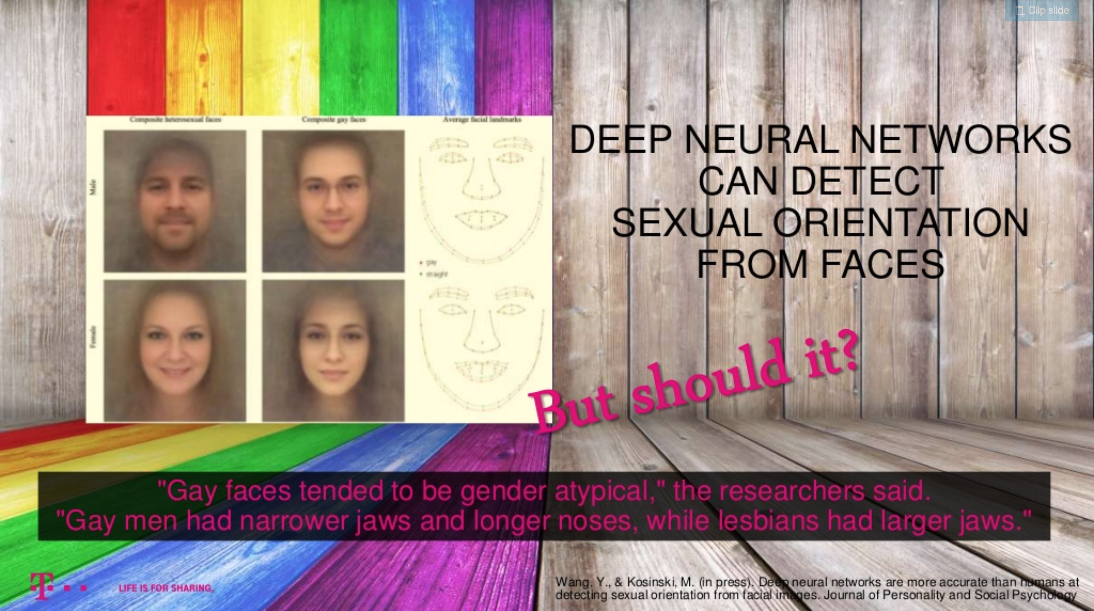
Source: Kyllesbech Larsen, A Tutorial to AI Ethics – Fairness, Bias & Perception

Slide 54
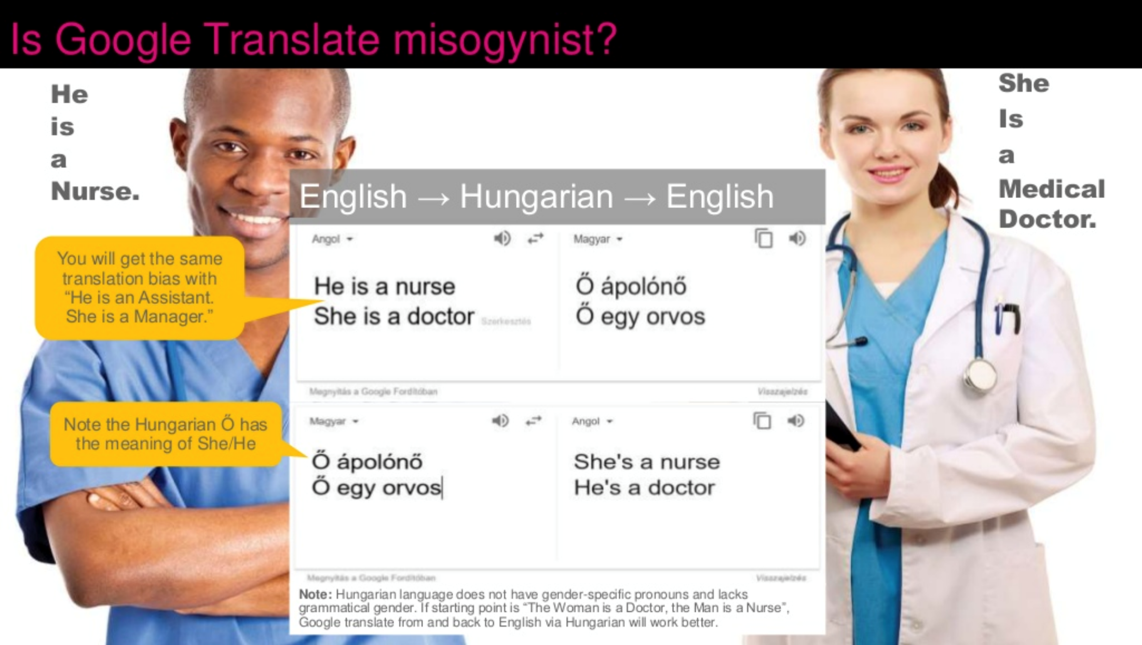
Misogyny is the hatred of, contempt for, or prejudice against women or girls.

Slide 55
AI shapes our view of the world

Slide 56
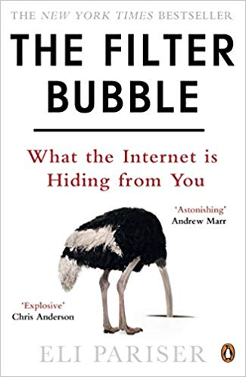
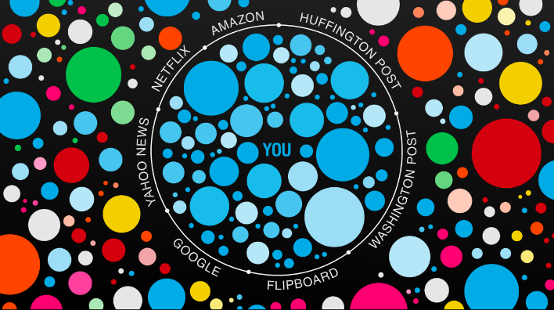
Filter Bubble
  Filter Bubble and web search engines
  Reinforcement effect: more and more of what you like
  ➔extremism and bias

Slide 57
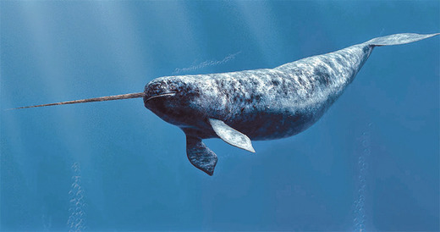
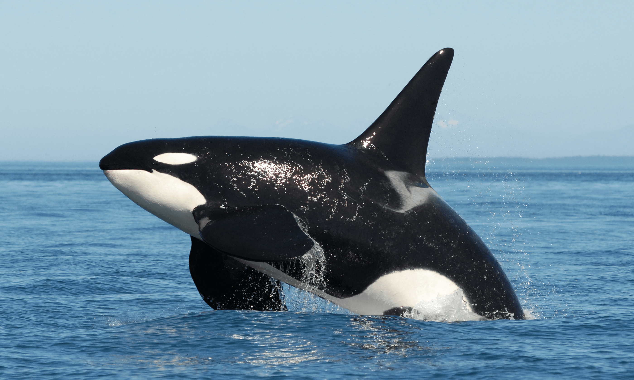
Obama: Narwhal project
Project Narwhal is the name of a computer program used by the 2012 campaign by Barack Obama.
It was contrasted in the Mitt Romney presidential campaign by Project Orca, so named because the orca is one of the few predators of the narwhal.

Slide 58
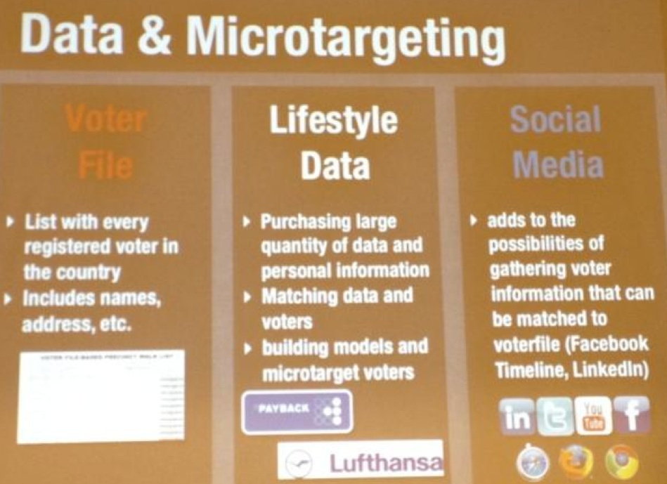
Merged databases on voters
a team of 120 people:
  Programmers, statisticians, mathematicians, and marketing Experts from google and twitter
The team worked exclusively on creating tools that collect and analyze data of voters.

Slide 59
Target Group: most uncertain candidates and higher probability to vote
In 2008 and 2012 elections, Obama campaign created statistical models to predict both the probability of an individual choosing to turn to polls (giving their vote), and the probability to vote for one candidate.
About 75% of the deciding factors: age, sex, race, neighborhood and voting history.
Thus he was able to get maximum benefits out of its funds, and focus on influencing the most uncertain candidates to their advantage

Slide 60
Sweet Zone
HIGH turnout
Voters are Consumers of politics.
Voter Turnout Index
Consumption level
Brand preference
LOW turnout
Democrat SKEW
Republican Index Minus Democrat Index
REPUBLICAN SKEW

Slide 61
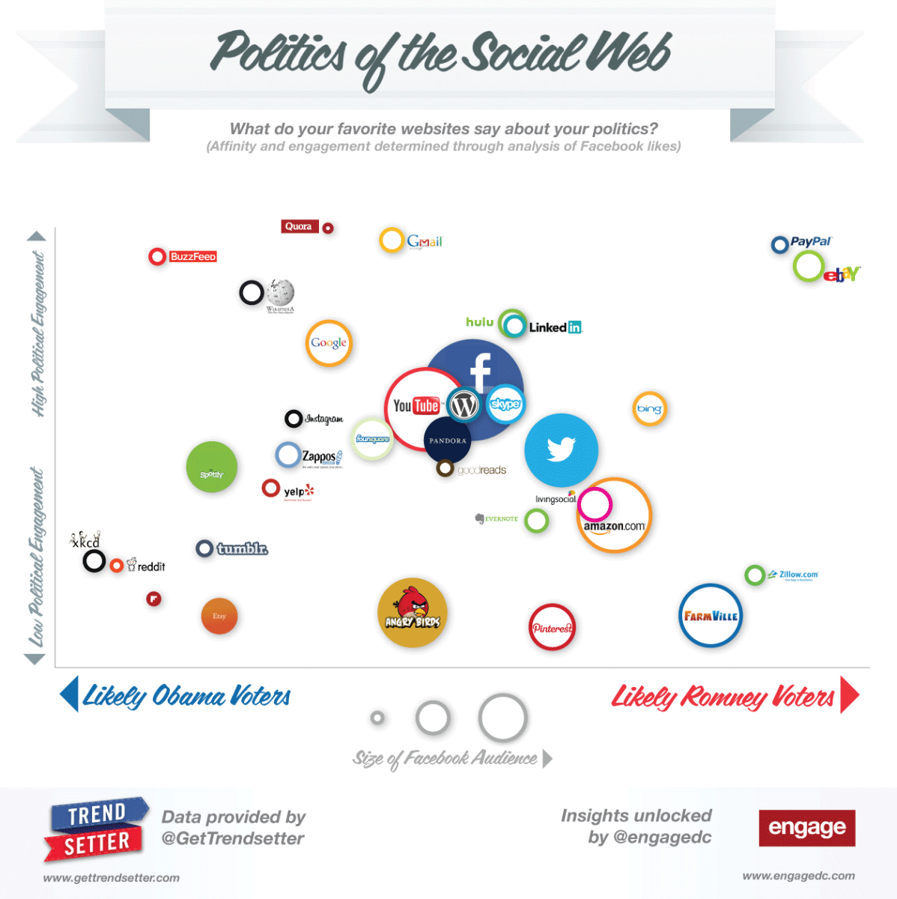
Social media
Democrats tend to use Spotify, while Republicans tend to use Pinterest. Good to Know when selecting social media platform.

Slide 62

AI Bias

Slide 63
AI Bias
AI Bias: amplification of error based on race or demographic group.
Danger:
  Loan
  Admission to university
  Insurances
  Urgent treatment (Emergency)
Notes:
begå en forbrytelse

Slide 64
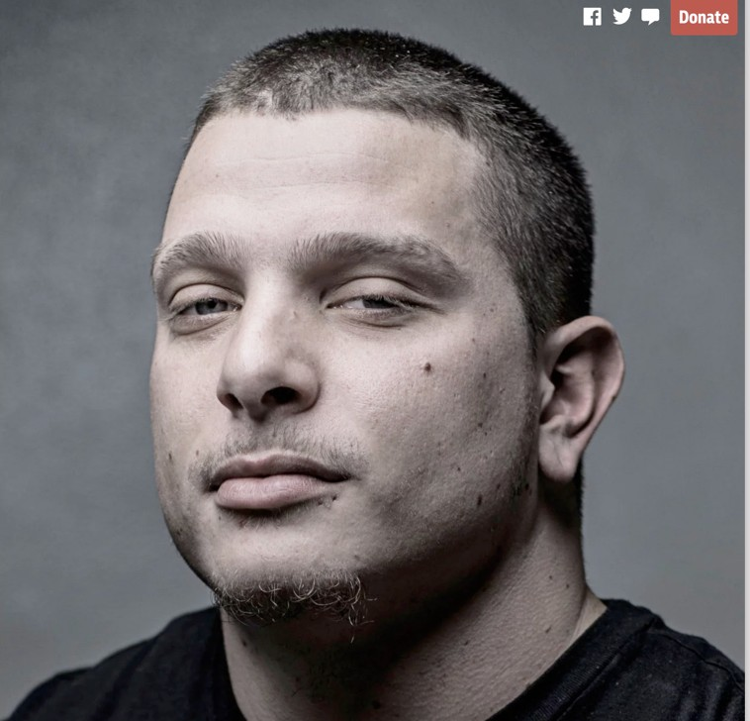
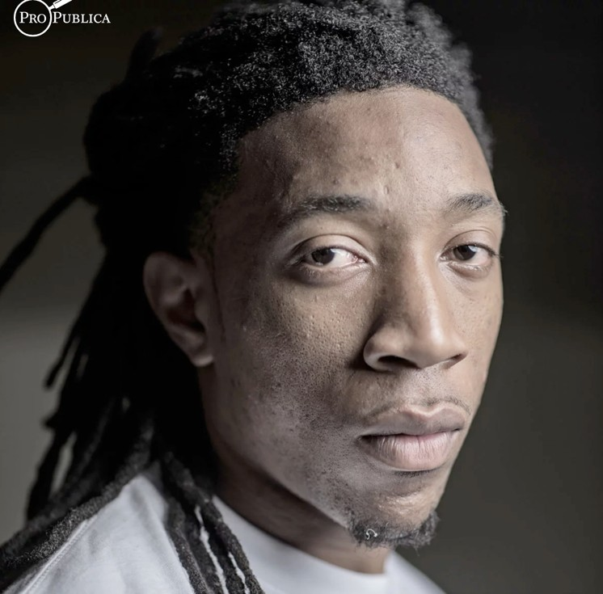
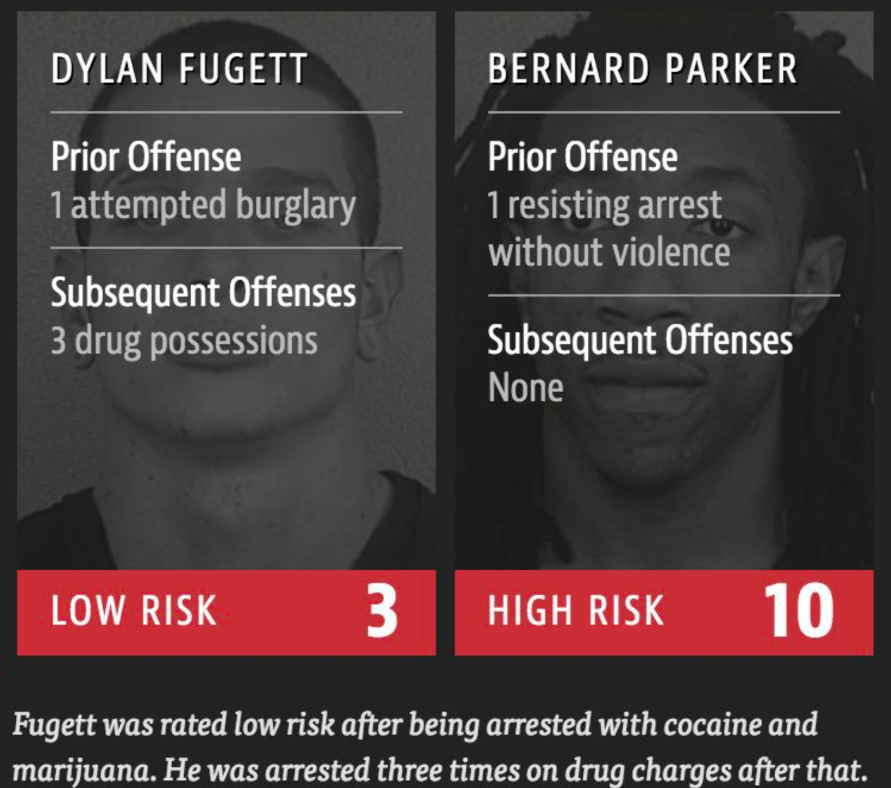
Discrimination in COMPAS
COMPAS used in US for predicting the likelihood of a criminal reoffending based on 137 questions.
The predictions of COMPASS might decide who continues in prison and who regains his freedom.
The system predicts that black defendants pose a higher risk of recidivism than they do, and the reverse for white defendants.
Jeff Larson, Surya Mattu, Lauren Kirchner and Julia Angwin, “How We Analyzed the COMPAS Recidivism Algorithm,” ProPublica, May 23, 2016, https://www.propublica.org/article/how-we-analyzed-the-compas-recidivism-algorithm.

Slide 65


Color matters in AI

Slide 66

Amazon
The machine learning algorithm was fed with a decade's worth of resumes of people applying for jobs at Amazon.

Slide 67


Slide 68
Bias: Sometimes Data Problem not algorithmic problem
The Amazon system has learned to downgrade resumes with the word "women" or "female" and assigned lower scores.
The developers said it was impossible to stop the system from finding new ways to discriminate women.
Apparently, the biggest issue was the data itself that.

Slide 69

Bias because of “non-inclusive” data set

Slide 70
Bias: hidden in the data
Our names are gendered
Resident cities, School names, postal code are correlated with ethnicity and socioeconomic status

Slide 71


Slide 72
XAI

Slide 73








Today
©Spin South West
Why did you do that?
Why not something else?
When do you succeed?
When do you fail?
When can I trust you?
How do I correct an error?
Learning
Process
This is a cat
(p = .93)
©University Of Toronto
http://explainthatstuff.com
Training
Data
Learned
Function
Output
User with
a Task
Tomorrow
©Spin South West
I understand why
I understand why not
I know when you’ll succeed
I know when you’ll fail
I know when to trust you
I know why you erred
New
Learning
Process
This is a cat:
It has fur, whiskers, and claws.
It has this feature:
©University Of Toronto
Training
Data
Explainable Model
Explanation Interface
User with
a Task

Slide 74

Motivation - Do we really need this?
Understanding the model
increases trust
helps us improve the model
Why Should I Trust You? Ribeiro, Marco & Singh, Sameer & Guestrin, Carlos (2016)

Slide 75

Motivation - Do we really need this? Husky classified as wolf
Why Should I Trust You? Ribeiro, Marco & Singh, Sameer & Guestrin, Carlos (2016)

Slide 76

Do we really need this?
Legally, yes!
GDPR Articles 13-14-15 give individuals the right to be informed of the existence of solely automated decision-making, meaningful information about the logic involved, and the signiﬁcance and envisaged consequences for the individual.
Crucial in other domains: medicine,
law-enforcement, security, ﬁnance, etc.
The impact of the General Data Protection Regulation (GDPR) on artiﬁcial intelligence, 2020

Slide 77

Map of ML methods and their Explainability

Slide 78



XAI
Directly explainable model
Post-hoc explainability
Linear model
Decision tree
Rule-based model
Breaking the trade-off
Generalized linear rule model
Generalized additive models
…
Deep neural networks
Ensemble models

Slide 79
Examples of high-performing directly explainable models
Generalized Linear Rule Model (GLRM) (Wei et al., 2019)
Wei et al. Generalized Linear Rule Models. ICML 2019 (GLRM for regression: https://github.com/IBM/AIX360/blob/master/aix360/ algorithms/rbm/GLRM.py)
Dash et al. Boolean Decision Rules via Column Generation, NeurIPS 2018 (BRCG for classification: https://github.com/IBM/AIX360/ blob/master/aix360/algorithms/rbm/BRCG.py)
Wang & Rudin (2015). Falling rule lists. In Artificial Intelligence and Statistics

Slide 80
XAI
Directly explainable model
Post-hoc explainability
Explaining the model (global)
Explaining a decision (local)
Inspecting counterfactual
Guidotti et al. (2018). A survey of methods for explaining black box models. ACM computing surveys (CSUR) .

Slide 81

Global: knowledge distillation (approximation)

Slide 82

Local explanation

Slide 83

Counterfactual explanations

Slide 84
Dealing with Uncertainty in AI

Slide 85

Models assign high confidence predictions for out-of-distribution (OOD) inputs
Example images where model assigns >99.5% confidence.
Image source: “Deep Neural Networks are Easily Fooled: High Confidence Predictions for Unrecognizable Images” Nguyen et al. 2014

Slide 86


Sources of uncertainty: Model uncertainty
Many models can fit the training data well
Also known as epistemic uncertainty
Model uncertainty is “reducible”
  Vanishes in the limit of infinite data (subject to model identifiability)
Models can be from same hypotheses class (e.g. linear classifiers in top figure) or belong to different hypotheses classes (bottom figure).

Slide 87

Sources of uncertainty: Data uncertainty
Labeling noise (ex: human disagreement)
Measurement noise (ex: imprecise tools)
Missing data (ex: partially observed features, unobserved confounders)
Also known as aleatoric uncertainty
Data uncertainty is “irreducible*”
  Persists even in the limit of infinite data
  *Could be reduced with additional features/views
Image source: Battleday et al. 2019 “Improving machine classification using human uncertainty measurements”

Slide 88

Uncertainty estimation
Abdar, Moloud, et al. "A review of uncertainty quantification in deep learning: Techniques, applications and challenges." Information Fusion 76 (2021): 243-297.

Slide 89


Slide 90
The National Strategy for AI
The National Strategy for AI points out that Norway can become a leader in applying AI, particularly in sectors where the country already has a strong global position, such as energy, ocean industries and health.

Slide 91

Völur
“Making optimal utilization of resources and effective processes through the value chain is a continuous challenge. From slaughtering the optimal number of animals that are required by the demand of finished products, to executing the right production cuttings, processing recipes and manufacturing plans to deliver market demand. All without leading to overproduction of undesired goods and waste, non-optimal inventories, excess of purchasing costs, lower product quality and unnecessary high CO2 emissions.”

Slide 92

eSmart Systems
eSmart Systems is using artificial intelligence to make it easier to maintain the electricity grid.
Taditially, helicopter are used to detect failure in power lines after huricane.
In collaboration with KONGSBERG, eSmart Systems aims towards fully autonomous flight.
Notes:
Their company attempts to reinvent energy systems through their predictive maintenance and Connected Drone using industrial grade deep learning to turn visual inspection data into actionable asset insight. Together with this they have a Connected Grid solution that works as an intelligent top system that provides decision support for optimal operation, maintenance and planning of grids. Not only do they do this on a delivery level however they are thinking about how to make it easier for the consumer to get an overview over energy consumption in what they call a Connected Prosumer providing real-time visualization of energy consumption detailed to the preferences of the consumer, as well as any of the energy production on site.

Slide 93

AI in fisheries and aquaculture

Slide 94

Scantrol
The Norwegian company Scantrol Deep Vision has developed a revolutionary, AI-based tool to help trawlers to catch the right fish. Using a subsea camera, the Deep Vision system identifies and measures fish under water – without bringing the catch onboard the vessel. This makes it easier to stop the trawl when the catch quota has been filled and to reduce bycatch.

Slide 95

DigiFarm
DigiFarm: Ag-Tech Startup Using AI for Accurate Field Boundaries
DigiFarm is an ag-tech startup that detects the world’s most accurate field boundaries through using super-resolution satellite imagery. With its focus on agriculture and AI, the company is well-positioned to help farmers increase their yield and optimize their operations.

Slide 96

The Human Touch Robotics
All robotic grippers to date miss one key component to automate the food packing process: the human touch.
Our core innovation is precisely that, a robotic gripper that perfectly adapts to the softness of the object it holds. Kind of like a Golden Retriever holding an egg in its mighty jaw without breaking the shell. Plus, it is food-agnostic and perfectly aligned with the latest health and safety regulations, making it ideal for handling food.

Slide 97


