Slide 1
Promoting know-how and research
Matyáš Strnad

Slide 2
Science communication
Stop!
Take a breath – it‘s not easy
Know your audience
Tell a compelling story
Be accurate and transparent
Use visuals effectively
Foster two-way communication
Be mindful of values and ethics
Choose correct communication channels
Practice empathy and active listening
Collaborate and engage with stakeholders

Slide 3
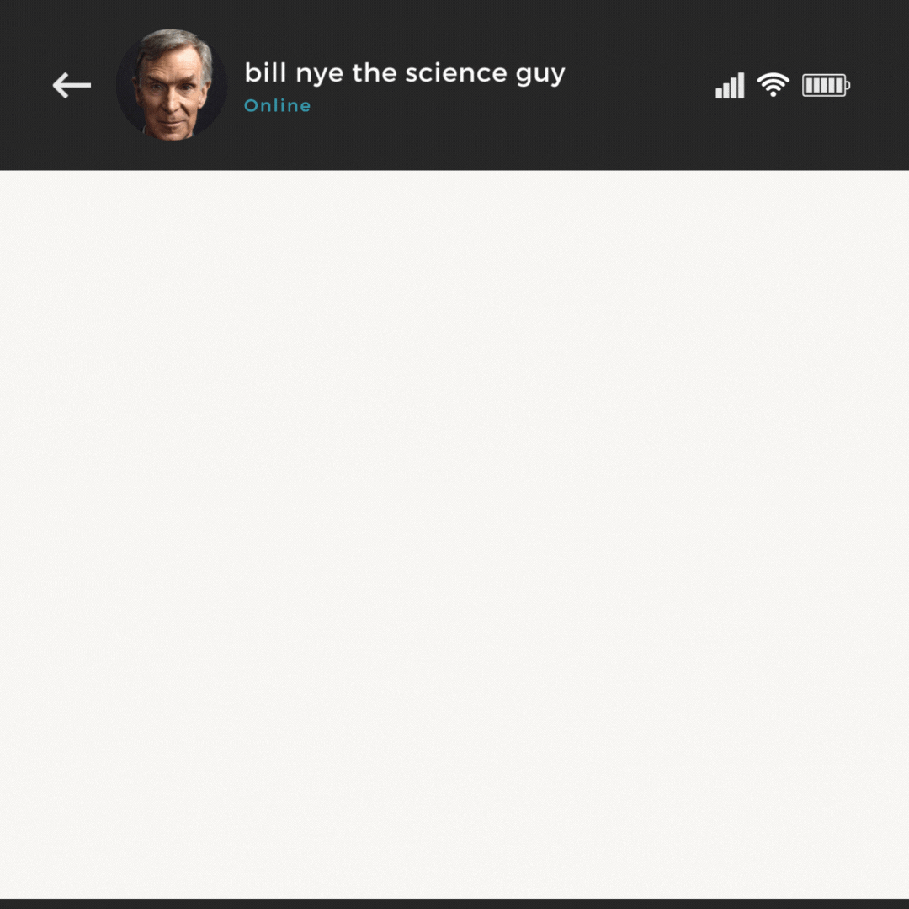
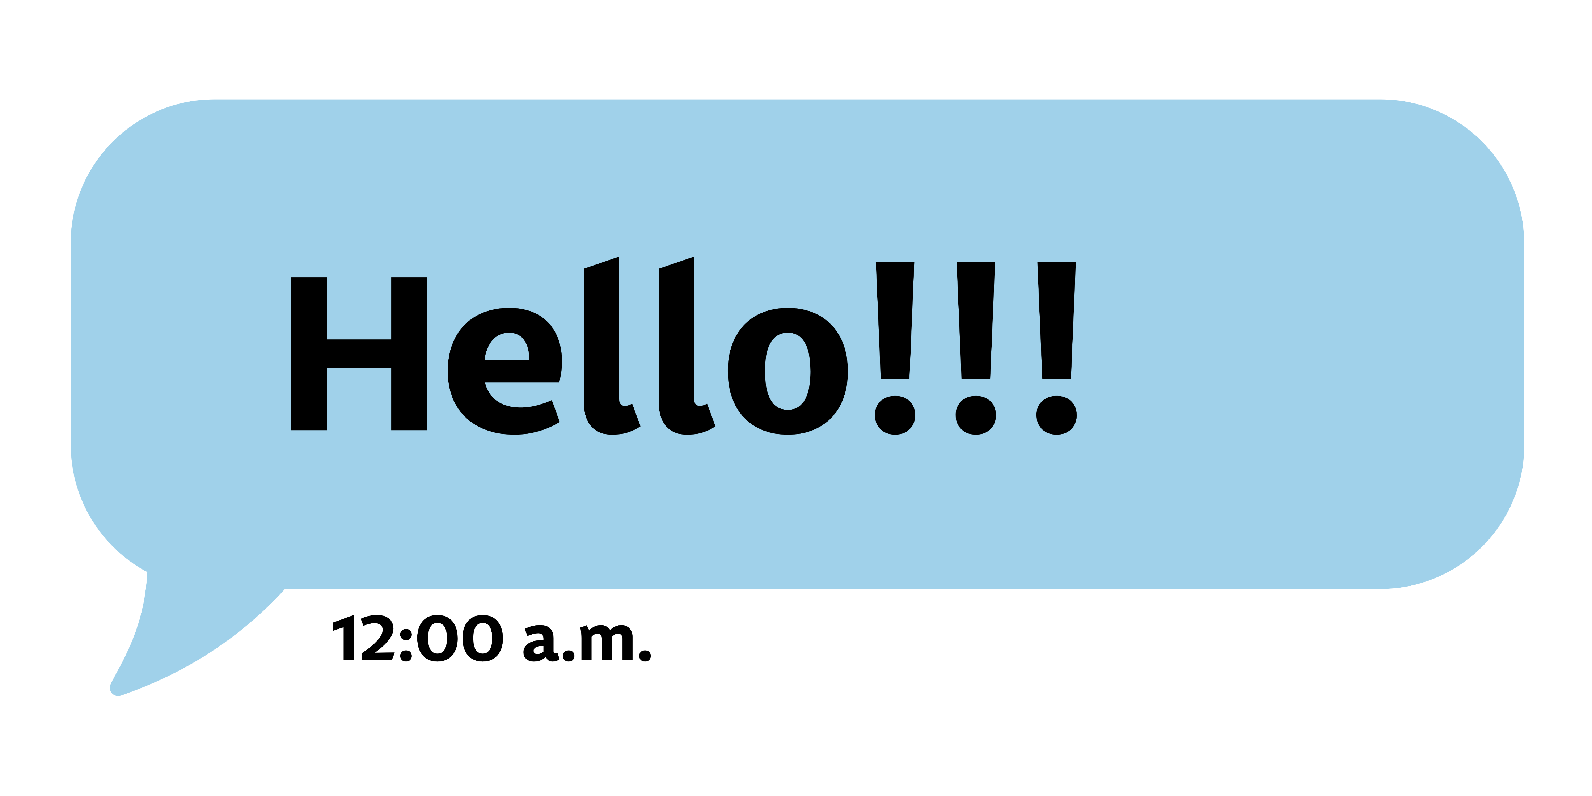

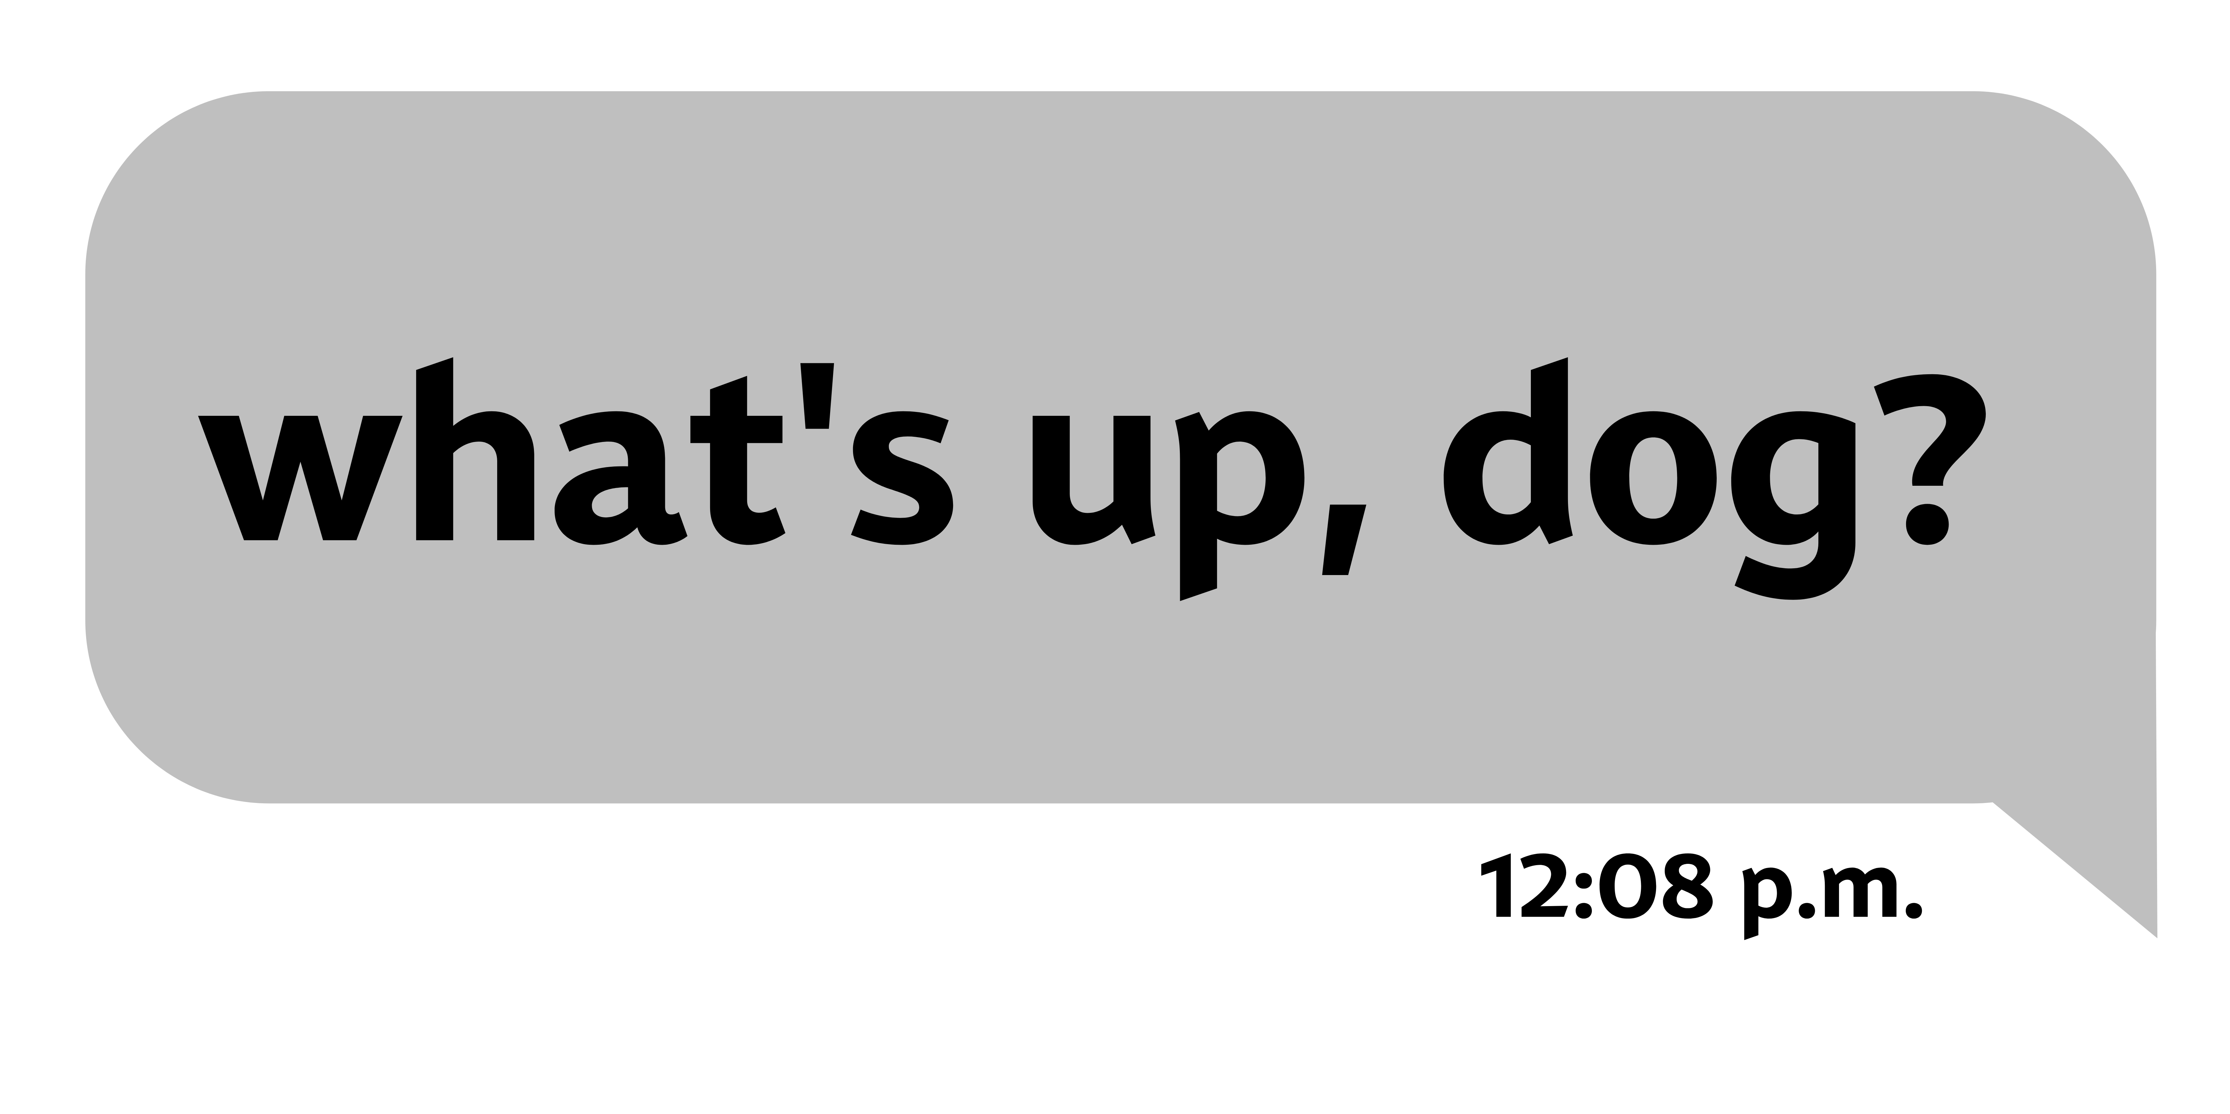
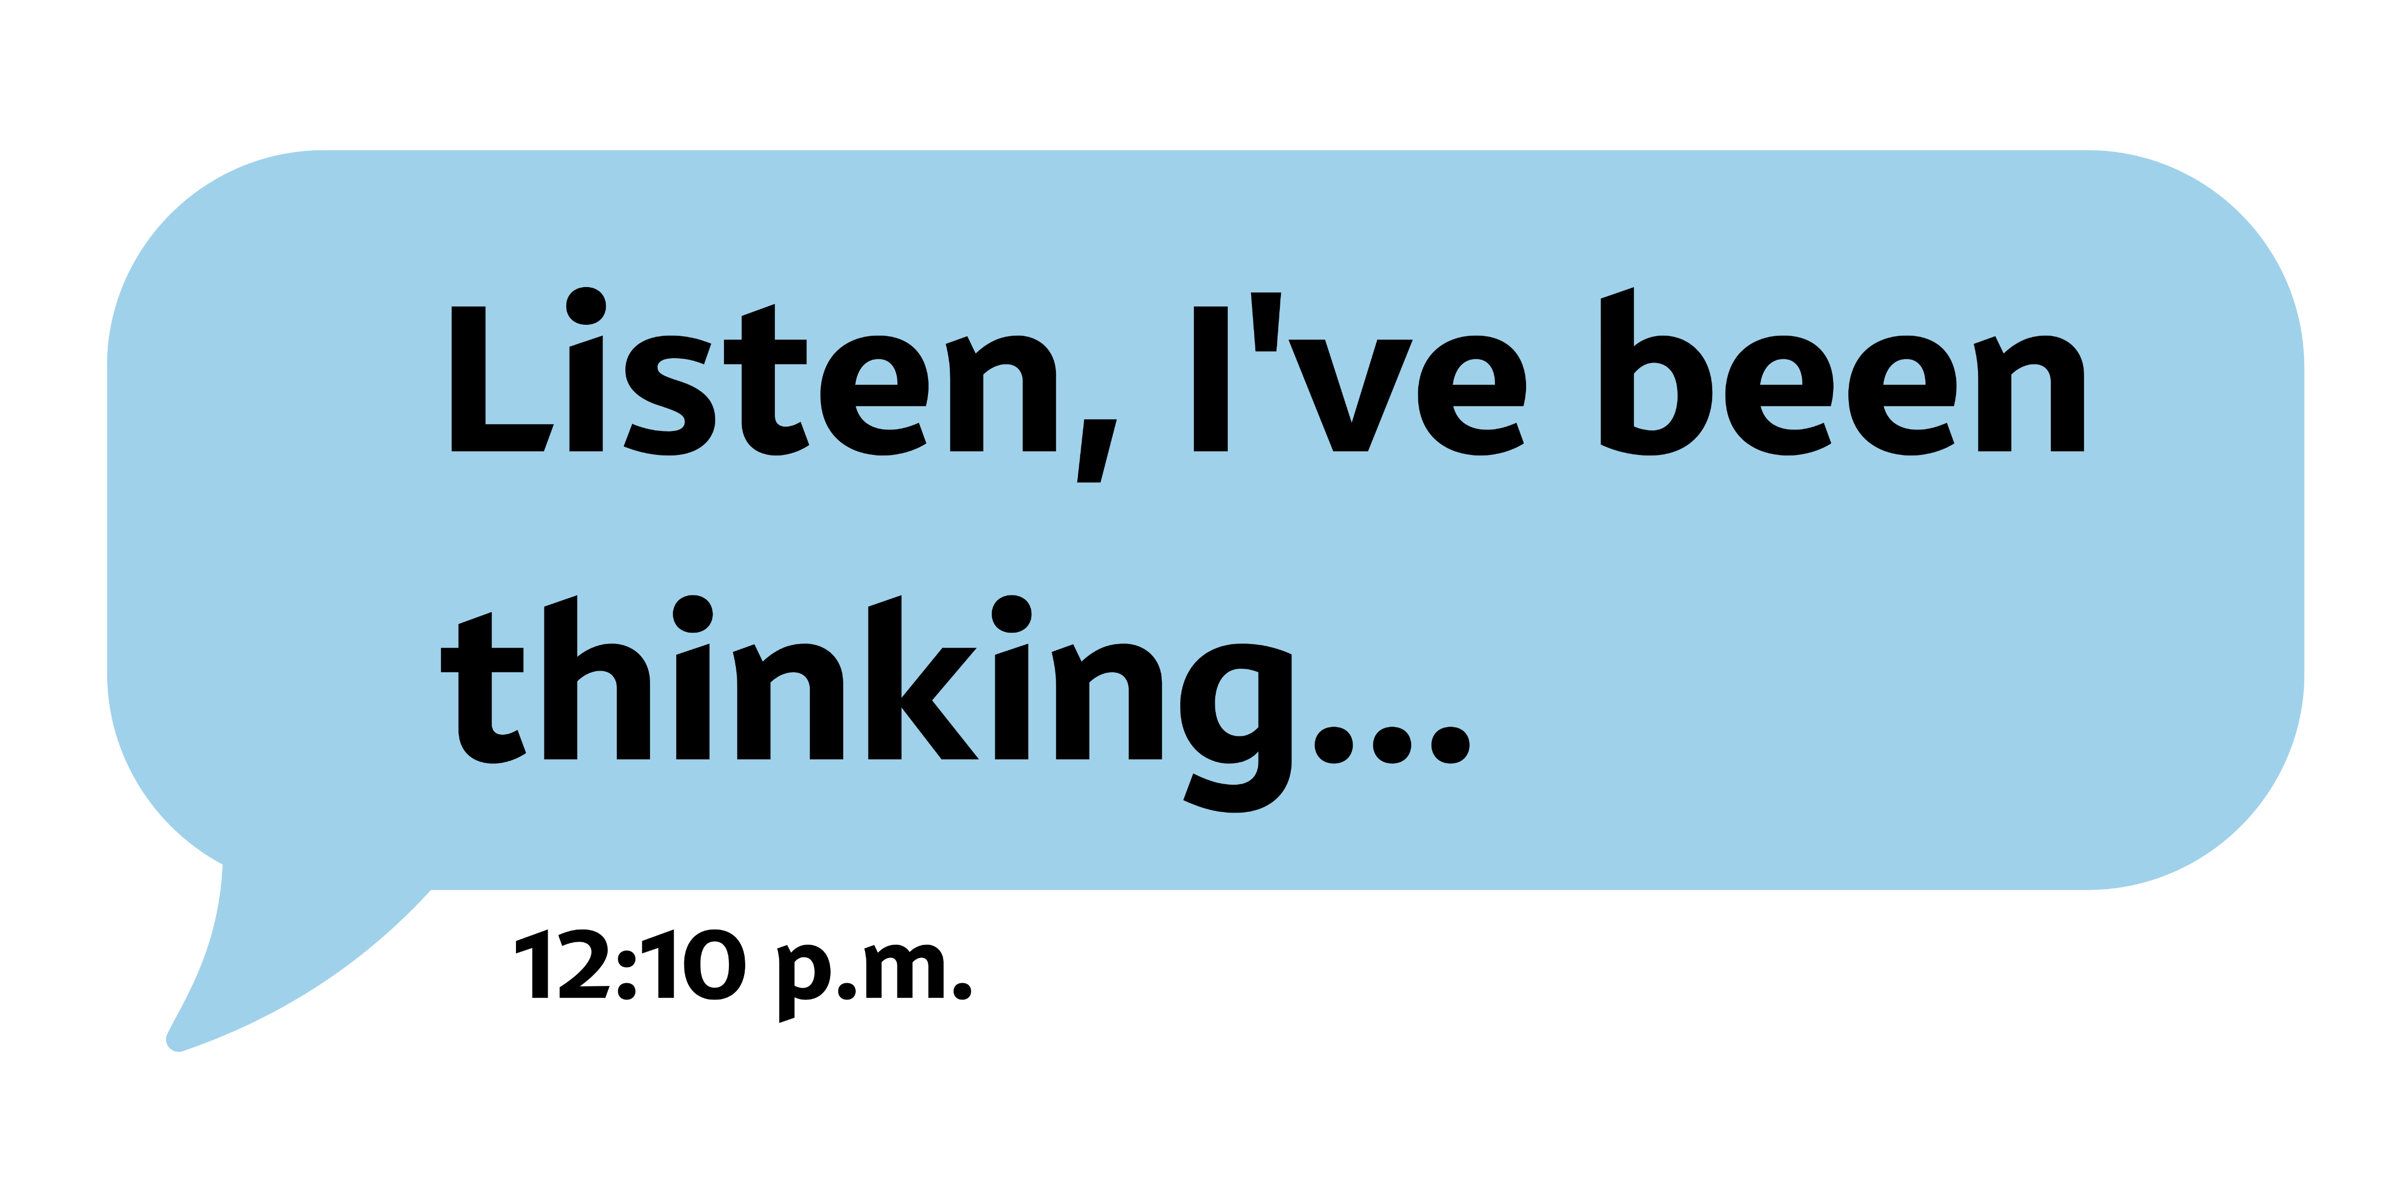
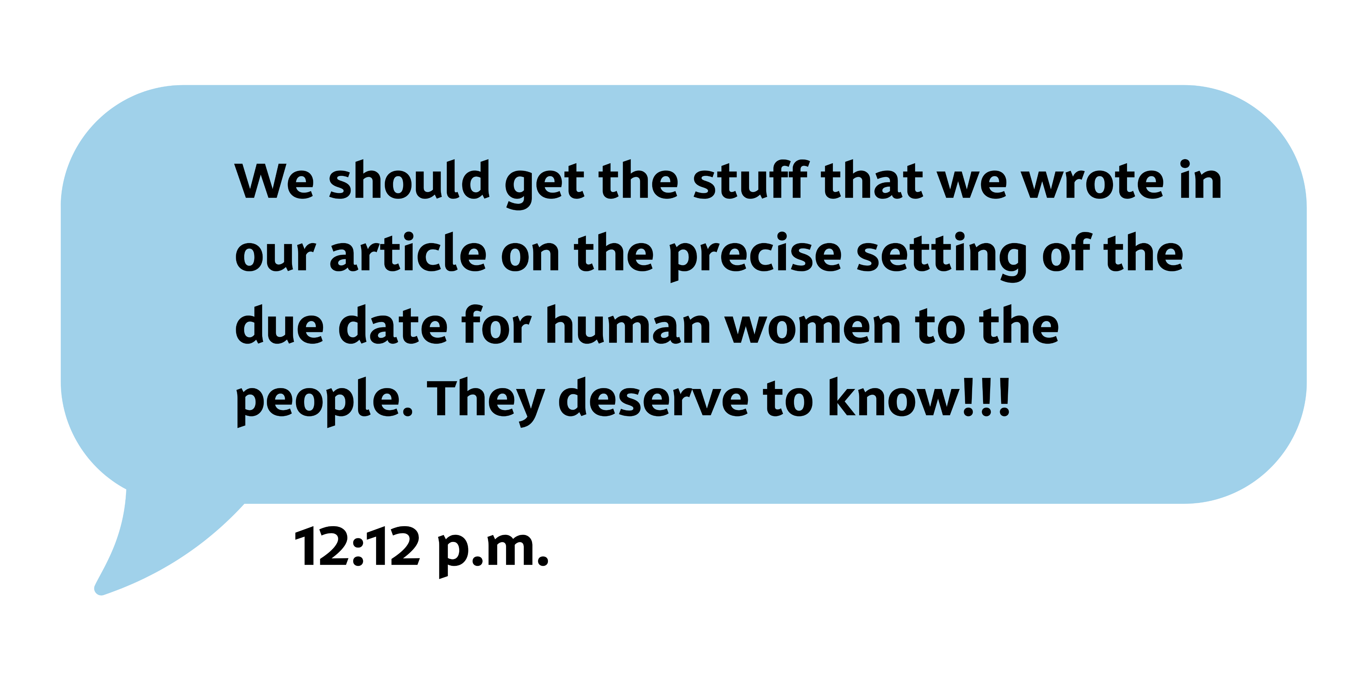
Case study
Brainsraining©

Slide 4
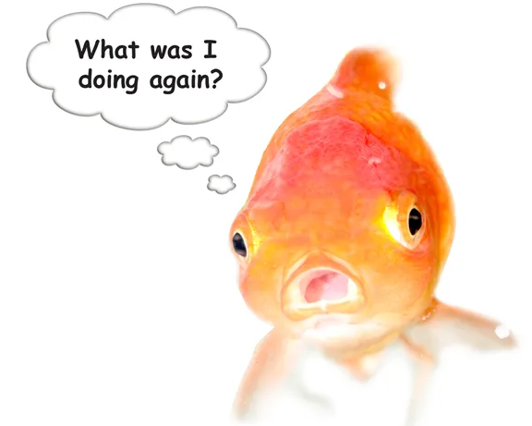
Categorization of promotion
Types of media
Traditional (printed) and audiovisual (Deník N, MF Dnes, Hradecký deník, Refresher, DVTV, Český rozhlas Radiožurnál, ČT24, Východočeská televize etc.)
Web (vedavyzkum.cz, universitas.cz, expats.cz, euforka.eu etc.)
Social media (goldfish paradox)

Slide 5
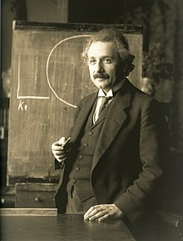
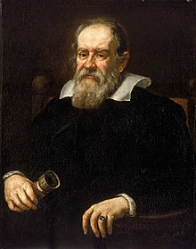
Science and the public opinion
Like it or not…
Cellar genius or influencer?

Slide 6
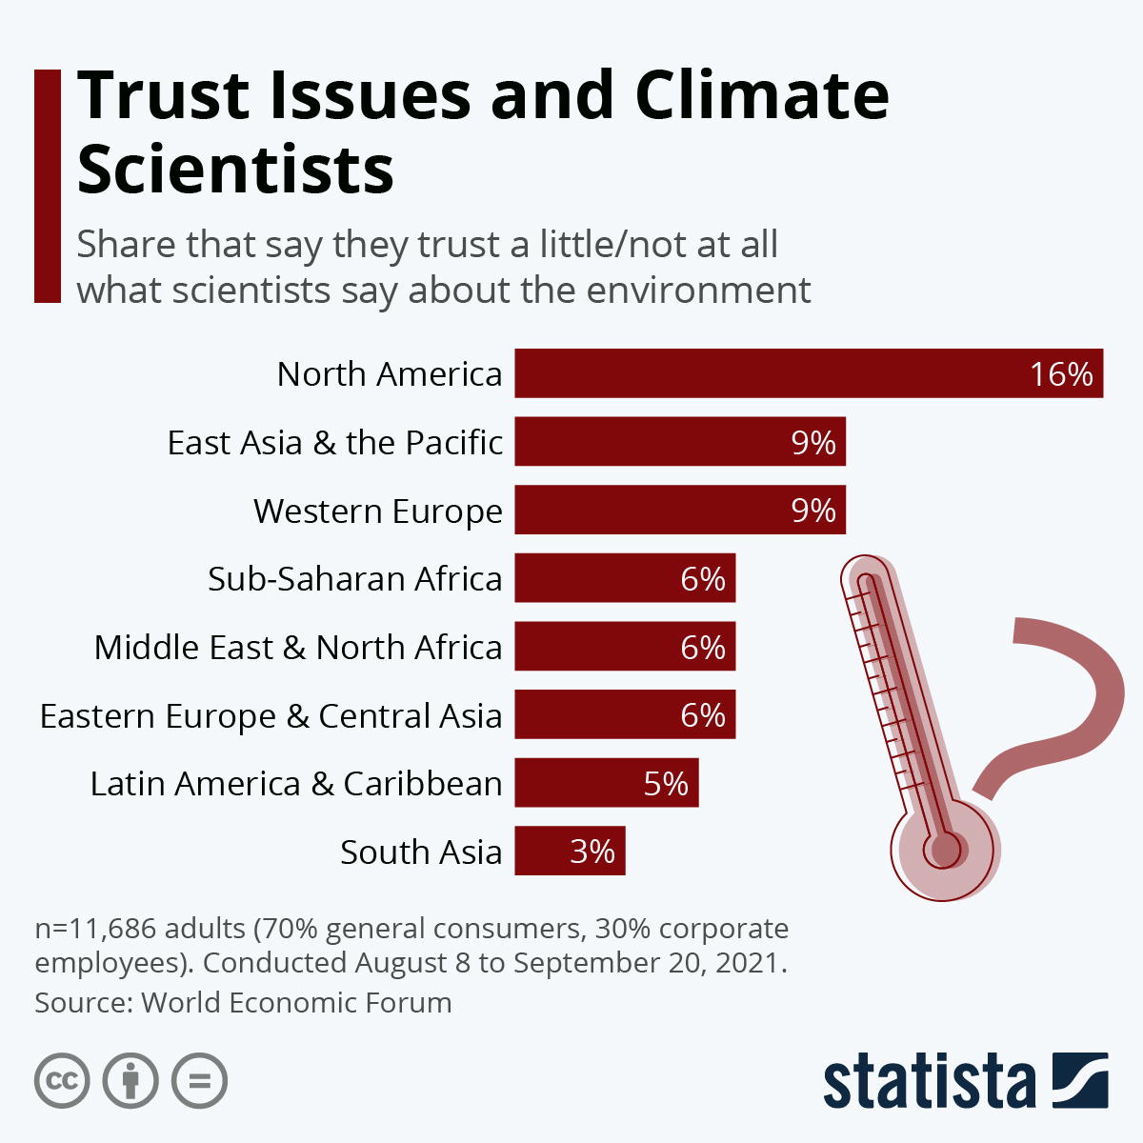
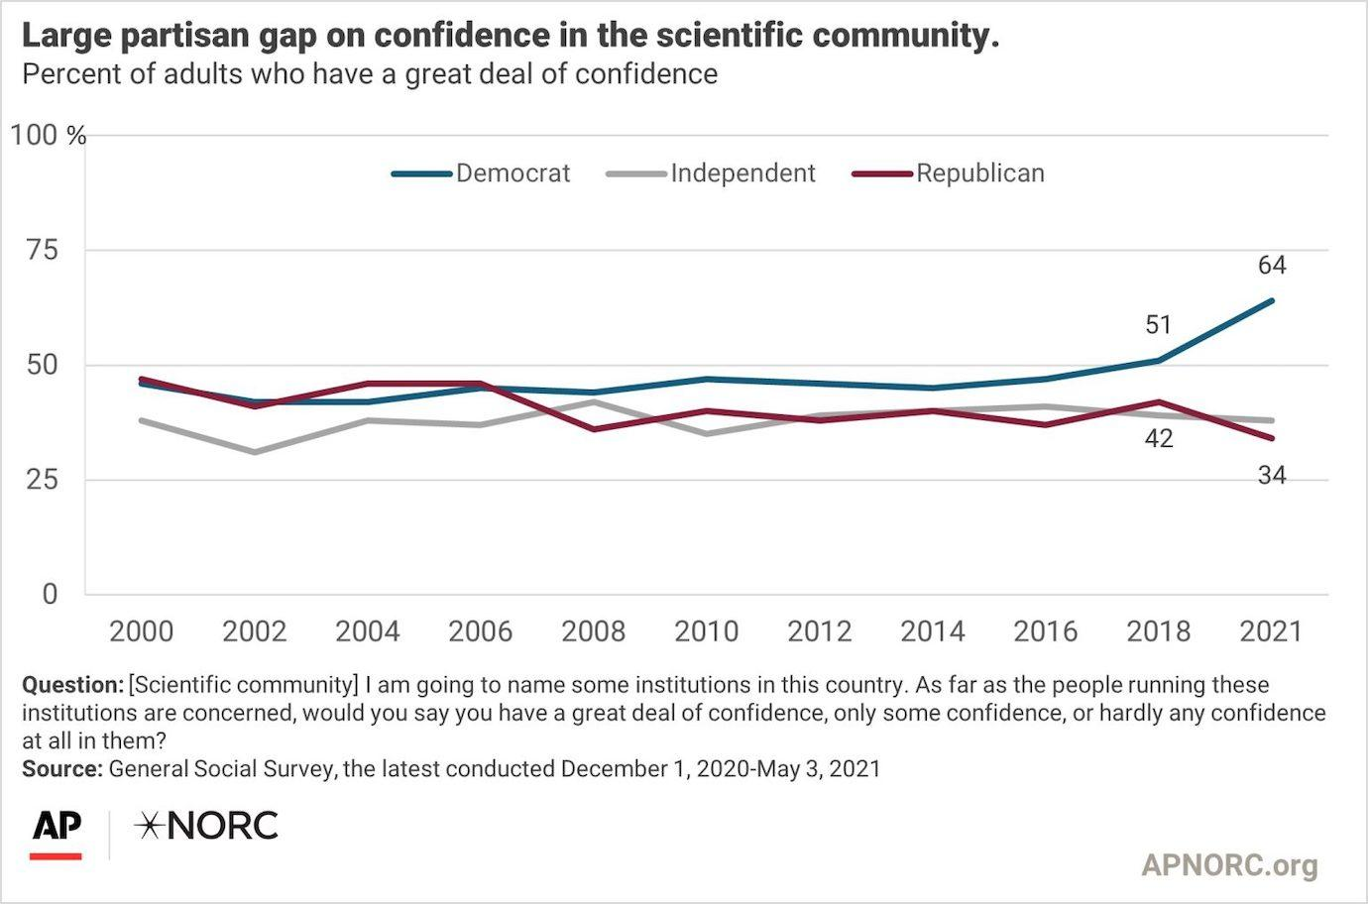
Science and the public opinion
(Dis)trust in science

Slide 7
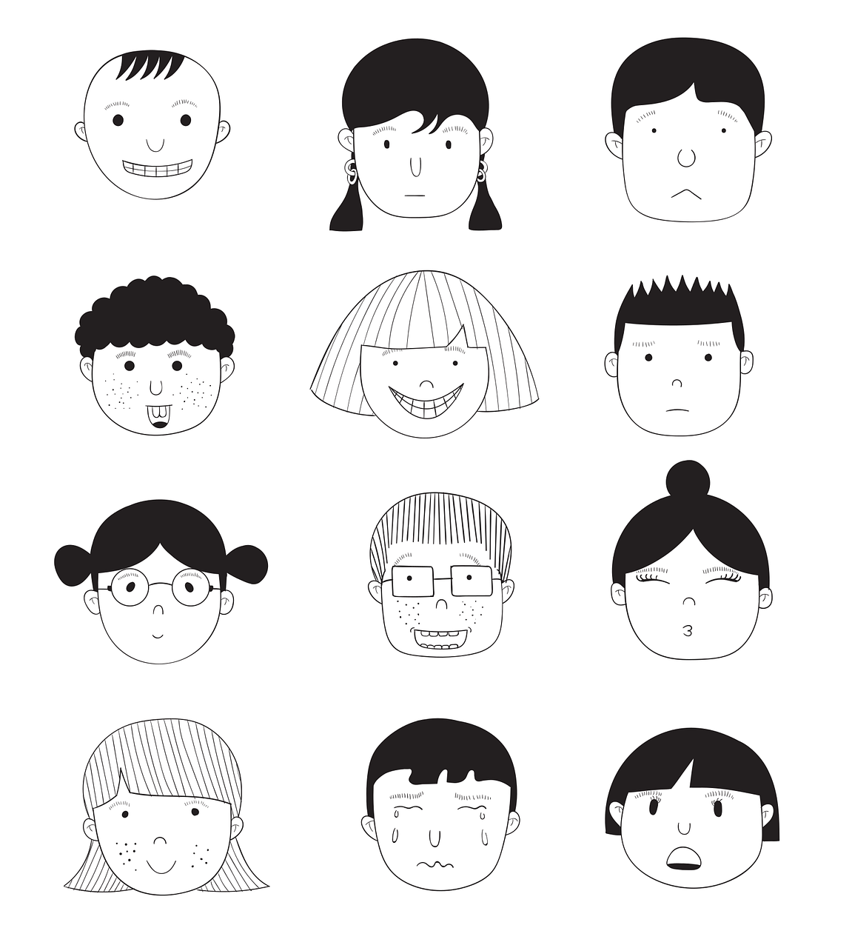




Science and the public opinion
What can (or should) you do?
Identify the problem:
  Identity of the reader
  Clickbaits
  Science tentativeness
  Political motivation
  Emotions

Slide 8
Science and the public opinion
What can (or should) you do?
Remedy
  Identity of the reader → look for common ground
  Clickbaits → avoid easy popularizations
  Science tentativeness → balance scientific language
  Political motivation → diversify resources
  Emotions → integrate into reasoning

Slide 9
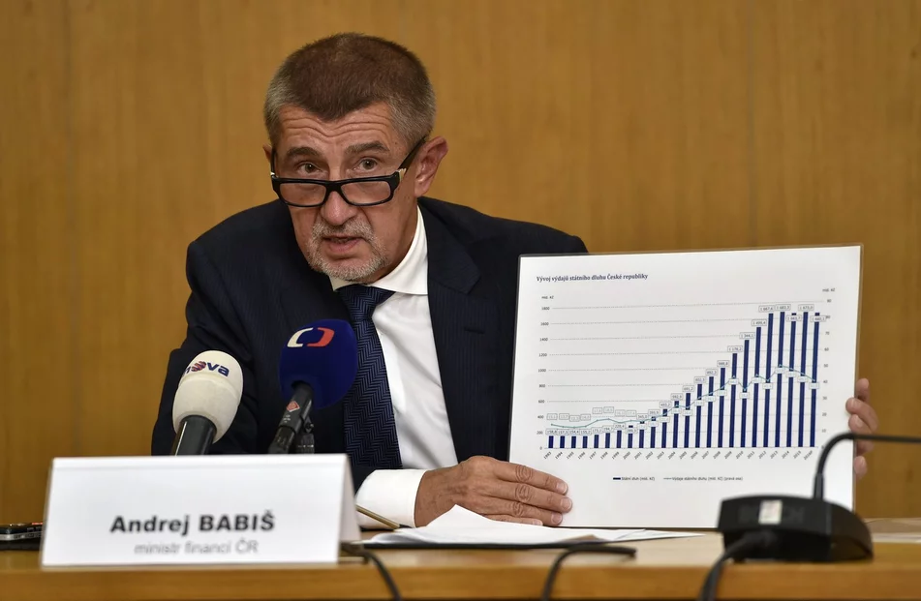
Mirroring science
Science is the basis for personal, social and political decisions.
For society, science is no longer sacrosanct.
Committed citizens communicate directly about science and with scientists. (e.g. Jaroslav Flegr)
But there are also those that are not reached by scientific topics and questions at all.
And there are people, initiatives, movements and parties who take positions that are far from or hostile to science.

Slide 10
Fundamentals of science communication
Truthfulness and credibility
Benefits for society
Transparency
Openness of science to active dialogue with society
Self-criticism and willingness to change
Independence
Willingness of all actors to cooperate
Principles of good scientific practice

Slide 11
Fundamentals of science communication
If it works it…
strengthens the understanding for all actors, especially scientists, citizens, journalists,
filters according to criteria that are as objective as possible,
is factual and creates transparency,
makes visible the limits of statements and methods of research,
works in a target group-oriented manner and communicates in a comprehensible manner,
creates space for the "stories" of scientists,
works strategically and value-driven, is self-reflective and self-critical,
is open to change and internationally networked.

Slide 12
Uncomfortable questions
Factual basis
Transparency of the methodology
Financing
Cooperation partners and possible conflicts of interest
Communication of the topic, expectations and goals
Transparency of sources
Possible applications and their consequences

Slide 13
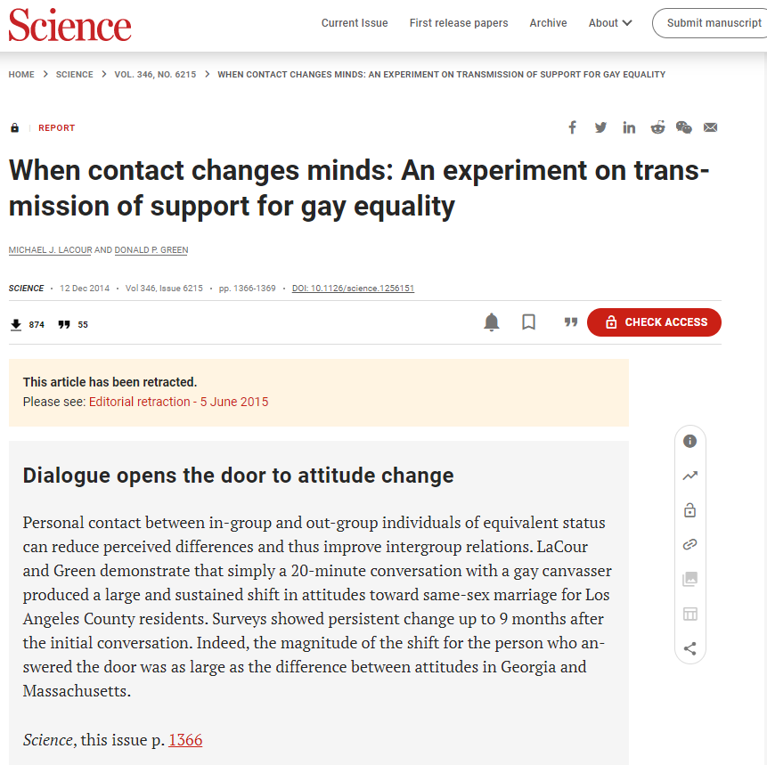
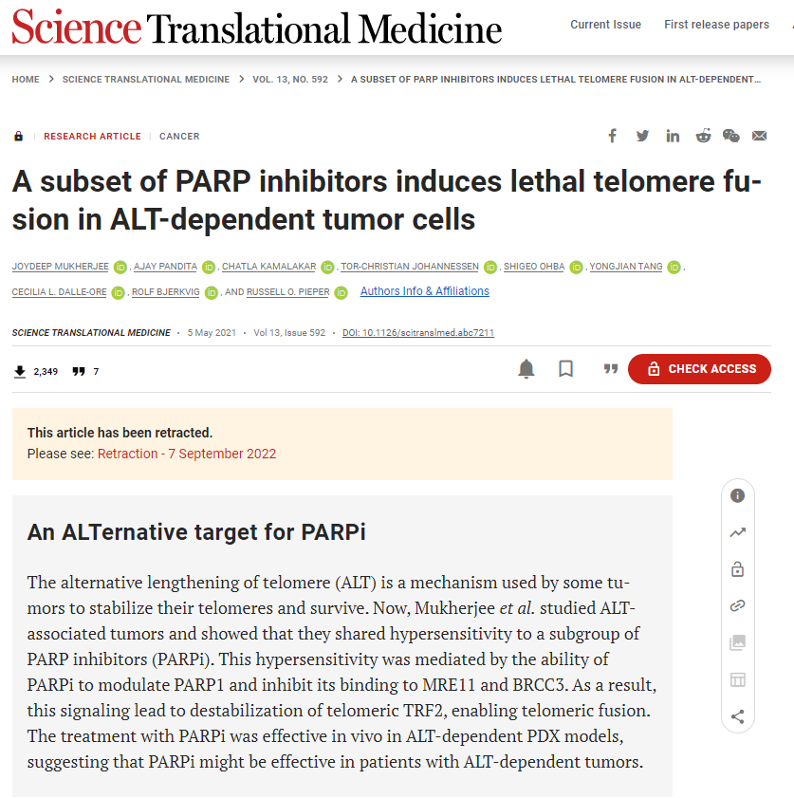
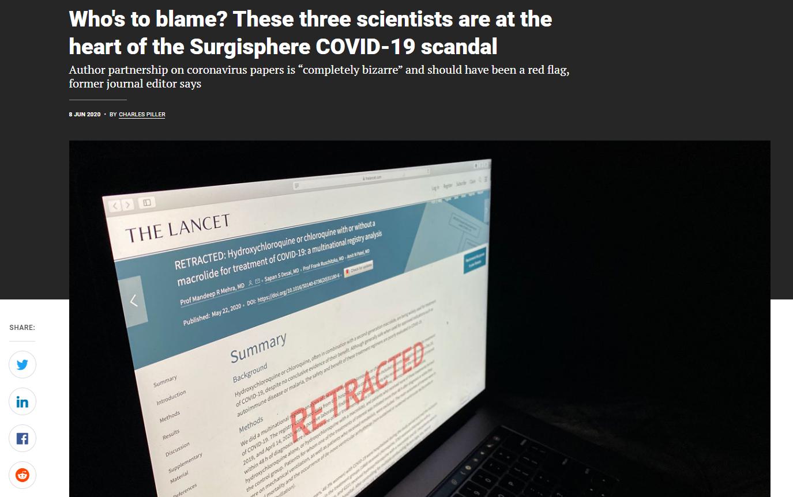
Bad practice

Slide 14
Good news!
You have help
Publicity and Communication Department UHK
  Matyáš Strnad
  International marketing specialist
  e: matyas.strnad@uhk.cz
  t: +420 493 332 526, +420 734 745 568
  Science and Knowledge Transfer Office UHK
    Veronika Hrůzová
    Coordinator for science and research projects
    e: veronika.hruzova@uhk.cz
    t: +420 493 332 833, +420 777 147 670
Thank you for the attention!

