Slide 1
Introduction to IP
1
Notes:
Title slide

Slide 2
GENERAL INTRODUCTION
2
Notes:
The following slides provide a general introduction to the different types of intellectual property.

Slide 3
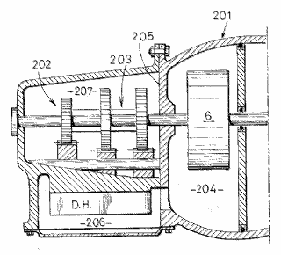


The different types of IP (I)
Legal right
What for?
How?
Patents
New inventions
Application and examination
Utility models
New inventions
Application and registration
Copyright
Original creative or artistic forms
Exists automatically
3
Notes:
Patents are granted for technical inventions. Applications for patents are examined by the patent office they are filed with, in order to determine whether they meet the stringent requirements for a patent to be granted. Patents generally last for a maximum of 20 years from the date of filing.
Utility models offer simpler protection, for a shorter period of time, but are usually registered and published much more quickly than patents.
Copyright does not need to be registered. It automatically exists when a work is created. It protects any type of original, creative expression, including literature, art, drama, music, photographs, recordings and broadcasts.
3

Slide 4



The different types of IP (II)
Legal right
What for?
How?
Trade marks
Distinctive identification of products or services
Use and/or
registration
Registered designs
Registered designs
Registered designs
External appearance
External appearance
External appearance
Registration
Trade secrets
Valuable information not known to the public
Reasonable efforts to keep secret
4
Notes:
Trade marks are distinctive signs indicating the source of a product or service. They include, for example, names, logos and colours applied to the owner's products or services, which distinguish them from products and services provided by competitors.
Registered designs protect the external appearance of a product. They do not give any protection for technical aspects. They include new patterns, ornaments and shapes. To be officially registered, designs need to be original and possess individual character distinctive. The artistic aspects of a design may also be protected by copyright.
Unregistered designs also enjoy some protection. An unregistered design is a free, automatic right that you get when you present a design to the public. It gives you the right to stop anyone from copying your design. The protection afforded by an unregistered design is normally of more limited duration than that available for a registered design.
Trade secrets cover information not known to the public. If the possessor of the information is careful to keep it confidential, he can sue anyone who steals it.
4

Slide 5
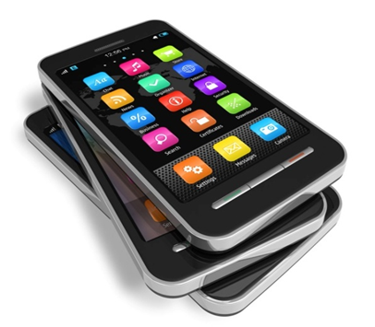
One product - many IP rights
Trade marks
NOKIA
Product "208"
Start-up tone
Patents and utility models
Data-processing methods
Operating system
Operation of user interface
Copyright
Software
User manuals
Ringtones
Start-up tone
Images
Designs
Form of overall phone
Arrangement and shape of buttons
Position and shape of screen
Trade secrets
Some technical know-how kept
"in-house" and not published
5
Notes:
This slide shows the wide range of intellectual property that can be involved in protecting a single product, in this case a mobile phone.
5

Slide 6
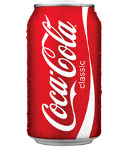
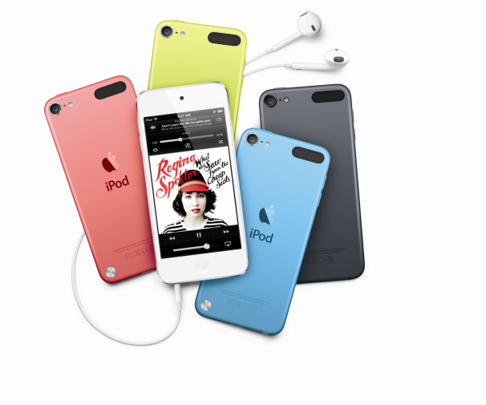
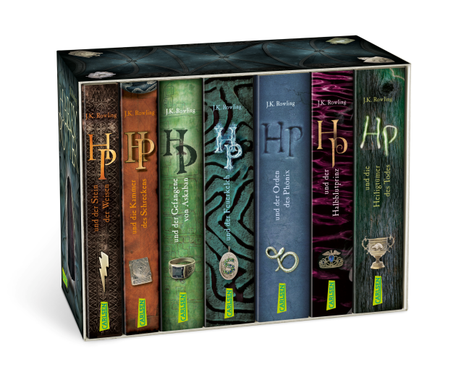
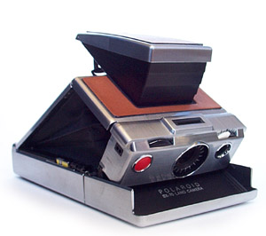
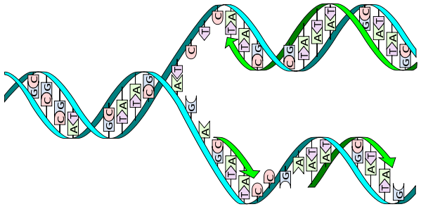
Examples of valuable intellectual property
Optional
Coca-Cola®
Apple® iPod touch®
Harry Potter
Polaroid® instant camera
DNA copying process
6
Notes:
Whenever a new product is successful on the market, it is very likely that competitors will attempt to make similar or identical products. The innovator will probably have invested significantly in developing the new product, establishing the supply chain for production, running marketing campaigns and finding distributors.
Competitors benefit from these efforts. They have greater market access, a better connection with distributors, and access to cheaper primary resources. As a result they are able to offer their products at a cheaper price.
Innovators are then under heavy pressure and may be driven out of business, while competitors get a free ride on the back of their creativity.
The IP system is there to help innovators protect their inventions, designs, brands, artistic works, and so on. It provides them with ownership over their work and the rights to exclude competitors from the production, import or sale of infringing goods.
6

Slide 7
PATENTS
7
Notes:
The following two slides provide a basic introduction to patents.
7

Slide 8
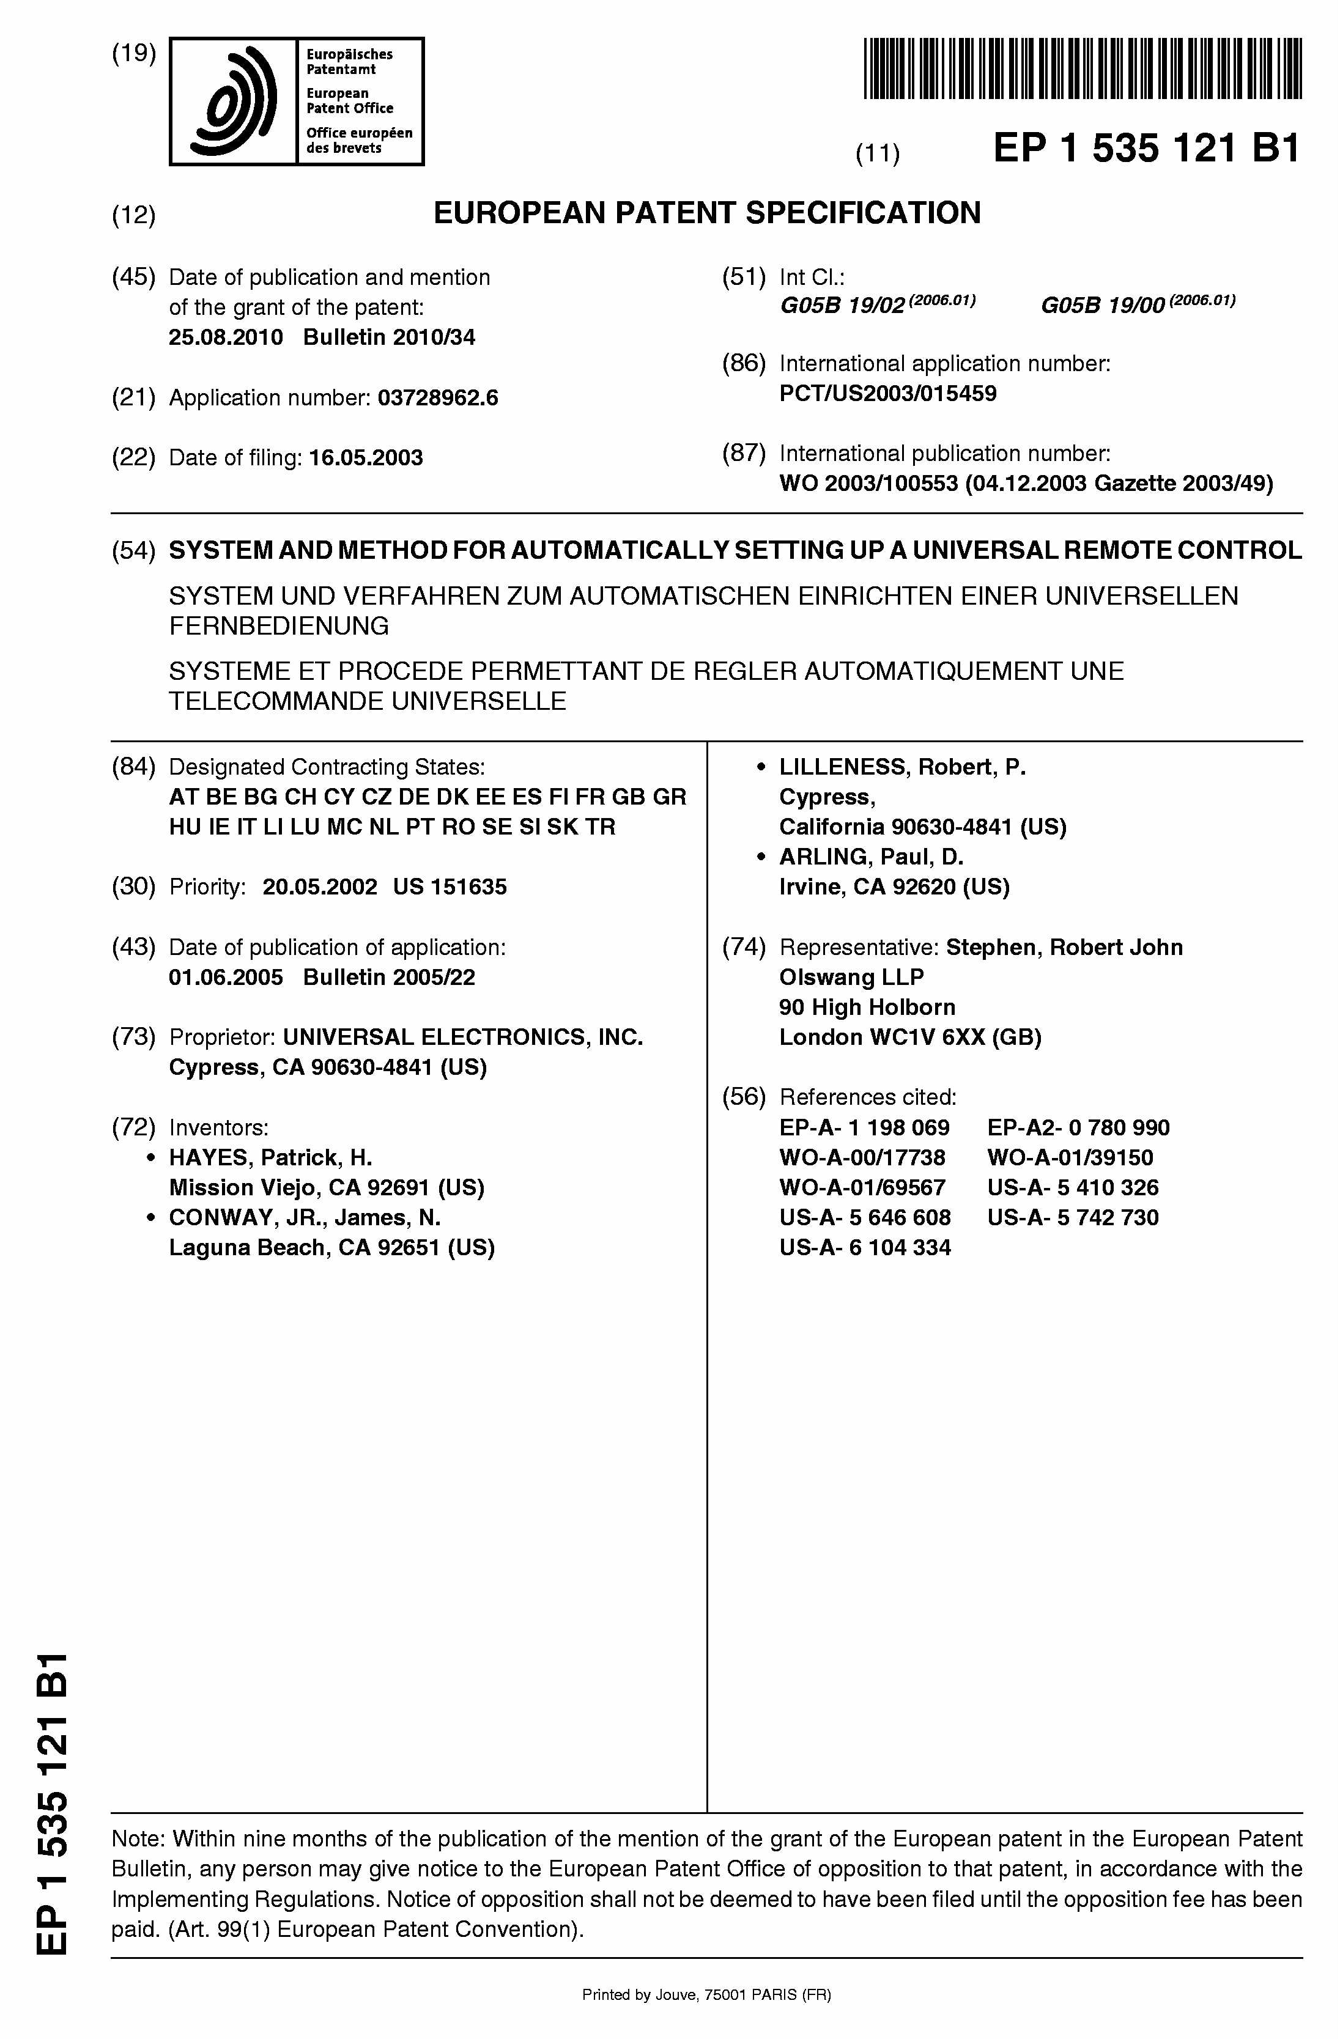


What is a patent?
A legal title which grants the holder
  the exclusive right to prevent others from making, using or offering for sale, selling or importing a product that infringes his patent without his authorisation
  in countries for which the patent was granted
  for a limited time (up to 20 years).
In return for this protection, the holder has to disclose the invention to the public.
Reveal
invention
(disclosure)
Get
exclusivity
(patent)
Patents are granted in nearly every country in the world!
Patent applicant
Public
8
Notes:
A patent is sometimes considered as a contract between the applicant and society.
Applicants and patent owners are interested in benefiting - personally - from their inventions.
They have the right to prevent others from making, using, offering for sale, selling or importing a product that infringes their patent, for a limited amount of time and in the country for which the patent has been granted. The exception to this is use for non-commercial purposes, for example private use or academic research.
Society is interested in:
encouraging innovation so that better products can be made and better production methods can be used for the benefit of all,
protecting new innovative companies so that they can compete with large established companies, in order to maintain a competitive economy,
learning the details of new inventions so that other engineers and scientists can further improve them, and
promoting technology transfer, for example from universities to industry.
In return for this protection, the applicant has to reveal his invention to the public, so others can build on it. As a rule, patent offices publish applications after 18 months. At this stage they become visible to everyone.
This "social contract" is institutionalised in the form of patent law.

Slide 9
Standard criteria for a patent: what can be patented?
If you believe you have a patent-eligible invention, you’ll need to meet three criteria to get a patent:
Novelty
Utility
Non-obviousness

Slide 10
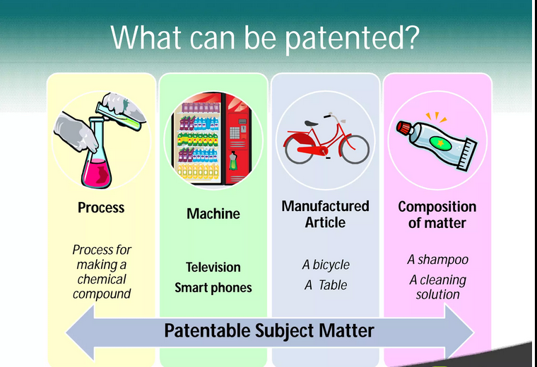

Slide 11
Patent?
Law of gravity
Idea to organize summer camp
Viagra
Mathematical theory
Biological process
A method of diagnossis
Harry Potter book
Tesla car

Slide 12
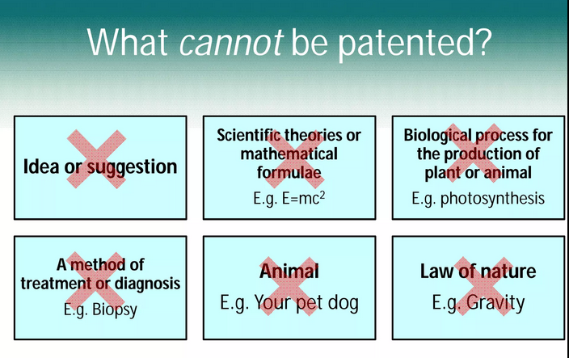

Slide 13
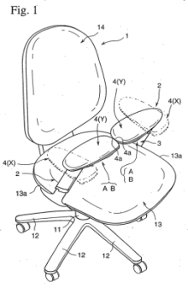
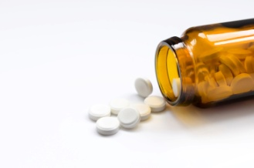



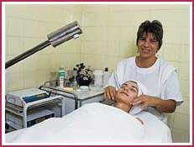
What exactly can be patented?
Patents protect inventions which solve technical problems:
chemical substances,
pharmaceuticals
processes,
methods, uses
products,
devices, systems
For an invention to be patented, it must usually be
  new to the world (i.e. not available to the public anywhere in the world)
  inventive (i.e. not an "obvious" solution), and
  susceptible of industrial application
In most countries, patents are not granted for business methods or rules of games as such, or for methods of treatment, diagnostics and surgery on the human or animal body.
12
Notes:
13
13
According to the European Patent Convention, or EPC, "European patents shall be granted for any inventions, in all fields of technology, provided that they are new, involve an inventive step and are susceptible of industrial application."
"New to the world" means that there should have been no previous public disclosure of the invention before the date of filing
"Inventive step" is quite difficult to assess. To ascertain whether an invention involves an inventive step, the European Patent Office compares it with what would have been obvious to an imaginary person skilled in the art at the time of filing.
The EPC does not define what an invention is. It does, however, provide a non-exhaustive list of subject-matter and activities that are not considered inventions. The items listed at the bottom of the slide are expressly excluded from patentability.

Slide 14
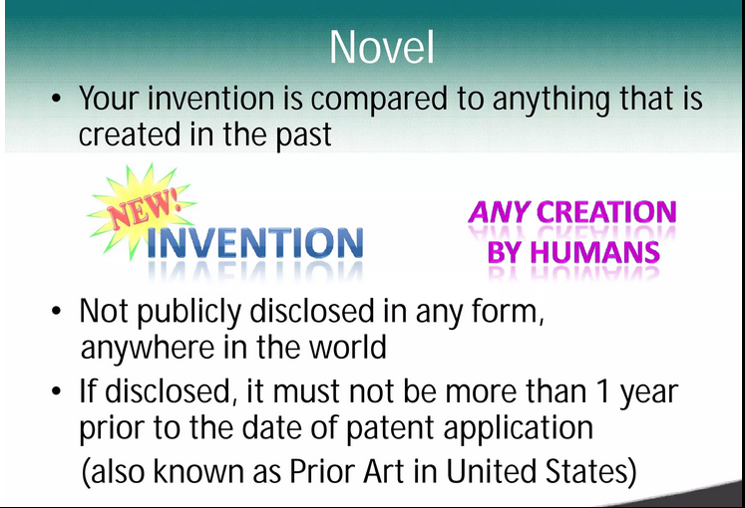

Slide 15
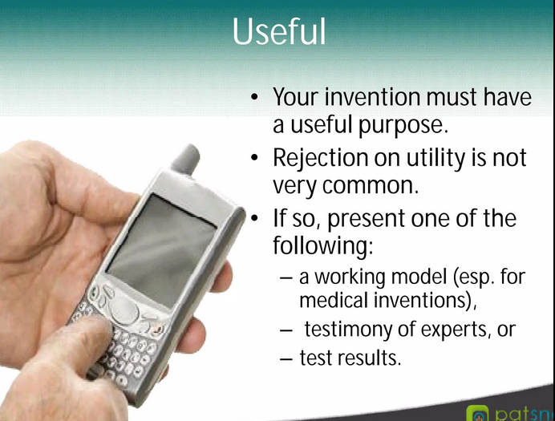

Slide 16
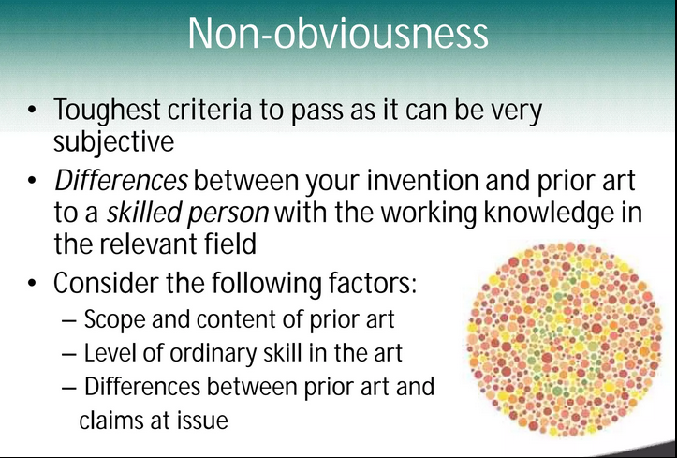

Slide 17
Trade marks
17
Notes:
The following slides provide a basic introduction to trade marks.
17

Slide 18
What is a trade mark?
A trade mark is any sign, capable of being represented graphically, which distinguishes the goods and services of one undertaking (company or organisation) from those of another
Many different types: word, figurative, colour, shape
Absolute grounds for refusal
  Distinctiveness
Relative grounds for refusal
  When peaceful co-existence of marks is impossible
18
Notes:
A trade mark consists of any signs capable of distinguishing goods or services of one firm or company (referred to in the legislation as an undertaking) from those of another. Trade marks serve to indicate the commercial source or origin of the products and services they relate to. Moreover, trade marks may fulfil other functions such as advertisement or goodwill.
In the EU, pursuant to Article 3 TMD, the above mentioned signs must be able to be represented in the Register of the European Union Trade Marks, in a manner which enables the competent authorities and the public to determine the clear and precise subject matter of the protection afforded to their proprietors. The elimination of the requirement of graphical representation will enter into force on 1 October of 2017, once the European Commission issues secondary legislation to complement and develop some of the provisions of the EUTMR.
The many different types of trade mark include word marks, figurative marks and colour and shape marks.
According to the definition, trade marks or signs must be distinctive. A lack of distinctive character is therefore an absolute ground for refusal of registration. Trade marks which are descriptive or generic are not capable of fulfilling the origin function.
Other absolute grounds for refusal include signs that are contrary to public policy and the accepted principles of morality.
Relative grounds for refusal exist where the peaceful co-existence of two marks is not possible because of the likelihood of confusion on the part of the consumer.
18

Slide 19
Routes for registration
National
International
EU
  European Union Trade Mark
19
Notes:
This slide shows the three different registration routes that can lead to trade mark protection.
Trade marks must be registered in order to obtain trade mark protection. It is essential to be the first to register.
Registration is possible at national level.
It is also possible to file an international application with WIPO, the World Intellectual Property Organization.
In Europe, applicants have the option of filing with the EUIPO with a view to obtaining a European Union Trade Mark, which affords protection in the whole of the EU.
19

Slide 20
Scope of protection
Exclusive right, but
  principle of speciality
  principle of territoriality
Potentially perpetual (renewal every ten years)
Risk of loss of protection if:
  not used after five years
  found to be invalid
Allowed uses
20
Notes:
Trade mark owners have an exclusive right to prevent others from using their mark in the course of trade.
Trade marks are registered for specific goods and services only. The exclusive right offered by the trade mark is linked to these specific goods and services. This is the principle of speciality.
A second limit is the principle of territoriality. Trade mark protection is limited to the territory where the mark is registered.
Unlike other IP rights, trade marks can be renewed indefinitely. Each renewal adds ten years of protection.
There are a number of different ways in which trade mark protection can end. For example, during the first five years after registration there is no obligation to use the mark. After this initial period, lack of genuine use can lead to cancellation of the mark. Also, a trade mark can still be declared invalid if, after registration, an absolute ground for refusal is identified or where peaceful co-existence on the market is no longer possible.
The scope of protection is broad, but some use by others is allowed, for example for private purposes only.
20

Slide 21
Designs
21
Notes:
The following slides provide a basic introduction to designs.
21

Slide 22
What is a design?
A design is the outward appearance of the whole or parts of a product resulting from its features.
A product is any industrial or handicraft item.
Requirements for protection
  Novelty
  Individual character
Some exclusions
22
Notes:
A design is the outward appearance of the whole or parts of a product. A product can be any industrial or handicraft item.
Examples of design features include lines, colours and shapes. Examples of the products to which they are applied or in which they are incorporated include packaging and logos.
There are two requirements for protection.
The first is novelty. The design must be new. In other words, no other identical design has been made available to the public.
The second is that the design must have individual character. This requirement is not met if another design which creates the same overall impression on the informed user has already been disclosed.
Some designs are excluded from protection by law because they run counter to public order and morality.
22

Slide 23
Registered and unregistered design rights
National
International
EU
  registered Community design
  unregistered Community design
23
Notes:
Design protection has two forms: registered and unregistered.
It is possible to register designs at national, international and EU level. The international registration of designs is run by WIPO. Registration for the whole of the EU is done by the EUIPO, where applicants can obtain a Registered Community Design.
Protection in the whole of the EU is possible without registration. This takes the form of Unregistered Community Designs. Unregistered Community Designs can be useful for products and designs that have an exceptionally short lifespan, where the registration process might take too long compared with the length of time for which the design is expected to be valuable.
23

Slide 24
Scope of protection
Exclusive right
Principle of territoriality
Duration
  registered design rights: maximum 25 years
  unregistered design rights: 3 years
Allowed uses
24
Notes:
Design rights are exclusive rights. Their scope of protection is broad and includes designs which do not produce a different overall impression on the informed user. Use of those designs can be prevented.
Design protection is limited to the territory in which the design is registered.
The scope of protection afforded by registered and unregistered designs is different. Unregistered rights protect the design against copying only, and for a limited time period of three years. Registered design rights are stronger. There is no need to prove copying by the infringer. Registered designs offer protection for an initial period of five years, and can be renewed up to four times.
There are some cases in which the right-holder cannot invoke any protection, i.e. where the law states that the use is allowed, for example for private use only.
24

Slide 25
UTILITY MODELS
28
Notes:
The following slides provide a basic introduction to utility models.
25

Slide 26
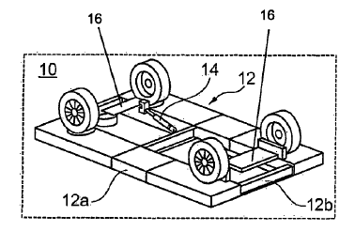
What is a utility model?
A utility model grants the holder the exclusive right to prevent third parties from:
  exploiting an invention (e.g. making, using, offering for sale)
  without authorisation in the country where the utility model was registered
for a short period (3 to 10 years).
The holder has to disclose the invention to the public.
Reveal
invention
(disclosure)
Get protection
(utility model)
29
Notes:
Utility models are intellectual property rights that protect technical inventions, just like patents. In contrast to patents, however, utility models are available in some countries - for example Austria, China, Germany and Japan - but not in others - for example Canada,the UK and the USA.
Generally speaking, applications for utility models must be filed in the country where the applicant is seeking protection for their invention.
There is no European or international utility model, nor, apart from in Africa, is there any centralised filing option. In some countries, however, utility models may be filed based on an international PCT application.
Depending on the law in the country concerned, utility models offer protection for up to a maximum of 10 years. This contrasts with patents, which offer 20 years of protection.
In most countries, utility models are registered without examination, within a few months of filing the application. They can be either in addition to or as an alternative to a patent.

Slide 27
Scope of protection compared with patents
Utility models
Registered territorial IP right
Available in limited number of countries
No central filing in Europe
Protection for 3 -10 years
Search reports in some countries only
Registered and published after
a few months
Generally no substantive examination (novelty, inventiveness)
Reviewed only in revocation or infringement proceedings
Patents
Registered territorial IP right
Available in most countries
Central filing possible
(e.g. EPO for Europe)
Protection for up to 20 years
Search reports standard
Application published after
18 months
Substantive examination
  (novelty, inventive step)
Grant or refusal after substantive examination procedure
30
Notes:
This slide compares some of the key aspects of utility models with those of patent applications and granted patents. Utility models and patents are both registered territorial rights offering protection for technical inventions. In contrast to patents, utility models are only available in certain countries. Utility models must be filed individually in each country where protection is desired, whereas patent applications may be filed centrally with the EPO or WIPO. Utility models offer protection for 3 to 10 years, while patents offer protection for 20 years.
Utility models are normally registered without a search - a report on the prior art - being carried out. Search reports are standard for patent applications. Exceptions exist, for example in Austria, where search reports are also produced for utility models. Utility models are normally registered and published within a few months, while patent applications are normally published after 18 months. The publication of a patent application is a procedural step prior to examination of the application.
In general, utility models are registered without substantive examination as to novelty, inventiveness or industrial applicability. There are some exceptions - for example Brazil. The result of the examination procedure is either the grant or the refusal of the application. The validity of utility models with respect to novelty and inventive step is only reviewed in revocation or infringement proceedings. Granted patents are the result of an examination procedure.
Patents can still be opposed in later proceedings. The financial advantage of utility models is often mentioned. However, while a single utility model is definitely cheaper than a plurality of patent applications, centrally filing one patent application for many countries is far less complex than filing a plurality of utility models in different countries with different languages.
The biggest advantage of filing a utility model is often the speed with which it is registered.

Slide 28
Plant variety rights
31
Notes:
The following slides provide a basic introduction to plant variety rights.
28

Slide 29
What are plant variety rights?
Exclusive exploitation rights for new plant varieties
Four requirements for protection:
  novelty
  distinctness
  uniformity
  stability
Right holder = breeder
Obtained through registration
32
Notes:
Plant variety rights give the holder the exclusive right to exploit new plant varieties.
A plant variety can be protected if it is new, distinct, uniform and stable.
The person who is entitled to the exclusive rights is referred to in the legal texts as the "breeder". The breeder can be the person who bred the variety, or that person's employer.
Plant variety rights are obtained through registration, either at national level in any of the member states of the UPOV Convention, or with the Community Plant Variety Office, which offers EU-wide protection.
29

Slide 30
Scope of protection
Duration
  At least 20 years
  At least 25 years for varieties of vine and tree species
Subject-matter
  Propagating material
  Harvested material
Acts subject to authorisation
Exceptions
33
Notes:
Plant variety rights are awarded for a fixed period of time. In UPOV member states this term of protection cannot be shorter than 20 years. For trees and vines the minimum term is 25 years.
The breeder has exclusive rights relating to the propagating material and the harvested material. "Propagating material" is the reproductive or vegetative propagating material of the variety. "Harvested material" is material obtained through the unauthorised use of propagating material. The breeder must not have had reasonable opportunity to exercise his right in relation to the propagating material.
Certain acts relating to this material require the authorisation of the breeder. These are production or reproduction (also known as multiplication), conditioning for the purpose of propagation, offering for sale, selling or other marketing, exporting and importing, and stocking for any of the purposes mentioned above.
The exclusive rights of the breeder are limited in that some acts done for certain purposes do not require his authorisation. These include acts done for:
private and non-commercial purposes
experimental purposes
the purpose of breeding other varieties
and the use of farm-saved seeds.
30

Slide 31
SEMICONDUCTOR TOPOGRAPHY RIGHTS
34
Notes:
The following slides provide a basic introduction to semiconductor topography rights.

Slide 32
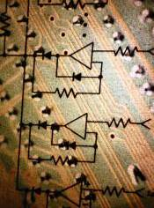
What are semiconductor topography rights?
Semiconductor topography rights protect layout
designs of integrated circuits.
Three-dimensional components and layers
and their interconnections
Copying relatively easy
Reverse engineering
accepted practice
Substantive requirements
Formal requirements
  Original, i.e. the result of the creator's own intellectual effort
  Not commonplace
  TRIPS member states may prescribe:
  registration
  disclosure of electronic function
  registration fee
  commercial exploitation
35
Notes:
32
Semiconductor integrated circuits (ICs) are embedded in a wide range of electronic devices such as computers, mobile phones and televisions. The size and performance of ICs is determined in part by the layout design.
A semiconductor consists of layers which are composed of semi-conducting material and upon which a pattern is fixed which performs an electronic function. The topography is the design of the pattern. Layout design or topography means the three-dimensional arrangement of the various layers and components and their interconnections.
IC chips are relatively easy to copy.
They are protected by the TRIPS Agreement of 1995. Under this agreement, to gain protection layout designs must be:
original in the sense that they are the result of the creator's own intellectual effort, and
not commonplace among creators of layout designs and manufacturers of integrated circuits at the time of their creation
TRIPS member states may stipulate that:
layout designs must be registered with the competent national authority
information on their electronic function must be disclosed
and a registration fee must be paid.
They may also stipulate that the design must have been commercially exploited somewhere in the world.

Slide 33
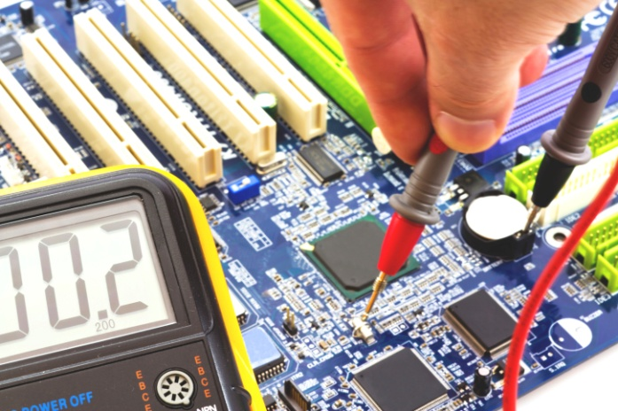
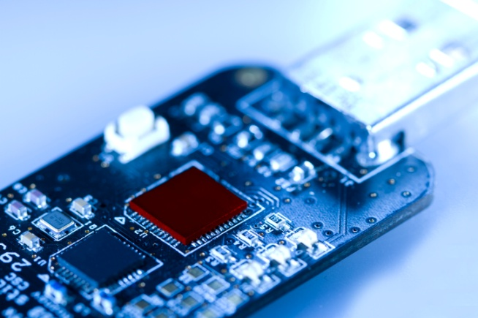
Scope of protection
Rights prevent others from reproducing, selling or importing part or all of the protected design and of products incorporating it
Duration of protection
10-15 years from the date of creation of the layout design
Exceptions and limitations
  No infringement if for
  private use, research or teaching
  Reverse engineering to foster innovation
  Independent creation of an identical design
  Innocent infringement
36
Notes:
33
Semiconductor topography rights give the owner the exclusive right to exploit a protected layout design - in whole or in part - for commercial purposes. Some countries have special laws concerning this IP right. Other countries offer protection using other laws.
The owner of the topography right can prevent others from reproducing, selling or importing all or part of the protected design or of products incorporating such a design, for example consumer electronics.
The duration of protection is a maximum of 10-15 years from the date of creation of the layout design.
There are a number of exceptions and limitations to this protection.
No infringement occurs if a protected design is reproduced for private purposes or for the purpose of evaluation, analysis, research or teaching.
The TRIPS agreement allows reverse engineering by a third party for the purposes of examining the circuit and fostering innovation. The third party may use the information to create a new - original - layout and use the new layout design in their own integrated circuit.
The rights holder may not enforce their rights in the design against another party if that party independently creates an identical design.
An "innocent infringement" due to the importation, sale or other commercial distribution of an integrated circuit that incorporates a protected layout design is not unlawful as long as the person or company doing so was unaware that the design was protected.

Slide 34
Copyright
37
Notes:
The following slides provide a basic introduction to copyright.
34

Slide 35
What is copyright?
Copyright protects any production of the human mind, such as literary and artistic works.
  This production must be an expression and not a mere idea.
  The expression must be original.
Copyright creates a special legal relationship between authors and their work.
It confers legal protection for a limited period of time.
38
Notes:
Copyright protects any production of the human mind, provided that this production is an expression, and not a mere idea, process or discovery. The expression must be original.
Examples of copyright-protected work in the artistic, literary and scientific fields include literary, dramatic, musical, artistic and photographic works, scientific articles and computer programs and databases.
Copyright creates a special legal relationship between authors and their work. The author is the physical person who created the work.
The period for which legal protection is conferred is called the "term". International treaties and conventions have laid down a term of a minimum of 50 years after the author’s death. This means that the author enjoys copyright protection throughout the whole of his life. In the EU the term is 70 years.
35

Slide 36
Scope of protection
Economic rights
- relate to the economic exploitation of the work
- are freely transferable or licensable
Moral rights
- relate to a moral interest of the author
- are always retained by the author
Exceptions and limitations
Infringement and remedies
39
Notes:
Copyright confers both economic and moral rights on the owner.
The economic exploitation rights include the rights of reproduction, communication to the public, translation, adaptation, distribution and resale.
The moral rights include the rights of authorship, integrity and divulgation.
These rights are limited in that third parties are allowed to use the protected work in certain situations and for certain purposes. These exceptions and limitations are in the public interest.
Copyright infringement occurs if the protected work is used without the consent of the author or rights-holder.
36

Slide 37
TRADE SECRETS
40
Notes:
The following slides provide a basic introduction to trade secrets.
37

Slide 38
What are trade secrets?
Information that
  is not generally known or easily discovered
  has a business, commercial or economic value (actual or potential) because the information is not generally known
  is subject to reasonable efforts to maintain secrecy
Unlimited life, provided the information does not become public knowledge.
41
Notes:
To become a trade secret, information must not be generally known or easily discoverable. At the same time, it must have a business, commercial or economic value from the fact that it is secret. It must also be possible to demonstrate that reasonable efforts have been or are being made to maintain the secrecy of the information.
Trade secrets are valid for as long as they remain secret, in other words for as long as they do not fall into the public domain.
According to the Proposal for a Directive of the European Parliament and of the Council on the protection of undisclosed know-how and business information (Trade Secrets) against their unlawful acquisition, use and disclosure, the definition of ‘trade secret’ contains three elements:
the information must be confidential;
it should have commercial value because of its confidentiality; and
the trade secret holder should have made reasonable efforts to keep it confidential. This definition follows the definition of ‘undisclosed information’ in the TRIPS Agreement.
38

Slide 39

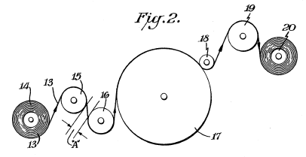
Scope of protection
  Products/processes where reverse engineering is difficult
Images from www.coca-cola.com
42
Notes:
39
Trade secrets can be just about anything that can be kept secret and that confers a commercial advantage.
One example of a trade secret is the formula for Coca-Cola, which is kept locked away in a vault at the Coca-Cola headquarters.
Chemical or other manufacturing processes can also be valuable. The diagram on the left is taken from the original GORE-TEX patent. Another company had kept a similar process secret for several years before Gore filed their patent.

Slide 40
Means of protection
Practical
Limited access to information
"Need to know"
Encryption of data
Monitored entry to installations
Contractual
Restrictive covenants in employment contracts
Non-disclosure agreements
43
Notes:
The protection of trade secrets involves both practical arrangements to restrict access to knowledge, and legal or contractual arrangements to ensure that those who have access to the secret or confidential information do not divulge it.
In many countries, employment agreements can include a restriction stipulating that key employees may not go and work for a competitor, and most employees have a so-called "fiduciary" duty to their former employers to not reveal confidential information.
Non-disclosure agreements help keep information exchanged with customers or potential partners confidential. They are only effective if the other side keeps the information secret.
A better way to protect information is to restrict access to those employees with a need to know the information. More generally, data can be encrypted (in particular if it is sent over the internet) and entry into certain areas of a manufacturing plant controlled.
40

Slide 41
IP in the real world
A practical exercise to help you decide what IP to use and when
44
Notes:
41

Slide 42
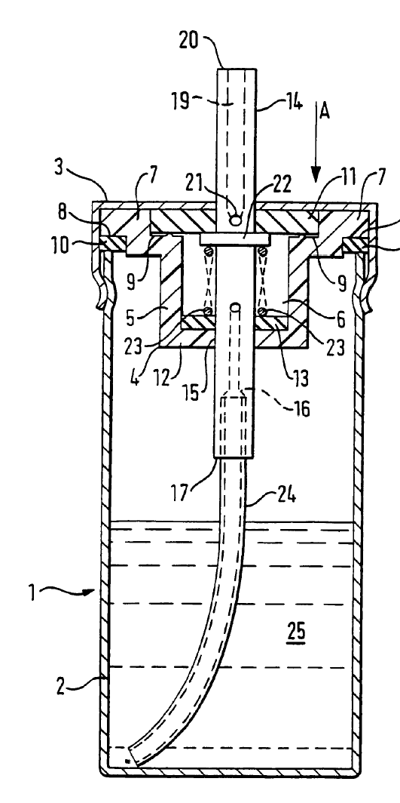

An anti-allergy sprayer and spray
NEBU-ALLERG
45
Notes:
Divide yourselves up into groups of 4-5 people and read the exercise you have been given.
The exercise is about a new medicinal product which has been developed by a university research team. The product is very effective in treating certain allergies. The team has also designed a nebuliser with a special nozzle design for nasal application that permits more effective delivery, and an improved pumping system which delivers a fixed, precise dose of the product.
In collaboration with an engineering company from the university's technology park, they have also developed an attractive design for the sprayer can.
Together with an advertising agency they have come up with a brand name, NEBU-ALLERG, an attractive logo and a slogan which reads "Press green for go!" The agency also plans to design a website and other material to support the promotional campaign.
In the next ten minutes I would like you to:
- Identify the various IP elements in this project,
- Suggest ways in which they can be protected, and
- Identify the potential contractual issues that might arise.

Slide 43
Divide yourselves up into groups and read the exercise you have been given.
The exercise is about a new medicinal product which has been developed by a university research team. The product is very effective in treating certain allergies. The team has also designed a nebuliser with a special nozzle design for nasal application that permits more effective delivery, and an improved pumping system which delivers a fixed, precise dose of the product.
In collaboration with an engineering company from the university's technology park, they have also developed an attractive design for the sprayer can.
Together with an advertising agency they have come up with a brand name, NEBU-ALLERG, an attractive logo and a slogan which reads "Press green for go!" The agency also plans to design a website and other material to support the promotional campaign.
In the next ten minutes I would like you to:
- Identify the various IP elements in this project,
- Suggest ways in which they can be protected, and
- Identify the potential contractual issues that might arise.

Slide 44
Which elements can be protected?
Medicinal product
Nozzle
Pumping system
Sprayer can
Brand name:
  "NEBU-ALLERG"
Logo
Slogan:
"Press green for go!"
Domain name
Advertising material
NEBU-
ALLERG
46
Notes:
Here are some of the aspects you should be focusing on.

Slide 45
First of all, how would you protect the medicinal product?
What about the process for making X?
And the formulation?
What about a method of using the spray to treat allergies?
What about the nozzle?
And the pumping system?
And the sprayer can?
And last but not least: who owns all this IP?

Slide 46
What about the brand name, logo and slogan? Registered trade marks can be obtained for them.
As far as the advertising materials are concerned, the text and artwork for posters, flyers, jingles, TV and radio advertisements and websites are all covered by copyright.
But be careful: who owns this IP? The advertising agency. So you must try and get these rights transferred.

Slide 47
What about confidentiality agreements with the agency? This is a good idea, as it will guard against leaks of commercially sensitive information such as pricing, marketing strategy, launch dates, technical data and so on.
With regard to the domain name, if "NEBU-ALLERG" becomes a registered trade mark, this will afford strong protection against cyber-squatters who might register "www.nebuallerg.com" - without a hyphen - or "www.nebu-allerg.eu" and other variations.
As customers are quite likely to ask their pharmacist for "that allergy medicine with the green button", it would be a good idea to register "www.thegreenbutton.com" as well.

Slide 48
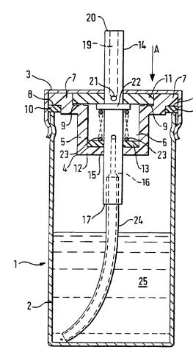
Patents and designs (I)
Medicinal product
Patents for
  the active ingredient?
  (the "chemical X")
  the method of making X?
  Better as a trade secret?
  the formulation?
  (combination of X with other ingredients)
  the method of use?
  (i.e. treatment of allergies using X)
47
Notes:
First of all, how would you protect the medicinal product?
What about the process for making X?
And the formulation?
What about a method of using the spray to treat allergies?

Slide 49
Patents and designs (II)
Nozzle
Pumping system
patent
utility model
patent
utility model
Sprayer can
designs: registered and unregistered
trade mark
But who owns all this IP?
48
Notes:
What about the nozzle?
And the pumping system?
And the sprayer can?
And last but not least: who owns all this IP?

Slide 50
Trade marks, copyright and domain names
Brand name: NEBU-ALLERG
Logo:
Slogan: "Press green for go!"
Advertising material:
trade mark ®
NEBU-
ALLERG
trade mark ®
trade mark ®
copyright ©
Domain names:
- www.nebu-allerg.com
- www.thegreenbutton.com
Who owns all this IP?
49
Notes:
What about the brand name, logo and slogan? Registered trade marks can be obtained for them.
As far as the advertising materials are concerned, the text and artwork for posters, flyers, jingles, TV and radio advertisements and websites are all covered by copyright.
But be careful: who owns this IP? The advertising agency. So you must try and get these rights transferred.
What about confidentiality agreements with the agency? This is a good idea, as it will guard against leaks of commercially sensitive information such as pricing, marketing strategy, launch dates, technical data and so on.
With regard to the domain name, if "NEBU-ALLERG" becomes a registered trade mark, this will afford strong protection against cyber-squatters who might register "www.nebuallerg.com" - without a hyphen - or "www.nebu-allerg.eu" and other variations.
As customers are quite likely to ask their pharmacist for "that allergy medicine with the green button", it would be a good idea to register "www.thegreenbutton.com" as well.

Slide 51


What next?
Patents - search for free in Espacenet's
90+ million documents
Trade marks and designs - search for free
in eSearch plus
Seek professional advice
  Is your invention novel, inventive and patentable?
  Do you risk infringing other people's rights?
  Who could you license it to?
  Who could you license from?
  Who are your potential customers,
  suppliers and competitors?
50
Notes:
So what happens next?
You need to check that you haven't re-invented technology that already exists and that you are not using a brand name that has already been registered as a trade mark.
You can check this by doing what we call a search.
You can perform an initial online search yourself, for example in Espacenet or TMview, both of which are free to use.
But you should also seek professional advice for answers to the key questions shown here.

