Slide 2


Transfer of results of a scientific project in a multinational company
Possibilities of scientific research collaboration and transfer of knowledge into practice
Ing. Tomáš Černický, Ph.D.
facility management

Slide 3
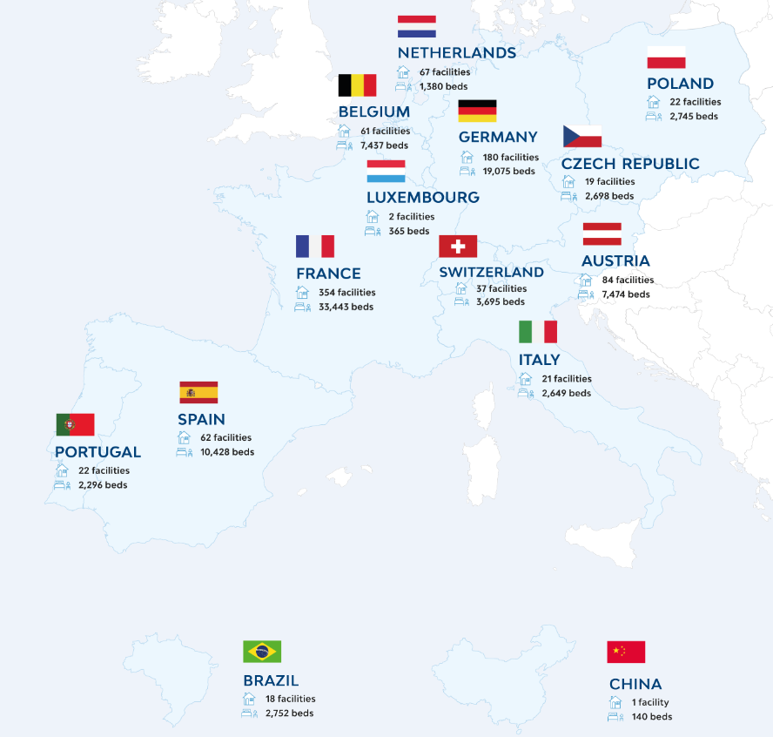
ABOUT ORPEA AND SENECURA GROUP
ORPEA GROUP provides social and health care primarily for the elderly.
The care is primarily focused on seniors with dementia.
ORPEA GROUP, which with its 1,114 facilities in 23 countries is one of the leading international companies in the social care business. Orpea employs over 68,000 people.
Notes:
Im Vergleich zum Halbjahresmeeting in Salzburg sind 23 Einrichtungen mit insgesamt 3000 Betten dazugekommen. Neu erschlossen wurden Portugal und Brasilien.

Slide 4
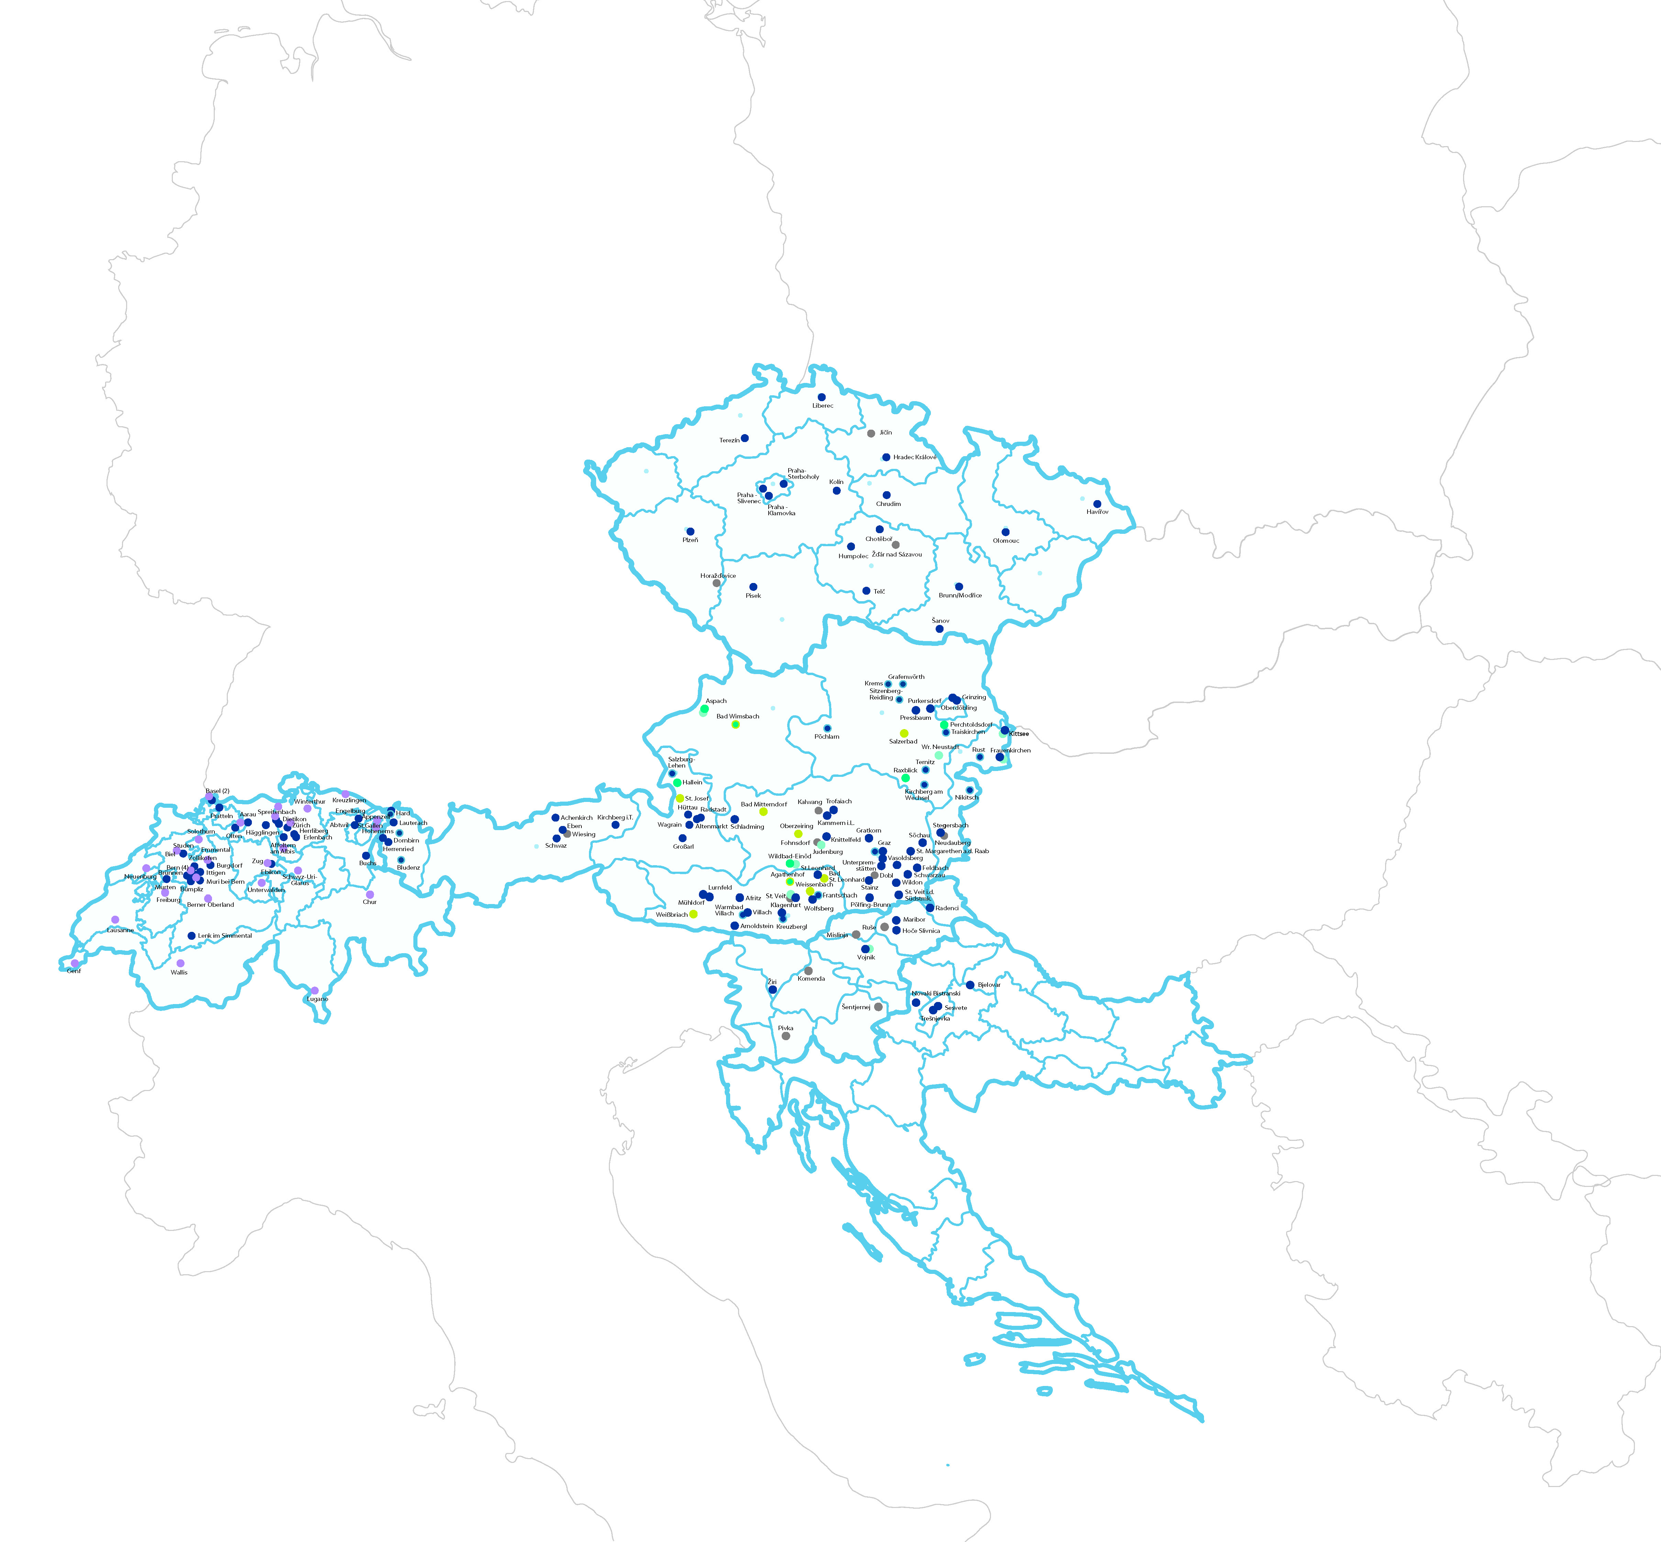

Part of orpea group is Senecura group (senecura cluster)
SeneCura was founded in 1998 and has been part of ORPEA Group, which was founded in 1989, since 2015.
Within the ORPEA Group, the SeneCura Group serves as a competence center for the region of Central and Eastern Europe.

Slide 5
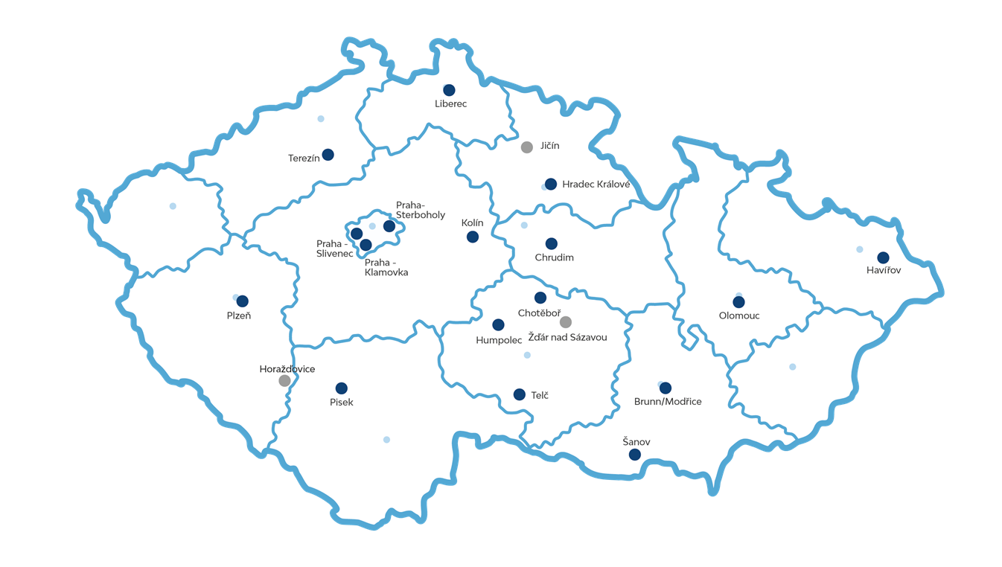
SENECURA CZECH REPUBLIC IS PART OF Senecura group

Slide 6



Senecura in czech republic
We are a leading recognized provider and employer in social services, that gives direction and increases the quality of care for elderly.
We are a member of the Association of Social Service Providers.
Our nursing homes are holders of the quality label and the certificate Vážka.
We have 17 SeniorCenters currently in operation in the Czech Republic, 2 under construction and another more in the project phase.
SeniorCenters: Havířov, Hradec Králové, Chrudim, Klamovka, Kolín, Modřice, Olomouc, Písek, Plzeň, Slivenec, Šanov, Štěrboholy, Terezín, Liberec, Telč, Humpolec, Chotěboř.
With 2400 beds, we are one of the biggest private provider of residential social services.
We provide services in the form of Home for Seniors (40%) and Home with Special care (60%).
Employing more than 1000 employees.
The growth of the company takes the form of its own construction activities and acquisitions. We belong to the Orpea group.

Slide 7
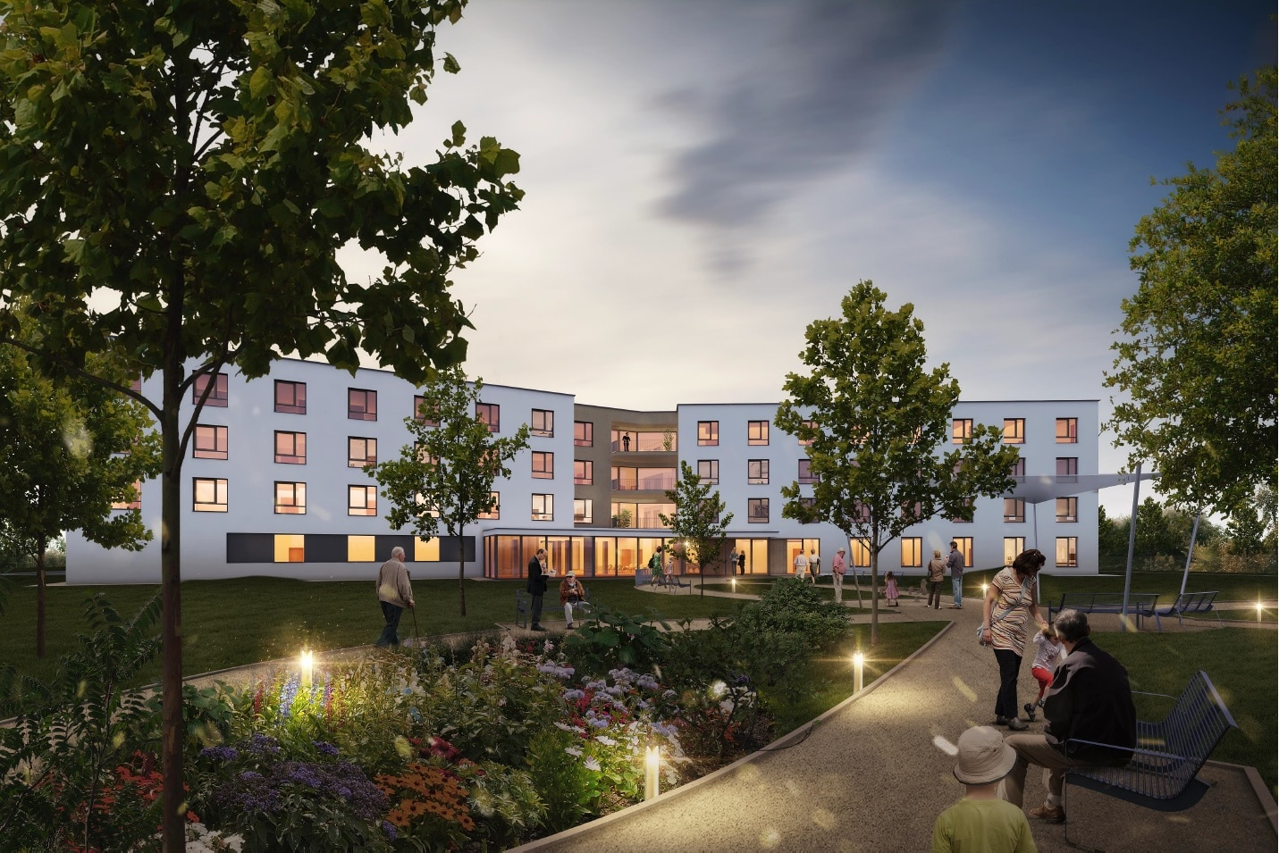
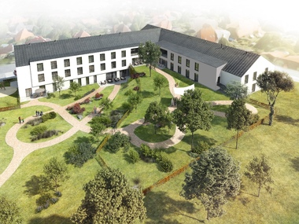
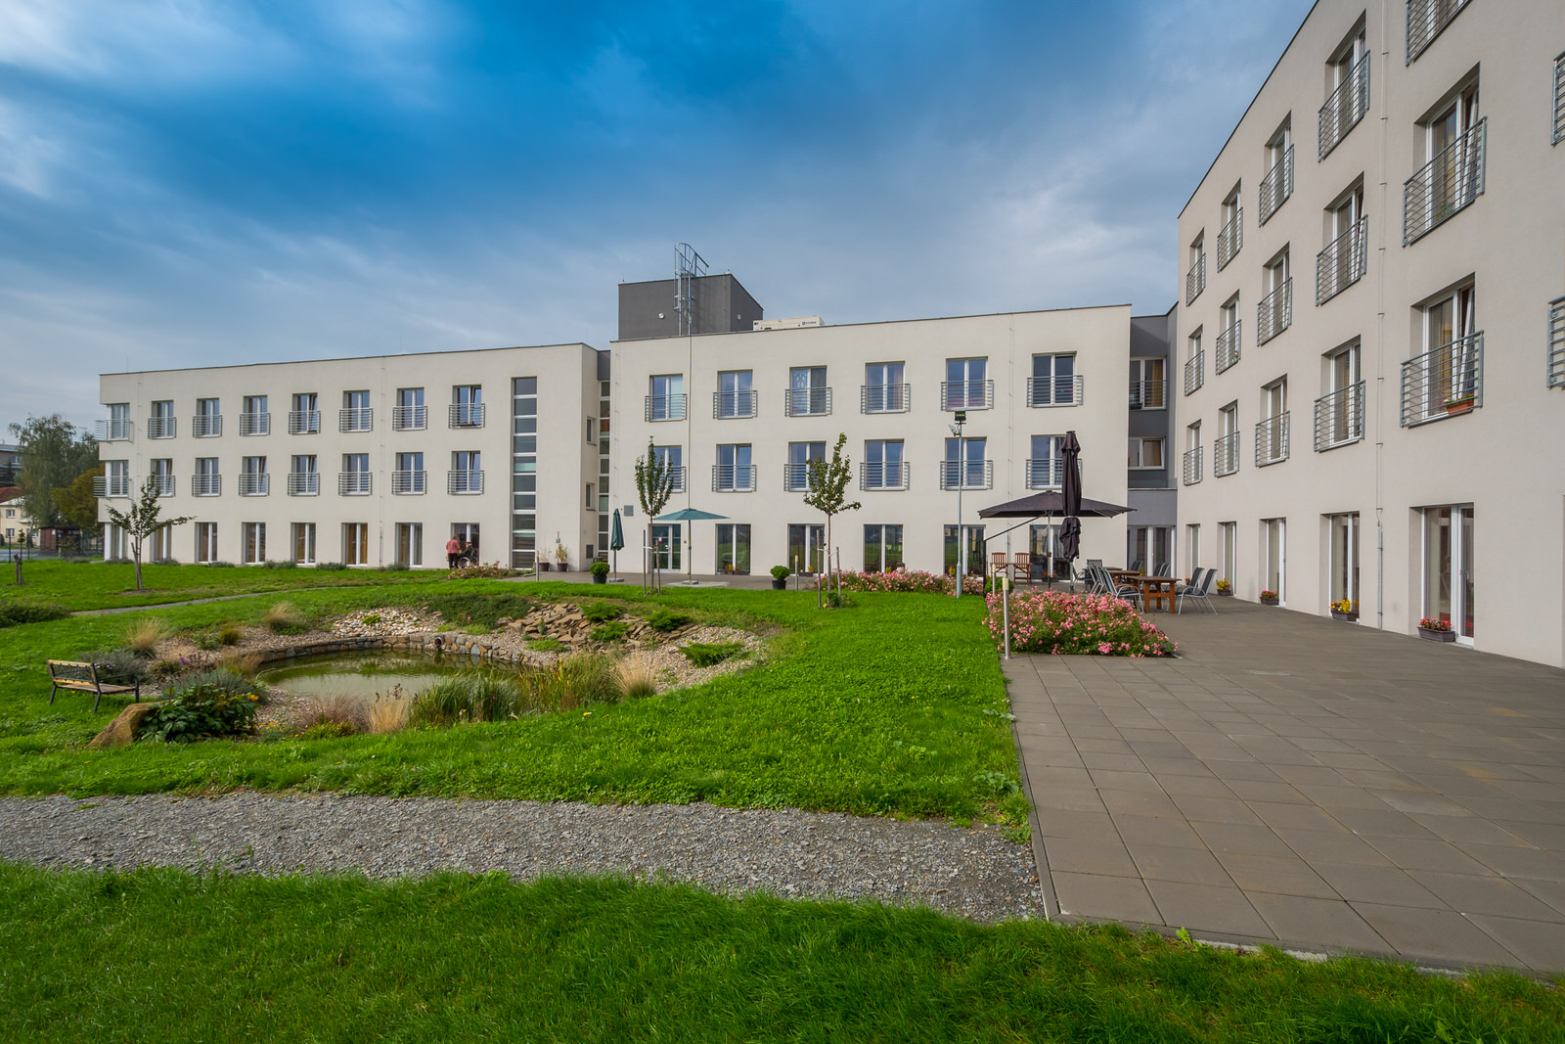
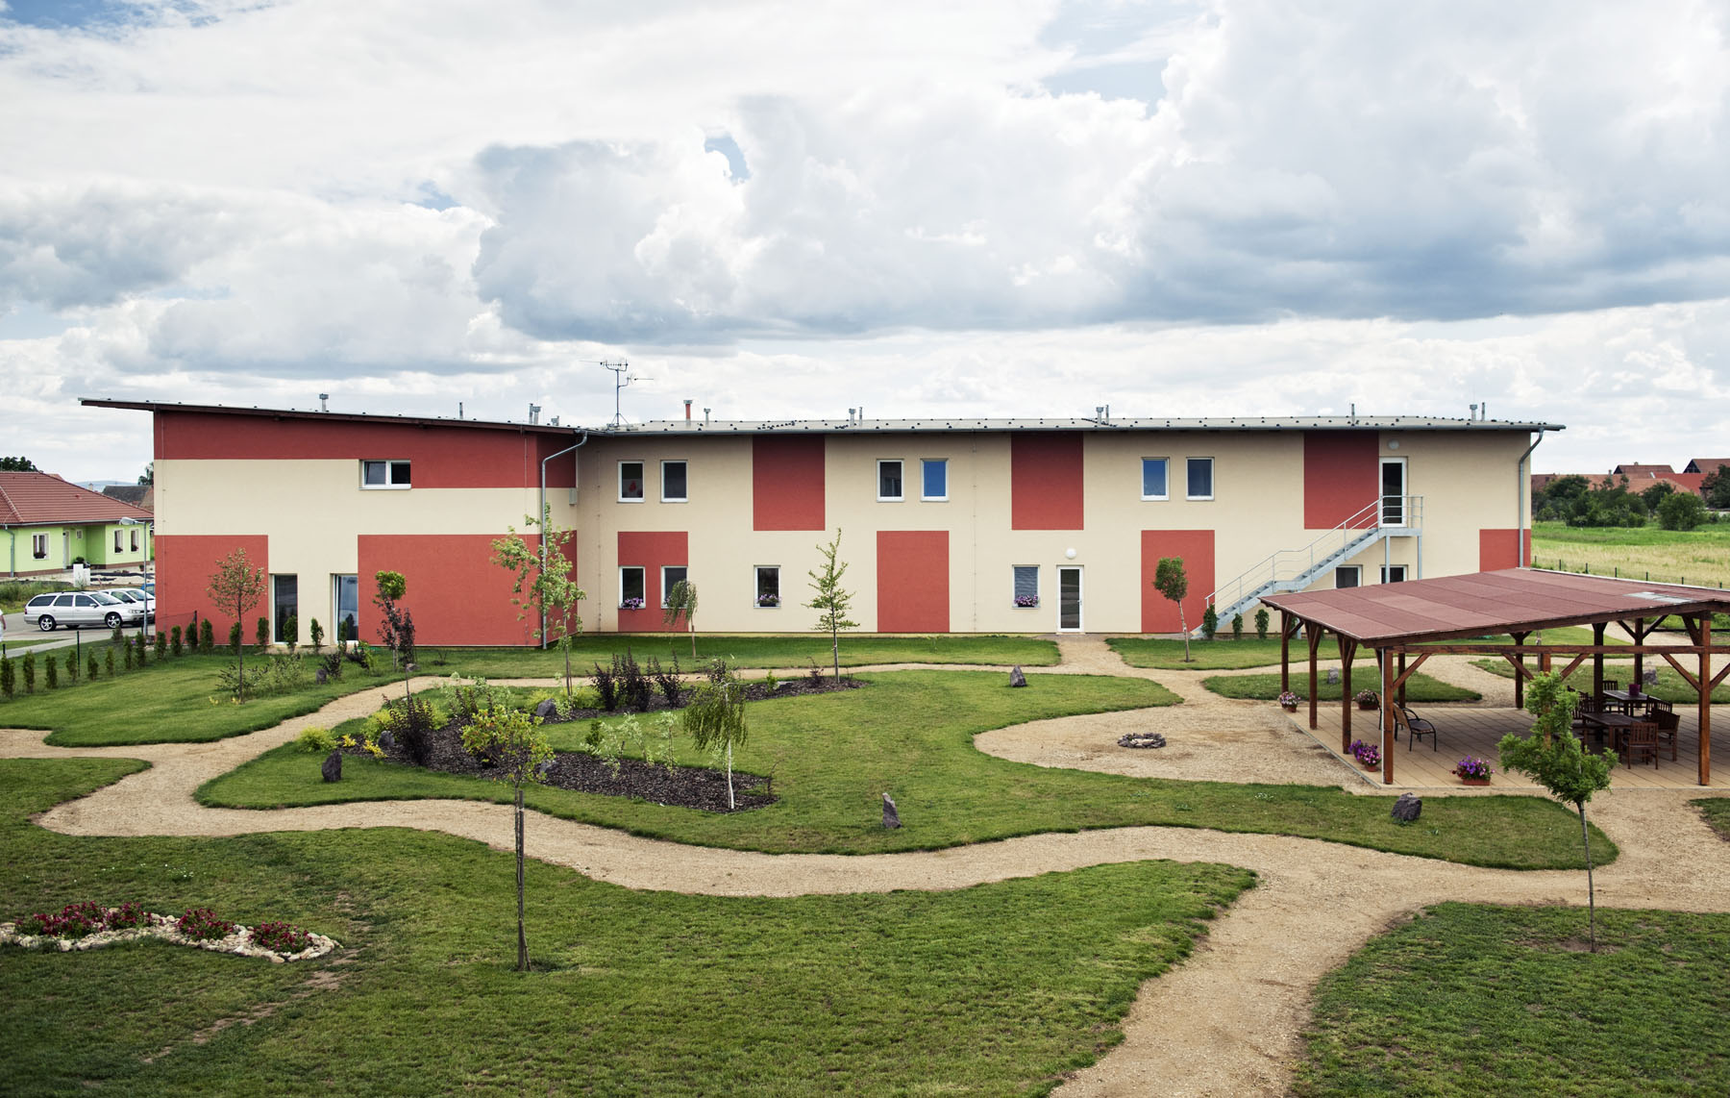
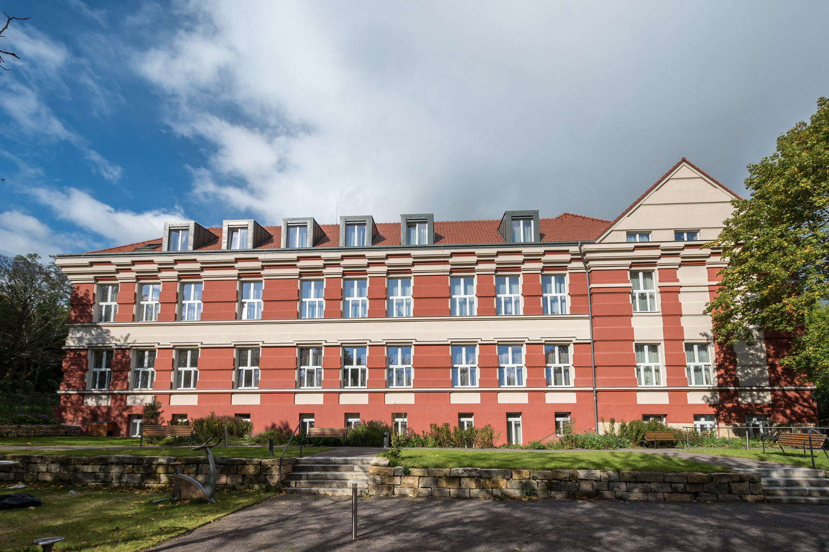
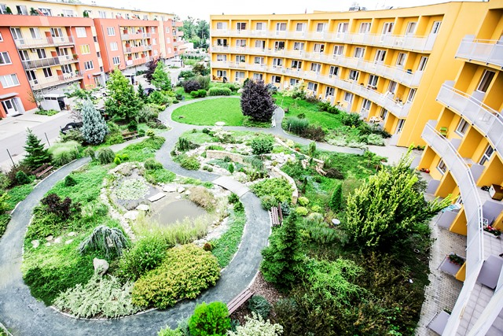
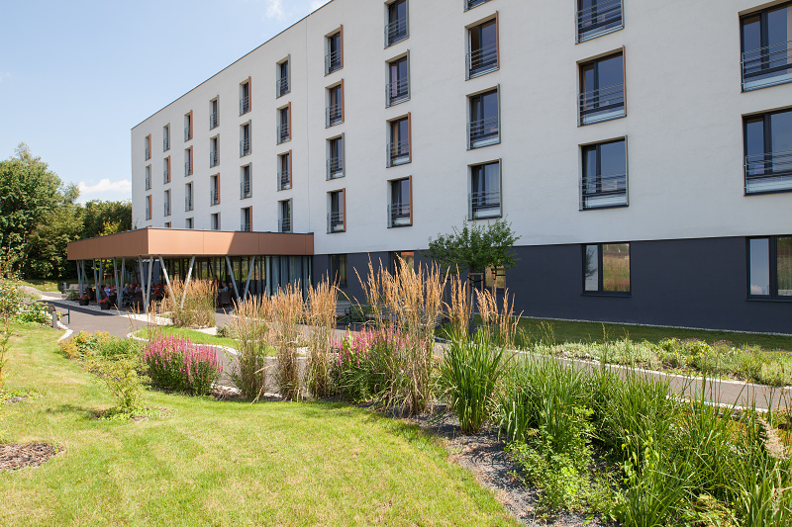
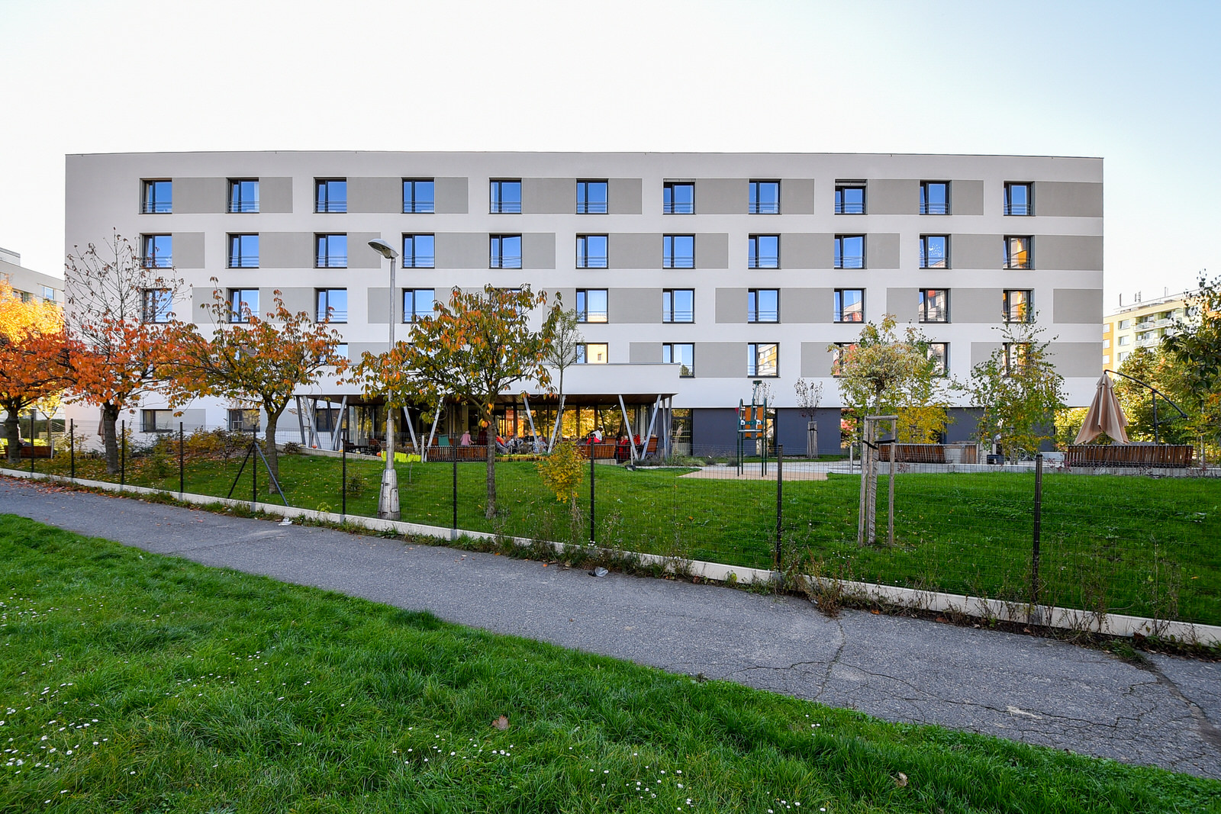
Senecura seniorcentres
Eastern REGION
Kolín
Humpolec Chotěboř
Olomouc Šanov Chrudim
Modřice Havířov Hradec Králové

Slide 8
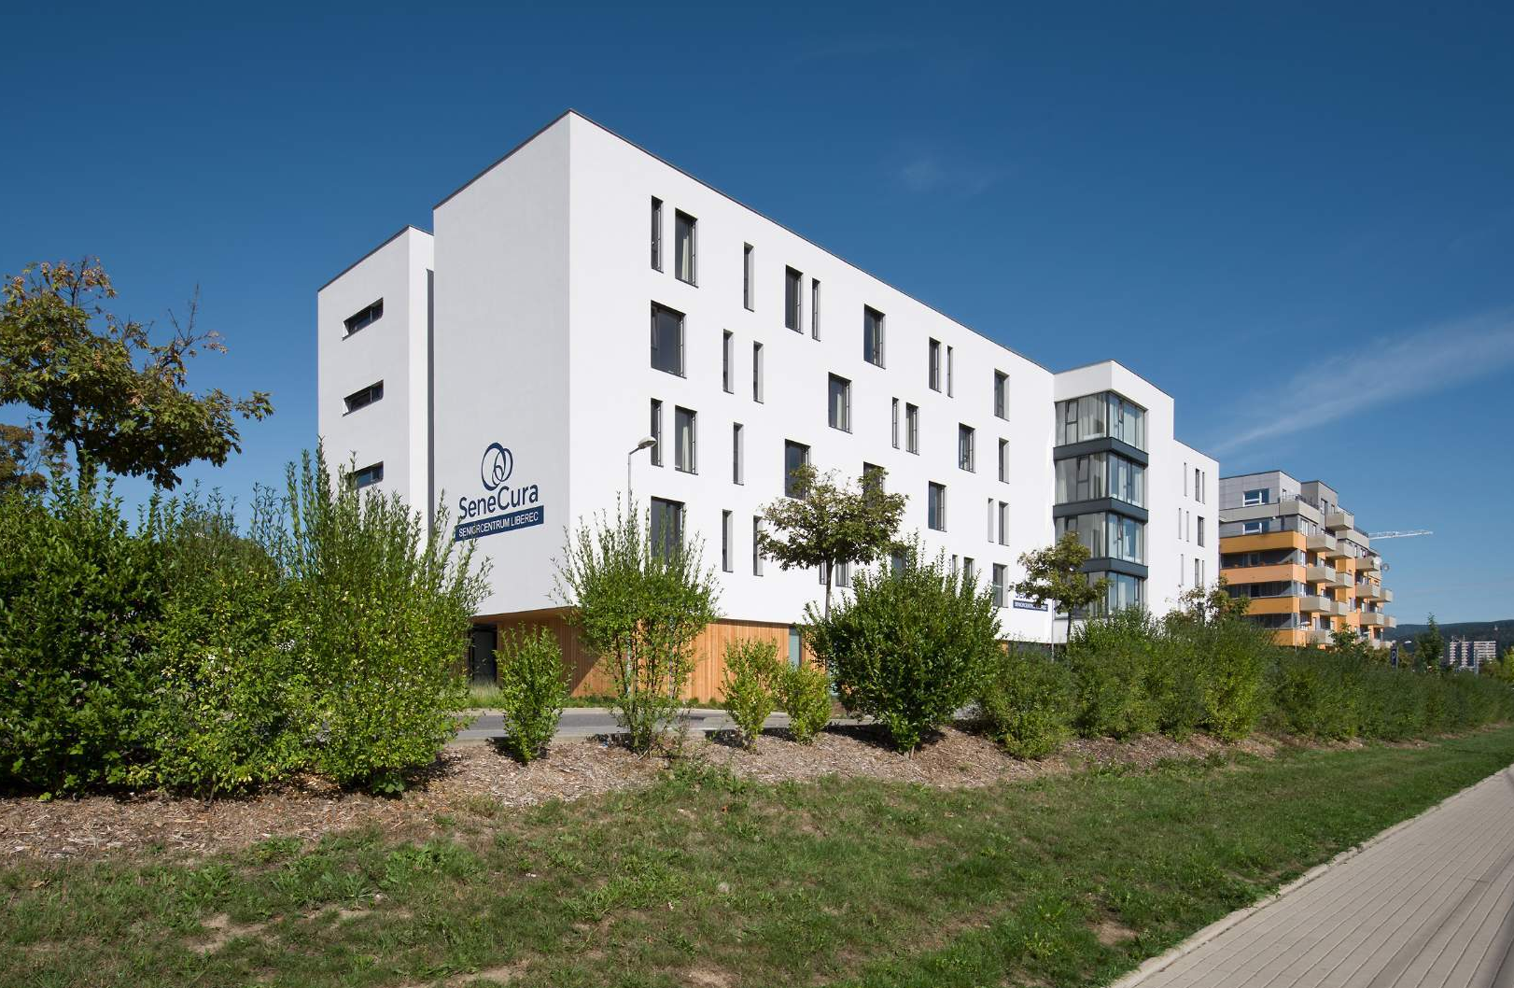
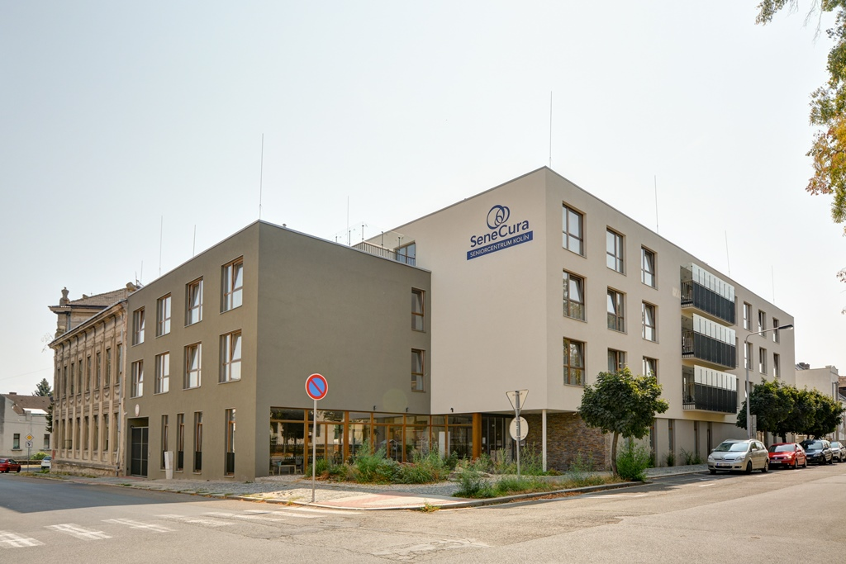
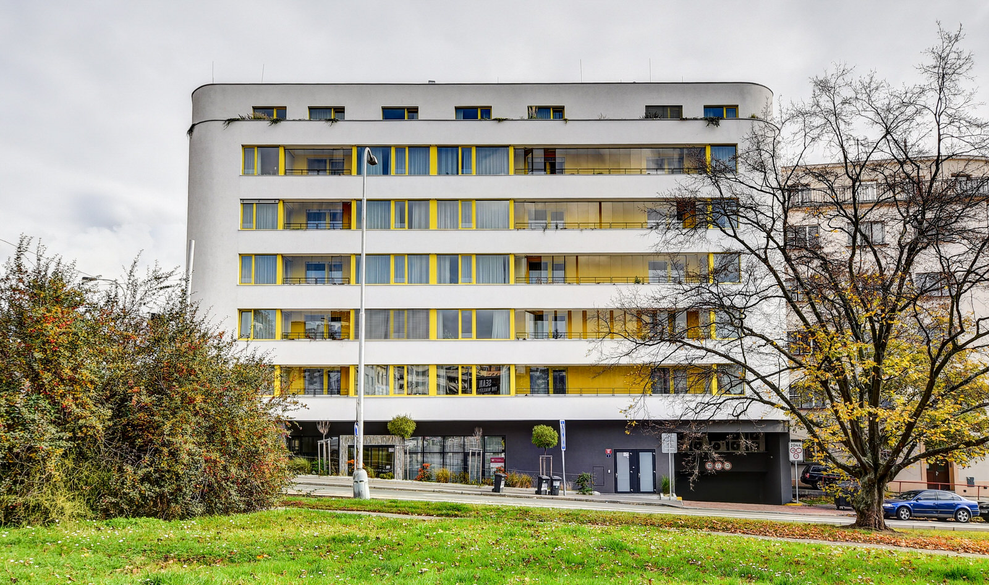
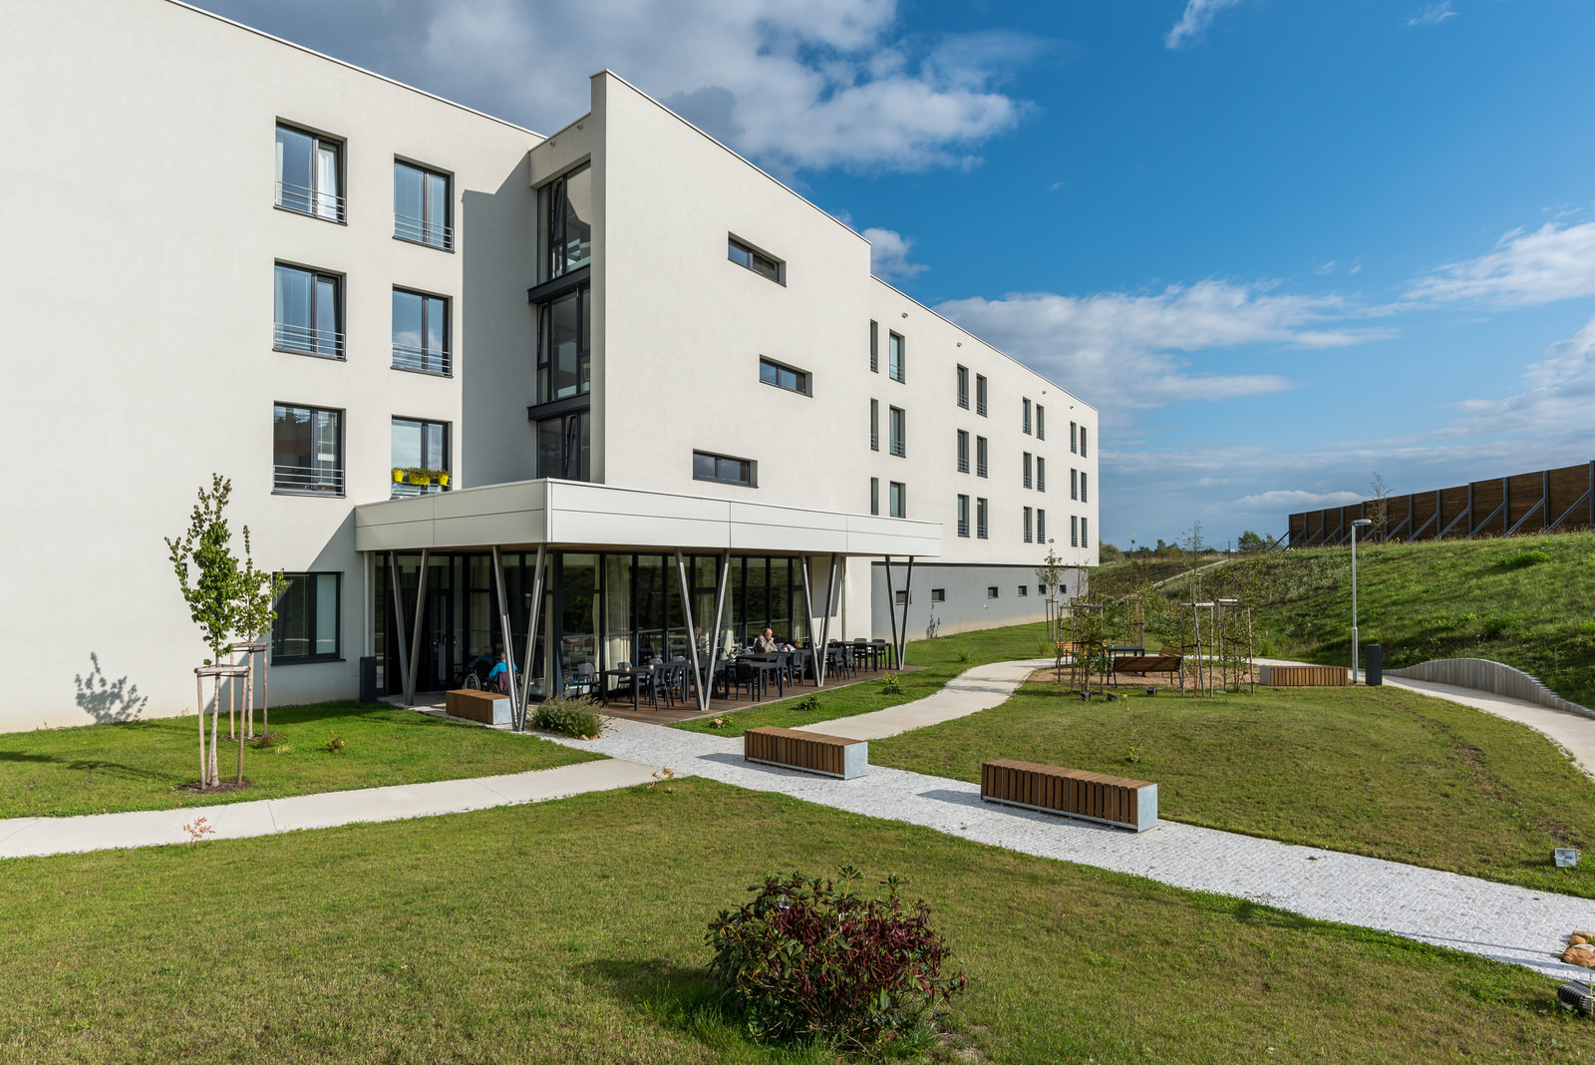
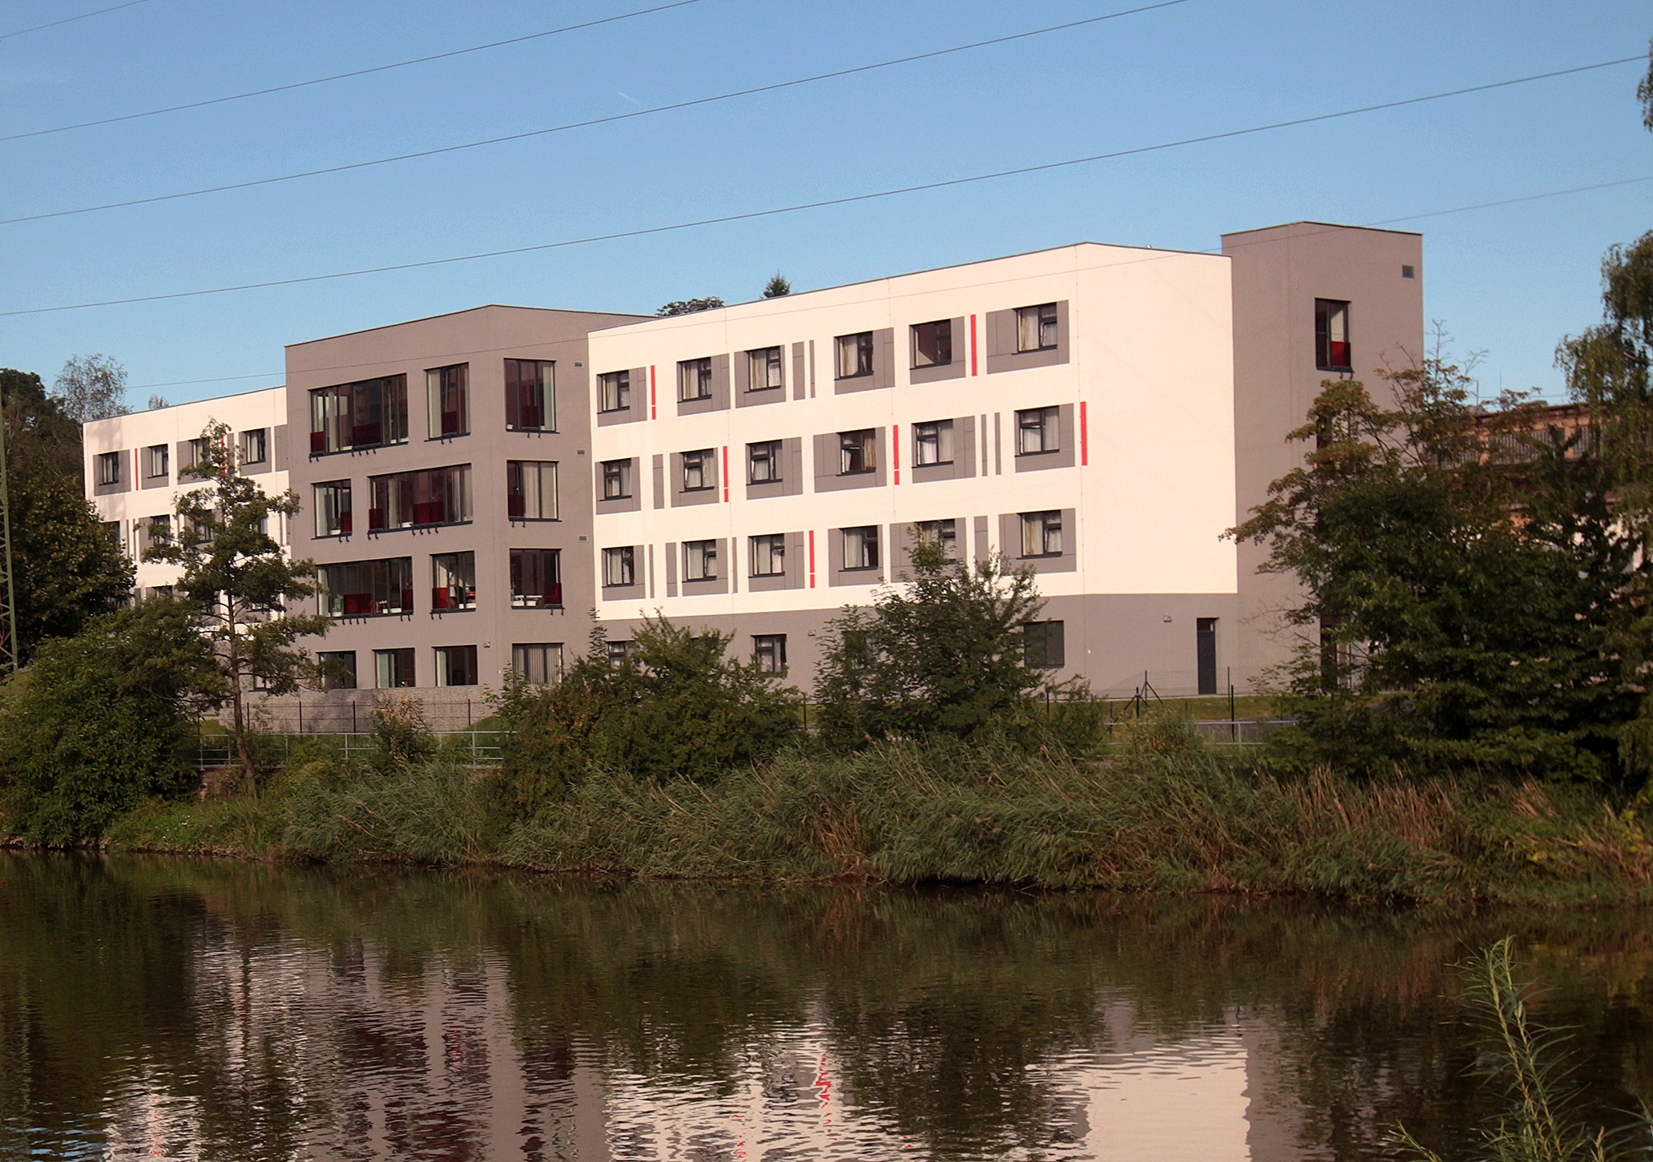
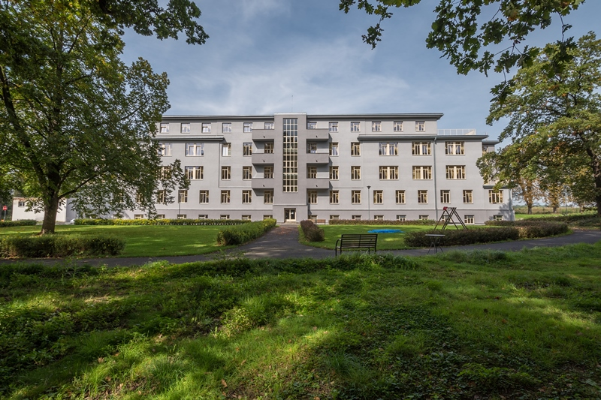
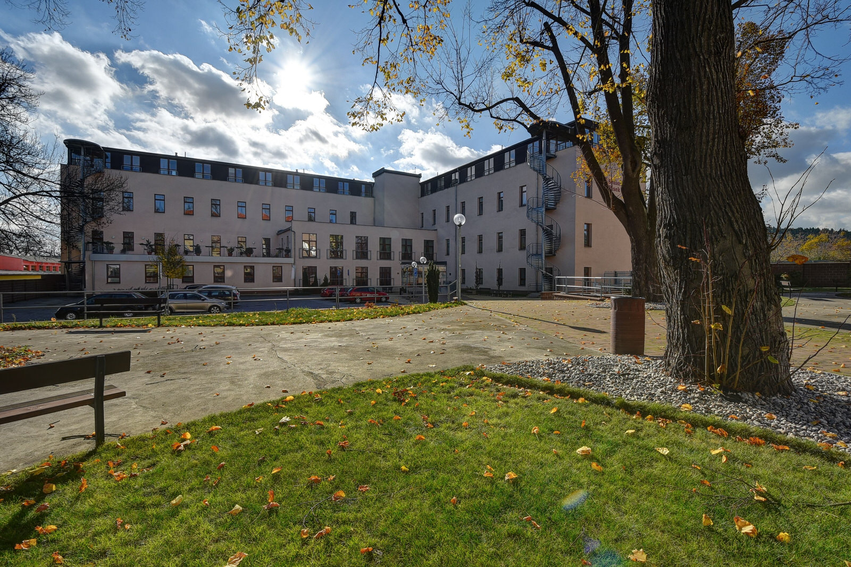
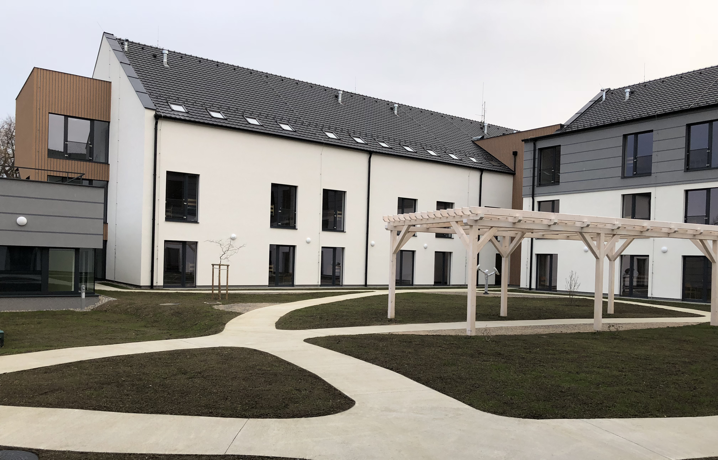
SeneCura Seniorcentres
westERN REGION
Liberec Kolín
Klamovka Štěrboholy Plzeň
Terezín Písek Slivenec

Slide 9
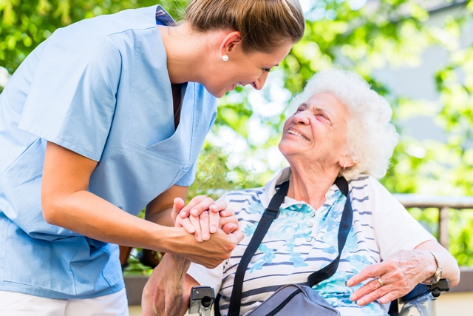
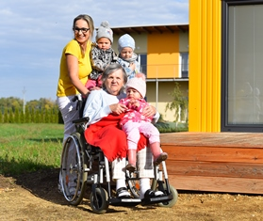
Our motto: life continues with us
Our philosophy is "Life continues with us" and to fulfill this philosophy, we put the person and their individuality, wishes and needs in the center of our interest. We make every effort to make our clients feel at home at our SeniorCentre.
Our values are Humanity and Respect. Counseling, listening, being empathic and understanding, these are key aspects for us in day-to-day contact with clients and their families.
The purpose of our philosophy "Life continues with us" is also to maximize support and develop coexistence of clients, residents, relatives, employees of SeneCura and public authorities.

Slide 10
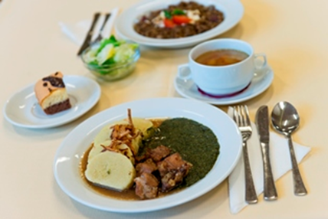
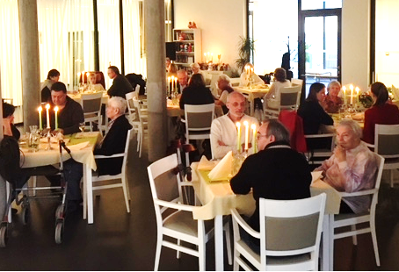
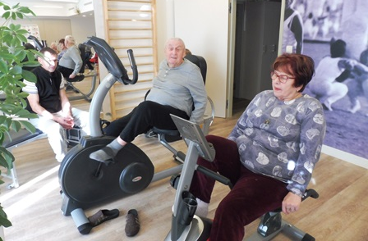

IMPLEMENTATION OF unique SENECURA/orpea program
Tasty and healthy: choice of two meals for lunch, special diets, cooperation with nutrition specialists. We meet the eating habits of each client.
Candlelight dinner: Once a year, we invite clients and their family members for a three-course galadinner to enjoy a beautiful evening with their families.
Exchange stays: Allow clients to spend their holiday within the SeniorCenter SeneCura network in the Czech Republic.
Yearly wishes: We are happy to meet the big and small wishes of our clients.
Fit and Moving 77+: the opportunity to participate in free movement activities for seniors over 70 years of age.
Interconnection and Generation Encounters - Children's Groups.
Animal Friends: Animals are always welcome in our country.

Slide 11
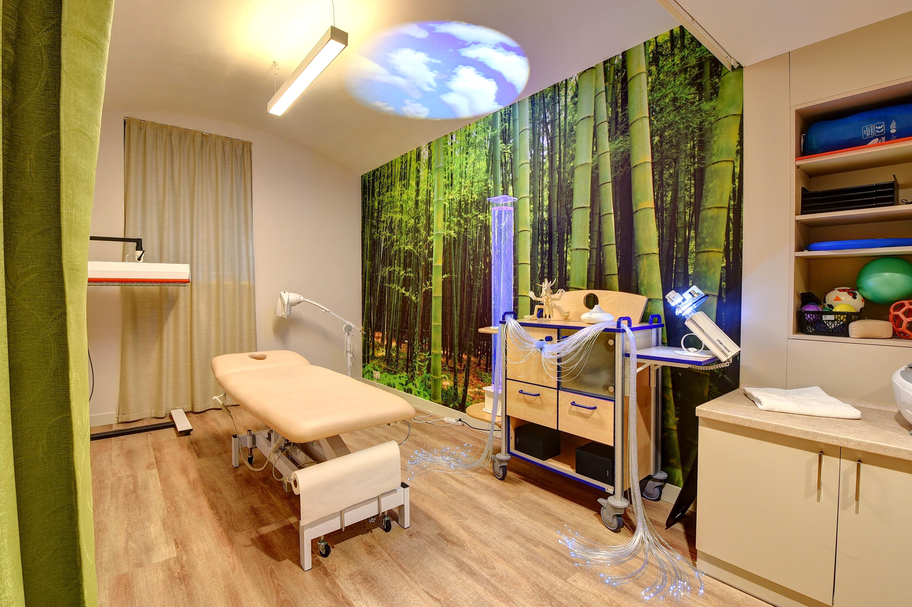
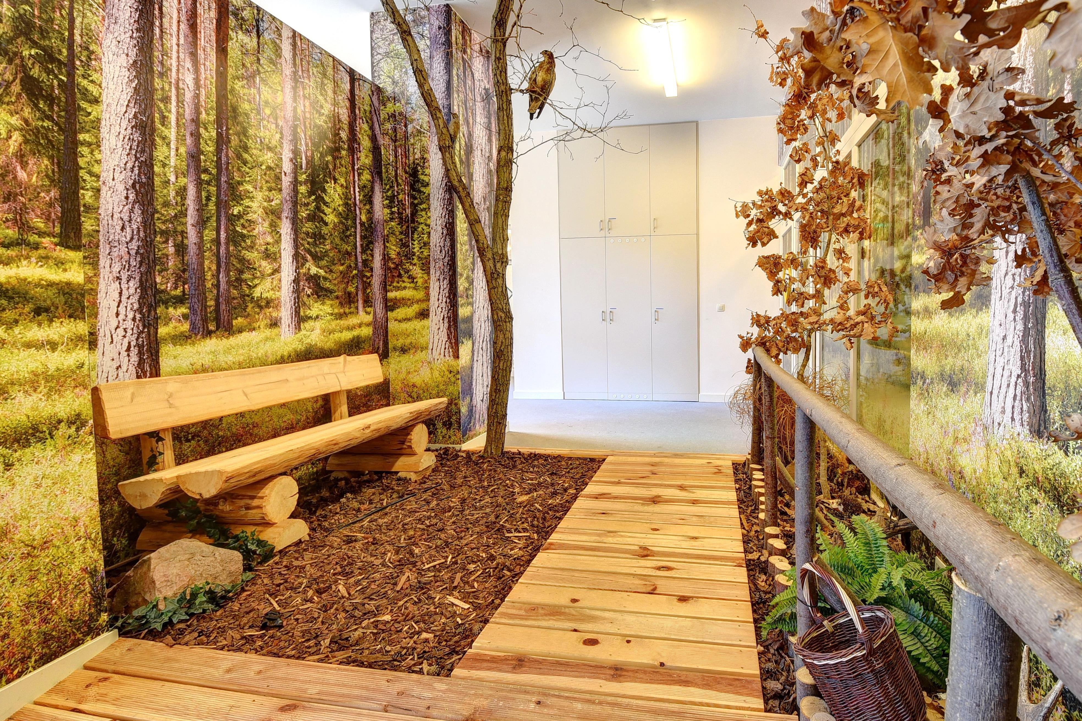
other specific senecura/orpea care programs
Social and Healthcare in 24/7/365.
Care is always built individually and according to the needs and customs of each client.
We use the concept of households for people with dementia.
Introduction of Naomi Feil's concept of care.
Use of reminiscence elements in the care of clients with dementia (creation of a book of life, etc.).
Maximum involvement of the life story and family in care.
The Memory Gardens and Memory Corridors.
Rehabilitation and physiotherapy services are available.
Collaboration with specialists: general practitioner, internist, psychiatrist, surgeon etc.
Activation activities and ergotherapy including sensual activation using Snoezelen.
Some senior centers also include a children's group. Children are therefore involved in clients' activities.

Slide 12
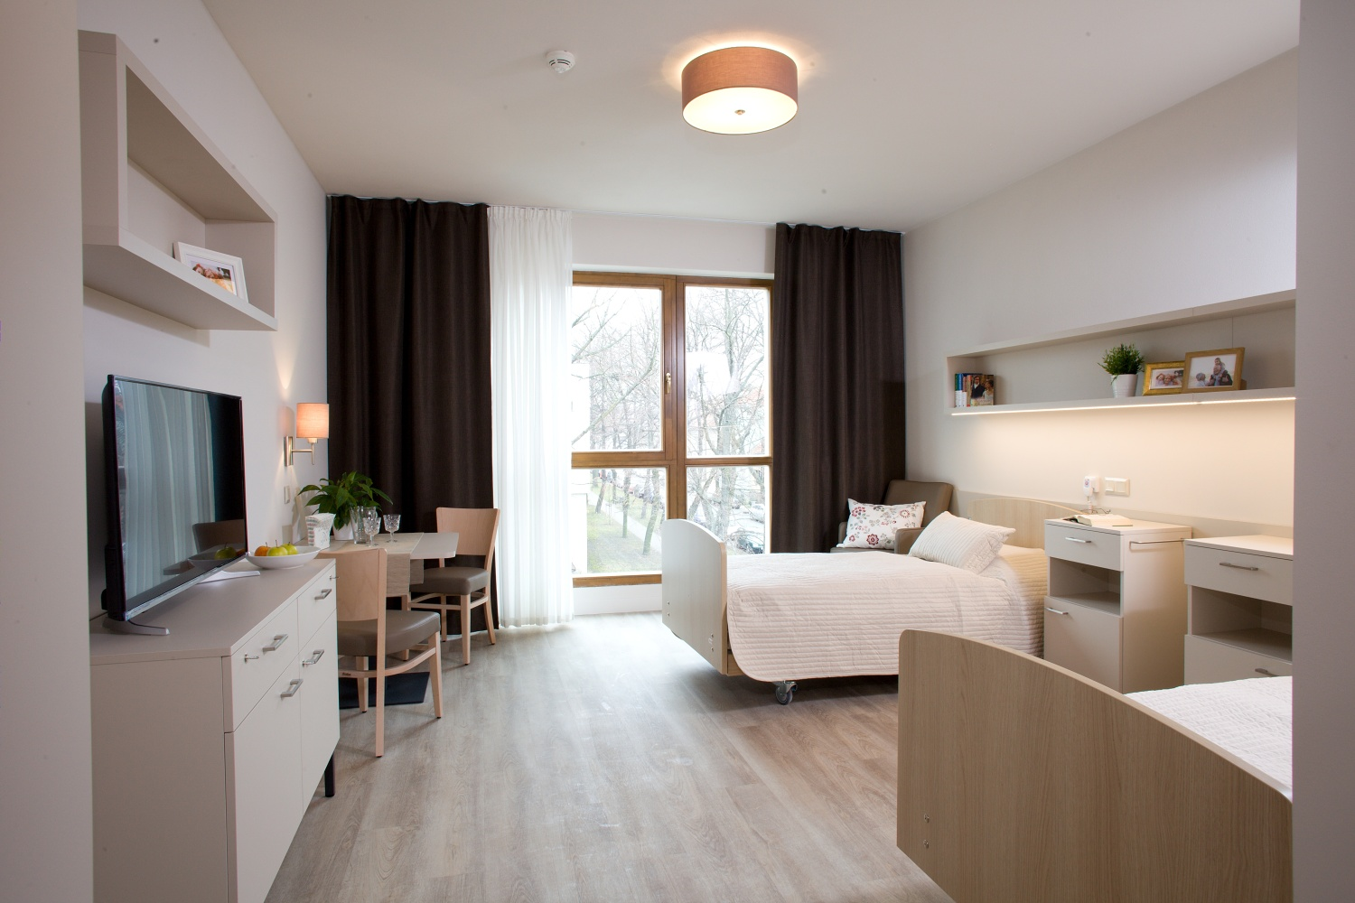
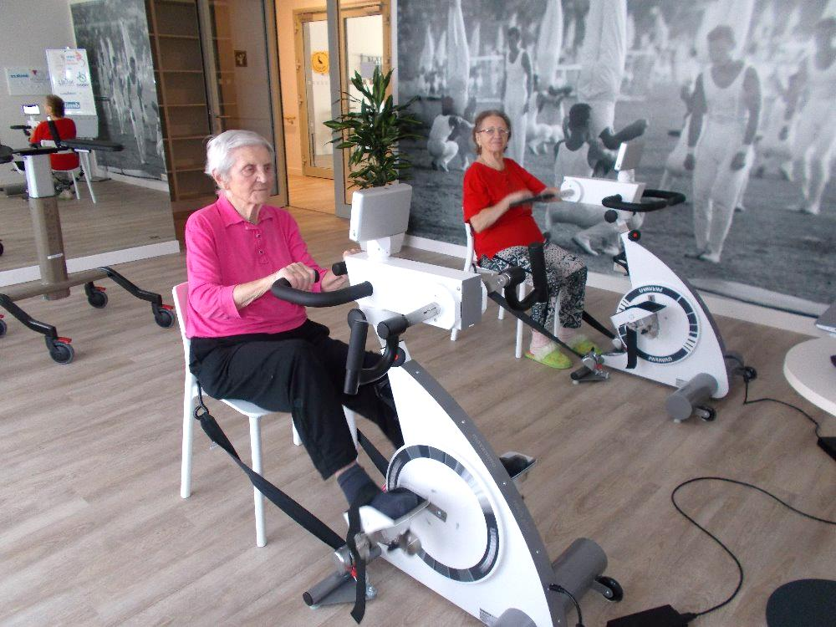
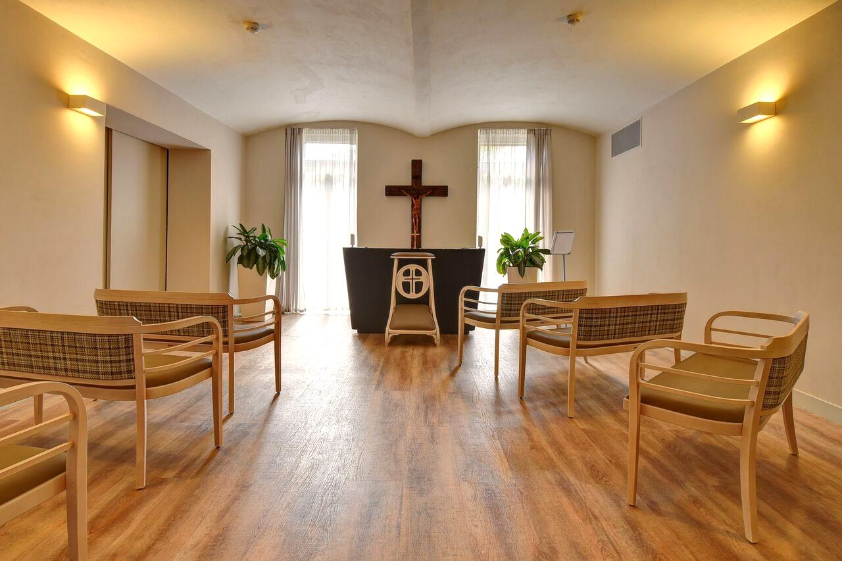
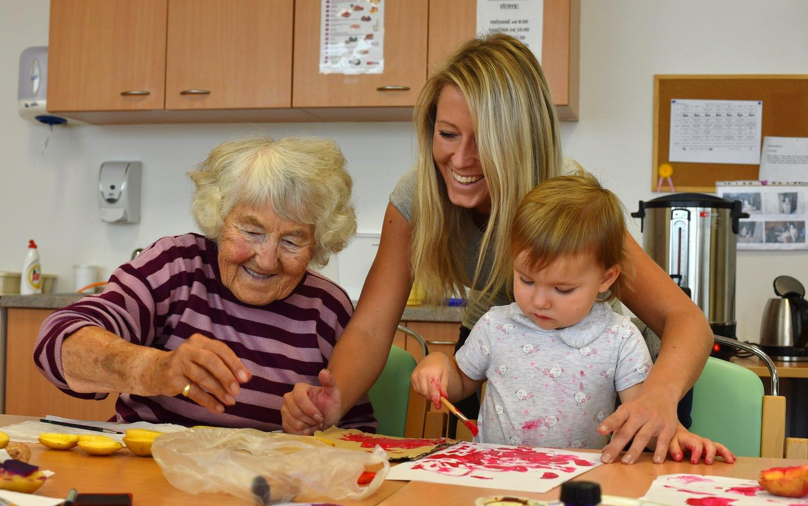
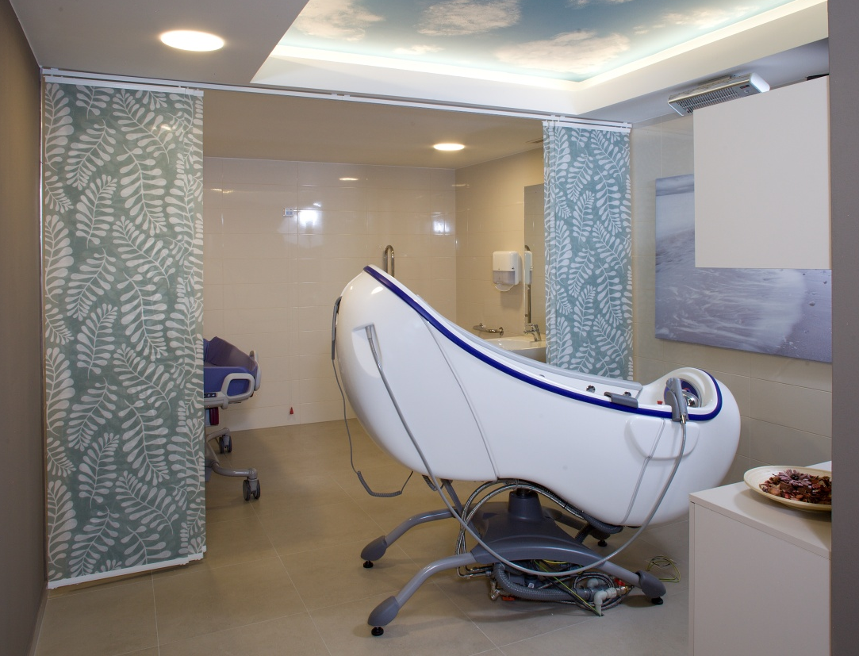
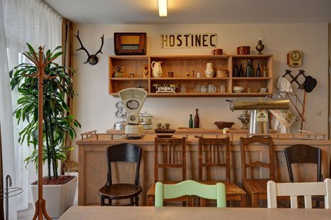
how does it look like at home?

Slide 13
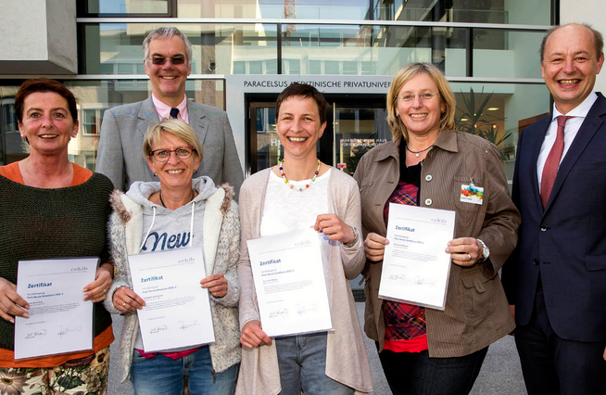


Scientific projects
We are looking for a research partner in the Czech Republic.
We can offer an interesting data set from 17 SeniorCenters in the Czech Republic for important scientific tasks. We offer the possibility of transferring research results into practice not only in our facilities in the Czech Republic.
RESEARCH THEMES
Alzheimer's disease
A painless home (OSiA), management of pains
Wound treatment management
Fit and Moving 77+ (rehabilitation and physiotherapy)
Medical checkup of clients' medication
Limitation and reduction of psychopharmacological treatment
Prevention of malnutrition
Support for scientific dissertations focusing on social services
Telemedicine – monitoring and control system

Slide 14





CURRENT EXAMPLE - SCIENTIFIC PROJECT:
SMART Solutions Across Continuum of Care for the Elderly
The aim of the project is to involve smart technologies in the care of seniors for improving their
quality of life and reducing caregiver burden for both informal home care and in residential facilities.
RESEARCH COLLECTIVE:
University of Hradec Kralove
University of Ostrava
ANUME – technology company
SeneCura - implementation partner
RESEARCH COLLECTIVE:
06/2020 – 09/2023
PROJECT FINANCING:
Partly project developers
Grant Agency - Technological Agency of the Czech Republic

Slide 15
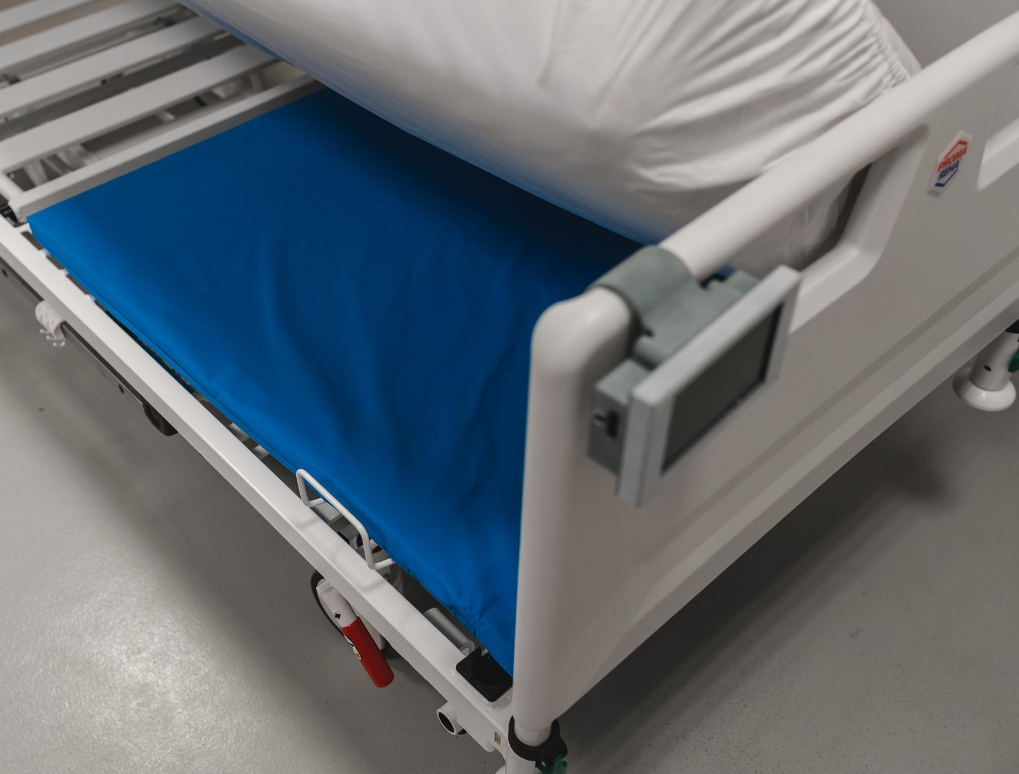
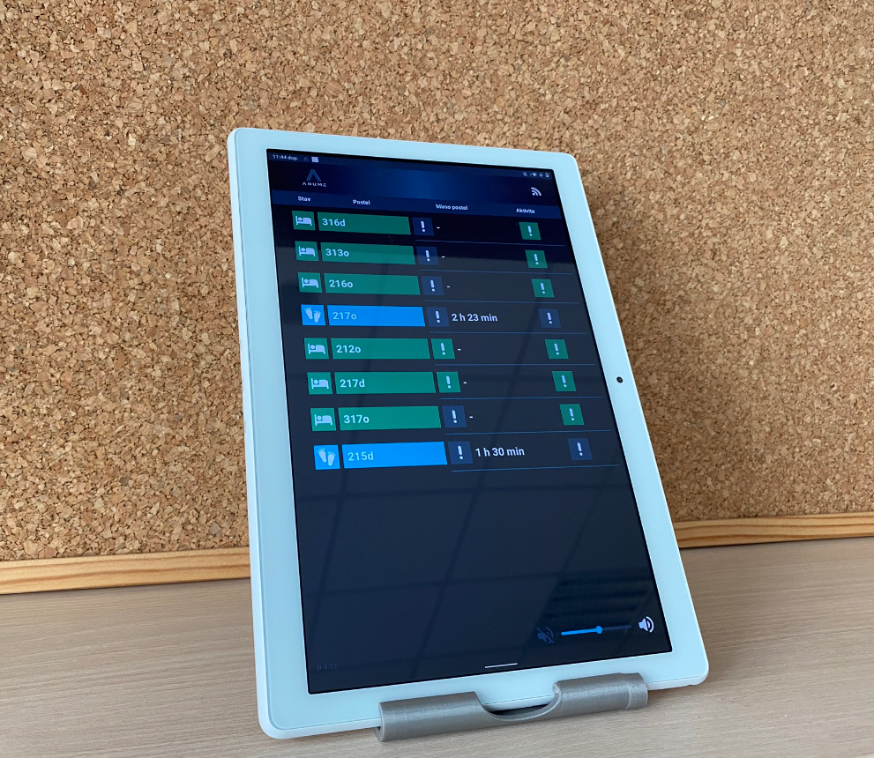
ANuME MONITOR PADS
Monitoring pad stored in the bed under the mattress.
Wirelessly connected to the tablet.
The tablet is at the nurses' station

Slide 16
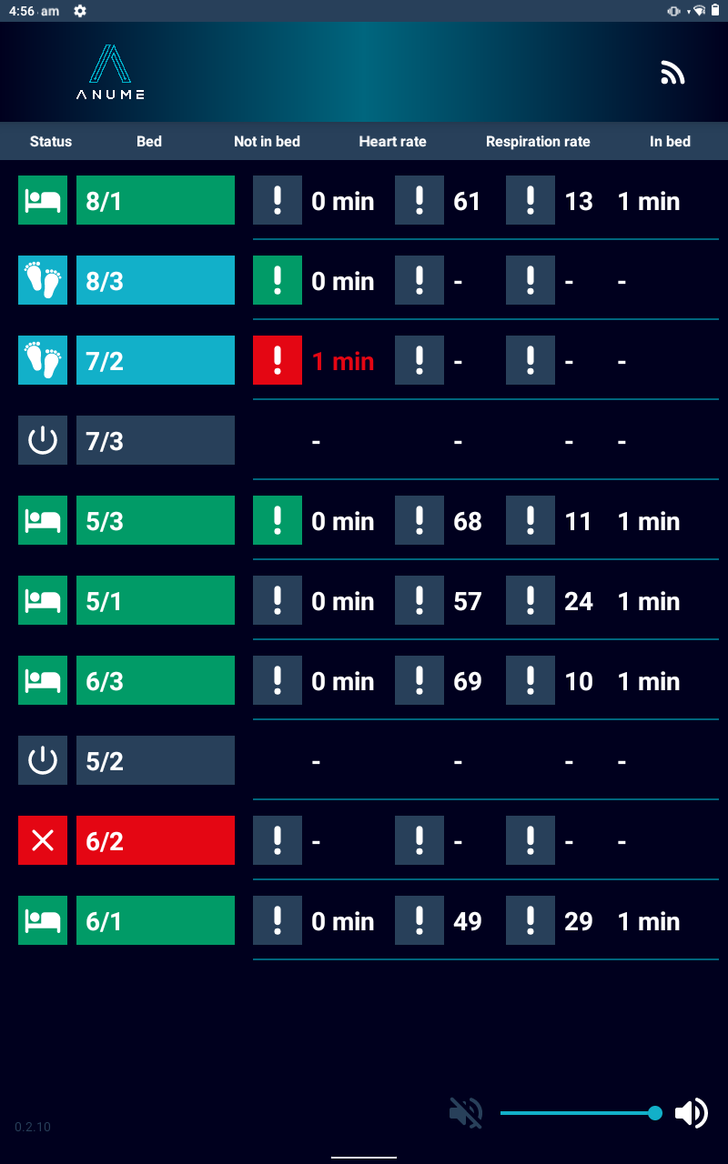
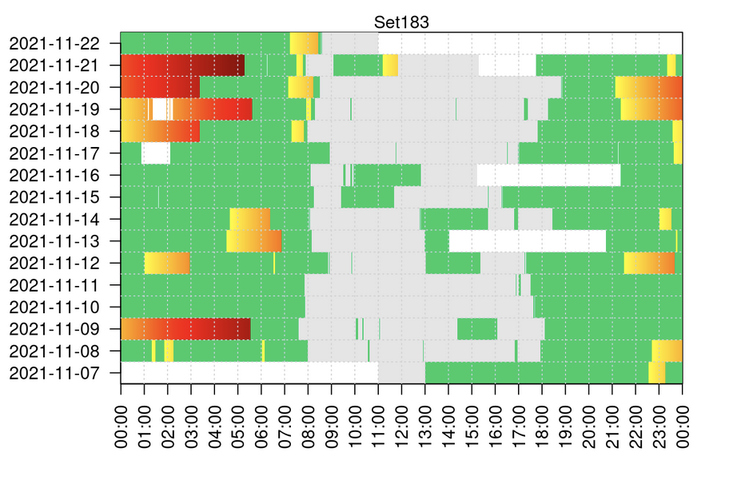

ANIME MONITOR PADS
For indicated clients, it records breathing and heart rate and time spent in bed.
We monitor the client's health and activity.
Monitoring takes place contactless.
Intended for restless clients with dementia or for clients with other types of illness.
Monitoring the change in position is important from the point of view of preventing pressure ulcers (decubitus).

Slide 17
PROGRESSIVE STEPS WITHIN TECHNOLOGY TRANSFER
STEP 2020 - Start of research, market research, search for the optimal technical solution.
STEP 2021 - Installation of the first pads in the SeniorCenter Hradec Kralove. Communicating and cooperation with staff about operational needs.
STEP 2022 - Expanding the use of pads in other SeniorCenters Czech Republic (Hradec Kralove, Slivenec, Klamovka, Kolin, Chrudim) and in Austria (Kitsee, Presbaum).
STEP 2023 - Commercial deployment of pads in other SeniorCenters in the Czech Republic and Austria. Start of production and sales.
  85 pads already purchased in the Czech Republic
  40 pads in the Czech Republic as part of a research project

Slide 18
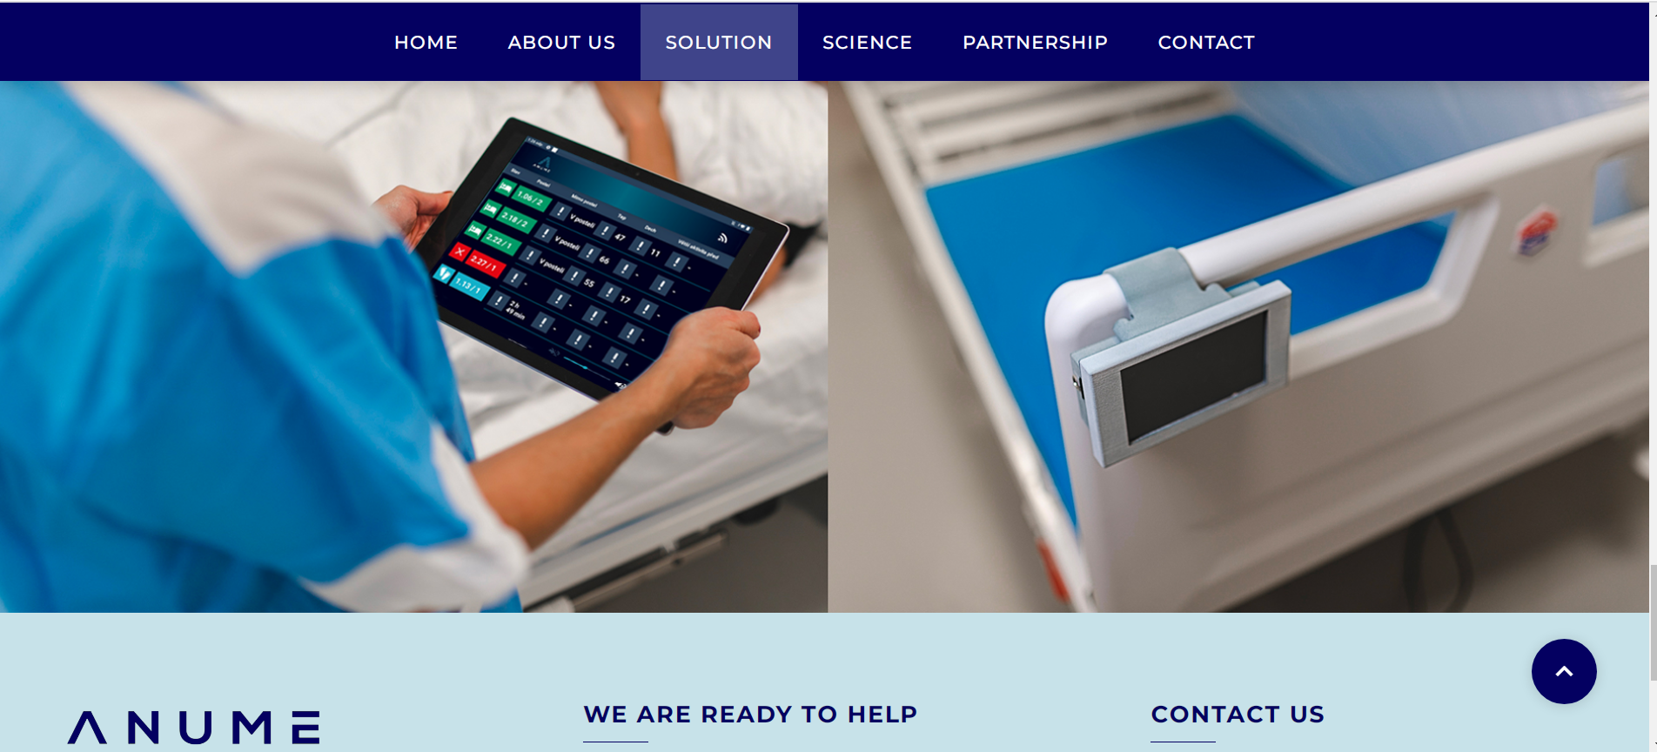
COMMERCIALIZATION OF THE RESULTS
https://www.anumecare.eu/

Slide 19

Ing. Tomáš Černický, Ph.D.
t.cernicky@senecura.cz
+420 734 797 246
www.senecura.cz

