Slide 1
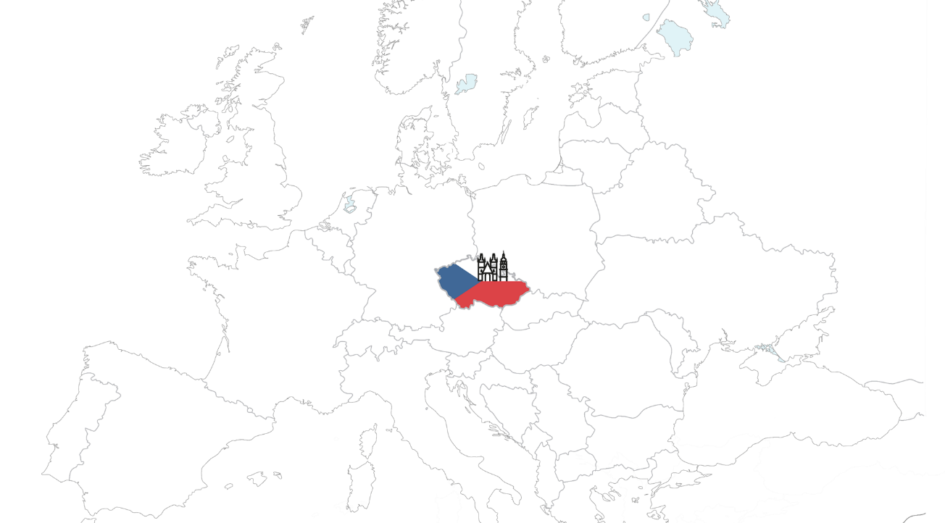


Introduction of the University of Hradec Králové

Slide 2
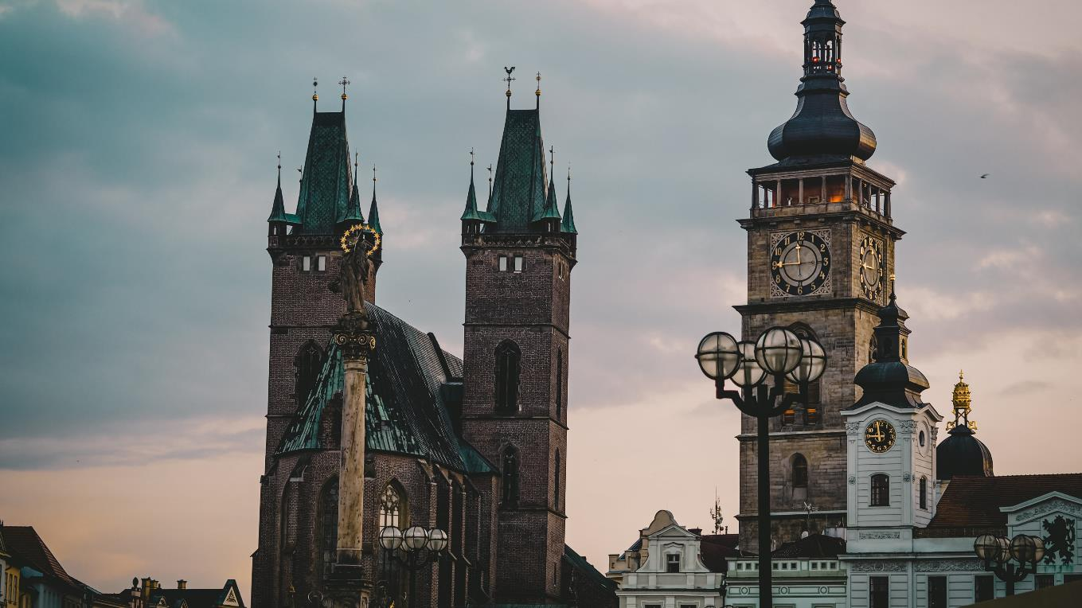

Location
Hradec Králové
Central Europe, Eastern Bohemia
Capital of the region, approx. 93 000 inhabitants
One of the safest cities in the Czech Republic

Slide 3
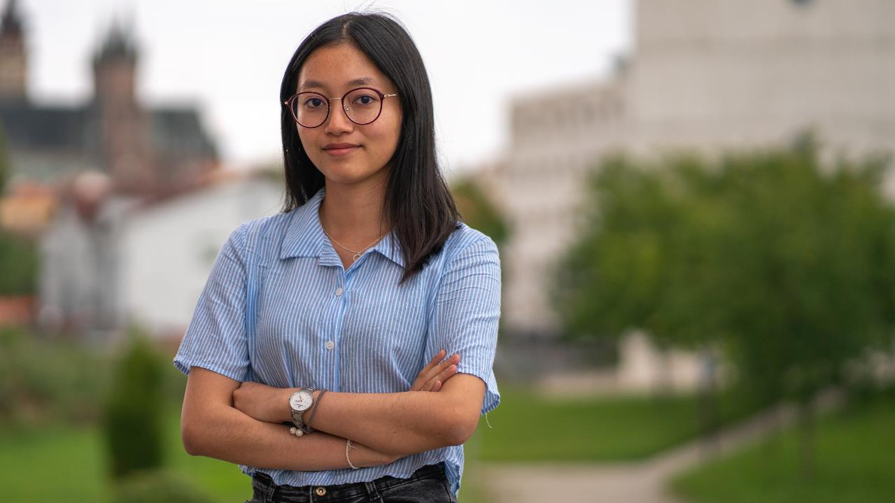
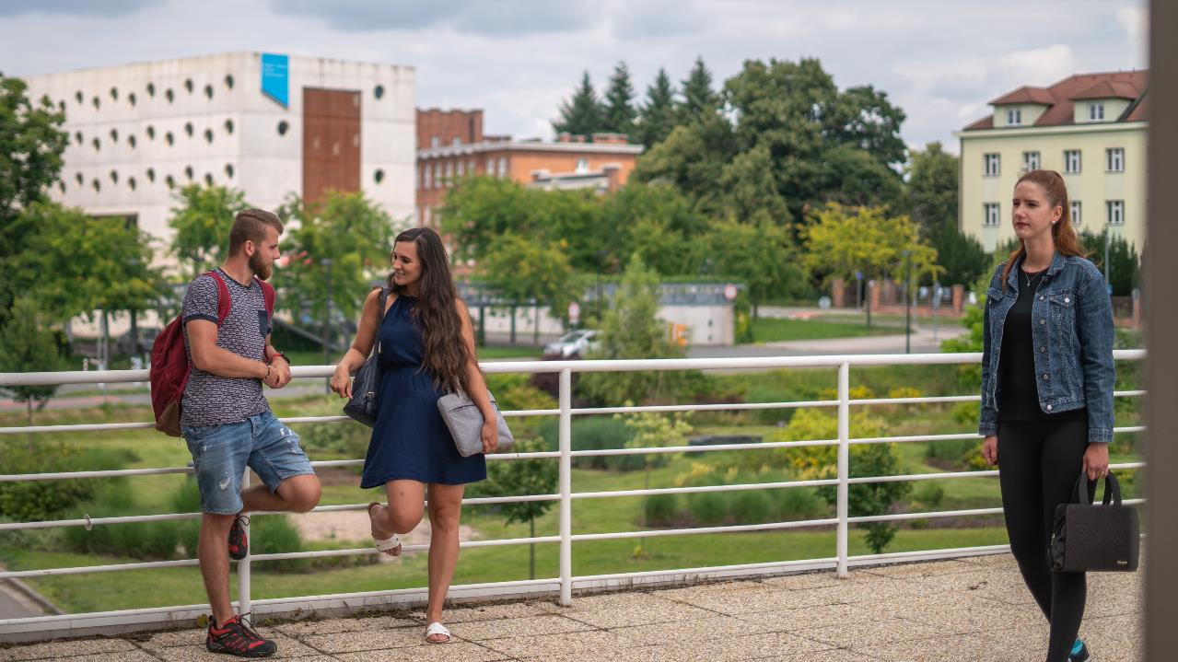
Location
Hradec Králové
Rich history
Green city
Amazing architecture
Cultural events
Easy transportation
Affordable cost of living

Slide 4
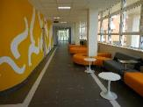
University of Hradec Králové

Slide 5




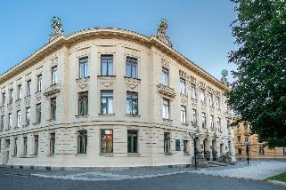
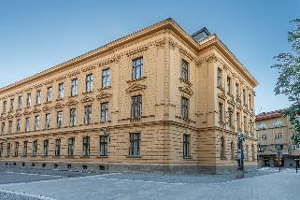
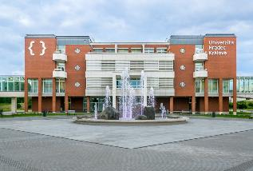
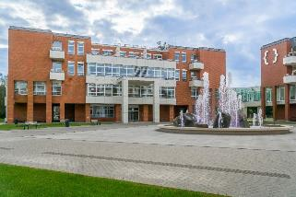
University of Hradec Králové

Slide 6

University of Hradec Králové
a public university since 1959
more than 6 000 students in full or part-time form of studies of all ages
preparing competitive graduates for the global labor market
keeping to high standards of the European education
around 200 study programmes in bachelor, masters and doctoral studies

Slide 7
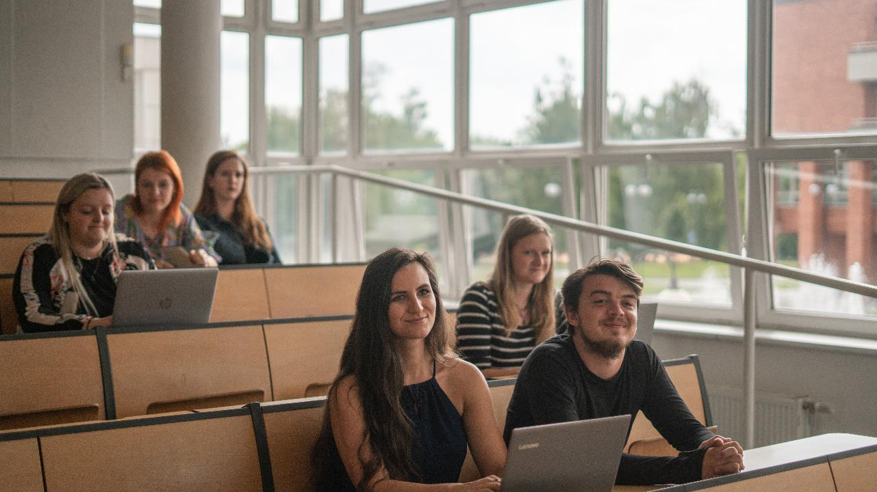
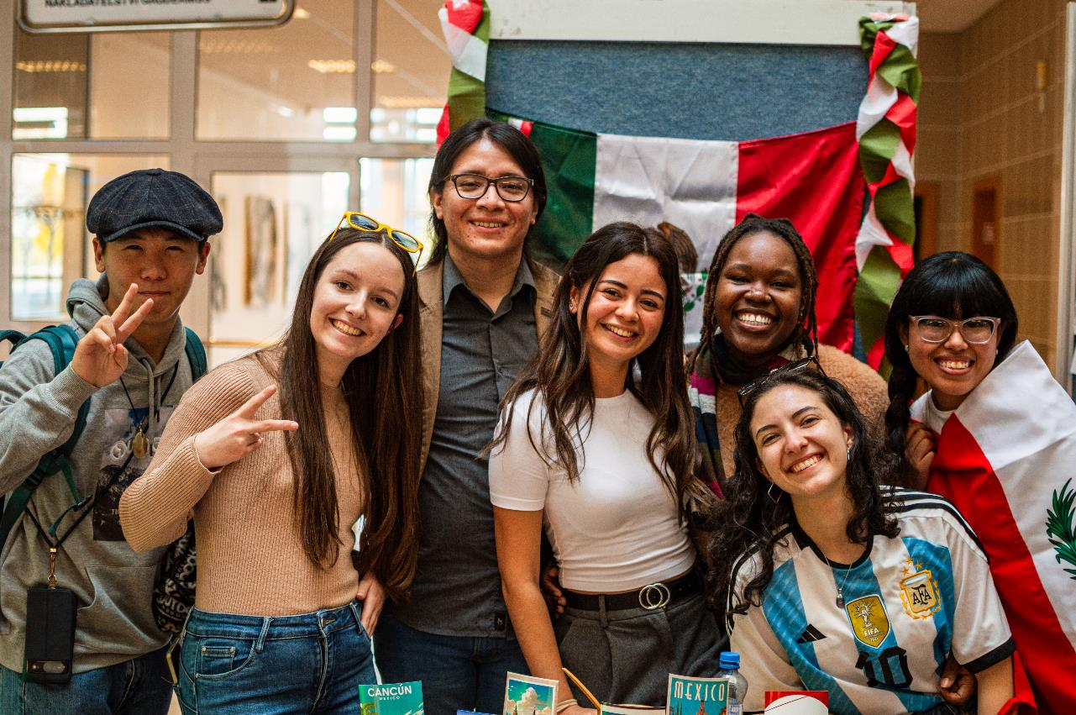
Study & Students

Slide 8
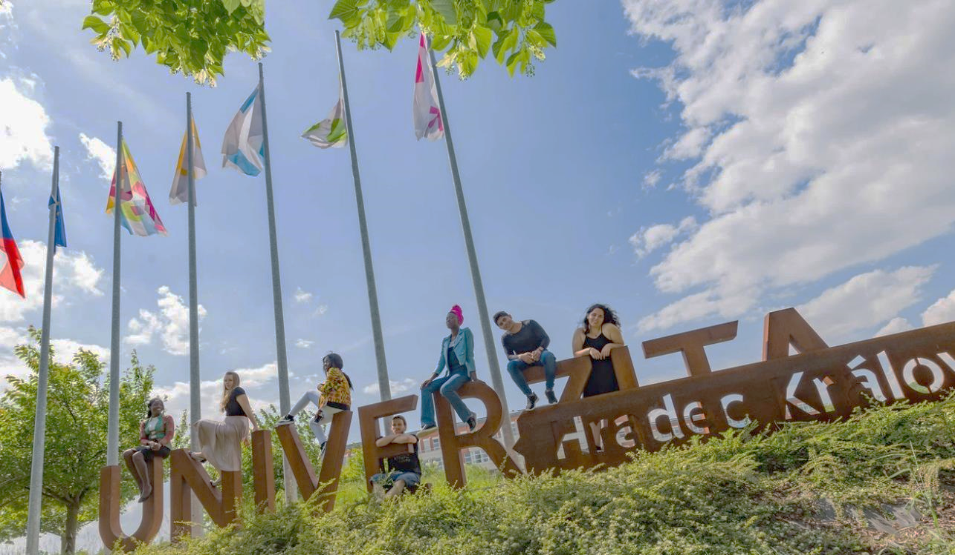
University of Hradec Králové
Degree programmes
3yrs Bachelor
2yrs Master
4yrs Doctoral
around 30 English-taught study programmes
summer schools with various focuses on IT, Czech culture and language or science, including extra leisure activities
modern campus, libraries, laboratories
vibrant student life (3 universities in town)

Slide 9
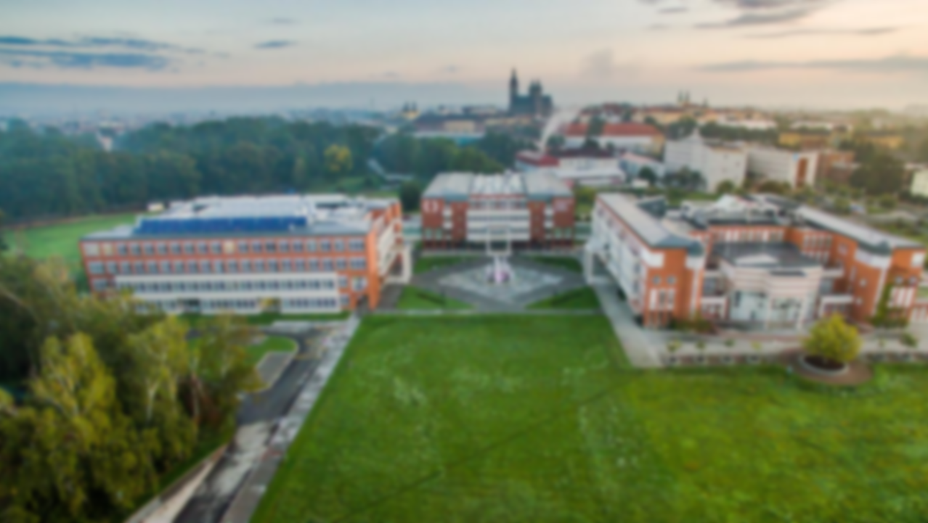



University of Hradec Králové
UHK proves its high standard by passing strict criteria of prestigious international rankings such as QS or THE, it has also successfully qualified in a ranking devoted to sustainability and ecology – the UI Green Metric.
UHK Rankings | 2024 | 2025
THE WUR | 1201–1500 | 1001–1200
THE by subject: Education Studies | N/A | 601+
THE by subject: Computer Science | 601–800 | 601–1000
THE by subject: Physical Science | 1001+ | 801–1000
THE by subject: Life Sciences | 601–800 | 501–600
THE by subject: Arts & Humanities | N/A | 601+
THE Young Universities | 351–400 | N/A
QS WUR | 1001–1200 | 1001–1200
QS EECA/Europe | 403 | N/A
QS Eastern Europe | 41 | N/A
UI GREEN METRIC | 527 | N/A

Slide 10
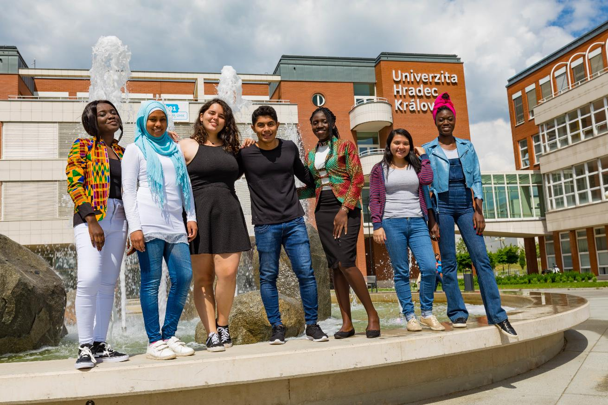

Internationalization
Internationalization as a cross-sectional activity
High importance for science and research as well as for teaching and education
Key element of many particular activities at the university

Slide 11
International Students

Slide 12
International Staff

Slide 13
Summer Schools

Slide 14
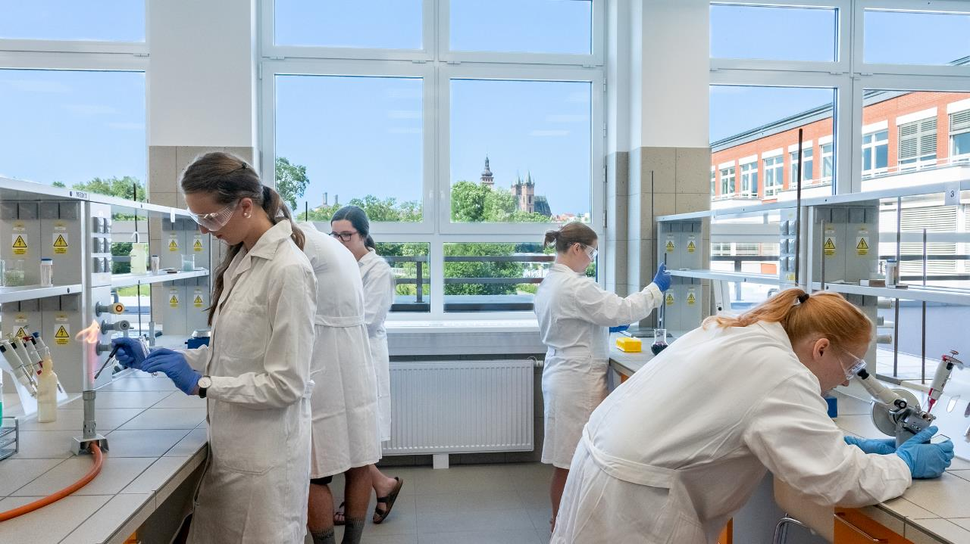
Research and Development

Slide 15



UHK Research – Topics
University-wide research topics
Healthy Ageing and Quality of Life
Security and Sustainable Development in the Digital Society
New Challenges in Education

Slide 16
UHK Research – Publications
UHK publications on the Web of Science – Journal Citation Report (Article, Review, Letter)

Slide 17
UHK Research – Publications
Scopus – SJR quartiles (Article, Review, Letter)

Slide 18
UHK Future Targets
Increasing number of PhD students / PhD programmes
New postdoc positions
Strengthen university – industry partnership
Double degree programmes
International strategic partnerships
EU & international projects
International teams / Centers
Consistent positions in rankings

Slide 19





www.uhk.cz/en

