Slide 1

Postdoctoral research project:
Search for new drugs by computer-aided methods
PharmDr. Martin Juhás, Ph.D.

Slide 2

Author’s details
Brief biography
Ph.D. in Pharmaceutical Chemistry
  2023 - Charles University, Faculty of Pharmacy in Hradec Králové
ORCID: 0000-0002-1890-9082
Researcher ID: S-9697-2018
Number of publications: 9 (4 as a first author)
H-index: 5

Slide 3
Project overview
Aim of my postdoctoral research
The main goal of my postdoctoral project is to introduce new state-of-the-art methods of computer-aided drug design to the research projects currently implemented at the Dept. of Chemistry and thus help with screening and/or with optimization procedures in search of potential drugs

Slide 4
Introduction
Computer-aided drug design
or CADD, is the modern way of finding drugs or other biologically active agents using computational tools
The main pros:
  Available to everyone, cheap and fast
  Allows (sub)molecular insights
The main cons:
  Easily misinterpreted or overinterpreted
  Requires knowledge of several research fields
  (computer science, physics, chemistry, biology...)

Slide 5

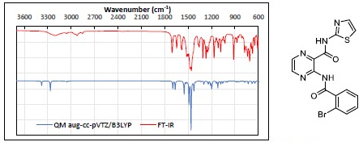
Previous work I
Inhibitors of MtMetAP1
(mycobacterial methionine aminopeptidase 1)
Synthesis and biological evaluation
(collaboration with University of Ljubljana)
Docking and QM studies:
Juhas, M., et al. Bioorg Chem, 2022. DOI: 10.1016/j.bioorg.2021.105489

Slide 6
Previous work II
AntiTB Inhibitors of MtFabH
(mycobacterial β-ketoacyl-acyl carrier protein synthetase III)
Synthesis and biological evaluation
Docking and MD studies:
Juhas, M., et al. Pharmaceuticals , 2022. DOI: 10.3390/ph15050580.

Slide 7

Previous work III
Inhibitors of HsProRS
(human prolyl t-RNA synthetase)
In silico stability studies using molecular dynamics
  In collaboration with KU Leuven
Pang, L.; Weeks, S. D.; Juhas, M.; et al. Int J Mol Sci, 2021. DOI: 10.3390/ijms22157793

