Slide 1


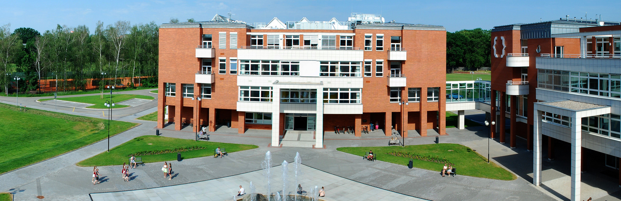
RNDr. Miroslav Psotka, PhD.

Slide 2
Position + scope of work
Postdoc:
University of Hradec Kralove – Faculty of Science – Department of Chemistry
Scientist/Organic Chemist:
syntheses of biological active natural compounds
used by patients with Alzheimer disease or urinary incontinence
from the group of insecticides; radioprotective agents; anticancer agents
Scientific Results on Web of Science (2014-present):
- 11 publications; 1 as a first author and 10 as a co-author; 4×Q1; 4×Q2; 3×Q3
- h-index = 5

Slide 3
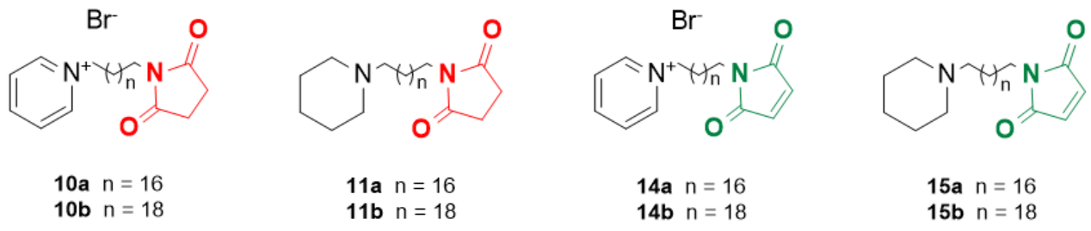
Publication from my labwork:
1.) Gorecki L., Andrys R., Schmidt M., Kucera T., Psotka M., Svobodova B., Hrabcova V., Hepnarova V., Bzonek P., Jun D., Kuca K., Korabecny J. a Musilek K. (2019):
Cysteine-targeted insecticides against A. Gambiae acetylcholinesterase are neither selective nor reversible inhibitors, ACS Med. Chem. Lett., 11:1, 65-71.
Insecticides:
a.) additives used in agriculture for protecting the plants from “bad” flies that may attack the plant in all growth stages => may damage all season harvest
b.) one of the major tools used for insect (in this article mosquito; Anopheles gambiae) elimination and/or prevention of the spread of vector-borne diseases (malaria mentioned in this paper)
a.) 8 compounds with a succinimide or maleimide moiety prepared
b.) syntheses deeply described
c.) evaluation as cysteine targeted insecticides.

Slide 4
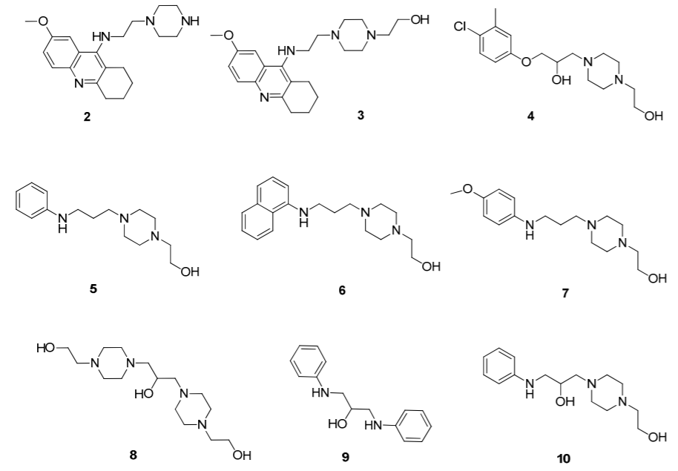
2.) Filipova A., Marek J., Havelek R., Pejchal J., Jelicova M., Cizkova J., Majorosova M., Muckova L., Kucera T., Prchal L., Psotka M., Zivna N., Koutova D., Sinkorova Z., Rezacova M. A Tichy A. (2020):
Substituted piperazines as novel potential radioprotective agents, Molecules, 25:3, 532-548.
risk of radiation exposure underlines the need for novel radioprotective agents
9 novel 1-(2-hydroxyethyl)piperazine derivatives 2-10 designed and synthesized

Slide 5
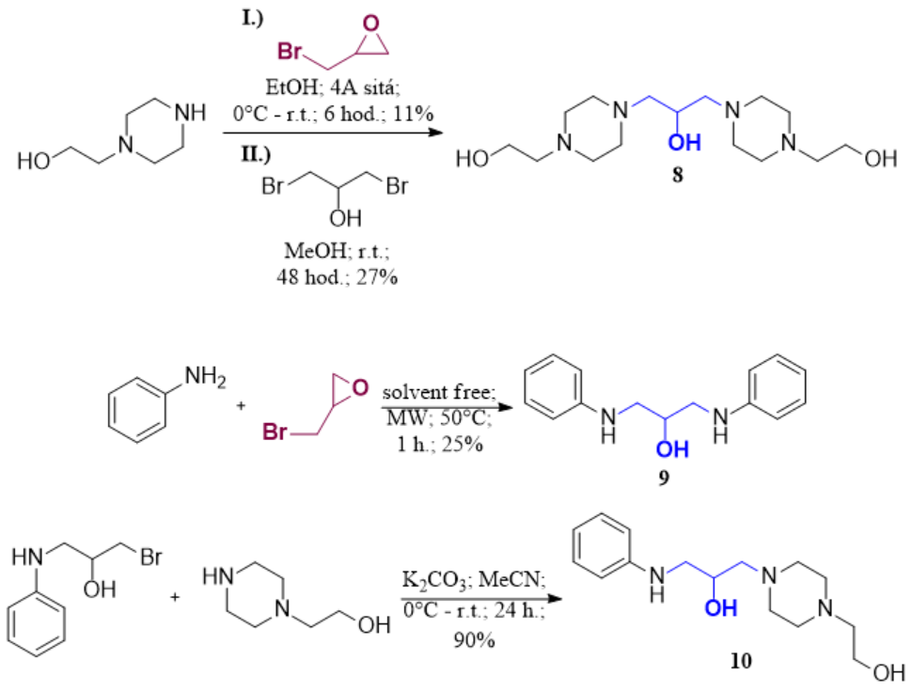
My work:
preparation of compounds 8-10 with –CH₂-CHOH-CH₂- linker using epibromohydrin as a starting compound
8 and 9 - symmetric molecules - side products in synthesis of compound 10
- towards the previous series of piperazine derivatives, compound 8 exhibited a radioprotective effect on cell survival in vitro and low toxicity in vivo
enhanced the survival of mice 30 days after whole-body irradiation
=> in vitro and in vivo data indicate that some of our compounds are valuable for further research as potential radioprotectors.

Slide 6
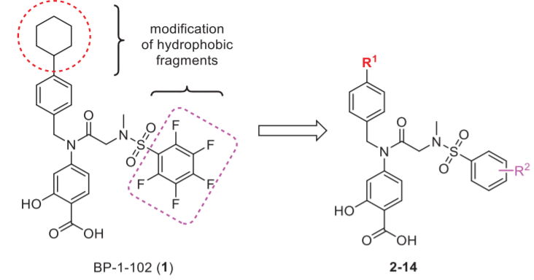
3.) Psotka, M.; Olekšák, P.; Vancurová, M.; Sapega, O.; Bieblová, J.; Reinis, M.; Rysanek, D.; Mikysková, R.; Chalupová, K.; Maliňák, D.; Svobodová, J.; Andrýs, R.; Řehulková, H.; Škopek, V.; Pham, N., L.; Bartek, J.; Hodný, Z.; Musílek, K. (2021):
Design, synthesis and in vitro evaluation of BP-1-102 analogs with modified hydrophobic fragments for STAT3 inhibition, J. Enzyme Inhib. Med. Chem., 36:1,
410-424.
- 12 novel analogs 3-14 of STAT3 inhibitor BP-1-102 (1) designed and synthesised
modified hydrophobic fragments important for interaction with the STAT3
SH2 domain and for effective cytotoxic activity
apoptosis and inhibition of STAT3 receptor-mediated phosphorylation confirmed for all analogs 3-14

Slide 7
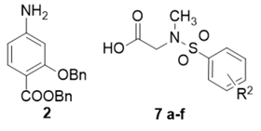
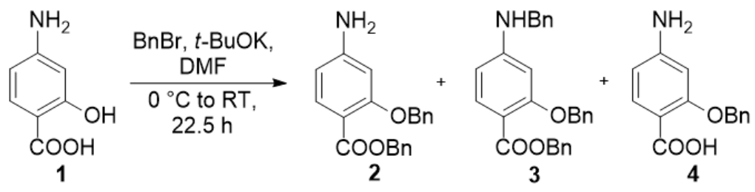
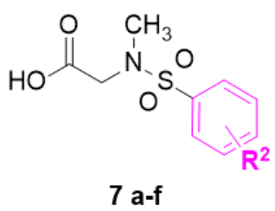
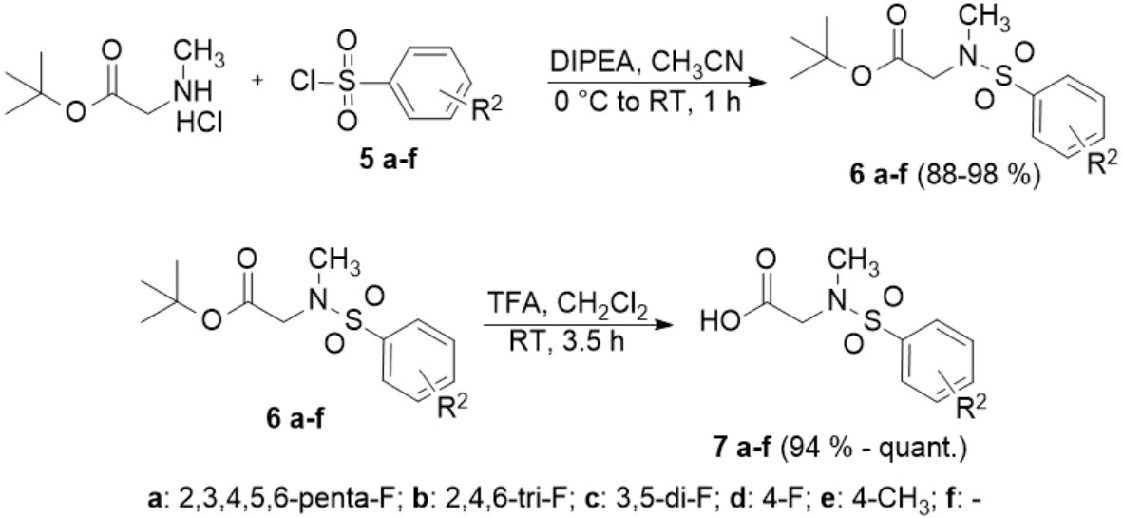
My work:
preparation of two main building blocks 2 and 7 a-f
1.) 2 prepared by benzylation of 4-amino salycilic acid (p-amino salycilic acid) (1)
- tribenzylated product 3 (side product) used in next steps
- monobenzylated product 4 (side product) used in another benzylation to get 2 and 3
2.) 7 a-f = 6 acids prepared in two steps differ in aromatic ring part

