Slide 1


Development of novel SFC/MS methods for the analysis of metabolites
RNDr. Oleksandr Kozlov, PhD.

Slide 2
Aim of postdoctoral project
The aim of the postdoctoral project is the development of new ultrahigh-performance supercritical fluid chromatography (UHPSFC) coupled to mass spectrometry (MS) methods for the analysis of both lipophilic and hydrophilic metabolites in biological samples.

Slide 3
UHPSFC/MS analysis of lipids
SFC usually employs CO₂-based mobile phases with certain portions (1–50%, v/v) of a polar organic co-solvent (methanol, isopropanol).
Ultrahigh-performance SFC – using of columns with sub–2 μm particles.
Lipids are a wide group of important metabolites that are involved in a wide range of functions in living organisms.
Lipid species can be used as biomarkers of serious diseases, including cancer.
Mass spectrometry (MS) is a key analytical technique for the detection and identification of lipids.
In general, UHPSFC separates lipids according to their polarity into lipid classes.

Slide 4
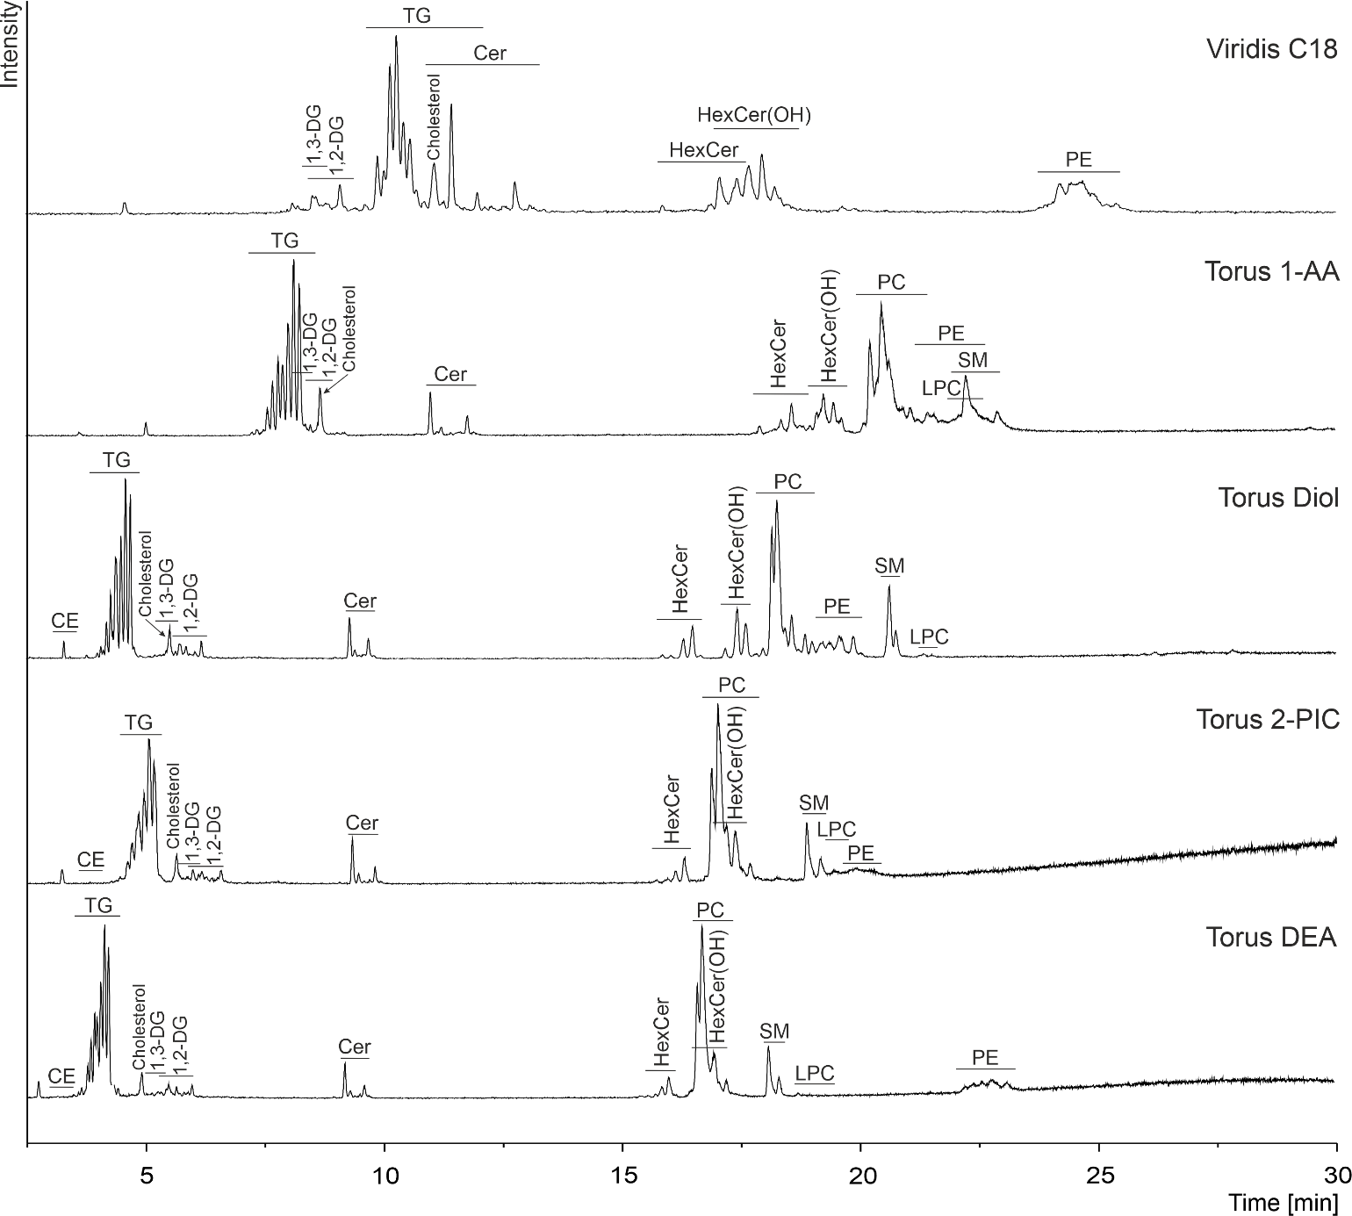
UHPSFC intraclass separation of lipids
Peak annotation:
CE – cholesteryl esters;
DG – diacylglycerols;
TG – triacylglycerols;
Cer – ceramides;
HexCer – hexosylceramides;
PE – phosphatidylethanolamines;
PC – phosphatidylcholines;
SM – sphingomyelins;
LPC – lysophosphatidylcholines.

Slide 5
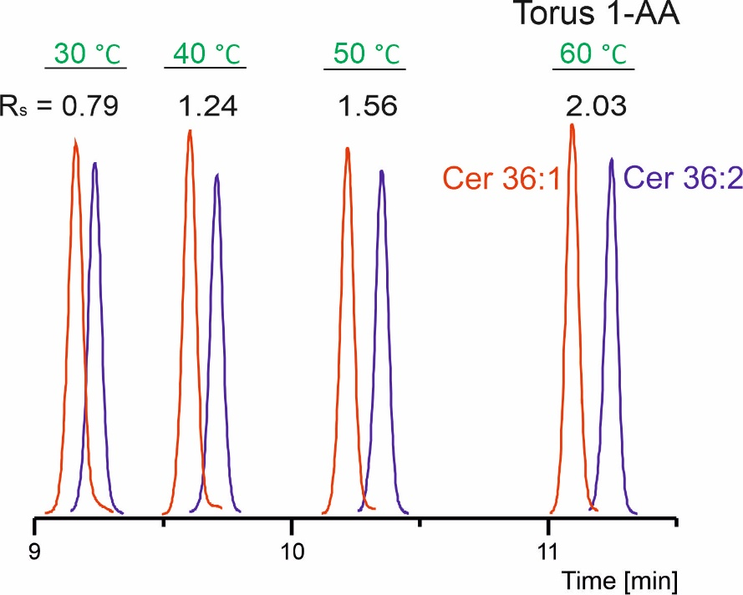
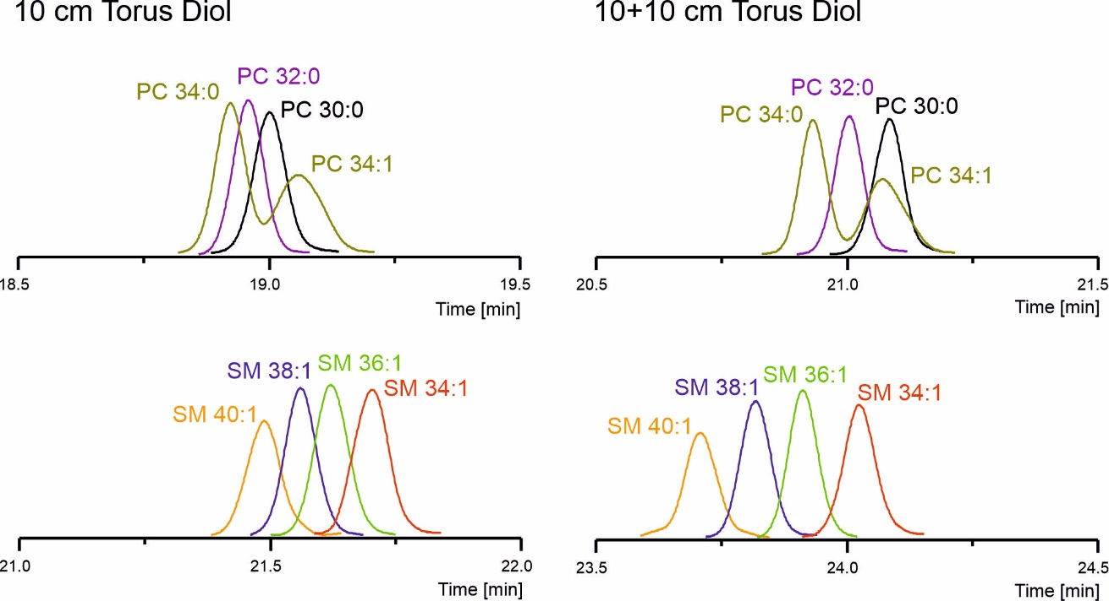
UHPSFC intraclass separation of lipids
The effects of mobile phase composition and gradient, flow rate, back pressure, temperature, and column coupling were evaluated in detail.
Influence of temperature:
Column coupling:

Slide 6
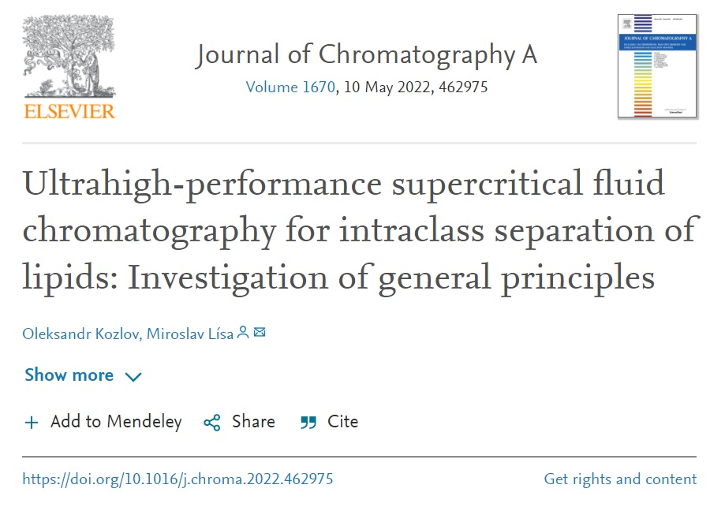
UHPSFC intraclass separation of lipids
Conclusions:
UHPSFC intraclass separation of lipids was achieved according to the acyl chain composition together with preserved interclass selectivity.
The nature of the stationary phase was the main factor influencing intraclass separations of lipids.
The Torus Diol and Torus 1-AA columns showed the best results.
The column temperature and column
coupling had the prominent effect on
the separation of lipids.
Separation of selected
regioisomers and isobaric species
was achieved in some cases.

Slide 7
Future directions
Development and optimization of UHPSFC/MS method for the analysis of polar metabolites in biological samples.

