Slide 1


Development of mTOR inhibitors for delayed onset and treatment of age-related diseases
RNDr. Patrik Olekšák, PhD.

Slide 2

GENERAL INFORMATION AND DEFINITIONS REGARDING AGING AND AGE-RELATED DISEASES
Aging and age-related diseases
Aging is a natural and inevitable process present in all living organisms.
As individuals advance in years, their bodies undergo a series of complex physiological changes that can impact their overall health and well-being.
These conditions, often referred to as geriatric or senescent diseases, are characterized by their tendency to manifest or worsen with advancing age.
One of the most significant and universal aspects of aging is an increased susceptibility to age-related diseases.
Li, Z.; Zhang, Z.; Ren, Y.; Wang, Y.; Fang, J.; Yue, H.; Ma, S.; Guan, F. Aging and Age‐related Diseases: From Mechanisms to Therapeutic Strategies. Biogerontology 2021, 22, 165–187, doi:10.1007/s10522-021-09910-5.

Slide 3
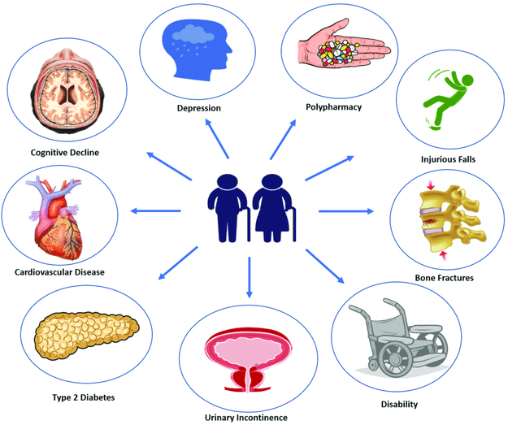
GENERAL INFORMATION AND DEFINITIONS REGARDING AGING AND AGE-RELATED DISEASES
Aging and age-related diseases
Term age-related disease includes various
undesirable health conditions such as:
  neurodegenerative diseases
  (Alzheimer's disease, Parkinson's disease)
  carcinogenic diseases
  (breast, prostate, colon cancer, etc.)
  cardiovascular disease
  (stroke, heart attack, hypertension, etc.)
  osteoarthritis
  type 2 diabetes
  cataracts
  hearing loss
  other diseases and conditions
Smith, G.S.; Breakstone, H.; Dean, L.T.; Thorpe, R.J. Impacts of Gentrification on Health in the US: A Systematic Review of the Literature. Journal of Urban Health 2020, 97, 845–856, doi:10.1007/s11524-020-00448-4.
Longo, M.; Bellastella, G.; Maiorino, M.I.; Meier, J.J.; Esposito, K.; Giugliano D. Diabetes and Aging: From Treatment Goals to Pharmacologic Therapy. Frontiers in Endocrinology 2019, 10, article 45, doi:10.3389/fendo.2019.00045.

Slide 4
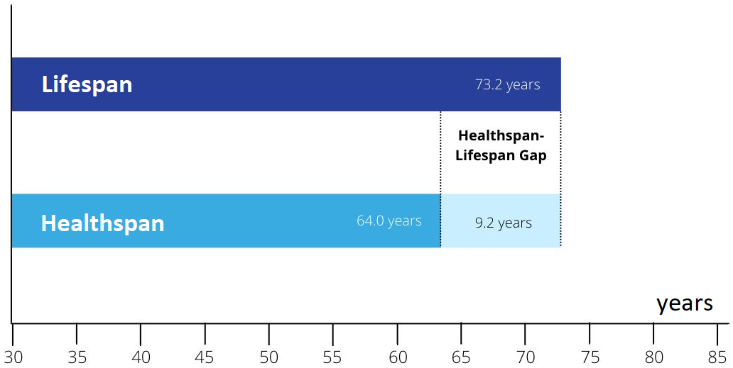
GENERAL INFORMATION AND DEFINITIONS REGARDING AGING AND AGE-RELATED DISEASES
Lifespan and healthspan
Lifespan is defined as the number of years someone lives from birth until death.
Healthspan represents the number of years someone is healthy without chronic and debilitating disease.
Garmany, A.; Yamada, S.; Terzic, A. Longevity leap: mind the healthspan gap. NPJ Regenerative Medicine 2021, 6, 57, 1-7, doi:10.1038/s41536-021-00169-5.

Slide 5
AGING AND AGE-RELATED DISEASES
In general, accumulation of damage and other deleterious changes associated with aging in organisms, humans included, are considered as irreversible. However, in this context several important notes have to be mentioned:
Firstly, the lifespan of several organisms is significantly longer, if compared to the lifespan of humans (Mesocentrotus franciscanus, 100‒200 years; Somniosus microcephalus, >270 years).
Secondly, there are several rare animal species and genera (Turritopsis dohrnii; Hydra) that are referred as "biologically immortal". However, this term is often used incorrectly and may refer to exceptional longevity, regenerative abilities, or other traits that give the impression of prolonged lifespan.
Thirdly, several recently-reported animal studies on aging suggest that the process of aging can be not only slowed down but also reversed.
Debes, C.; Papadakis, A.; Gronke, S.; Karalay, O.; Tain, L.S.; Mizi, A.; Nakamura, S.; Hahn, O.; Weigelt, C.; Josipovic, N.; Zirkel, A.; Brusius, I.; Sofiadis, K.; Lamprousi, M.; Lu, Y.X.; Huang, W.; Esmaillie, R.; Kubacki, T.; Spath, M.R.; Schermer, B.; Benzing, T.; Muller, R.U.; Antebi, A.; Partridge, L.; Papantonis, A.; Beyer, A. Ageing-associated changes in transcriptional elongation influence longevity. Nature 2023, 616, 814-821, doi:10.1038/s41586-023-05922-y.

Slide 6
AGING AND AGE-RELATED DISEASES
Is it possible to live longer and healthier?
Based on previously-mentioned notes, there is an important question that must be answered:
Are we able to extend our lifespan and healthspan?
Fortunately, the answer is simple:
YES! And we already did it!
Over the last 200 years, life expectancy in most of the developed countries has doubled!
This success has been achieved as a complex interplay of advancements in medicine and sanitation coupled with new modes of familial, social, economic, and political organization.
Kinsella, K.; Velkoff, V.A. Life expectancy and changing mortality. Aging Clinical and Experimental Research 2002, 14, 5, 322-332, doi:10.1007/bf03324458.

Slide 7
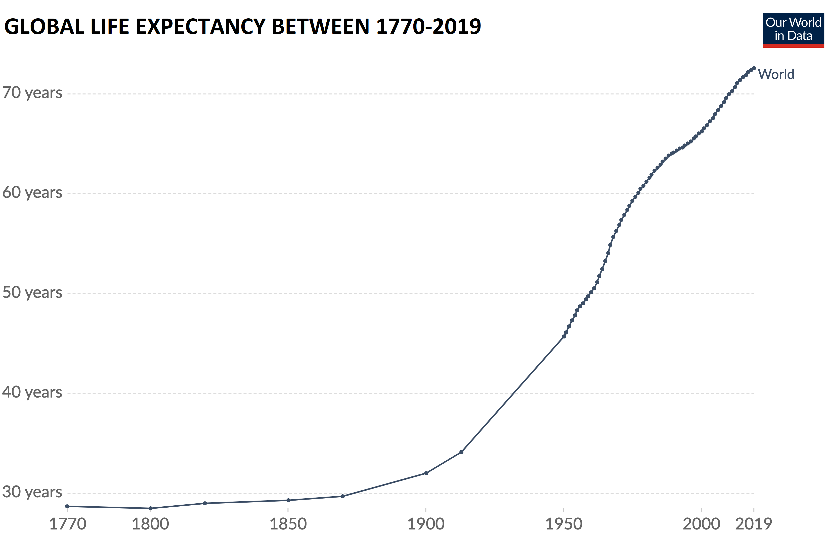
AGING AND AGE-RELATED DISEASES
Our World In Data, Life expectancy 2019. URL: https://ourworldindata.org/life-expectancy (accessed: 7th February 2024).

Slide 8
AGING AND AGE-RELATED DISEASES
Current approach of medicine
Direct disease-targeting therapies to improve undesired health condition of patient represent a classical medicinal approach, which can be described as "one treatment to overcome one disease".
The main goal of this approach is an improvement of acute health condition; the secondary outcome is indirect improvement of healthspan and lifespan of the patient.
Novel approach of medicine
Direct longevity-targeting therapies to maintain and prolong desired health condition of patient represent a novel medicinal approach, which can be described as "one treatment to prevent multiple age-related diseases".
The main goal of this approach is to prolong both, healthspan and lifespan; the secondary outcome is a delayed onset and reduced risk of various age-related complications.
Luo, J.; Mills, K.; le Cessie, S.; Noordam, R.; van Heemst, D. Ageing, age-related diseases and oxidative stress: What to do next?. Ageing Research Reviews 2020, 57, 100982, doi:10.1016/j.arr.2019.100982.

Slide 9
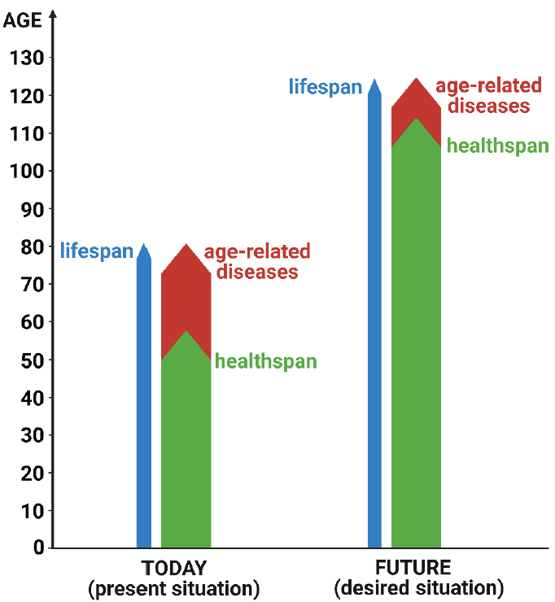
AGING AND AGE-RELATED DISEASES
Targeting of aging
Direct targeting of aging may not only increase the lifespan itself, but significantly increase the healthspan as well.
In addition to health benefits, this effect can further have positive implications for the economy, such as increased workforce productivity or reduced healthcare costs.
Based on findings of the study reported in 2021, humans may be able to live for 120‒150 years. Moreover, data suggest that the period of age-related diseases should be significantly reduced.
Pyrkov, T.V.; Avchaciov, K.; Tarkhov, A.E.; Menshikov, L.I.; Gudkov, A.V.; Fedichev, P.O. Longitudinal analysis of blood markers reveals progressive loss of resilience and predicts human lifespan limit. Nature Communications 2021, 12, 2765, doi:10.1038/s41467-021-23014-1.

Slide 10
AGING AND AGE-RELATED DISEASES
How to target aging and age-related diseases?
Targeting aging and age-related diseases is a complex and multifaceted challeng.
However, one of the key cellular protein kinase that has been implicated in many of the processes associated with aging, including cellular senescence, immune responses, cell stem regulation, autophagy, mitochondrial function, and protein homeostasis is mechanistic target of rapamycin (mTOR).
In higher eukaryotes mTOR is a protein that forms two distinct complexes: mTOR complex 1 (mTORC1) and 2 (mTORC2).
The both complexes, mTORC1 and mTORC2, differ functionally and structurally and in their sensitivity to rapamycin, a natural product isolated in 1972 from Streptomyces hygroscopicus.
Papadopoli, D.; Boulay, K.; Kazak, L.; Pollak, M.; Mallette, F.A.; Topisirovic, I.; Hulea L. mTOR as a central regulator of lifespan and aging. F1000Research 2019, 8, 998, doi:10.12688/f1000research.17196.1.

Slide 11
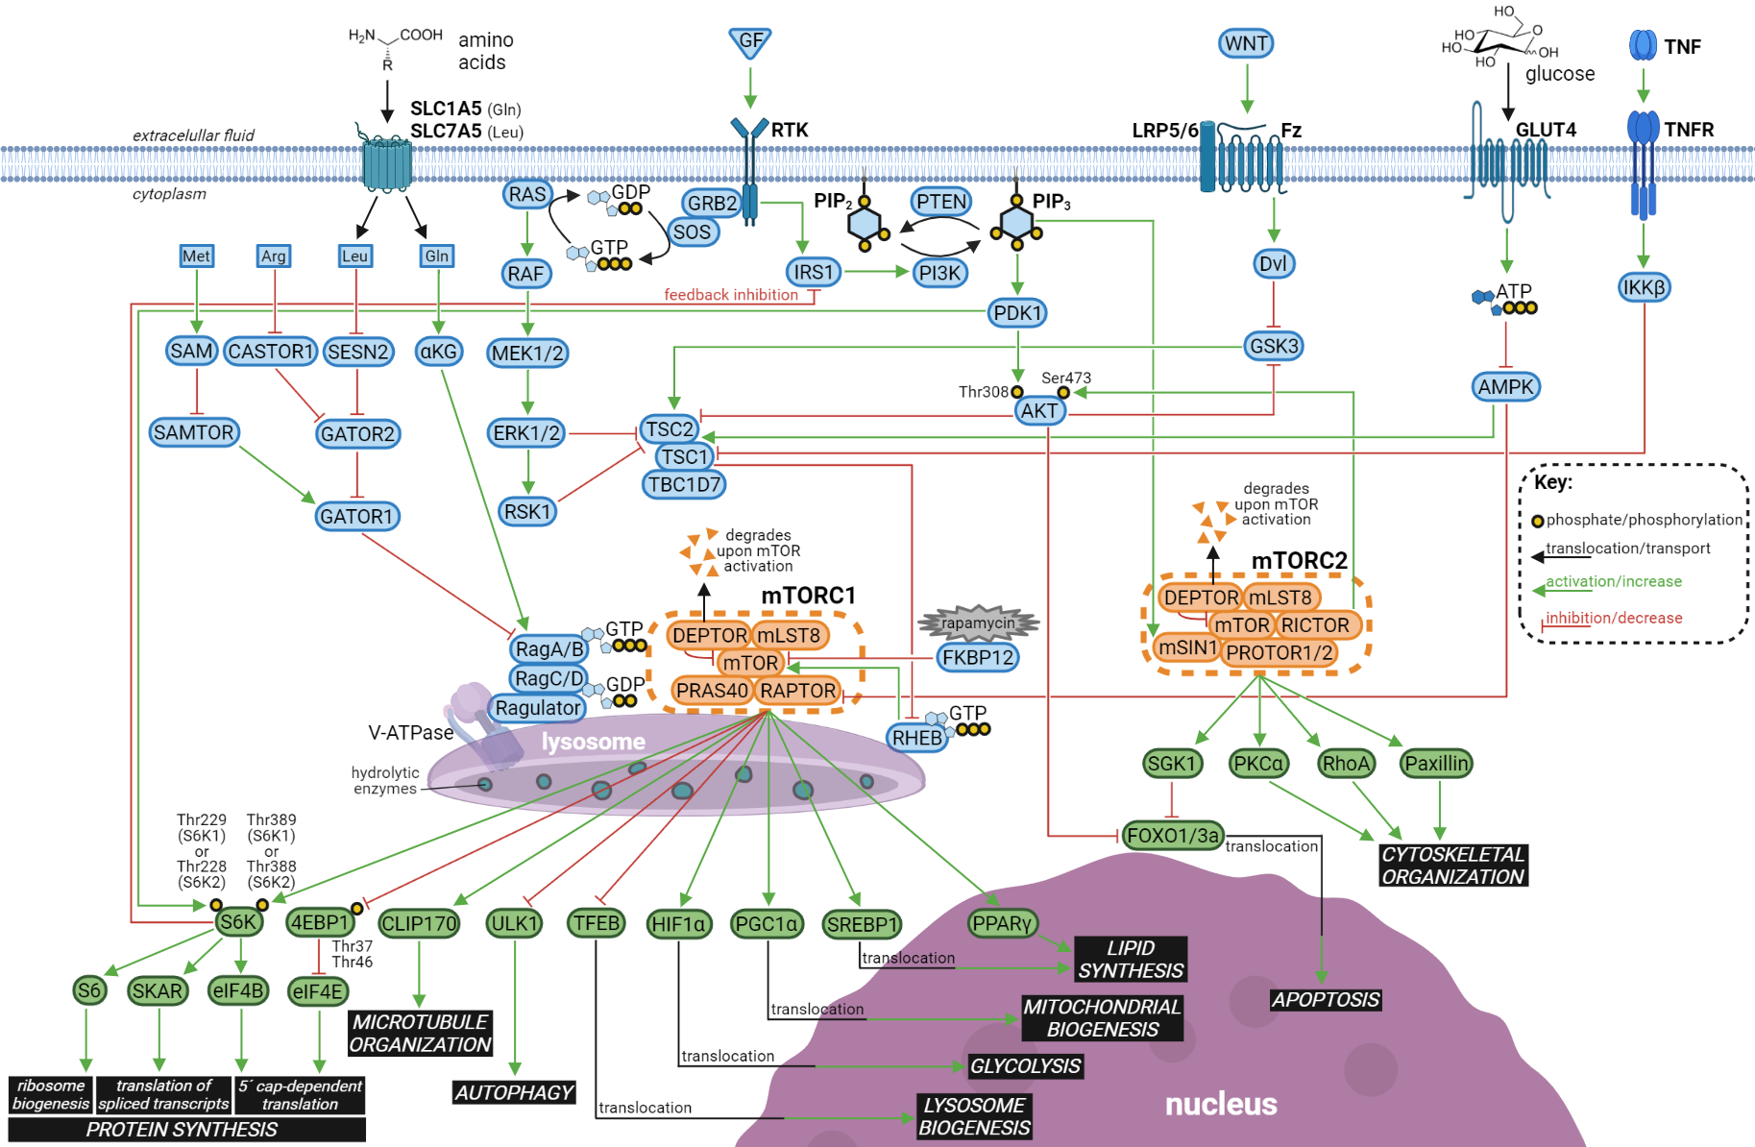
mTOR AND ITS ROLE IN AGING AND AGE-RELATED DISEASES
mTOR signaling pathway
The mTOR, as a subunit of mTORC1 and mTORC2, represents one of the key components of the mTOR signaling pathway.
The pathway involves at least 254 components mutually connected via at least 478 linkages.
The pathway regulates various essential functions in cell.
Oleksak, P.; Nepovimova, E.; Chrienova, Z.; Musilek, K.; Patocka, J.; Kuca, K. Contemporary mTOR inhibitor scaffolds to diseases breakdown: A patent review (2015-2021). European Journal of Medicinal Chemistry 2022, 238, 114498, doi: 10.1016/j.ejmech.2022.114498.

Slide 12
mTOR AND ITS ROLE IN AGING AND AGE-RELATED DISEASES
mTOR inhibitors as therapeutics
Overactivated mTOR is associated with pathogenesis and age-related diseases such as neurodegenerative diseases, cancer, obesity, type 2 diabetes mellitus, and other.
Therefore, inhibitors of mTOR have are considered as potential therapeutics against these diseases as well as in delaying of aging.
Indeed, several mTOR inhibitors, such as rapamycin, everolimus, and temsirolimus are approved for clinical use.
Moreover, nowadays there are numerous types of mTOR inhibitors, usually clustered in three different generations, on the basis of their mode of action.
Oleksak, P.; Nepovimova, E.; Chrienova, Z.; Musilek, K.; Patocka, J.; Kuca, K. Contemporary mTOR inhibitor scaffolds to diseases breakdown: A patent review (2015-2021). European Journal of Medicinal Chemistry 2022, 238, 114498, doi: 10.1016/j.ejmech.2022.114498.

Slide 13
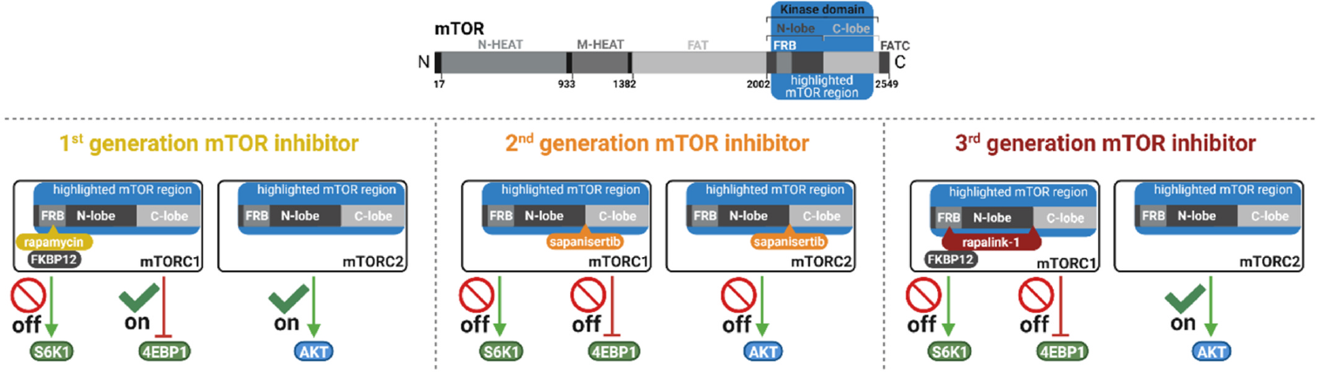
mTOR INHIBITORS
Three generations of mTOR inhibitors
Different mode of action of three generations of mTOR inhibitors.
Oleksak, P.; Nepovimova, E.; Chrienova, Z.; Musilek, K.; Patocka, J.; Kuca, K. Contemporary mTOR inhibitor scaffolds to diseases breakdown: A patent review (2015-2021). European Journal of Medicinal Chemistry 2022, 238, 114498, doi: 10.1016/j.ejmech.2022.114498.

Slide 14
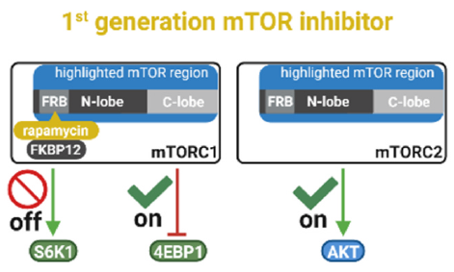
mTOR INHIBITORS
The first generation of mTOR inhibitors
The first generation of mTOR inhibitors represents the oldest class of mTOR inhibitors.
These inhibitors include rapamycin and its analogs, therefore this class of inhibitors is also known as "rapalogs".
Rapalogs are structurally complicated macrolides that involve several stereocenters.
Mode of action is based on formation of FKBP12-rapalog complex which interacts with FRB domain of mTOR.
The first generation of mTOR inhibitors selectively inhibits mTORC1 while activity of mTORC2 is unaffected during acute inhibition, however reduced upon chronic inhibition.
Oleksak, P.; Nepovimova, E.; Chrienova, Z.; Musilek, K.; Patocka, J.; Kuca, K. Contemporary mTOR inhibitor scaffolds to diseases breakdown: A patent review (2015-2021). European Journal of Medicinal Chemistry 2022, 238, 114498, doi: 10.1016/j.ejmech.2022.114498.

Slide 15
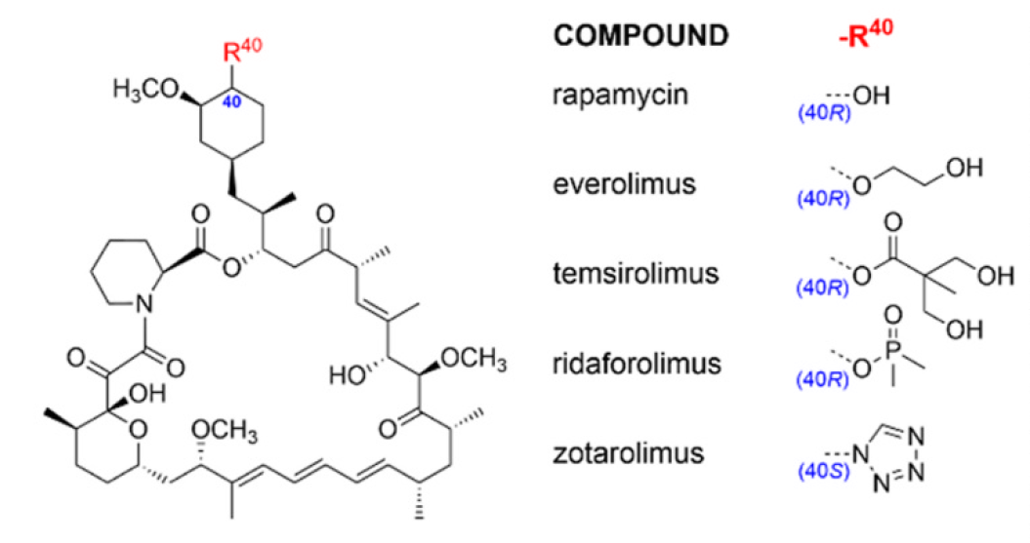
mTOR INHIBITORS
The first generation of mTOR inhibitors
Structures of notable rapalogs, representants of the first generation of mTOR inhibitors.
Oleksak, P.; Nepovimova, E.; Chrienova, Z.; Musilek, K.; Patocka, J.; Kuca, K. Contemporary mTOR inhibitor scaffolds to diseases breakdown: A patent review (2015-2021). European Journal of Medicinal Chemistry 2022, 238, 114498, doi: 10.1016/j.ejmech.2022.114498.

Slide 16
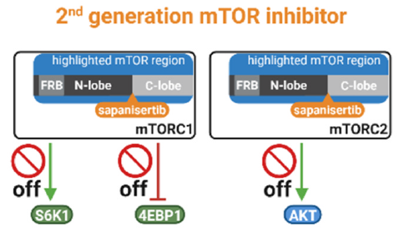
mTOR INHIBITORS
The second generation of mTOR inhibitors
The second generation of mTOR inhibitors is structurally the most variable class of inhibitors.
These compounds are commonly represented by small-molecule that target ATP-binding site localized at kinase domain of mTOR protein.
Inhibitors belonging to the second generation reduce activity of both, mTORC1 as well as mTORC2.
These inhibitors can be easily prepared and modified.
Oleksak, P.; Nepovimova, E.; Chrienova, Z.; Musilek, K.; Patocka, J.; Kuca, K. Contemporary mTOR inhibitor scaffolds to diseases breakdown: A patent review (2015-2021). European Journal of Medicinal Chemistry 2022, 238, 114498, doi: 10.1016/j.ejmech.2022.114498.

Slide 17
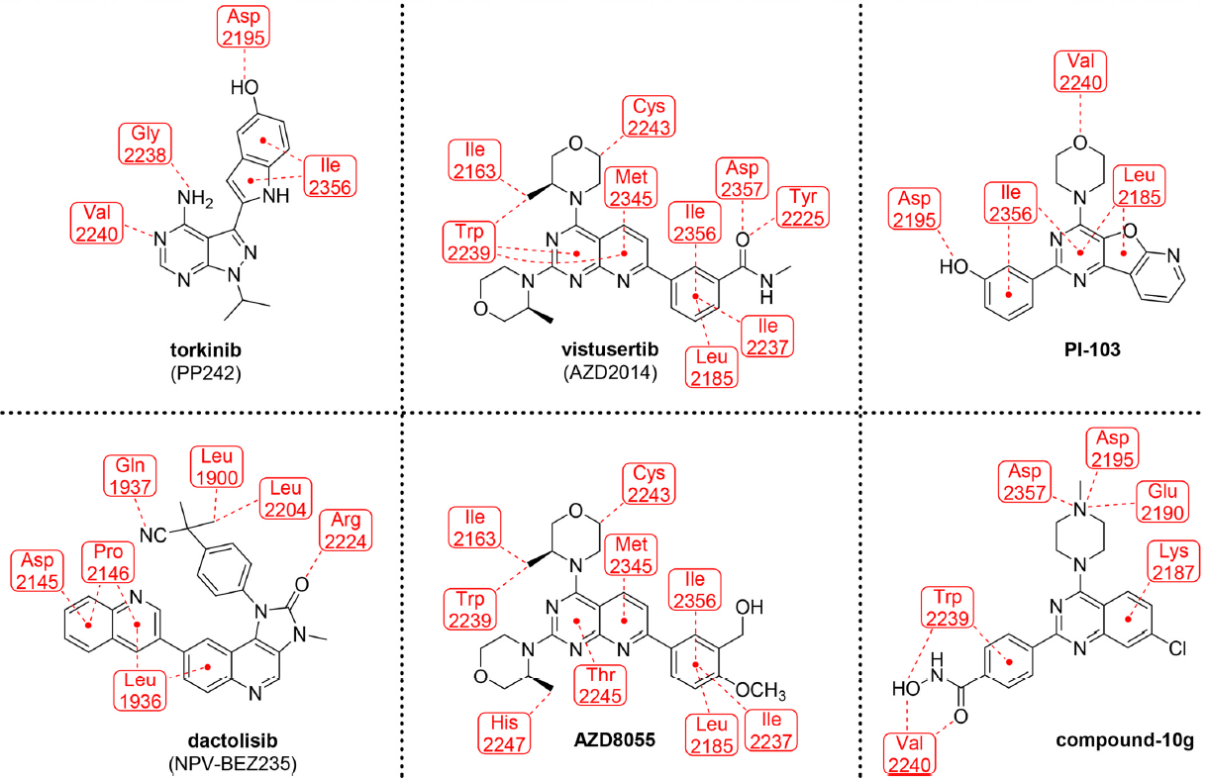
mTOR INHIBITORS
The second generation of mTOR inhibitors
Examples of the second generation mTOR inhibitors with their binding interactions to kinase domain of mTOR.
Oleksak, P.; Nepovimova, E.; Chrienova, Z.; Musilek, K.; Patocka, J.; Kuca, K. Contemporary mTOR inhibitor scaffolds to diseases breakdown: A patent review (2015-2021). European Journal of Medicinal Chemistry 2022, 238, 114498, doi: 10.1016/j.ejmech.2022.114498.

Slide 18
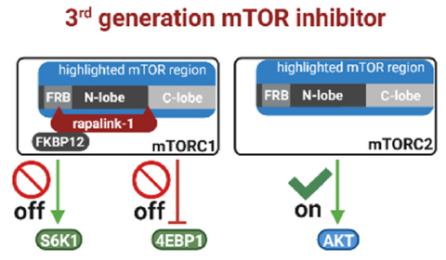
mTOR INHIBITORS
The third generation of mTOR inhibitors
In addition to first and second generation of mTOR inhibitors, third generation of inhibitors has been developed.
Third generation of mTOR inhibitor combines scaffolds of the both previous generations of mTOR inhibitors.
General structure of the third generation representant consists of rapalog, a first generation mTOR inhibitor, which is connected via linker of different length and motif with inhibitor of mTOR kinase, a second generation mTOR inhibitor.
Therefore, representants of the third generation are commonly termed as "rapalinks".
Oleksak, P.; Nepovimova, E.; Chrienova, Z.; Musilek, K.; Patocka, J.; Kuca, K. Contemporary mTOR inhibitor scaffolds to diseases breakdown: A patent review (2015-2021). European Journal of Medicinal Chemistry 2022, 238, 114498, doi: 10.1016/j.ejmech.2022.114498.

Slide 19
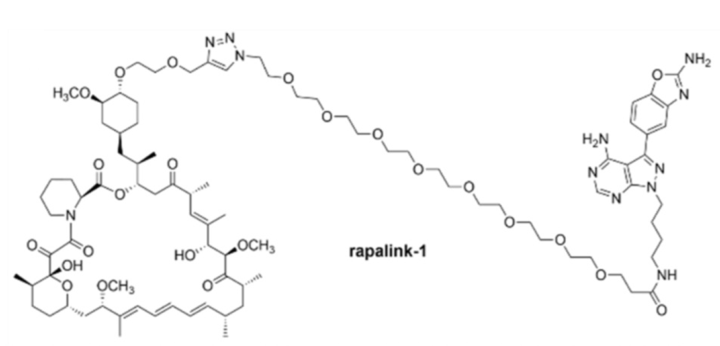
mTOR INHIBITORS
The third generation of mTOR inhibitors
Structure of rapalink-1, a representant of the third generation of mTOR inhibitors.
Oleksak, P.; Nepovimova, E.; Chrienova, Z.; Musilek, K.; Patocka, J.; Kuca, K. Contemporary mTOR inhibitor scaffolds to diseases breakdown: A patent review (2015-2021). European Journal of Medicinal Chemistry 2022, 238, 114498, doi: 10.1016/j.ejmech.2022.114498.

Slide 20
mTOR INHIBITORS
Indirect mTOR inhibitors
It's important to note that in addition to direct mTOR inhibitors (classified into three generations) there is a huge number of indirect mTOR inhibitors acting on other components of the mTOR signaling pathway. Several examples of indirect mTOR inhibitors involve:
  Metformin, a commonly prescribed medication for type 2 diabetes, is known to activate AMPK. By doing so, it indirectly inhibits mTOR and influences cellular energy balance.
  Resveratrol, found in red wine and certain fruits, has been studied for its potential to modulate mTOR signaling indirectly.
  Sulforaphane, found in cruciferous vegetables like broccoli, can activate the nuclear factor erythroid 2–related factor 2 (Nrf2) pathway, which may indirectly impact mTOR signaling.
Oleksak, P.; Nepovimova, E.; Chrienova, Z.; Musilek, K.; Patocka, J.; Kuca, K. Contemporary mTOR inhibitor scaffolds to diseases breakdown: A patent review (2015-2021). European Journal of Medicinal Chemistry 2022, 238, 114498, doi: 10.1016/j.ejmech.2022.114498.

Slide 21
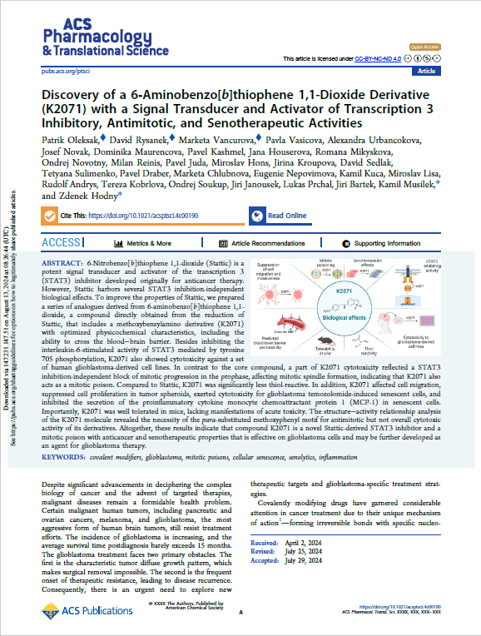
RESULTS no. 1
Discovery of K2071
Aging is a primary risk factor for age-related diseases, including cancer.
Both cancer and various age-related diseases are associated with
dysregulation of cellular processes and signaling pathways.
As mentioned above, hyperactivated mTOR is linked with pathologic
conditions, therefore its inhibition is considered as suitable therapeutic strategy.
This strategy involves direct mTOR inhibitors as well as indirect mTOR inhibitors that act in upstream or downstream mTOR signaling.
Oleksak, P.; Rysanek, D.; Vancurova, M.; Vasicova, P.; Urbancokova, A.; Novak, J.; Maurencova, D.; Kashmel, P.; Houserova, J.; Mikyskova, R.; Novotny, O.; Reinis, M.; Juda, P.; Hons, M.; Kroupova, J.; Sedlak, D.; Sulimenko, T.; Draber, P.; Chlubnova, M.; Nepovimova, E.; Kuca, K.; Lisa, M.; Andrys, R.; Kobrlova, T.; Soukup, O.; Janousek, J.; Prchal, L.; Bartek, J.; Musilek, K.; Hodny, Z. Discovery of a 6‑Aminobenzo[b]thiophene 1,1-Dioxide Derivative (K2071) with a Signal Transducer and Activator of Transcription 3 Inhibitory, Antimitotic, and Senotherapeutic Activities. ACS Pharmacology & Translational Science 2024, 7, 9, 2755-2783, doi: 10.1021/acsptsci.4c00190.

Slide 22
RESULTS no. 1
Discovery of K2071
Signal transducer and activator of transcription 3 (STAT3) is a transcription
factor that belongs to the signal transducer and activator of transcription (STAT)
protein family.
A STAT3 signaling pathway is functionally involved in most hallmarks of
cancer, as defined by including tumor cell proliferation, tumor-promoting
inflammation, tumor cell invasion and metastasis, angiogenesis, resistance
to cell death, and deregulation of cancer cell energetics.
It is important to note that there is a complex connection between mTOR and STAT3 that involves a bidirectional interactions.
Oleksak, P.; Rysanek, D.; Vancurova, M.; Vasicova, P.; Urbancokova, A.; Novak, J.; Maurencova, D.; Kashmel, P.; Houserova, J.; Mikyskova, R.; Novotny, O.; Reinis, M.; Juda, P.; Hons, M.; Kroupova, J.; Sedlak, D.; Sulimenko, T.; Draber, P.; Chlubnova, M.; Nepovimova, E.; Kuca, K.; Lisa, M.; Andrys, R.; Kobrlova, T.; Soukup, O.; Janousek, J.; Prchal, L.; Bartek, J.; Musilek, K.; Hodny, Z. Discovery of a 6‑Aminobenzo[b]thiophene 1,1-Dioxide Derivative (K2071) with a Signal Transducer and Activator of Transcription 3 Inhibitory, Antimitotic, and Senotherapeutic Activities. ACS Pharmacology & Translational Science 2024, 7, 9, 2755-2783, doi: 10.1021/acsptsci.4c00190.

Slide 23
RESULTS no. 1
Discovery of K2071
mTOR's influence on STAT3:
  Phosphorylation of STAT3: mTOR can directly phosphorylate STAT3,
  a crucial step for activating STAT3 and allowing it to enter
  the nucleus to regulate gene expression.
  Upregulation of STAT3: mTOR signaling can increase the
  production of STAT3 protein, further enhancing STAT3 activity.
Oleksak, P.; Rysanek, D.; Vancurova, M.; Vasicova, P.; Urbancokova, A.; Novak, J.; Maurencova, D.; Kashmel, P.; Houserova, J.; Mikyskova, R.; Novotny, O.; Reinis, M.; Juda, P.; Hons, M.; Kroupova, J.; Sedlak, D.; Sulimenko, T.; Draber, P.; Chlubnova, M.; Nepovimova, E.; Kuca, K.; Lisa, M.; Andrys, R.; Kobrlova, T.; Soukup, O.; Janousek, J.; Prchal, L.; Bartek, J.; Musilek, K.; Hodny, Z. Discovery of a 6‑Aminobenzo[b]thiophene 1,1-Dioxide Derivative (K2071) with a Signal Transducer and Activator of Transcription 3 Inhibitory, Antimitotic, and Senotherapeutic Activities. ACS Pharmacology & Translational Science 2024, 7, 9, 2755-2783, doi: 10.1021/acsptsci.4c00190.

Slide 24
RESULTS no. 1
Discovery of K2071
STAT3's Influence on mTOR:
  Regulation of mTOR components: STAT3 can regulate the expression
  of genes involved in the mTOR pathway, including those encoding
  proteins that make up the mTOR complex. This can influence
  mTOR activity.
  Feedback loops: STAT3 can participate in feedback loops that either positively or negatively regulate mTOR signaling, depending on the cellular context.
Oleksak, P.; Rysanek, D.; Vancurova, M.; Vasicova, P.; Urbancokova, A.; Novak, J.; Maurencova, D.; Kashmel, P.; Houserova, J.; Mikyskova, R.; Novotny, O.; Reinis, M.; Juda, P.; Hons, M.; Kroupova, J.; Sedlak, D.; Sulimenko, T.; Draber, P.; Chlubnova, M.; Nepovimova, E.; Kuca, K.; Lisa, M.; Andrys, R.; Kobrlova, T.; Soukup, O.; Janousek, J.; Prchal, L.; Bartek, J.; Musilek, K.; Hodny, Z. Discovery of a 6‑Aminobenzo[b]thiophene 1,1-Dioxide Derivative (K2071) with a Signal Transducer and Activator of Transcription 3 Inhibitory, Antimitotic, and Senotherapeutic Activities. ACS Pharmacology & Translational Science 2024, 7, 9, 2755-2783, doi: 10.1021/acsptsci.4c00190.

Slide 25
RESULTS no. 1
Discovery of K2071
The interplay between STAT3 and mTOR plays a critical role in various
cellular processes, including:
  Cell Growth and Proliferation: Both STAT3 and mTOR promote cell
  growth and division, and their interaction amplifies these effects.
  Metabolism: Both pathways regulate metabolic processes, and their
  coordinated activity ensures efficient energy production and utilization.
  Immune Response: Both STAT3 and mTOR are involved in immune cell activation and function, and their interaction fine-tunes immune responses.
Oleksak, P.; Rysanek, D.; Vancurova, M.; Vasicova, P.; Urbancokova, A.; Novak, J.; Maurencova, D.; Kashmel, P.; Houserova, J.; Mikyskova, R.; Novotny, O.; Reinis, M.; Juda, P.; Hons, M.; Kroupova, J.; Sedlak, D.; Sulimenko, T.; Draber, P.; Chlubnova, M.; Nepovimova, E.; Kuca, K.; Lisa, M.; Andrys, R.; Kobrlova, T.; Soukup, O.; Janousek, J.; Prchal, L.; Bartek, J.; Musilek, K.; Hodny, Z. Discovery of a 6‑Aminobenzo[b]thiophene 1,1-Dioxide Derivative (K2071) with a Signal Transducer and Activator of Transcription 3 Inhibitory, Antimitotic, and Senotherapeutic Activities. ACS Pharmacology & Translational Science 2024, 7, 9, 2755-2783, doi: 10.1021/acsptsci.4c00190.

Slide 26
RESULTS no. 1
Discovery of K2071
Although several STAT3 inhibitors are known, they also come with potential
disadvantages such as lack of specificity, toxicity, development
of resistance, immunosuppression, and other.
In our study, we modified a known STAT3 inhibitor,
6-nitrobenzo[b]thiophene 1,1-dioxide (stattic), to a series of novel
6-aminobenzo[b]thiophene 1,1-dioxide derivatives.
Synthesis of novel derivatives consists of various reaction types that are summarized in following slides.
Oleksak, P.; Rysanek, D.; Vancurova, M.; Vasicova, P.; Urbancokova, A.; Novak, J.; Maurencova, D.; Kashmel, P.; Houserova, J.; Mikyskova, R.; Novotny, O.; Reinis, M.; Juda, P.; Hons, M.; Kroupova, J.; Sedlak, D.; Sulimenko, T.; Draber, P.; Chlubnova, M.; Nepovimova, E.; Kuca, K.; Lisa, M.; Andrys, R.; Kobrlova, T.; Soukup, O.; Janousek, J.; Prchal, L.; Bartek, J.; Musilek, K.; Hodny, Z. Discovery of a 6‑Aminobenzo[b]thiophene 1,1-Dioxide Derivative (K2071) with a Signal Transducer and Activator of Transcription 3 Inhibitory, Antimitotic, and Senotherapeutic Activities. ACS Pharmacology & Translational Science 2024, 7, 9, 2755-2783, doi: 10.1021/acsptsci.4c00190.

Slide 27
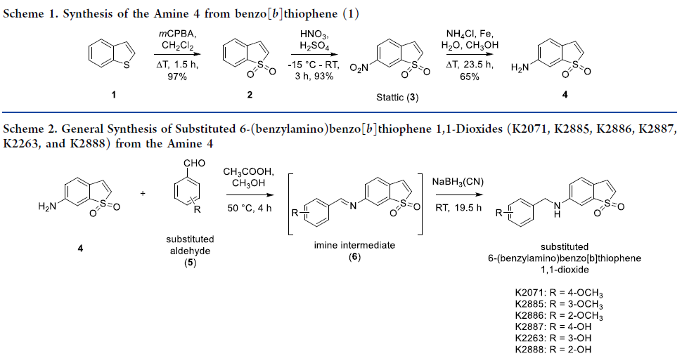
RESULTS no. 1
Discovery of K2071
Oleksak, P.; Rysanek, D.; Vancurova, M.; Vasicova, P.; Urbancokova, A.; Novak, J.; Maurencova, D.; Kashmel, P.; Houserova, J.; Mikyskova, R.; Novotny, O.; Reinis, M.; Juda, P.; Hons, M.; Kroupova, J.; Sedlak, D.; Sulimenko, T.; Draber, P.; Chlubnova, M.; Nepovimova, E.; Kuca, K.; Lisa, M.; Andrys, R.; Kobrlova, T.; Soukup, O.; Janousek, J.; Prchal, L.; Bartek, J.; Musilek, K.; Hodny, Z. Discovery of a 6‑Aminobenzo[b]thiophene 1,1-Dioxide Derivative (K2071) with a Signal Transducer and Activator of Transcription 3 Inhibitory, Antimitotic, and Senotherapeutic Activities. ACS Pharmacology & Translational Science 2024, 7, 9, 2755-2783, doi: 10.1021/acsptsci.4c00190.

Slide 28
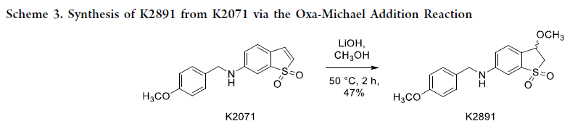
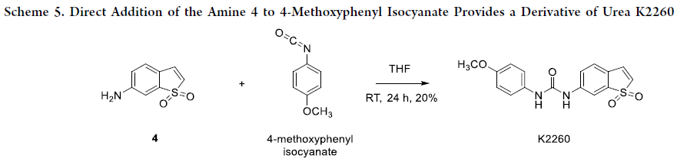
RESULTS no. 1
Discovery of K2071
Oleksak, P.; Rysanek, D.; Vancurova, M.; Vasicova, P.; Urbancokova, A.; Novak, J.; Maurencova, D.; Kashmel, P.; Houserova, J.; Mikyskova, R.; Novotny, O.; Reinis, M.; Juda, P.; Hons, M.; Kroupova, J.; Sedlak, D.; Sulimenko, T.; Draber, P.; Chlubnova, M.; Nepovimova, E.; Kuca, K.; Lisa, M.; Andrys, R.; Kobrlova, T.; Soukup, O.; Janousek, J.; Prchal, L.; Bartek, J.; Musilek, K.; Hodny, Z. Discovery of a 6‑Aminobenzo[b]thiophene 1,1-Dioxide Derivative (K2071) with a Signal Transducer and Activator of Transcription 3 Inhibitory, Antimitotic, and Senotherapeutic Activities. ACS Pharmacology & Translational Science 2024, 7, 9, 2755-2783, doi: 10.1021/acsptsci.4c00190.

Slide 29
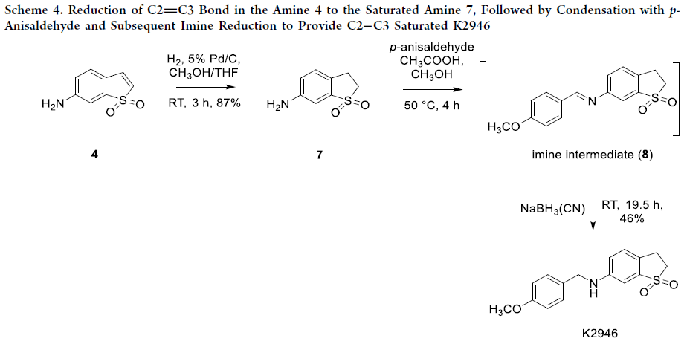
RESULTS no. 1
Discovery of K2071
Oleksak, P.; Rysanek, D.; Vancurova, M.; Vasicova, P.; Urbancokova, A.; Novak, J.; Maurencova, D.; Kashmel, P.; Houserova, J.; Mikyskova, R.; Novotny, O.; Reinis, M.; Juda, P.; Hons, M.; Kroupova, J.; Sedlak, D.; Sulimenko, T.; Draber, P.; Chlubnova, M.; Nepovimova, E.; Kuca, K.; Lisa, M.; Andrys, R.; Kobrlova, T.; Soukup, O.; Janousek, J.; Prchal, L.; Bartek, J.; Musilek, K.; Hodny, Z. Discovery of a 6‑Aminobenzo[b]thiophene 1,1-Dioxide Derivative (K2071) with a Signal Transducer and Activator of Transcription 3 Inhibitory, Antimitotic, and Senotherapeutic Activities. ACS Pharmacology & Translational Science 2024, 7, 9, 2755-2783, doi: 10.1021/acsptsci.4c00190.

Slide 30
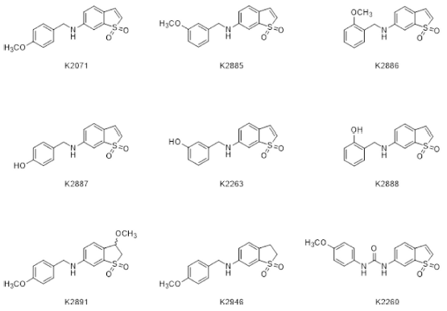
RESULTS no. 1
Discovery of K2071
Summary of novel prepared inhibitors
Oleksak, P.; Rysanek, D.; Vancurova, M.; Vasicova, P.; Urbancokova, A.; Novak, J.; Maurencova, D.; Kashmel, P.; Houserova, J.; Mikyskova, R.; Novotny, O.; Reinis, M.; Juda, P.; Hons, M.; Kroupova, J.; Sedlak, D.; Sulimenko, T.; Draber, P.; Chlubnova, M.; Nepovimova, E.; Kuca, K.; Lisa, M.; Andrys, R.; Kobrlova, T.; Soukup, O.; Janousek, J.; Prchal, L.; Bartek, J.; Musilek, K.; Hodny, Z. Discovery of a 6‑Aminobenzo[b]thiophene 1,1-Dioxide Derivative (K2071) with a Signal Transducer and Activator of Transcription 3 Inhibitory, Antimitotic, and Senotherapeutic Activities. ACS Pharmacology & Translational Science 2024, 7, 9, 2755-2783, doi: 10.1021/acsptsci.4c00190.

Slide 31
RESULTS no. 1
Discovery of K2071
One of the novel prepared inhibitors,
6-[(4′-methoxybenzyl)amino]benzo[b]thiophene 1,1-dioxide (K2071)
with optimized physicochemical characteristics, including the ability
to cross the blood−brain barrier (BBB) also showed cytotoxicity
against a set of human glioblastoma-derived cell lines.
In contrast to the core compound, a part of K2071 cytotoxicity reflected
a STAT3 inhibition-independent block of mitotic progression in the prophase,
affecting mitotic spindle formation, indicating that K2071 also acts as a mitotic poison.
Oleksak, P.; Rysanek, D.; Vancurova, M.; Vasicova, P.; Urbancokova, A.; Novak, J.; Maurencova, D.; Kashmel, P.; Houserova, J.; Mikyskova, R.; Novotny, O.; Reinis, M.; Juda, P.; Hons, M.; Kroupova, J.; Sedlak, D.; Sulimenko, T.; Draber, P.; Chlubnova, M.; Nepovimova, E.; Kuca, K.; Lisa, M.; Andrys, R.; Kobrlova, T.; Soukup, O.; Janousek, J.; Prchal, L.; Bartek, J.; Musilek, K.; Hodny, Z. Discovery of a 6‑Aminobenzo[b]thiophene 1,1-Dioxide Derivative (K2071) with a Signal Transducer and Activator of Transcription 3 Inhibitory, Antimitotic, and Senotherapeutic Activities. ACS Pharmacology & Translational Science 2024, 7, 9, 2755-2783, doi: 10.1021/acsptsci.4c00190.

Slide 32
RESULTS no. 1
Discovery of K2071
Compared to Stattic, K2071 was significantly less thiol-reactive.
In addition, K2071 affected cell migration, suppressed cell proliferation
in tumor spheroids, exerted cytotoxicity for glioblastoma
temozolomide-induced senescent cells, and inhibited
the secretion of the proinflammatory cytokine
monocyte chemoattractant protein 1 (MCP-1) in senescent cells.
Importantly, K2071 was well tolerated in mice, lacking manifestations of acute toxicity.
Oleksak, P.; Rysanek, D.; Vancurova, M.; Vasicova, P.; Urbancokova, A.; Novak, J.; Maurencova, D.; Kashmel, P.; Houserova, J.; Mikyskova, R.; Novotny, O.; Reinis, M.; Juda, P.; Hons, M.; Kroupova, J.; Sedlak, D.; Sulimenko, T.; Draber, P.; Chlubnova, M.; Nepovimova, E.; Kuca, K.; Lisa, M.; Andrys, R.; Kobrlova, T.; Soukup, O.; Janousek, J.; Prchal, L.; Bartek, J.; Musilek, K.; Hodny, Z. Discovery of a 6‑Aminobenzo[b]thiophene 1,1-Dioxide Derivative (K2071) with a Signal Transducer and Activator of Transcription 3 Inhibitory, Antimitotic, and Senotherapeutic Activities. ACS Pharmacology & Translational Science 2024, 7, 9, 2755-2783, doi: 10.1021/acsptsci.4c00190.

Slide 33
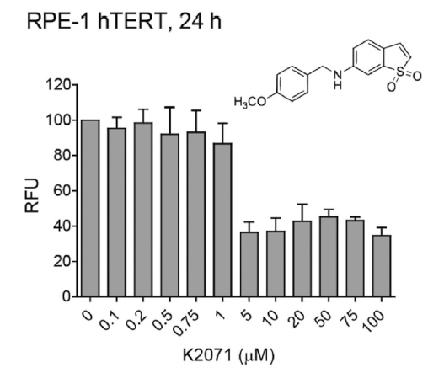
RESULTS no. 1
Discovery of K2071
Oleksak, P.; Rysanek, D.; Vancurova, M.; Vasicova, P.; Urbancokova, A.; Novak, J.; Maurencova, D.; Kashmel, P.; Houserova, J.; Mikyskova, R.; Novotny, O.; Reinis, M.; Juda, P.; Hons, M.; Kroupova, J.; Sedlak, D.; Sulimenko, T.; Draber, P.; Chlubnova, M.; Nepovimova, E.; Kuca, K.; Lisa, M.; Andrys, R.; Kobrlova, T.; Soukup, O.; Janousek, J.; Prchal, L.; Bartek, J.; Musilek, K.; Hodny, Z. Discovery of a 6‑Aminobenzo[b]thiophene 1,1-Dioxide Derivative (K2071) with a Signal Transducer and Activator of Transcription 3 Inhibitory, Antimitotic, and Senotherapeutic Activities. ACS Pharmacology & Translational Science 2024, 7, 9, 2755-2783, doi: 10.1021/acsptsci.4c00190.

Slide 34
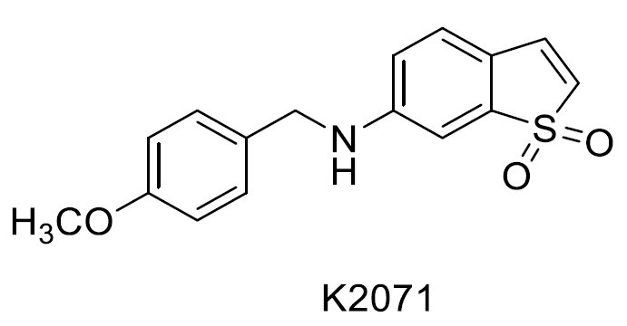
RESULTS no. 1
Discovery of K2071
In conclusion, K2071 harbors antimitotic activity arresting cells in prophase
by altering mitotic spindle formation, resulting in cell death in
nontransformed cells or mitotic slippage and developing senescent-like
phenotype in cancer cells.
Oleksak, P.; Rysanek, D.; Vancurova, M.; Vasicova, P.; Urbancokova, A.; Novak, J.; Maurencova, D.; Kashmel, P.; Houserova, J.; Mikyskova, R.; Novotny, O.; Reinis, M.; Juda, P.; Hons, M.; Kroupova, J.; Sedlak, D.; Sulimenko, T.; Draber, P.; Chlubnova, M.; Nepovimova, E.; Kuca, K.; Lisa, M.; Andrys, R.; Kobrlova, T.; Soukup, O.; Janousek, J.; Prchal, L.; Bartek, J.; Musilek, K.; Hodny, Z. Discovery of a 6‑Aminobenzo[b]thiophene 1,1-Dioxide Derivative (K2071) with a Signal Transducer and Activator of Transcription 3 Inhibitory, Antimitotic, and Senotherapeutic Activities. ACS Pharmacology & Translational Science 2024, 7, 9, 2755-2783, doi: 10.1021/acsptsci.4c00190.

Slide 35
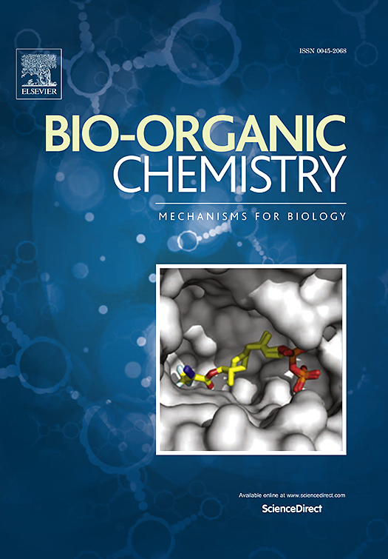
RESULTS no. 2
The structure-activity relationship study of torkinib derivatives
Torkinib, is a selective and potent inhibitor of the mammalian target of rapamycin (mTOR). It has garnered significant interest in research due to its distinct mechanism of action compared to older mTOR inhibitors like rapamycin.
Unlike rapamycin, which acts as an allosteric inhibitor primarily affecting mTORC1 by binding to the FKBP12-rapamycin binding (FRB) domain of mTOR, torkinib is an ATP-competitive inhibitor. This means it directly binds to the ATP-binding site within the catalytic domain of mTOR.
Oleksak, P.; Rysanek, D.; Vancurova, M.; Novak, J.; Maurencova, D.; Rousarova, E.; Capek, J.; Rousar, T.; Vales, K.; Skopek, V.; Maslowska, M. J.; Gumauskaite, K.; Stankus, G.; Kuca, K.; Andrys, R.; Skarka, A.; Lisa, M.; Fresser, L.; Surovcova, S.; Chrienova, Z.; Popr, M.; Nepovimova, E.; Hodny, Z. The structure-activity relationship study of torkinib derivatives as mTOR inhibitors with senolytic and signal transducer and activator of transcription 3 inhibitory activities. Bioorganic Chemistry 2026, 176, 109868, doi: 10.1016/j.bioorg.2026.109868.

Slide 36
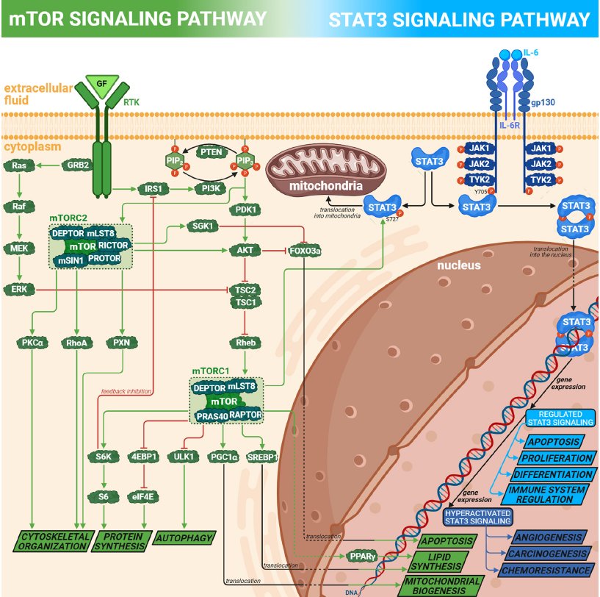
RESULTS no. 2
The structure-activity relationship study of torkinib derivatives
Simplified scheme of signaling:
  mTOR (green)
  STAT3 (blue)
  and their interconnection.
Oleksak, P.; Rysanek, D.; Vancurova, M.; Novak, J.; Maurencova, D.; Rousarova, E.; Capek, J.; Rousar, T.; Vales, K.; Skopek, V.; Maslowska, M. J.; Gumauskaite, K.; Stankus, G.; Kuca, K.; Andrys, R.; Skarka, A.; Lisa, M.; Fresser, L.; Surovcova, S.; Chrienova, Z.; Popr, M.; Nepovimova, E.; Hodny, Z. The structure-activity relationship study of torkinib derivatives as mTOR inhibitors with senolytic and signal transducer and activator of transcription 3 inhibitory activities. Bioorganic Chemistry 2026, 176, 109868, doi: 10.1016/j.bioorg.2026.109868.

Slide 37
RESULTS no. 2
The structure-activity relationship study of torkinib derivatives
Torkinib, a member of second-generation mTOR inhibitors, has been reported that in vitro inhibits mTOR with a half-maximal inhibitory concentration (IC₅₀) value of 8 nM.
In our study, we synthesized and evaluated 10 torkinib derivatives (4b-k) as potential mTOR inhibitors. These novel compounds underwent comprehensive in vitro investigation with aim to determine their potential in age-related diseases.
Oleksak, P.; Rysanek, D.; Vancurova, M.; Novak, J.; Maurencova, D.; Rousarova, E.; Capek, J.; Rousar, T.; Vales, K.; Skopek, V.; Maslowska, M. J.; Gumauskaite, K.; Stankus, G.; Kuca, K.; Andrys, R.; Skarka, A.; Lisa, M.; Fresser, L.; Surovcova, S.; Chrienova, Z.; Popr, M.; Nepovimova, E.; Hodny, Z. The structure-activity relationship study of torkinib derivatives as mTOR inhibitors with senolytic and signal transducer and activator of transcription 3 inhibitory activities. Bioorganic Chemistry 2026, 176, 109868, doi: 10.1016/j.bioorg.2026.109868.

Slide 38
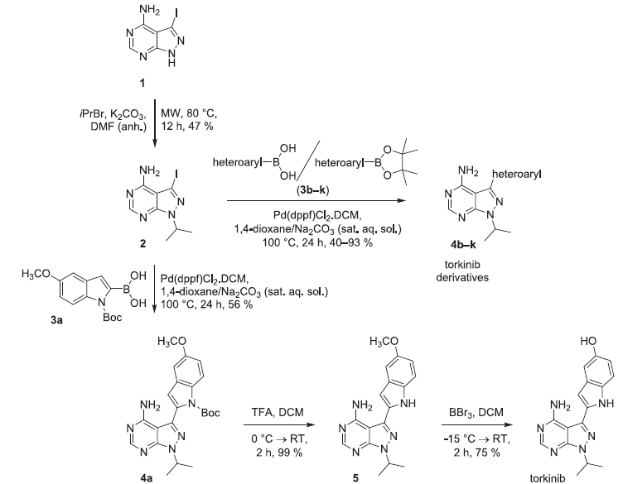
RESULTS no. 2
The structure-activity relationship study of torkinib derivatives
Synthetic conditions for preparation of torkinib and general condition for the synthesis of torkinib derivatives (4b–k).
Abbreviations: anh., anhydrous; h,
hour(s); MW, microwave; RT, room temperature; sat. aq. sol., saturated aqueous solution.
Oleksak, P.; Rysanek, D.; Vancurova, M.; Novak, J.; Maurencova, D.; Rousarova, E.; Capek, J.; Rousar, T.; Vales, K.; Skopek, V.; Maslowska, M. J.; Gumauskaite, K.; Stankus, G.; Kuca, K.; Andrys, R.; Skarka, A.; Lisa, M.; Fresser, L.; Surovcova, S.; Chrienova, Z.; Popr, M.; Nepovimova, E.; Hodny, Z. The structure-activity relationship study of torkinib derivatives as mTOR inhibitors with senolytic and signal transducer and activator of transcription 3 inhibitory activities. Bioorganic Chemistry 2026, 176, 109868, doi: 10.1016/j.bioorg.2026.109868.

Slide 39
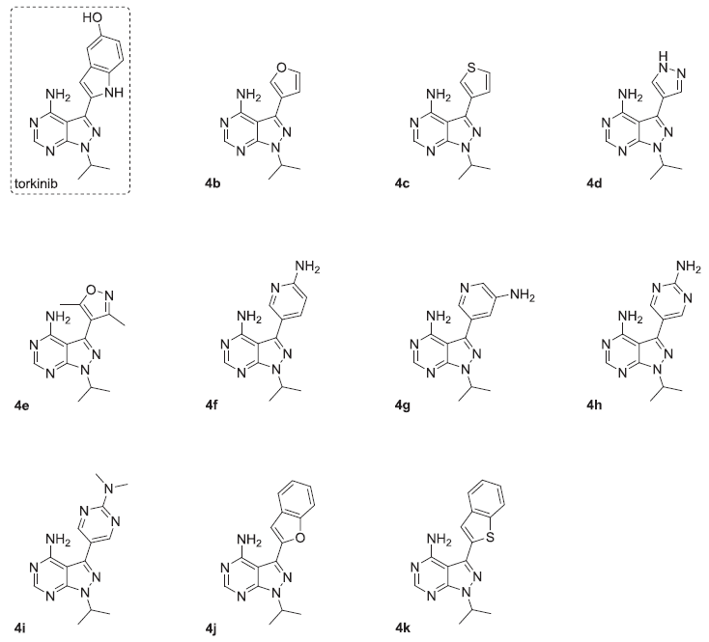
RESULTS no. 2
The structure-activity relationship study of torkinib derivatives
Comprehensive summarization of synthesized torkinib derivatives (4b–k) with the structure of torkinib (dashed rectangle), used as a standard.
Oleksak, P.; Rysanek, D.; Vancurova, M.; Novak, J.; Maurencova, D.; Rousarova, E.; Capek, J.; Rousar, T.; Vales, K.; Skopek, V.; Maslowska, M. J.; Gumauskaite, K.; Stankus, G.; Kuca, K.; Andrys, R.; Skarka, A.; Lisa, M.; Fresser, L.; Surovcova, S.; Chrienova, Z.; Popr, M.; Nepovimova, E.; Hodny, Z. The structure-activity relationship study of torkinib derivatives as mTOR inhibitors with senolytic and signal transducer and activator of transcription 3 inhibitory activities. Bioorganic Chemistry 2026, 176, 109868, doi: 10.1016/j.bioorg.2026.109868.

Slide 40
RESULTS no. 2
The structure-activity relationship study of torkinib derivatives
Our comprehensive in vitro investigation of novel torkinib derivatives includes:
  Antiproliferative effects examined in human normal and cancer cells
  Senolytic activity of novel torkinib derivatives on human senescent cells
  Screening for inhibition of mTOR kinase activity by novel torkinib derivatives by activition of downstream targets
  Determination of inhibitory effect by mTOR activity
  mTOR inhibitory activity correlations with IL6-induced STAT3 phosphorylation inhibition
Oleksak, P.; Rysanek, D.; Vancurova, M.; Novak, J.; Maurencova, D.; Rousarova, E.; Capek, J.; Rousar, T.; Vales, K.; Skopek, V.; Maslowska, M. J.; Gumauskaite, K.; Stankus, G.; Kuca, K.; Andrys, R.; Skarka, A.; Lisa, M.; Fresser, L.; Surovcova, S.; Chrienova, Z.; Popr, M.; Nepovimova, E.; Hodny, Z. The structure-activity relationship study of torkinib derivatives as mTOR inhibitors with senolytic and signal transducer and activator of transcription 3 inhibitory activities. Bioorganic Chemistry 2026, 176, 109868, doi: 10.1016/j.bioorg.2026.109868.

Slide 41
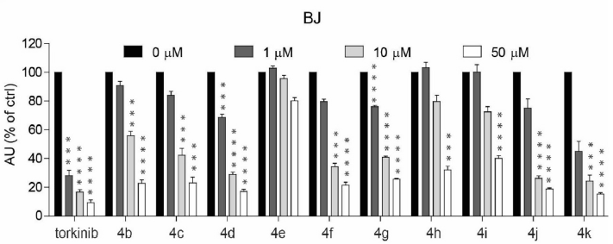
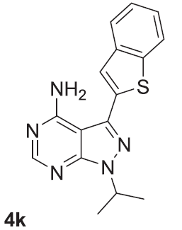
RESULTS no. 2
The structure-activity relationship study of torkinib derivatives
1) Antiproliferative effects in human normal and cancer cells
Were evaluated in different concentrations of novel derivatives on:
  a) normal human dermal fibroblasts BJ
Compound 4k showed a higher growth suppressing effect within novel derivatives.
Oleksak, P.; Rysanek, D.; Vancurova, M.; Novak, J.; Maurencova, D.; Rousarova, E.; Capek, J.; Rousar, T.; Vales, K.; Skopek, V.; Maslowska, M. J.; Gumauskaite, K.; Stankus, G.; Kuca, K.; Andrys, R.; Skarka, A.; Lisa, M.; Fresser, L.; Surovcova, S.; Chrienova, Z.; Popr, M.; Nepovimova, E.; Hodny, Z. The structure-activity relationship study of torkinib derivatives as mTOR inhibitors with senolytic and signal transducer and activator of transcription 3 inhibitory activities. Bioorganic Chemistry 2026, 176, 109868, doi: 10.1016/j.bioorg.2026.109868.

Slide 42
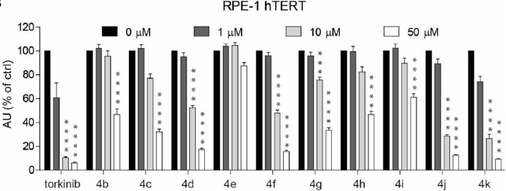
RESULTS no. 2
The structure-activity relationship study of torkinib derivatives
1) Antiproliferative effects in human normal and cancer cells
Were evaluated in different concentrations of novel derivatives on:
  b) human immortalized retinal pigment epithelium RPE-1 hTERT
Compound 4k showed a higher growth suppressing effect within novel derivatives.
Oleksak, P.; Rysanek, D.; Vancurova, M.; Novak, J.; Maurencova, D.; Rousarova, E.; Capek, J.; Rousar, T.; Vales, K.; Skopek, V.; Maslowska, M. J.; Gumauskaite, K.; Stankus, G.; Kuca, K.; Andrys, R.; Skarka, A.; Lisa, M.; Fresser, L.; Surovcova, S.; Chrienova, Z.; Popr, M.; Nepovimova, E.; Hodny, Z. The structure-activity relationship study of torkinib derivatives as mTOR inhibitors with senolytic and signal transducer and activator of transcription 3 inhibitory activities. Bioorganic Chemistry 2026, 176, 109868, doi: 10.1016/j.bioorg.2026.109868.

Slide 43
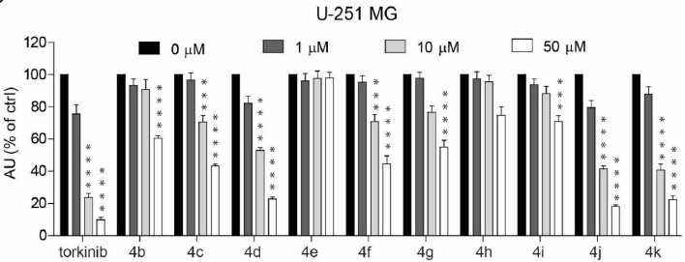
RESULTS no. 2
The structure-activity relationship study of torkinib derivatives
1) Antiproliferative effects in human normal and cancer cells
Were evaluated in different concentrations of novel derivatives on:
  c) cancerous human glioblastoma U-251 MG cells
Compound 4k showed a higher growth suppressing effect within novel derivatives.
Oleksak, P.; Rysanek, D.; Vancurova, M.; Novak, J.; Maurencova, D.; Rousarova, E.; Capek, J.; Rousar, T.; Vales, K.; Skopek, V.; Maslowska, M. J.; Gumauskaite, K.; Stankus, G.; Kuca, K.; Andrys, R.; Skarka, A.; Lisa, M.; Fresser, L.; Surovcova, S.; Chrienova, Z.; Popr, M.; Nepovimova, E.; Hodny, Z. The structure-activity relationship study of torkinib derivatives as mTOR inhibitors with senolytic and signal transducer and activator of transcription 3 inhibitory activities. Bioorganic Chemistry 2026, 176, 109868, doi: 10.1016/j.bioorg.2026.109868.

Slide 44
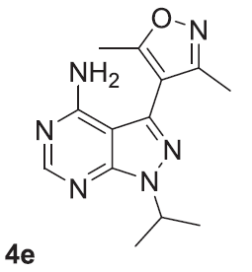
RESULTS no. 2
The structure-activity relationship study of torkinib derivatives
2) Senolytic activity of novel torkinib derivatives on human senescent cells
To examine the cytotoxicity of novel compounds against senescent cells (i.e., senolytic effect), ionizing radiation (IR)-induced cellular senescence in RPE-1 cells (IR RPE-1) and drug-induced (docetaxel) cellular senescence in BJ cells (DTX BJ) were employed.
Except for compound 4e, harboring no senolytic effect, all other substances showed cytotoxic activity on senescent cells at 10 μM concentration.
Oleksak, P.; Rysanek, D.; Vancurova, M.; Novak, J.; Maurencova, D.; Rousarova, E.; Capek, J.; Rousar, T.; Vales, K.; Skopek, V.; Maslowska, M. J.; Gumauskaite, K.; Stankus, G.; Kuca, K.; Andrys, R.; Skarka, A.; Lisa, M.; Fresser, L.; Surovcova, S.; Chrienova, Z.; Popr, M.; Nepovimova, E.; Hodny, Z. The structure-activity relationship study of torkinib derivatives as mTOR inhibitors with senolytic and signal transducer and activator of transcription 3 inhibitory activities. Bioorganic Chemistry 2026, 176, 109868, doi: 10.1016/j.bioorg.2026.109868.

Slide 45
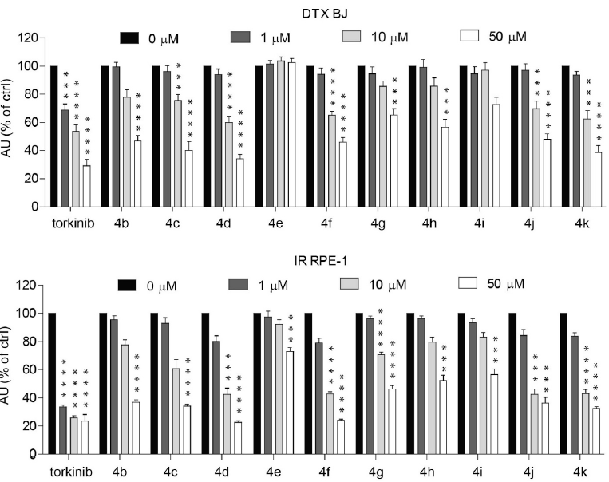
RESULTS no. 2
The structure-activity relationship study of torkinib derivatives
2) Senolytic activity of novel torkinib derivatives on human senescent cells
Senolytic effects of novel torkinib derivatives.
(TOP) Normal human dermal fibroblasts BJ - senescence induced by docetaxel (DTX BJ).
(BOTTOM) human immortalized retinal pigment epithelium RPE-1 hTERT induced to senescence by γ-radiation (IR RPE-1). Exposed to torkinib and derivatives 4b–k in the for 72 h.
Oleksak, P.; Rysanek, D.; Vancurova, M.; Novak, J.; Maurencova, D.; Rousarova, E.; Capek, J.; Rousar, T.; Vales, K.; Skopek, V.; Maslowska, M. J.; Gumauskaite, K.; Stankus, G.; Kuca, K.; Andrys, R.; Skarka, A.; Lisa, M.; Fresser, L.; Surovcova, S.; Chrienova, Z.; Popr, M.; Nepovimova, E.; Hodny, Z. The structure-activity relationship study of torkinib derivatives as mTOR inhibitors with senolytic and signal transducer and activator of transcription 3 inhibitory activities. Bioorganic Chemistry 2026, 176, 109868, doi: 10.1016/j.bioorg.2026.109868.

Slide 46
RESULTS no. 2
The structure-activity relationship study of torkinib derivatives
3) Screening for inhibition of mTOR kinase activity by novel torkinib derivatives by activition of downstream targets
Next, we determined the mTOR kinase-inhibiting activity of novel compounds by determining specific phosphorylation levels of its substrate, p70 S6 kinase (S6K), on threonine 389 by immunoblotting with specific antibodies.
The most effective compounds 4d, 4f, 4j, and 4k were compared with torkinib.
Oleksak, P.; Rysanek, D.; Vancurova, M.; Novak, J.; Maurencova, D.; Rousarova, E.; Capek, J.; Rousar, T.; Vales, K.; Skopek, V.; Maslowska, M. J.; Gumauskaite, K.; Stankus, G.; Kuca, K.; Andrys, R.; Skarka, A.; Lisa, M.; Fresser, L.; Surovcova, S.; Chrienova, Z.; Popr, M.; Nepovimova, E.; Hodny, Z. The structure-activity relationship study of torkinib derivatives as mTOR inhibitors with senolytic and signal transducer and activator of transcription 3 inhibitory activities. Bioorganic Chemistry 2026, 176, 109868, doi: 10.1016/j.bioorg.2026.109868.

Slide 47
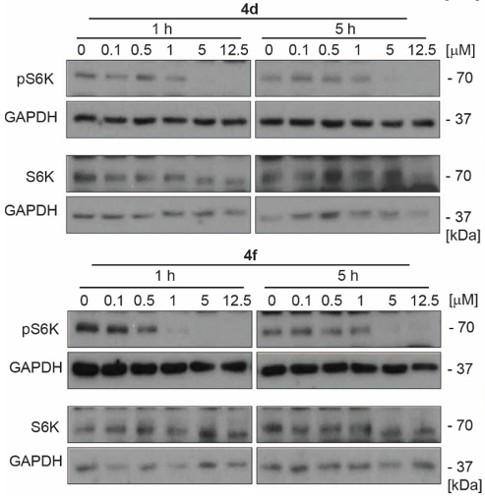
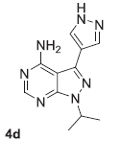
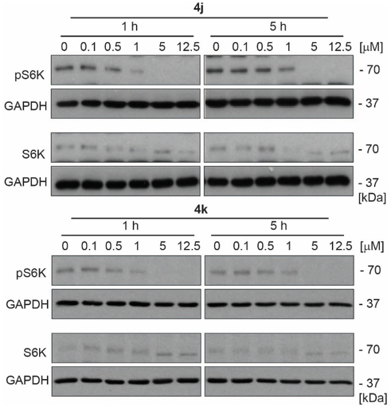
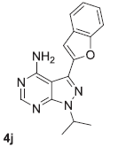
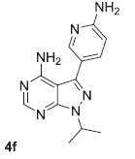
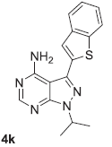
RESULTS no. 2
The structure-activity relationship study of torkinib derivatives
3) Screening for inhibition of mTOR kinase activity by novel torkinib derivatives by activition of downstream targets
Oleksak, P.; Rysanek, D.; Vancurova, M.; Novak, J.; Maurencova, D.; Rousarova, E.; Capek, J.; Rousar, T.; Vales, K.; Skopek, V.; Maslowska, M. J.; Gumauskaite, K.; Stankus, G.; Kuca, K.; Andrys, R.; Skarka, A.; Lisa, M.; Fresser, L.; Surovcova, S.; Chrienova, Z.; Popr, M.; Nepovimova, E.; Hodny, Z. The structure-activity relationship study of torkinib derivatives as mTOR inhibitors with senolytic and signal transducer and activator of transcription 3 inhibitory activities. Bioorganic Chemistry 2026, 176, 109868, doi: 10.1016/j.bioorg.2026.109868.

Slide 48
RESULTS no. 2
The structure-activity relationship study of torkinib derivatives
4) Determination of inhibitory effect by mTOR activity
Based on the results presented above, selected torkinib derivatives were subjected to further evaluation of their potential to inhibit the mTOR protein by a commercial assay using the advanced time-resolved fluorescence resonance energy transfer method (TR-FRET).
The most inhibitory effect was detected with the 4k derivate (IC₅₀ ~120 nM). Compounds 4b and 4h had IC₅₀ values of 280 nM and 930 nM, respectively. Other derivatives tested inhibited mTOR activity at concentration >1 µM.
Oleksak, P.; Rysanek, D.; Vancurova, M.; Novak, J.; Maurencova, D.; Rousarova, E.; Capek, J.; Rousar, T.; Vales, K.; Skopek, V.; Maslowska, M. J.; Gumauskaite, K.; Stankus, G.; Kuca, K.; Andrys, R.; Skarka, A.; Lisa, M.; Fresser, L.; Surovcova, S.; Chrienova, Z.; Popr, M.; Nepovimova, E.; Hodny, Z. The structure-activity relationship study of torkinib derivatives as mTOR inhibitors with senolytic and signal transducer and activator of transcription 3 inhibitory activities. Bioorganic Chemistry 2026, 176, 109868, doi: 10.1016/j.bioorg.2026.109868.

Slide 49
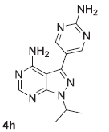
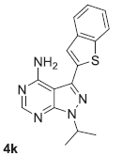
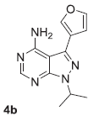
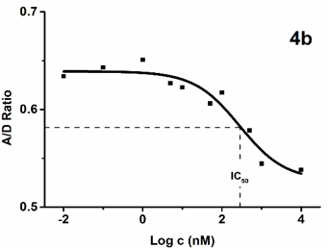
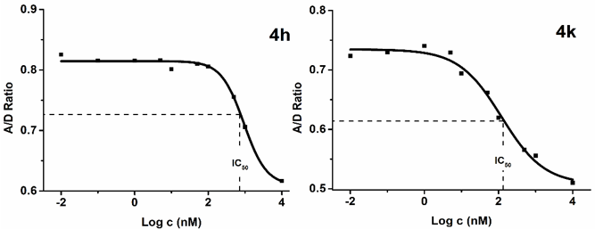
RESULTS no. 2
The structure-activity relationship study of torkinib derivatives
4) Determination of inhibitory effect by mTOR activity
Oleksak, P.; Rysanek, D.; Vancurova, M.; Novak, J.; Maurencova, D.; Rousarova, E.; Capek, J.; Rousar, T.; Vales, K.; Skopek, V.; Maslowska, M. J.; Gumauskaite, K.; Stankus, G.; Kuca, K.; Andrys, R.; Skarka, A.; Lisa, M.; Fresser, L.; Surovcova, S.; Chrienova, Z.; Popr, M.; Nepovimova, E.; Hodny, Z. The structure-activity relationship study of torkinib derivatives as mTOR inhibitors with senolytic and signal transducer and activator of transcription 3 inhibitory activities. Bioorganic Chemistry 2026, 176, 109868, doi: 10.1016/j.bioorg.2026.109868.

Slide 50
RESULTS no. 2
The structure-activity relationship study of torkinib derivatives
5) mTOR inhibitory activity correlations with IL6-induced STAT3 phosphorylation inhibition
As STAT3 inhibitory activity is a substantial part of the senomorphic effects, we analyzed torkinib and its novel derivatives for STAT3 phosphorylation inhibitory activity using IL6-stimulated RPE-1 cells.
Novel torkinib derivatives 4d, 4f, 4g, 4h, 4i, and 4j showed only mild STAT3 phosphorylation inhibitory activity. In contrast, the compounds 4b, 4c, 4e, and 4k did not affect phosphorylation of STAT3.
Oleksak, P.; Rysanek, D.; Vancurova, M.; Novak, J.; Maurencova, D.; Rousarova, E.; Capek, J.; Rousar, T.; Vales, K.; Skopek, V.; Maslowska, M. J.; Gumauskaite, K.; Stankus, G.; Kuca, K.; Andrys, R.; Skarka, A.; Lisa, M.; Fresser, L.; Surovcova, S.; Chrienova, Z.; Popr, M.; Nepovimova, E.; Hodny, Z. The structure-activity relationship study of torkinib derivatives as mTOR inhibitors with senolytic and signal transducer and activator of transcription 3 inhibitory activities. Bioorganic Chemistry 2026, 176, 109868, doi: 10.1016/j.bioorg.2026.109868.

Slide 51

RESULTS no. 3
In silico screening, synthesis, and biology of novel mTOR inhibitors
Cellular senescence is a stress-induced state characterized by irreversible cell cycle arrest. Senescent cells accumulate during aging and contribute to age-related diseases, including neurodegeneration, cancer, and type 2 diabetes mellitus. The mTOR signaling pathway plays a critical role in maintaining and regulating senescence-associated features.
In this study, we employed virtual high-throughput screening and fragment-based design to identify novel small-molecule competitive mTOR kinase inhibitors with favorable physicochemical properties. Six lead compounds (1–6) were selected, and torkinib was synthesized and used as a reference.
Rysanek, D.; Chrienova, Z.; Stary, D.; Bajda, M.; Novak, J.; Vasicova, P.; Kroupova, J.; Andrys, R.; Skarka, A.; Rousarova, E.; Capek, J.; Rousar, T.; Milovanovic, Z.; Grujic-Milanovic, J.; Jacevic, V.; Kolla, J.N.; Popr, M.; Maurencova, D.; Oleksak, P.; Fresser, L.; Kuca, K.; Hodny, Z.; Nepovimova, E. In silico screening, synthesis, and biological evaluation of pyrazolopyrimidine-derived mTOR inhibitors for anticancer and senomorphic effects. Cancer Cell International 2026, 26, 247, doi:10.1186/s12935-026-04308-0.

Slide 52
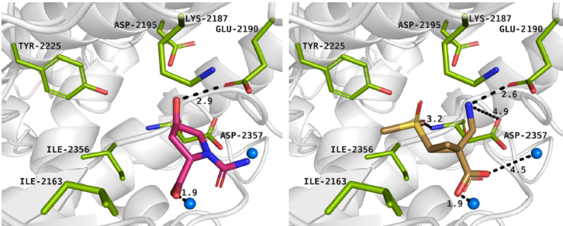
RESULTS no. 3
In silico screening, synthesis, and biology of novel mTOR inhibitors
Computational study
Binding modes of compound 2 (left panel) and compound 4 (right panel) within the ATP-binding site of mTOR kinase. Protein residues are shown in green. Magnesium ions are represented as blue spheres and interactions are indicated by black dashed lines.
Rysanek, D.; Chrienova, Z.; Stary, D.; Bajda, M.; Novak, J.; Vasicova, P.; Kroupova, J.; Andrys, R.; Skarka, A.; Rousarova, E.; Capek, J.; Rousar, T.; Milovanovic, Z.; Grujic-Milanovic, J.; Jacevic, V.; Kolla, J.N.; Popr, M.; Maurencova, D.; Oleksak, P.; Fresser, L.; Kuca, K.; Hodny, Z.; Nepovimova, E. In silico screening, synthesis, and biological evaluation of pyrazolopyrimidine-derived mTOR inhibitors for anticancer and senomorphic effects. Cancer Cell International 2026, 26, 247, doi:10.1186/s12935-026-04308-0.

Slide 53
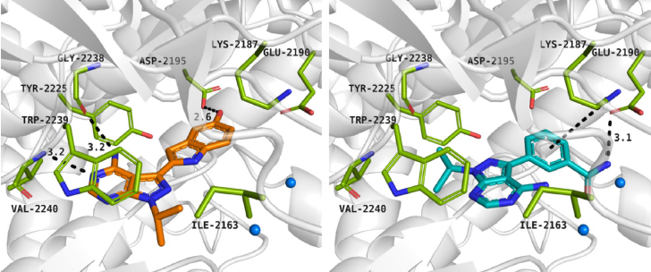
RESULTS no. 3
In silico screening, synthesis, and biology of novel mTOR inhibitors
Computational study
Binding modes of compound 7 (left panel) and compound 5 (right panel) within the ATP-binding site of mTOR kinase. Protein residues are shown in green. Magnesium ions are represented as blue spheres and interactions are indicated by black dashed lines.
Rysanek, D.; Chrienova, Z.; Stary, D.; Bajda, M.; Novak, J.; Vasicova, P.; Kroupova, J.; Andrys, R.; Skarka, A.; Rousarova, E.; Capek, J.; Rousar, T.; Milovanovic, Z.; Grujic-Milanovic, J.; Jacevic, V.; Kolla, J.N.; Popr, M.; Maurencova, D.; Oleksak, P.; Fresser, L.; Kuca, K.; Hodny, Z.; Nepovimova, E. In silico screening, synthesis, and biological evaluation of pyrazolopyrimidine-derived mTOR inhibitors for anticancer and senomorphic effects. Cancer Cell International 2026, 26, 247, doi:10.1186/s12935-026-04308-0.

Slide 54
RESULTS no. 3
In silico screening, synthesis, and biology of novel mTOR inhibitors
Selected compounds for further analysis
Rysanek, D.; Chrienova, Z.; Stary, D.; Bajda, M.; Novak, J.; Vasicova, P.; Kroupova, J.; Andrys, R.; Skarka, A.; Rousarova, E.; Capek, J.; Rousar, T.; Milovanovic, Z.; Grujic-Milanovic, J.; Jacevic, V.; Kolla, J.N.; Popr, M.; Maurencova, D.; Oleksak, P.; Fresser, L.; Kuca, K.; Hodny, Z.; Nepovimova, E. In silico screening, synthesis, and biological evaluation of pyrazolopyrimidine-derived mTOR inhibitors for anticancer and senomorphic effects. Cancer Cell International 2026, 26, 247, doi:10.1186/s12935-026-04308-0.

Slide 55
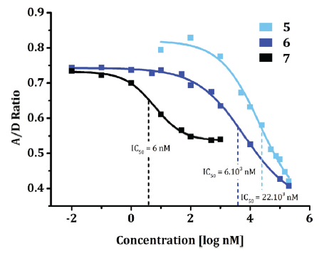
RESULTS no. 3
In silico screening, synthesis, and biology of novel mTOR inhibitors
Dose-response curves of mTOR inhibition in compounds 5, 6, and 7 (0–200 μM). The mTOR inhibitory activity of compounds 5, 6, and 7 was assessed using a commercial assay employing advanced time-resolved fluorescence resonance energy transfer (TR-FRET) technology. IC₅₀ values were calculated using non-linear regression.
Rysanek, D.; Chrienova, Z.; Stary, D.; Bajda, M.; Novak, J.; Vasicova, P.; Kroupova, J.; Andrys, R.; Skarka, A.; Rousarova, E.; Capek, J.; Rousar, T.; Milovanovic, Z.; Grujic-Milanovic, J.; Jacevic, V.; Kolla, J.N.; Popr, M.; Maurencova, D.; Oleksak, P.; Fresser, L.; Kuca, K.; Hodny, Z.; Nepovimova, E. In silico screening, synthesis, and biological evaluation of pyrazolopyrimidine-derived mTOR inhibitors for anticancer and senomorphic effects. Cancer Cell International 2026, 26, 247, doi:10.1186/s12935-026-04308-0.

Slide 56
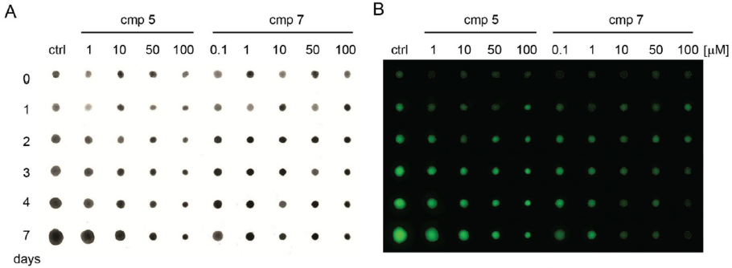
RESULTS no. 3
In silico screening, synthesis, and biology of novel mTOR inhibitors
Compounds 5 and 7 affect cell growth in 3D spheroids prepared from proliferating U87 cells expressing GFP: (A) size, (B) green fluorescence intensity.
Rysanek, D.; Chrienova, Z.; Stary, D.; Bajda, M.; Novak, J.; Vasicova, P.; Kroupova, J.; Andrys, R.; Skarka, A.; Rousarova, E.; Capek, J.; Rousar, T.; Milovanovic, Z.; Grujic-Milanovic, J.; Jacevic, V.; Kolla, J.N.; Popr, M.; Maurencova, D.; Oleksak, P.; Fresser, L.; Kuca, K.; Hodny, Z.; Nepovimova, E. In silico screening, synthesis, and biological evaluation of pyrazolopyrimidine-derived mTOR inhibitors for anticancer and senomorphic effects. Cancer Cell International 2026, 26, 247, doi:10.1186/s12935-026-04308-0.

Slide 57
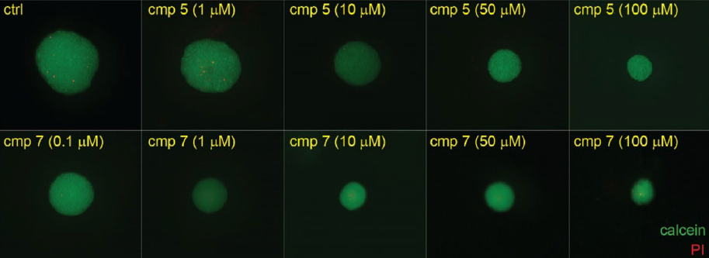
RESULTS no. 3
In silico screening, synthesis, and biology of novel mTOR inhibitors
Compounds 5 and 7 affect cell growth in 3D spheroids prepared from proliferating U87 cells expressing GFP: (C) calcein AM with propidium iodide (PI)
Rysanek, D.; Chrienova, Z.; Stary, D.; Bajda, M.; Novak, J.; Vasicova, P.; Kroupova, J.; Andrys, R.; Skarka, A.; Rousarova, E.; Capek, J.; Rousar, T.; Milovanovic, Z.; Grujic-Milanovic, J.; Jacevic, V.; Kolla, J.N.; Popr, M.; Maurencova, D.; Oleksak, P.; Fresser, L.; Kuca, K.; Hodny, Z.; Nepovimova, E. In silico screening, synthesis, and biological evaluation of pyrazolopyrimidine-derived mTOR inhibitors for anticancer and senomorphic effects. Cancer Cell International 2026, 26, 247, doi:10.1186/s12935-026-04308-0.

Slide 58
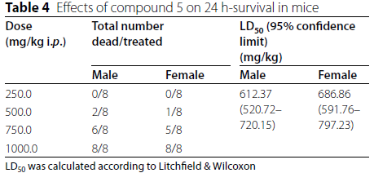
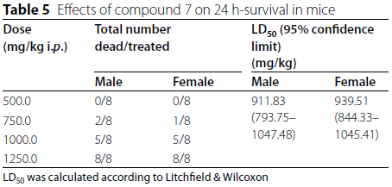
RESULTS no. 3
In silico screening, synthesis, and biology of novel mTOR inhibitors
In vivo safety study
Tables 4 and 5 demonstrate that the calculated LD₅₀ value of 7 was the highest in female mice (939.51 mg/kg). A slightly lower LD₅₀ value was recorded in female mice treated with 5 (686.86 mg/kg). Additionally, from the same Tables, it is evident that studied compounds 5 and 7 were less toxic for females than for males, indicating sex differences.
Rysanek, D.; Chrienova, Z.; Stary, D.; Bajda, M.; Novak, J.; Vasicova, P.; Kroupova, J.; Andrys, R.; Skarka, A.; Rousarova, E.; Capek, J.; Rousar, T.; Milovanovic, Z.; Grujic-Milanovic, J.; Jacevic, V.; Kolla, J.N.; Popr, M.; Maurencova, D.; Oleksak, P.; Fresser, L.; Kuca, K.; Hodny, Z.; Nepovimova, E. In silico screening, synthesis, and biological evaluation of pyrazolopyrimidine-derived mTOR inhibitors for anticancer and senomorphic effects. Cancer Cell International 2026, 26, 247, doi:10.1186/s12935-026-04308-0.

Slide 59
RESULTS no. 3
In silico screening, synthesis, and biology of novel mTOR inhibitors
Conclusion
Search for Rapamycin Alternatives: The study aimed to discover novel small-molecule competitive mTOR inhibitors with better physicochemical properties and fewer side effects than rapamycin.
Development of Compound 5: Using in silico methods, researchers identified compound 5 (a torkinib derivative) with rationally optimized drug-like properties, including a more favorable CNS MPO score, lower lipophilicity, and optimized molecular weight.
Moderate but Beneficial Profile: Although compound 5 has weaker enzymatic potency than torkinib, it exhibits a safer, predominantly cytostatic (rather than cytotoxic) effect, triggers transient autophagy, and successfully inhibits the migration of glioma cell lines.
Rysanek, D.; Chrienova, Z.; Stary, D.; Bajda, M.; Novak, J.; Vasicova, P.; Kroupova, J.; Andrys, R.; Skarka, A.; Rousarova, E.; Capek, J.; Rousar, T.; Milovanovic, Z.; Grujic-Milanovic, J.; Jacevic, V.; Kolla, J.N.; Popr, M.; Maurencova, D.; Oleksak, P.; Fresser, L.; Kuca, K.; Hodny, Z.; Nepovimova, E. In silico screening, synthesis, and biological evaluation of pyrazolopyrimidine-derived mTOR inhibitors for anticancer and senomorphic effects. Cancer Cell International 2026, 26, 247, doi:10.1186/s12935-026-04308-0.

Slide 60
RESULTS no. 3
In silico screening, synthesis, and biology of novel mTOR inhibitors
Conclusion
Senomorphic Activity: Instead of killing senescent cells directly (senolytic effect), compound 5 acts as a senomorphic agent it regulates mTOR signaling to suppress the senescence-associated secretory phenotype (SASP), significantly reducing pro-inflammatory cytokines like IL-6 even during radiation-induced senescence.
Future Potential: Despite in vivo testing showing slightly higher toxicity than torkinib, compound 5 proves that optimizing physicochemical properties is just as crucial as target affinity, making it a highly promising molecule for further optimization.
Rysanek, D.; Chrienova, Z.; Stary, D.; Bajda, M.; Novak, J.; Vasicova, P.; Kroupova, J.; Andrys, R.; Skarka, A.; Rousarova, E.; Capek, J.; Rousar, T.; Milovanovic, Z.; Grujic-Milanovic, J.; Jacevic, V.; Kolla, J.N.; Popr, M.; Maurencova, D.; Oleksak, P.; Fresser, L.; Kuca, K.; Hodny, Z.; Nepovimova, E. In silico screening, synthesis, and biological evaluation of pyrazolopyrimidine-derived mTOR inhibitors for anticancer and senomorphic effects. Cancer Cell International 2026, 26, 247, doi:10.1186/s12935-026-04308-0.

Slide 61
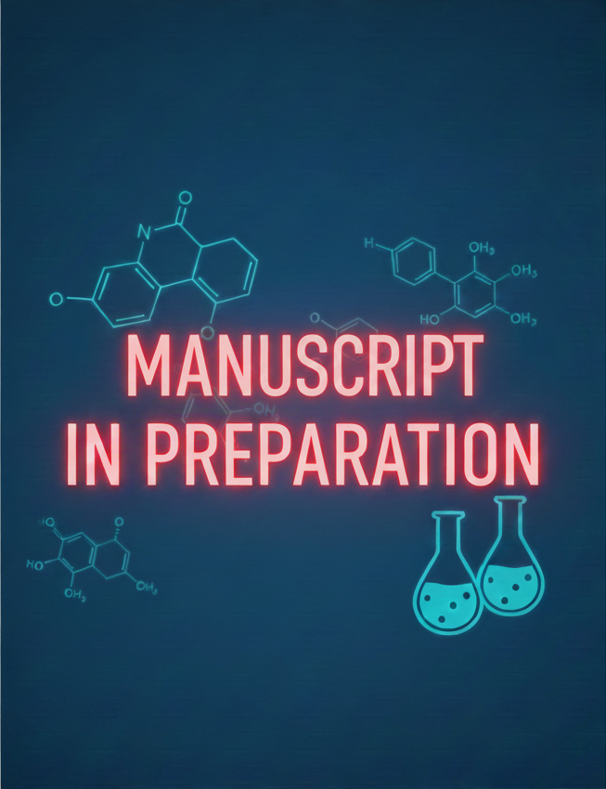
RESULTS no. 4
Torkinib derivatives with 4-tetrahydropyranyl motif
Among the diverse chemical classes of mTOR inhibitors, the pyrazolopyrimidine scaffold has proven to be a highly privileged framework, providing optimal orientation within the ATP-binding pocket.
This study investigates the design and synthesis of pyrazolopyrimidine derivatives featuring a 4-tetrahydropyranyl (THP) moiety and various heteroaryl substituents.
It should be noted that the pyrazolopyrimidine core functionalized with the THP moiety, has been the subject of several previous medicinal chemistry investigations. This study seeks to expand the current understanding of the mTOR binding site's requirements, potentially uncovering candidates with improved potency and enhanced therapeutic potential.
Oleksak, P.; Rysanek, D.; Vancurova, M.; Novak, J.; Maurencova, D.; Rousarova, E.; Capek, J.; Rousar, T.; Krejci, D.; Hotovcova, E.; Kuca, K.; Andrys, R.; Skarka, A.; Lisa, M.; Fresser, L.; Nepovimova, E.; Hodny, Z.
[MANUSCRIPT IN PREPARATION].

Slide 62
RESULTS no. 4
Torkinib derivatives with 4-tetrahydropyranyl motif
Unlike planar aryl substituents or small flexible alkyl groups (such as the isopropyl group found in the parent torkinib), the THP ring is a saturated, six-membered heterocycle that adopts a stable chair conformation.
Several pyrazolopyrimidine-THP fused derivatives, such as mTORi-THP-1, have been previously reported to exhibit superior inhibitory potency against mTOR relative to phosphatidylinositol 3-kinases (PI3Ks).
Oleksak, P.; Rysanek, D.; Vancurova, M.; Novak, J.; Maurencova, D.; Rousarova, E.; Capek, J.; Rousar, T.; Krejci, D.; Hotovcova, E.; Kuca, K.; Andrys, R.; Skarka, A.; Lisa, M.; Fresser, L.; Nepovimova, E.; Hodny, Z.
[MANUSCRIPT IN PREPARATION].
Ren, P.; Liu, Y.; Li, L.; Chan, K.; Wilson, T.E. Kinase Inhibitors and Methods of Use, Applicant, Intellikine Llc (US), 2016, 157, US2016024099A1.

Slide 63
RESULTS no. 4
Torkinib derivatives with 4-tetrahydropyranyl motif
In this study, a library of 12 novel pyrazolopyrimidine derivatives was designed and synthesized, maintaining the N1-tetrahydropyranyl anchor while varying the heteroaryl substituents at the C3 position.
The biological evaluation revealed that while none of the newly synthesized derivatives surpassed the reference compound torkinib, several candidates exhibited significant inhibitory activity against mTOR.
Preliminary pharmacokinetic assessments indicated that several derivatives possessed notable bioavailability and improved aqueous solubility.
Oleksak, P.; Rysanek, D.; Vancurova, M.; Novak, J.; Maurencova, D.; Rousarova, E.; Capek, J.; Rousar, T.; Krejci, D.; Hotovcova, E.; Kuca, K.; Andrys, R.; Skarka, A.; Lisa, M.; Fresser, L.; Nepovimova, E.; Hodny, Z.
[MANUSCRIPT IN PREPARATION].

Slide 64
RESULTS no. 4
Torkinib derivatives with 4-tetrahydropyranyl motif
To further validate the therapeutic potential of the library, the compounds were evaluated for their antiproliferative effects of selected human cancer cell lines.
While the cellular potency of the new derivatives was generally attenuated compared to torkinib, the compounds maintained significant biological activity, mirroring the trends observed in the kinase assays.
A particularly compelling finding of this study was the discovery that several derivatives exhibit senolytic activity.
Oleksak, P.; Rysanek, D.; Vancurova, M.; Novak, J.; Maurencova, D.; Rousarova, E.; Capek, J.; Rousar, T.; Krejci, D.; Hotovcova, E.; Kuca, K.; Andrys, R.; Skarka, A.; Lisa, M.; Fresser, L.; Nepovimova, E.; Hodny, Z.
[MANUSCRIPT IN PREPARATION].

Slide 65
RESULTS no. 4
Torkinib derivatives with 4-tetrahydropyranyl motif
In summary, we have designed and synthesized a series of 12 novel pyrazolopyrimidine scaffolds bearing THP motif with diverse heteroaryl moieties at the C3 position.
Our findings confirm that the derivatives maintain significant biological activity.
Ultimately, these results underscore the value of the N-THP pyrazolopyrimidine framework as a versatile template for the development of next-generation mTOR inhibitors with specialized biological functions.
This manuscript is currently in preparation.
Oleksak, P.; Rysanek, D.; Vancurova, M.; Novak, J.; Maurencova, D.; Rousarova, E.; Capek, J.; Rousar, T.; Krejci, D.; Hotovcova, E.; Kuca, K.; Andrys, R.; Skarka, A.; Lisa, M.; Fresser, L.; Nepovimova, E.; Hodny, Z.
[MANUSCRIPT IN PREPARATION].

Slide 66
CONCLUSION
Potential of mTOR inhibitors in delayed onset and treatment of age-related diseases
Direct and indirect mTOR ihibitors have a great potential to extend our healthspan and lifespan.
Inhibition of mTOR has been studied in the context of neuroprotection and age-related neurodegenerative diseases. It may have potential benefits for preserving cognitive function and reducing the risk of neurodegeneration.
Inhibitors of mTOR may influence immune function, and modulation of the immune system is crucial for healthy aging. Enhanced immune responses can help defend against infections and diseases associated with aging.
mTOR is a key regulator of protein synthesis, and its inhibition may promote cellular maintenance processes, such as autophagy, which is responsible for the removal of damaged cellular components. Enhanced autophagy can contribute to cellular rejuvenation and longevity.

