Slide 1

RESEARCH ACTIVITIES (December 31st, 2025)
Toshitaka Hayashi.
toshitaka.hayashi@uhk.cz
Supervisor: Ing. Richard Cimler, Ph.D.
Faculty of Science UHK

Slide 2
Brief biography and research interests
Education:
Ph.D. (Software and Information Science), Iwate Prefectural University, Japan, 2021.
Working experience:
Postdoctoral researcher (October 2021-Present), University of Hradec Kralove
Research interest
Theoretical machine learning
One-class classification
Machine Learning for Machine Learning models.
Research project at UHK:
Unseen data discovery using Ballistocardiogram (BCG) signals (-2023)
One-class classification for time series data (2024-2026)

Slide 3
Project: One-class classification for time series
Goal
Develop OCC algorithms for time series data
Expected outputs are categorized into the following contents:
Develop OCC algorithms with new hypotheses focused on specific symptoms, or individual difference between patients.
Extending OCC algorithms for images into time series data.
Extending time series OCC algorithms to other data types for obtaining different views.
Application of OCC for biometric signals

Slide 4
Supervised classification
Train a classification model from training dataset.
Training dataset: Samples and classes
Training: Training dataset → Model
Model: Testing Data → Class
However, the model cannot output unknown classes that are not included in the training dataset.

Slide 5
We cannot teach everything to machine.
Learning specific type of samples are difficult or impossible:
When data is rare.
When collecting data is dangerous.
Ex. fire, nuclear explosion, drinking too much alcohol…
When data is not existing yet.
Ex. COVID2030.

Slide 6
One-class classification
Special supervised classification problem, where training dataset is solely one class.
OCC trains a classification model using training dataset.
Training dataset: Samples and a class (only one)
Training: Dataset → Model
Model: Testing sample → Class (one or other)
OCC is the simplest setting to detect unknown class.

Slide 7
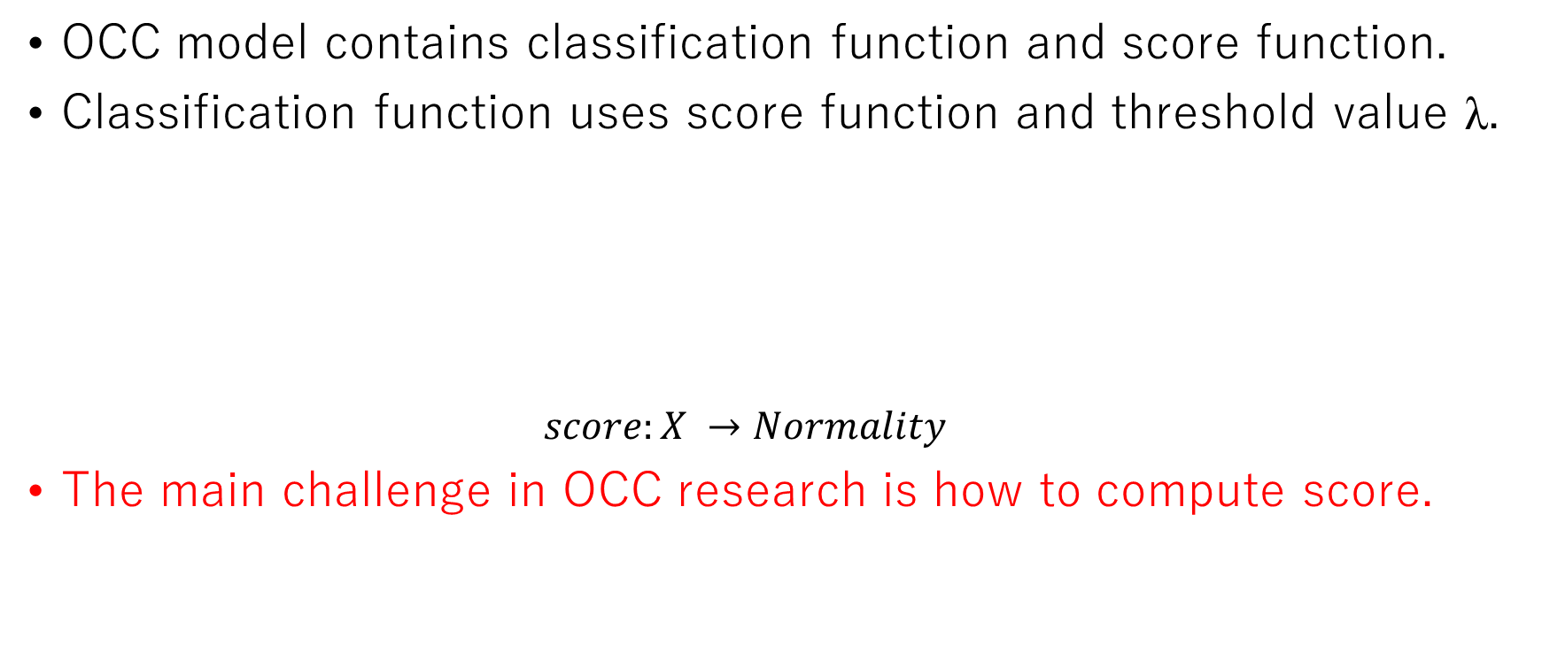
OCC model
OCC model contains classification function and score function.
Classification function uses score function and threshold value λ.
$$score:X →Normality$$
The main challenge in OCC research is how to compute score.

Slide 8
Five types of OCC algorithms
Boundary-based approach
Compute boundary between one class and other classes
Distance-based approach
Compute distance/similarity from one class.
Probability-based approach
Compute probability belonging to one class.
Fake-based approach
Create fake data belonging to other class and use binary classification.
Subtask-based approach
Use error of subtasks.

Slide 9
Research questions
How can we decide on the hyperparameter of OCC algorithms without the evaluation?
Evaluation of OCC needs the access to other classes.
However, the algorithm will no longer be OCC after evaluation.
Is it possible to classify OCC algorithms and the rest of machine learning algorithms?
Is there any gray zone to keep OCC algorithm as OCC while accessing other classes?

Slide 10
Publication in UHK
Year | Paper title | Journal name
2022 | OCFSP: Self-supervised One-class Classification Approach Using Feature-slide Prediction Subtask for Feature Data | Soft Computing
2022 | OCSTN: One-class time-series classification approach using signal transformation network into a goal signal | Information Sciences
2023 | Classification of health deterioration by geometric invariants | Computer Methods and Programs in Biomedicine
2023 | Distance-based one-class time-series classification approach using local cluster balance | Expert Systems with Application
2023 | Image Entropy Equalization: a novel preprocessing technique for image recognition tasks | Information Sciences
2023 | Patient deterioration detection using one-class classification via cluster period estimation subtask | Information Sciences
2023 | Interpretable synthetic signals for explainable one-class time-series classification | Engineering Application of Artificial Intelligence

Slide 11
Publication in UHK
Year | Paper title | Journal name
2025 | The fusion of hyperparameter candidates for one-class classification problems | Information Sciences
2025 | Critical review for one-class classification: recent advances and the reality behind them | WIREs Data Mining and Knowledge Discovery (accepted)

Slide 12
Conference papers
Conference paper | Conference information
Image Entropy Equalization for Autoencoder-Based One-Class Classification | SOMET 2022: 20-22 September 2022, Kitakyushu, Japan
Machine learning could be easier if all data were MNIST | SOMET 2023: 20-22 September 2023 Naples, Italy
One-class classification approach using one-class classification subtask | SOMET 2024: 20-22 September 2024 Cancun, Mexico (Best theory paper)
Anomalous Anomaly Detector Detection | SOMET 2025: 23-26 September 2025 Kitakyushu, Japan

Slide 13
Submitted and revising papers
Title | Journal
Size free one-class classification using probabilistic local cluster balance | Results in Engineering (Major revision)
Decomposing one-class support vector machine into an ensemble of one-data support vector machines | Pattern Recognition
Selfless Clustering: pre-training strategy using interpretable self-labeled dataset without the original label
Imbalanced classification with selective unlearning using k-nearest centroids and hyperparameter fusion

Slide 14
On-going research
Topic
Classification of OCC models
Clustering of OCC models
Deterioration detection via remaining life prediction subtask
One-class classification with subtask for local region
Machine unlearning
OCC using OCC subtask (journal extension)

Slide 15
Thank you very much!
Email: toshitaka.hayashi@uhk.cz

