Slide 1


Development of novel SFC/MS methods for the analysis of metabolites
RNDr. Oleksandr Kozlov, PhD.

Slide 2
Aim of postdoctoral project
The aim of the postdoctoral project is the development of new supercritical fluid chromatography (SFC) coupled to mass spectrometry (MS) methods for the analysis of both lipophilic and hydrophilic metabolites in biological samples.

Slide 3
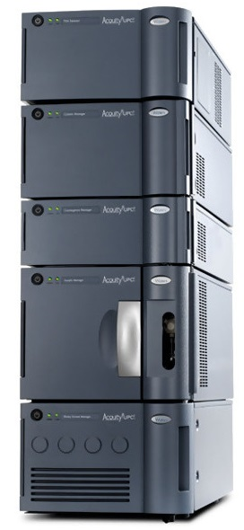
SFC/MS analysis of lipids
T > T_{k} and p > p_{k} = supercritical fluid
Mobile phase:
CO₂ – main component, low elution power
Modifier (cosolvent) – commonly 5-50%, increasing of polarity (MeOH, EtOH, IPA…)
Additives – salts (ammonium acetate, ammonium formate), acids (FA, TFA), base (DEA, TEA), water
Stationary phases:
Polar and nonpolar
Dedicated to SFC
LC columns, achiral and chiral

Slide 4
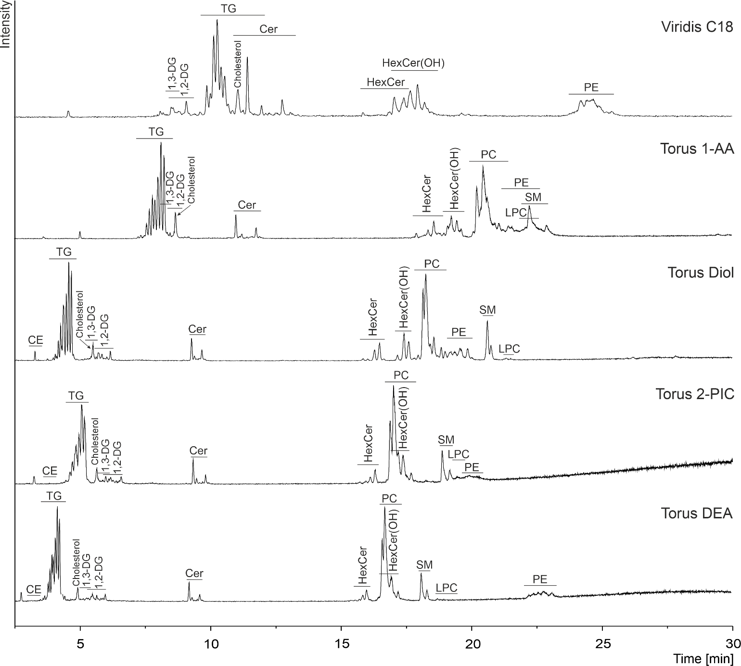
1. UHPSFC intraclass separation of lipids
Peak annotation:
CE – cholesteryl esters;
DG – diacylglycerols;
TG – triacylglycerols;
Cer – ceramides;
HexCer – hexosylceramides;
PE – phosphatidylethanolamines;
PC – phosphatidylcholines;
SM – sphingomyelins;
LPC – lysophosphatidylcholines.

Slide 5
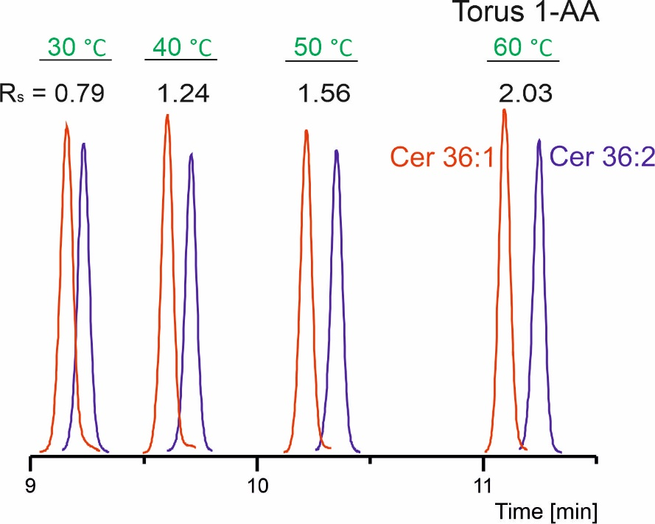
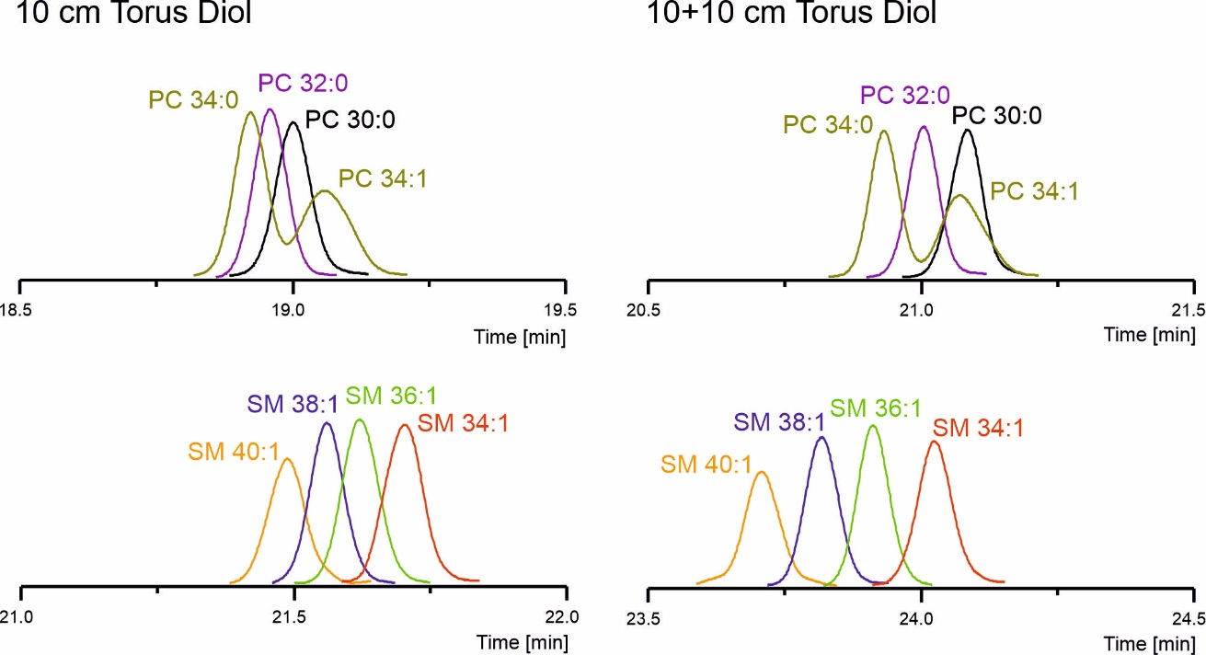
1. UHPSFC intraclass separation of lipids
The effects of mobile phase composition and gradient, flow rate, back pressure, temperature, and column coupling were evaluated in detail.
Influence of temperature:
Column coupling:

Slide 6
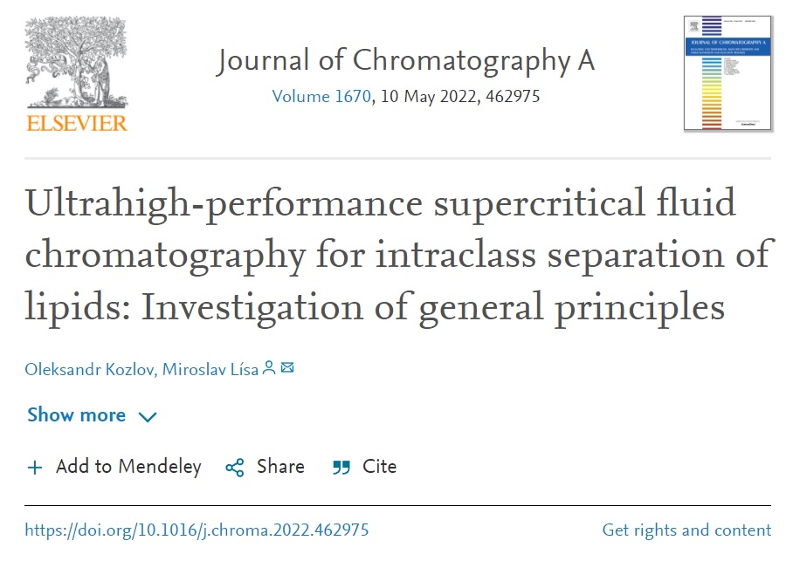
1. UHPSFC intraclass separation of lipids
Conclusions:
UHPSFC intraclass separation of lipids was achieved according to the acyl chain composition together with preserved interclass selectivity.
The nature of the stationary phase was the main factor influencing intraclass separations of lipids.
The Torus Diol and Torus 1-AA columns showed the best results.
The column temperature and column
coupling had the prominent effect on
the separation of lipids.
Separation of selected
regioisomers and isobaric species
was achieved in some cases.

Slide 7
2. Chiral SFC separation of MG and DG
Monoacylglycerols (MG) and diacylglycerols (DG) are important in a wide range of metabolic pathways; signaling molecules
Emulsifiers in the pharmaceutical, food and cosmetics industries
Enantiomeric MG and DG are potential precursors for the synthesis of lipids

Slide 8
2. Chiral SFC separation of MG and DG
Synthesis of MG and DG enantiomers using the 7 most commonly occurring fatty acids in biological samples such as palmitic, stearic, oleic, linoleic, linolenic, arachidonic, and docosahexaenoic acids was performed.
Chiral SFC/MS method development
Column chemistry, mobile phase composition and gradient, flow rate,
backpressure, and temperature were carefully assessed.
Lipase-catalyzed hydrolysis of triacylglycerols
The developed method was used for the analysis of hydrolysis products of triacylglycerols and to evaluate selectivity of lipases from porcine pancreas and Pseudomonas fluorescens.

Slide 9
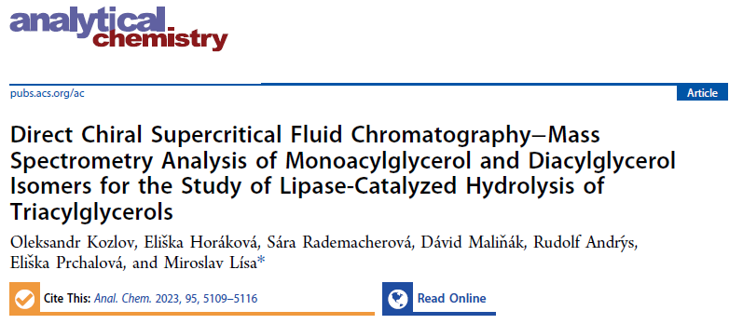
2. Chiral SFC separation of MG and DG
Conclusions:
The baseline separation of all MG and DG in 5 min under the optimized conditions was achieved.
The most prominent effects of stationary phase and mobile phase modifier types on the enantioseparation was confirmed.
The different stereoselectivities of lipases were observed, which strongly depended on the type of prochiral substrate.

Slide 10
3. SFC-MS analysis of MG and DG enantiomers: selectivity modulation
Coelution of MG and DG with highly abundant triacylglycerols (TG) in biological samples
MS response may be affected due to ion suppression effects inaccurate quantification
Solution:
Coupling of achiral and chiral columns, modulation of acylglycerol selectivity

Slide 11
3. SFC-MS analysis of MG and DG enantiomers: selectivity modulation
Coupling of chiral and achiral (C18) columns
Single amylose-based
chiral columns

Slide 12
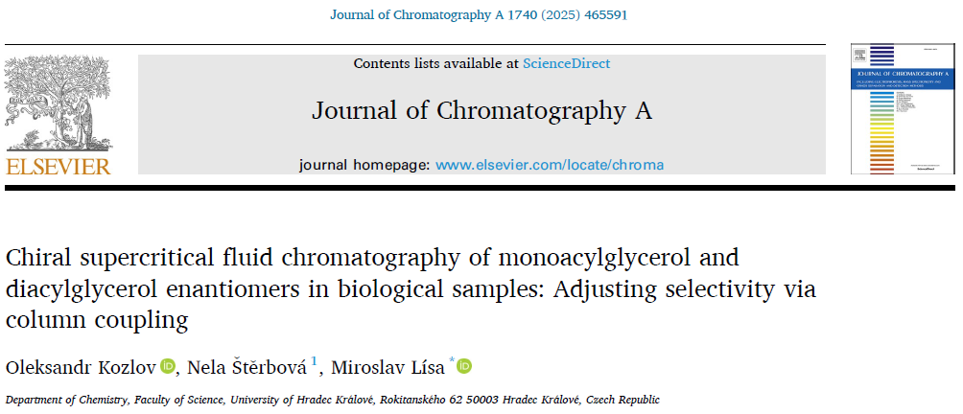
3. SFC-MS analysis of MG and DG enantiomers in biological samples
Chiral SFC-MS analysis of egg yolk, human plasma, and porcine brain samples showed different ratios of enantiomers, suggesting their unique roles within each
sample type.

Slide 13
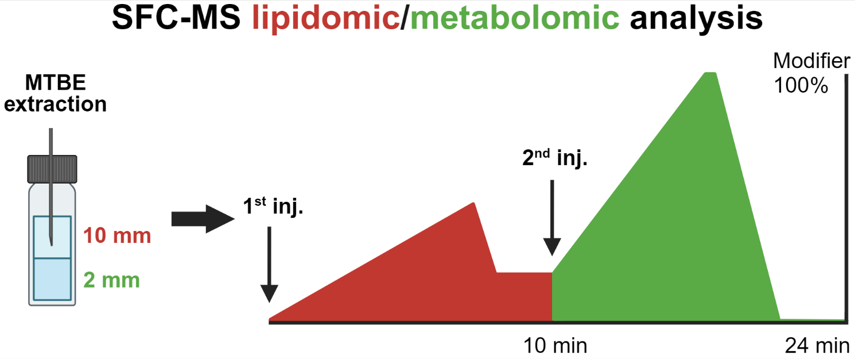
4. SFC-MS lipidomic/metabolomic analysis
Proof of concept for the application of a commercial SFC-MS instrument for the comprehensive analysis of metabolites with the full range of polarities was demonstrated.
The developed single-platform SFC−MS lipidomic/metabolomic method is based on two consecutive injections of lipid and polar metabolite extracts from biphase methyl tert-butyl ether extraction.

Slide 14
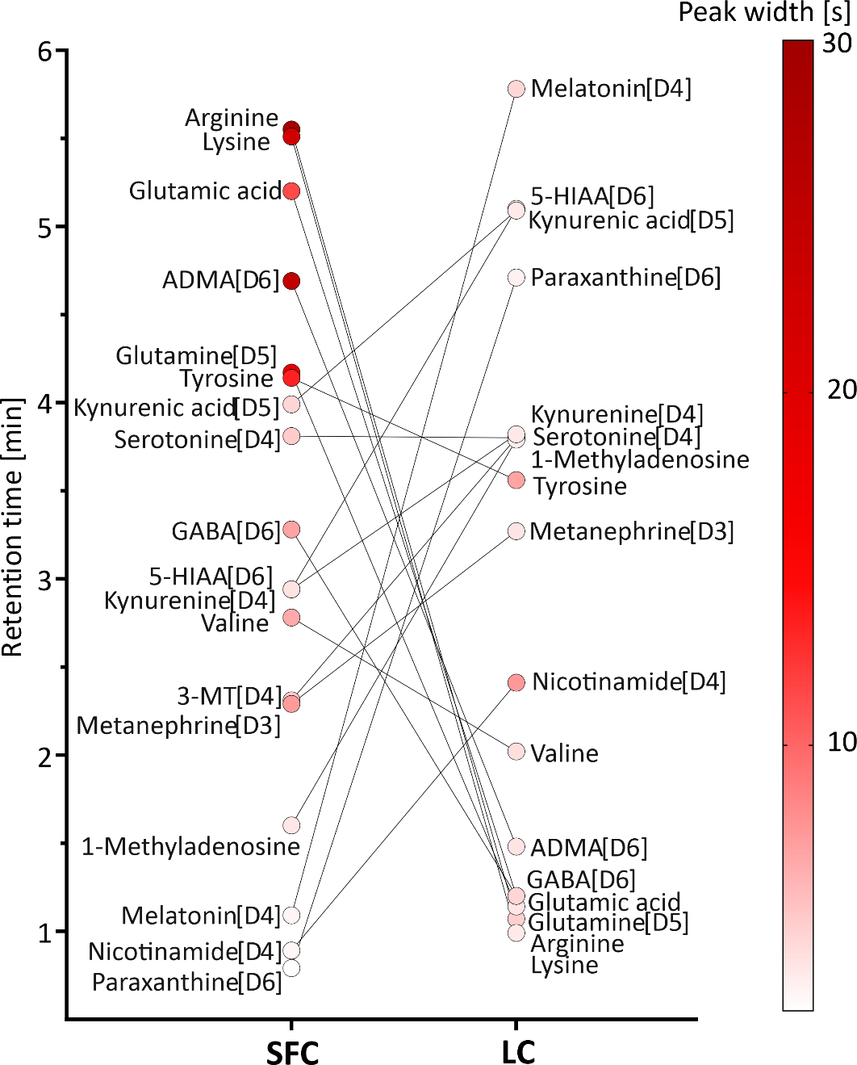
4. SFC-MS lipidomic/metabolomic analysis
Comparison of LC−MS and SFC−MS in the analysis of polar metabolites
differences in the selectivity of the SFC and LC separation.
SFC provides a better separation of early eluted compounds in LC.

Slide 15
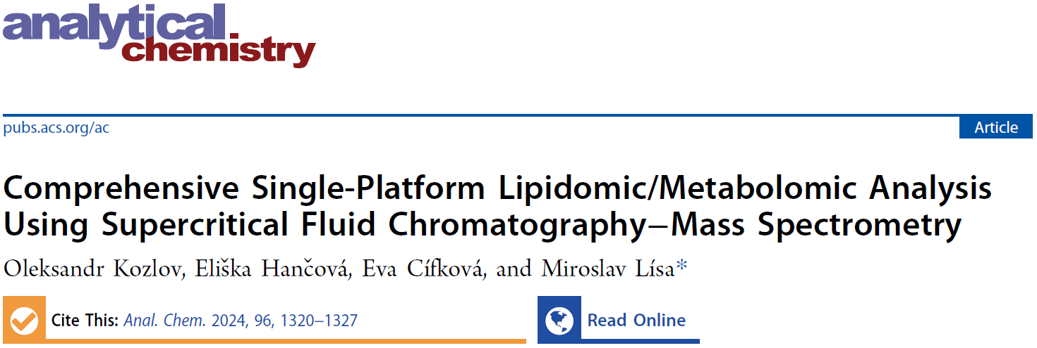
4. SFC-MS lipidomic/metabolomic analysis
Fast and comprehensive SFC-MS analysis of lipids and polar metabolites from plasma was performed from the same vial by adjustment of the needle placement using a simple analytical platform based on a single instrument, column, and mobile phase.

Slide 16
5. Chiral SFC-MS analysis of fatty acid esters of hydroxy fatty acids (FAHFAs)
FAHFAs are endogenous lipids with anti-diabetic and anti-inflammatory effects
Possible combinations of HFAs and FAs with the different positions of the estolide bond generate multiple isomers
Based on the configuration of the stereogenic branching carbon, FAHFAs can exist either as R or S enantiomers
The biological roles of many individual FAHFAs remain currently unknown

Slide 17
5. Chiral SFC-MS analysis of FAHFAs: method development
21 commercially available FAHFA standards:
5-, 9-, 10-, 12-, 13-PAHSA / SAHSA / POHSA / OAHSA and 9-PAHPA
FAHFA composition
Fatty acid Hydroxy fatty acid
PA – palmitic acid (16:0) HSA – hydroxystearic acid
SA – stearic acid (18:0) HPA – hydroxypalmitic acid
PO – palmitoleic acid (16:1)
OA – oleic acid (18:1)
5 polysaccharide-based chiral stationary phases (3 amylose and 2 cellulose) with MeOH
Column screening
ethanol
propan-2-ol
acetonitrile
ACN/2-PrOH 1/1
Selection of modifier
mobile phase additives
temperature
gradient
flow rate
Optimization

Slide 18
5. Chiral SFC-MS analysis of FAHFAs: method development
Amylose-based column from Lux i-Amylose-3 and ACN/MeOH modifier
R enantiomer before S
Coelution of FAHFA positional isomers! RP-LC fractionation is required
R only?

Slide 19
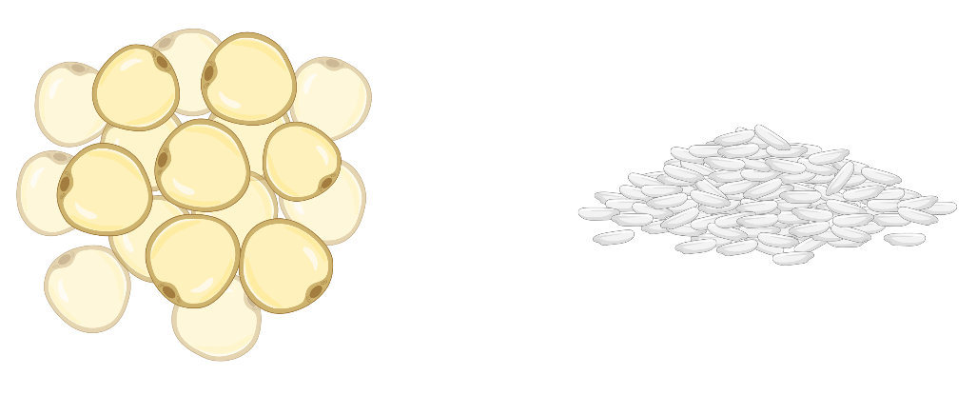
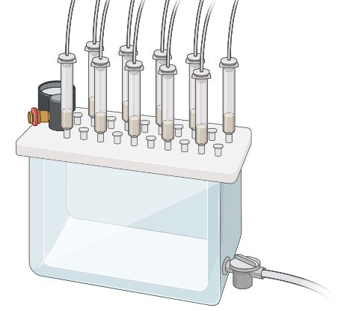
5. Chiral SFC-MS analysis of FAHFAs in biological samples
Two representative samples were selected:
White adipose tissue (WAT) is a complex organ with metabolic and endocrine functions. Dysregulation of WAT functions in obesity contributes to the development of insulin resistance and type-2 diabetes. FAHFAs were initially discovered in WAT.
Rice – natural source of FAHFAs. Dietary intake of FAHFAs correlates with increased endogenous levels, which can positively affect human health.
Sample preparation:
Samples were homogenized in a mixture of citric acid buffer and ethyl acetate (ratio 1:2, v/v).
SPE extraction of organic phase using silica column was performed.
Evaporated extracts were aliquoted and stored at -80 °C.
biorender.com

Slide 20
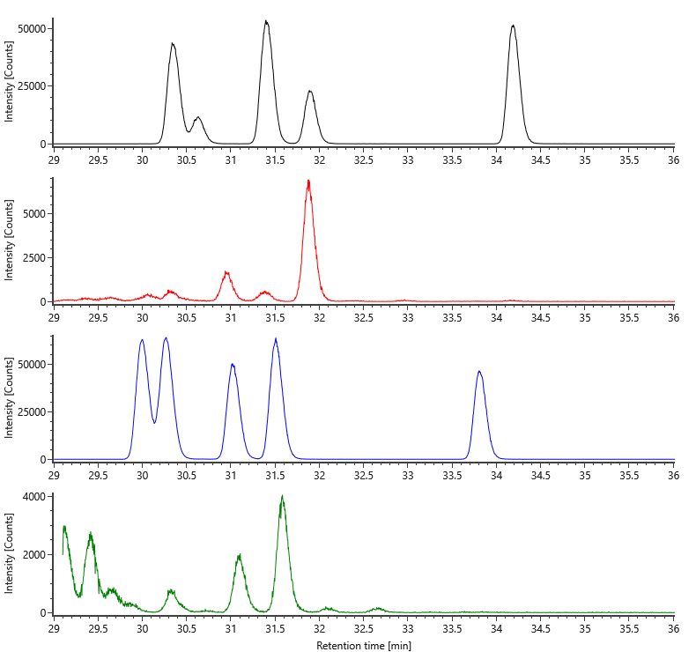
5. Chiral SFC-MS analysis of FAHFAs in biological samples
13-
5-
PAHSA standards
537.5 > 255.2
9-
12-
9-
PAHSA WAT
537.5 > 255.2
10-
13-
12-
9-
10-
5-
OAHSA standards
563.5 > 281.2
9-
10-
OAHSA Rice
563.5 > 281.2

Slide 21
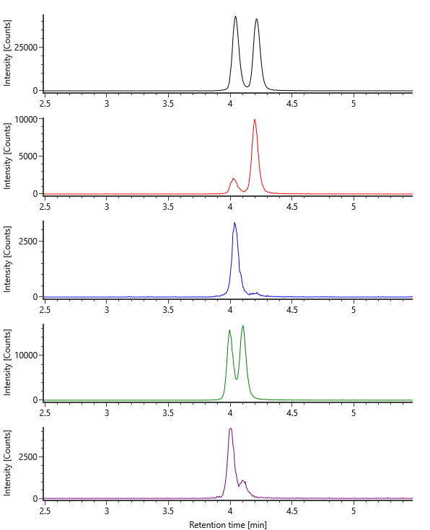
5. Chiral SFC-MS analysis of FAHFAs in biological samples
9-OAHSA standard
563.5 > 281.2
9-OAHSA Rice
81%
19%
WAT |  | FAHFA | Rice
R, % | S, % |  | R, % | S, %
93 | 7 | 9-POHSA
95 | 5 | 9-PAHSA | 21 | 79
96 | 4 | 9-OAHSA | 19 | 81
93 | 7 | 9-PAHPA | 52 | 48
 |  | 10-PAHSA | 72 | 28
 |  | 10-OAHSA | 81 | 19
9-OAHSA WAT
96%
4%
10-OAHSA standard
10-OAHSA Rice
563.5 > 281.2
81%
19%

Slide 22
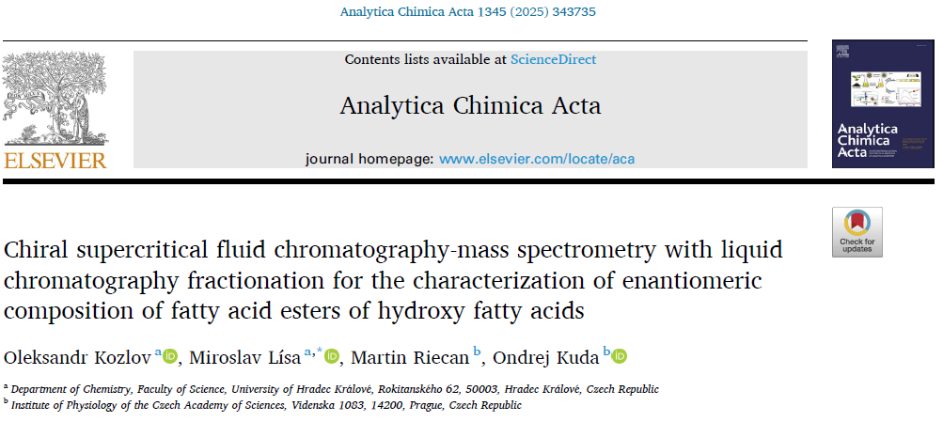
5. Chiral SFC-MS analysis of FAHFAs
The SFC/MS method for the fast enantioselective separation of FAHFAs was developed.
The chiral selector and modifier type showed the most prominent effect on resolution.
Due to the coelution of FAHFA positional isomers in chiral SFC, the RP-LC fractionation was performed.
The enantiomeric composition of selected FAHFAs from WAT and rice samples was determined.

