Slide 1
Determinants of tropical tree growth along a climate gradient on Mount Cameroon
Lenka Plavcová

Slide 2
The goal of the study is to elucidate determinants of tropical tree growth using anatomical and dendrometric data collected from trees growing along a climate gradient on Mount Cameroon.

Slide 3
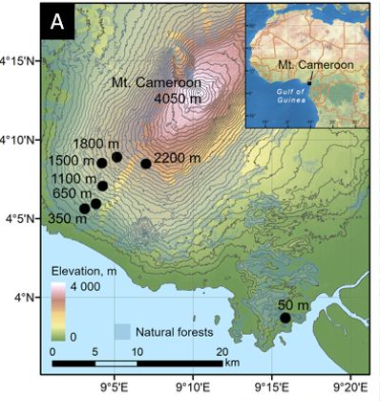
Sampling sites

Slide 4
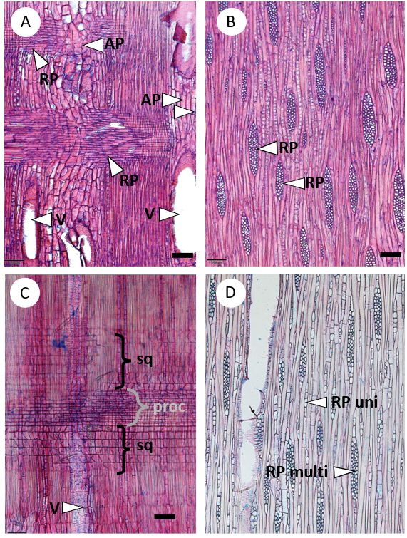
Radial parenchyma anatomy

Slide 5
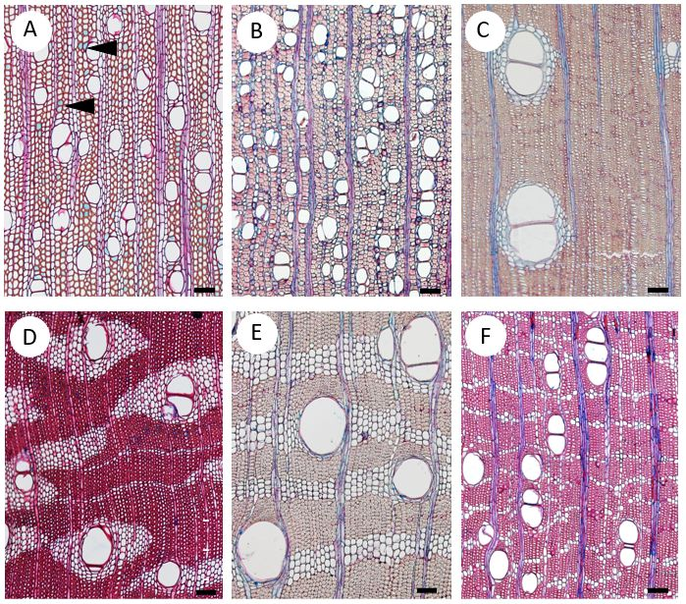
Axial parenchyma anatomy

Slide 6
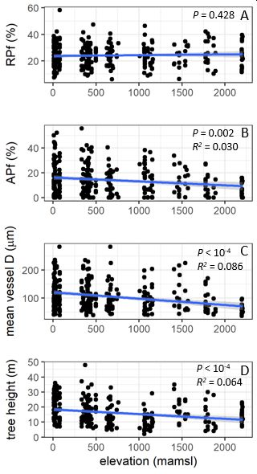
Changes in radial and axial parenchyma fractions, mean vessel diameter nad tree height along the elevational gradient on Mount Cameroon

Slide 7
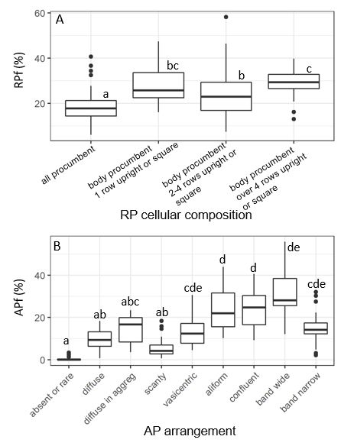
Radial and axial parenchyma fractions in trees with
differing radial and axial parenchyma anatomy

Slide 8
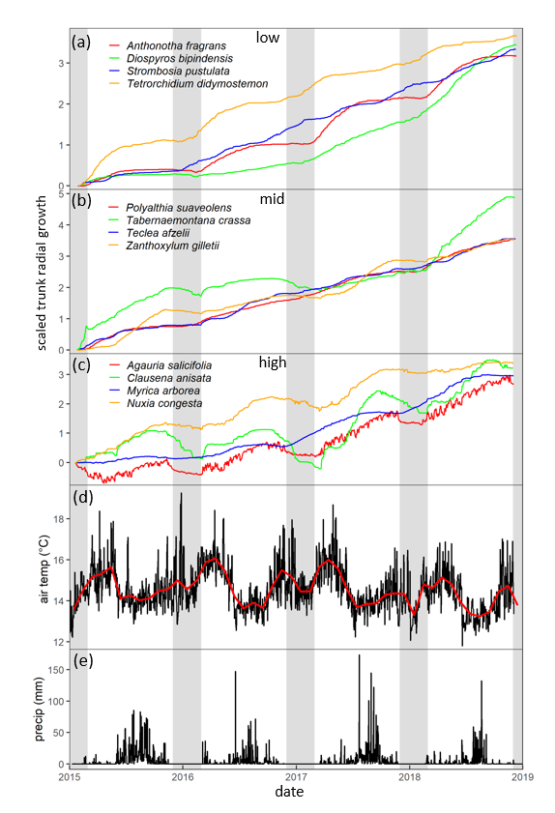
Trunk radial growth patterns in selected tropical trees growing in low, mid or high elevation on Mount Cameroon. Microclimate data are also shown.

Slide 9
Conclusions
Tall trees with wide vessels in coastal and lowland tropical forests displayed increased fractions of AP and greater vessel-to-parenchyma connectivity. There was no evidence of a higher occurrence of RAP in montane forests characterized by greater environmental seasonality.
The study documents diverse patterns in trunk radial growth in tropical trees growing along an Afrotropical elevational gradient. While trees at low elevation tended to grow continuously and linearly, there was a clear trend for a greater growth seasonality with increasing elevation.

