Slide 1
PORTAL IS/STAG STUDENT´S PERSONAL DATA ENROLMENT OF SUBJECTS REGISTRATION FOR EXAMS AND CONTROL OF YOUR STUDY

Slide 2
USERNAME AND PASSWORD https://stag.uhk.cz/portal
1.
Change the language English/Czech
(Česky)
2.
USERNAME and PASSWORD: on extra sheet
Log into the system by using the same access data as for the UHK network

Slide 3
MY STUDY/MY DATA

Slide 4
REGISTRATION OF SUBJECTS
CHOOSE SUBJECT AND ADJUST YOUR SCHEDULE

Slide 5
YOUR TIMETABLE AND COURSES
OVERVIEW OF THE ENROLLED SUBJECTS, COMPLETED EXAMINATIONS
YOUR SCHEDULE

Slide 6
MY STUDY/REGISTRATION FOR EXAMINATIONS
Shows an updated overview of achieved grades.
Automatically offers a list of available dates (according to the registered and not completed subjects).
Registration for a date
The list of dates contains only dates for those subjects which the students registered for. For each examination date there is information about the date, time and the place where it is held, about the capacity, the deadlines for enrolment/registration cancellation etc.

Slide 7
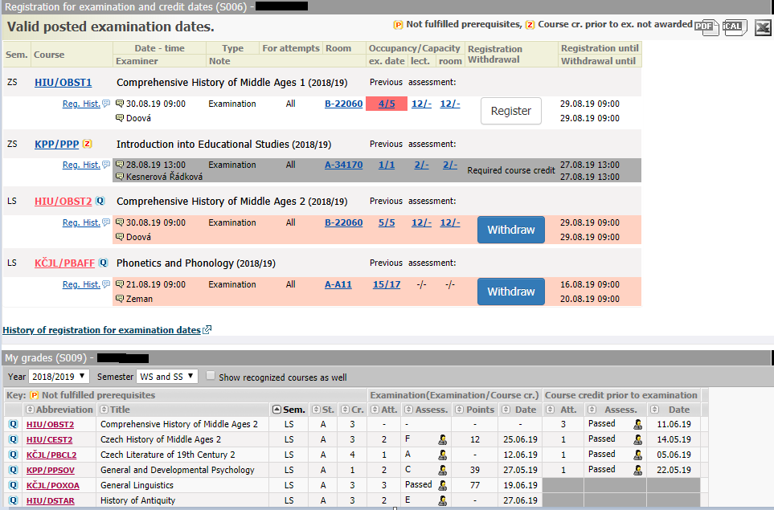
REGISTRATION FOR EXAMS/WITHDRAWAL
REGISTRATION
WITHDRAWAL
CONTROL OF
YOUR GRADES

Slide 8
MY STUDY/REGISTRATION FOR EXAMINATIONS
You can register for a chosen examination date by clicking on the link Register. That will change into Withdraw (for possible cancellation). Dates also differ in colour:
Dates also differ in It is possible to enrol for no more than one date of a particular subject and a particular type of date (examination, credit ).
If the date is set as a “retake”, only the students who were registered for a previous date can enrol for it.
It is impossible to cancel registration from a completed examination.
It is impossible to enrol for a date as a substitute.
It is not possible to enrol for a cancelled date. However, a student can withdraw his registration from a cancelled date. The system notifies students of a cancelled date. Click on the link Zrušeno – nutno odepsat/Cancelled – Withdrawal required, your participation in the date will be immediately cancelled.

Slide 9
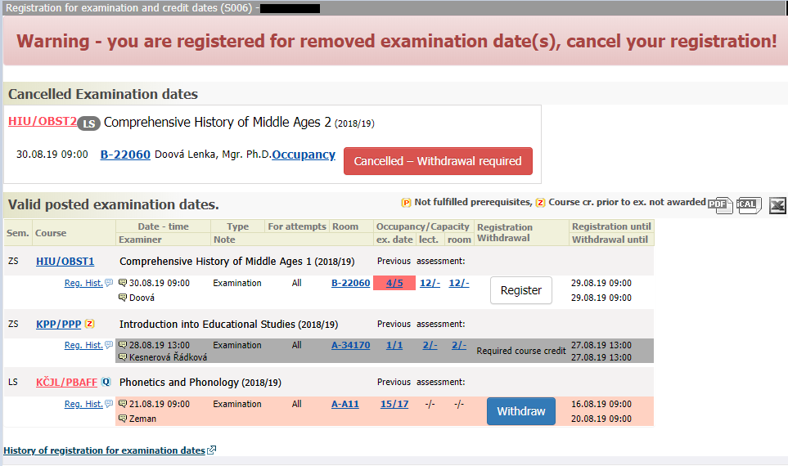
REGISTRATION FOR EXAMS/WITHDRAWAL

Slide 10
QUALIFICATION WORK
You will submit your final thesis in the eVŠKP system (https://ris.uhk.cz/eVSKP/). In the portlet Témata VŠKP/Theses topics you can complete and then print an application for the final thesis.

Slide 11
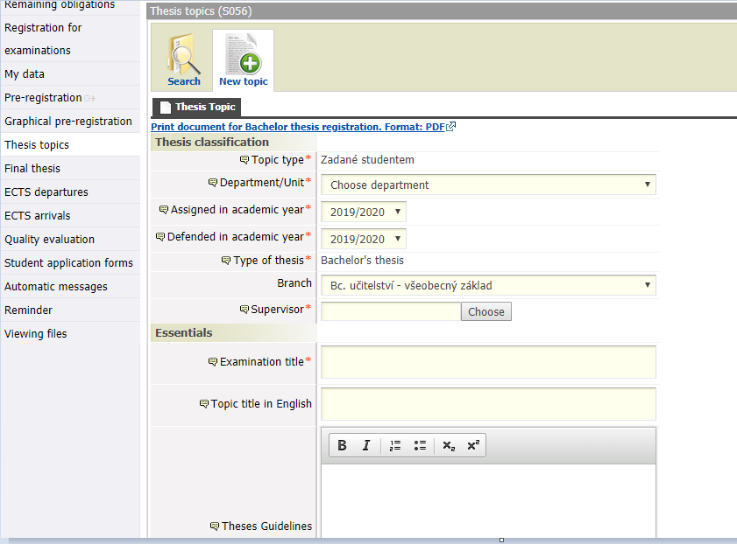
QUALIFICATION WORK

