Slide 1


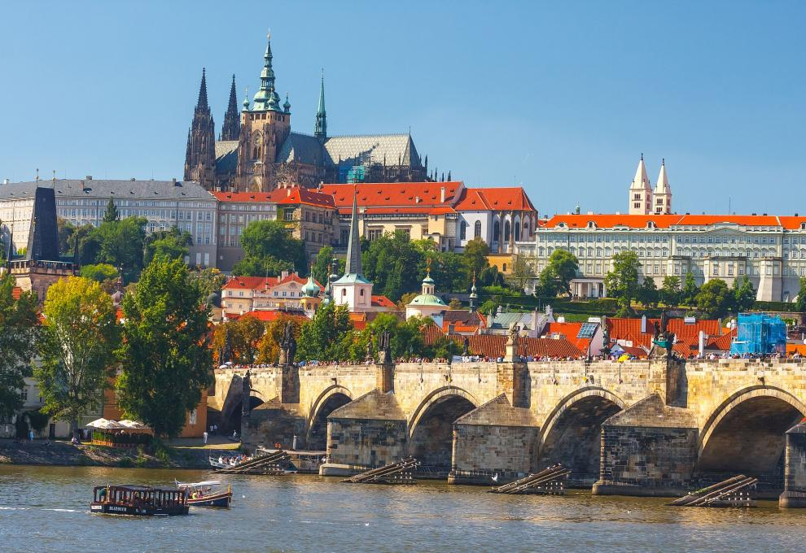
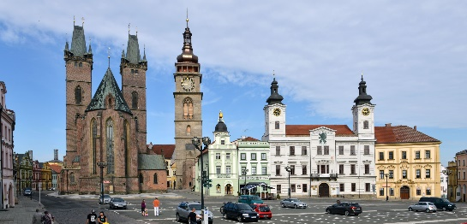
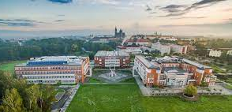

Welcome to the Czech Republic
Welcome to HRADEC KRÁLOVÉ
Welcome to the University of Hradec Králové

Slide 2

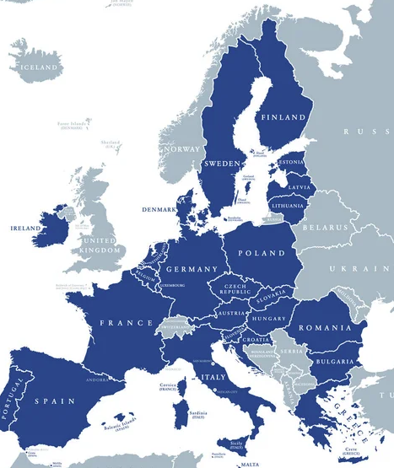
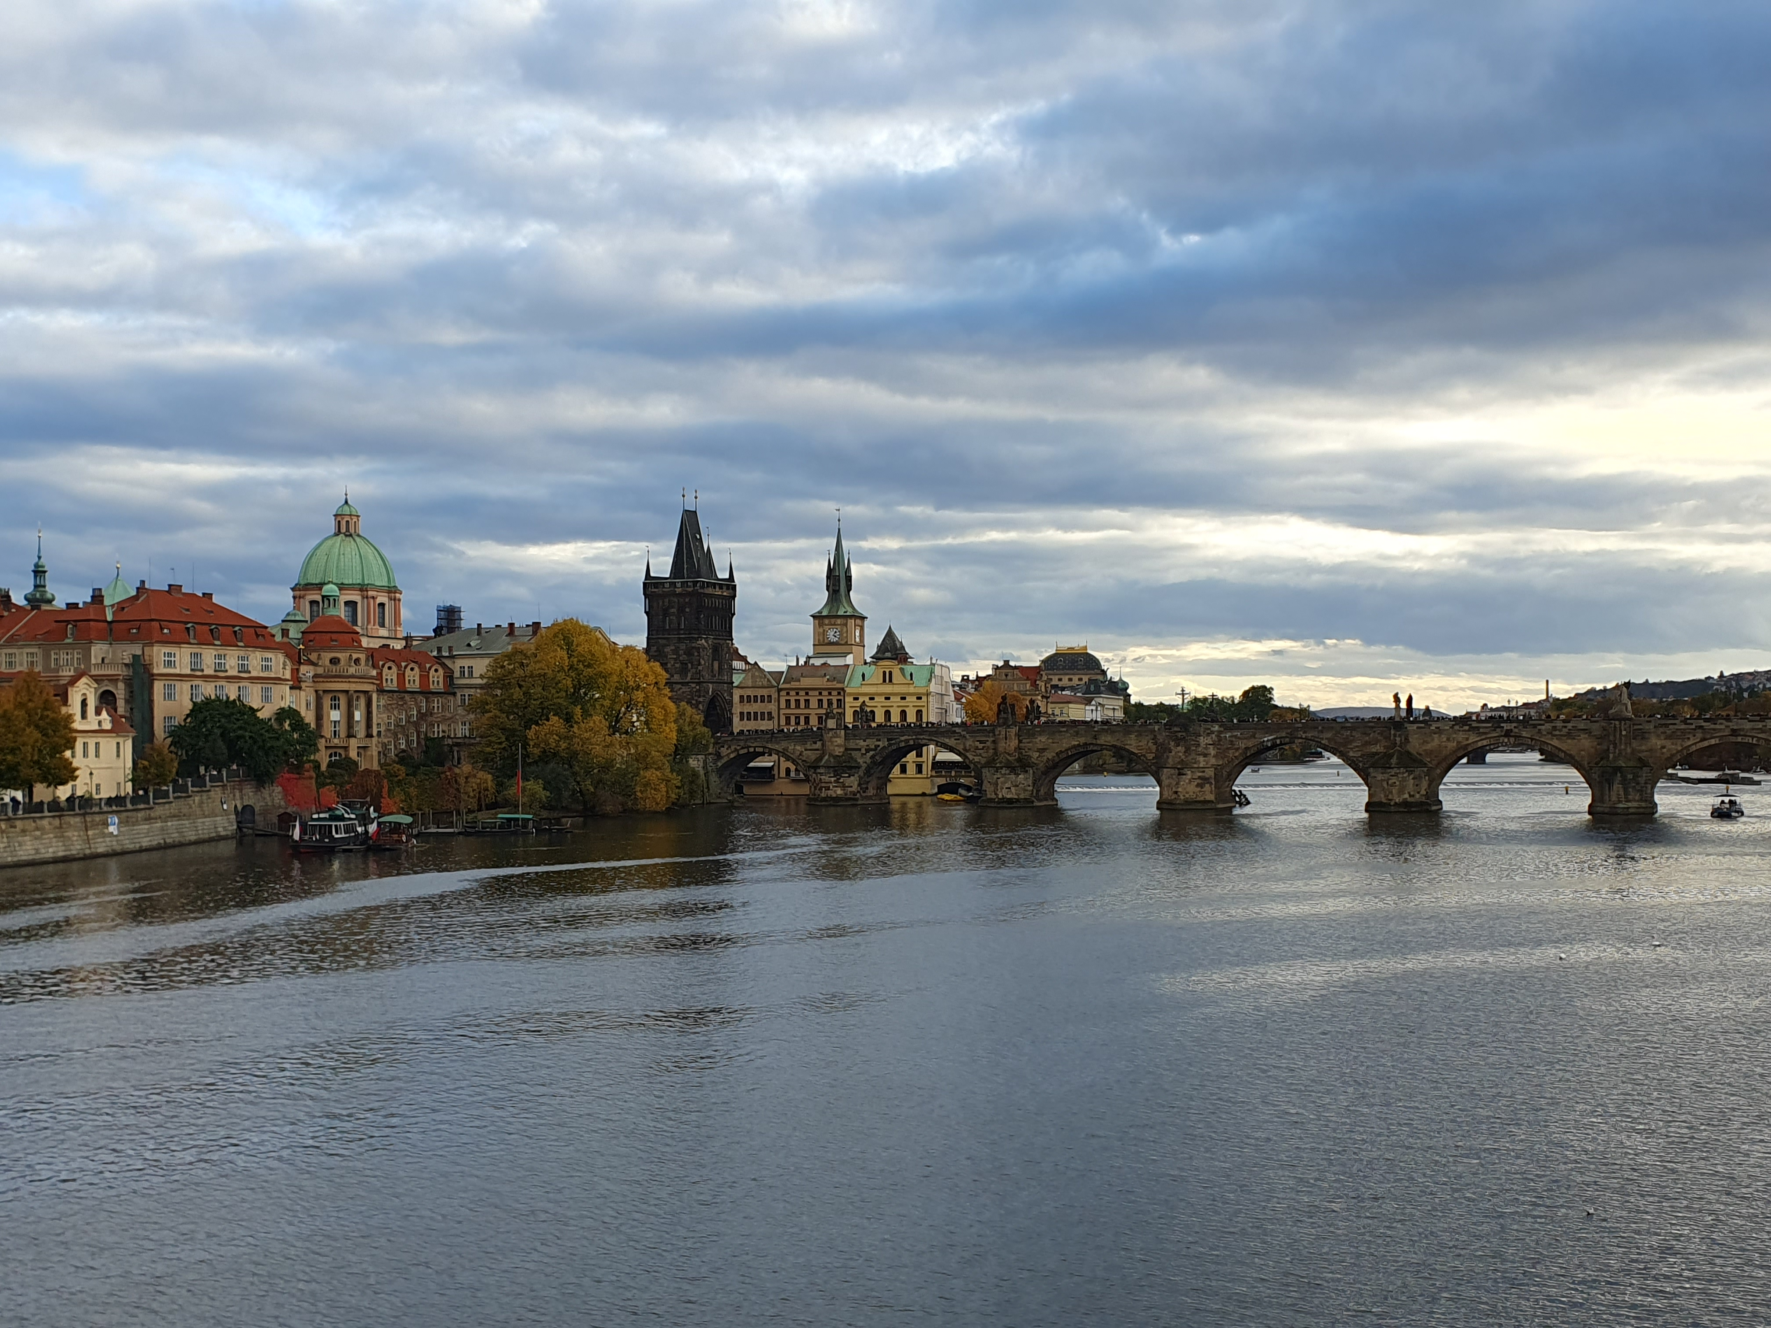


the Czech Republic
Founded: 1.1.1993 (the Czech Republic)
28.10.1918 (Czechoslovakia)
Population: 10 millions
Area: 78,871 km²
Capital: Prague (1,000,000 citizens)
Official language: Czech
Currency: Czech crown
Political system: Unitary parliamentary republic
Well known companies:
Brewery Plzeňský Prazdroj
Škoda Auto a.s. – the largest
car manufacturer in Czech
2

Slide 3

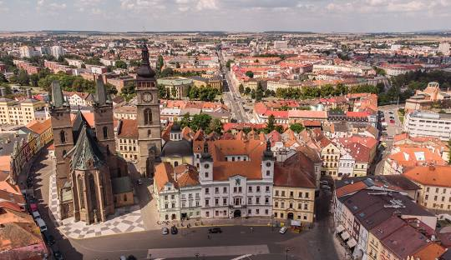
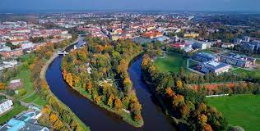
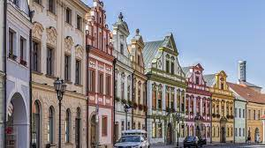
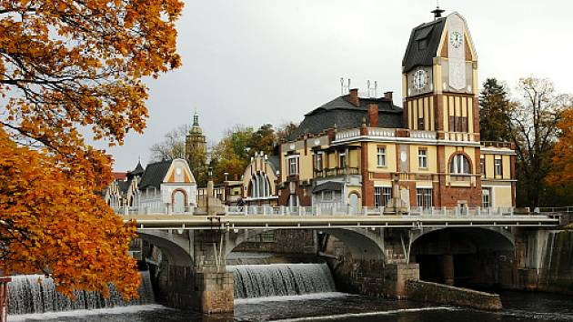
Hradec Králové
Location: 100 km far from Prague (east direction)
Population: 93,506 citizens
It is the capital of the Hradec Králové Region
Universities in Hradec Králové:
University of Hradec Králové
Charles University – Faculty of Medicine
Charles University – Faculty of Pharmacy
University of Defence – Faculty of Military
Health Sciences
3

Slide 4
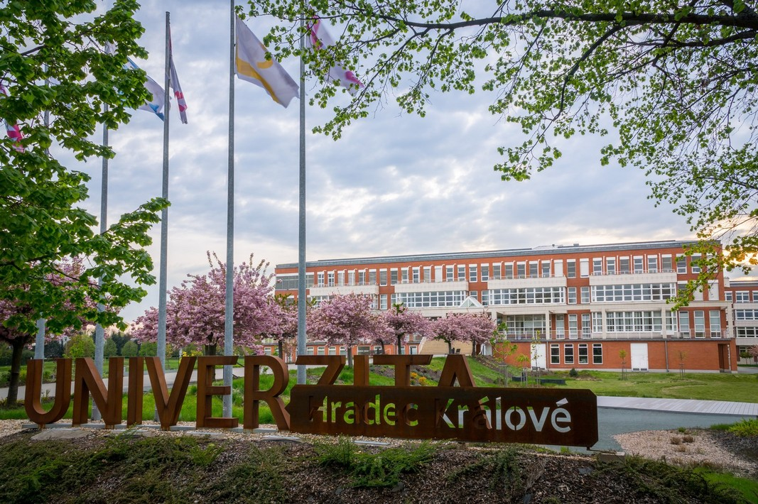
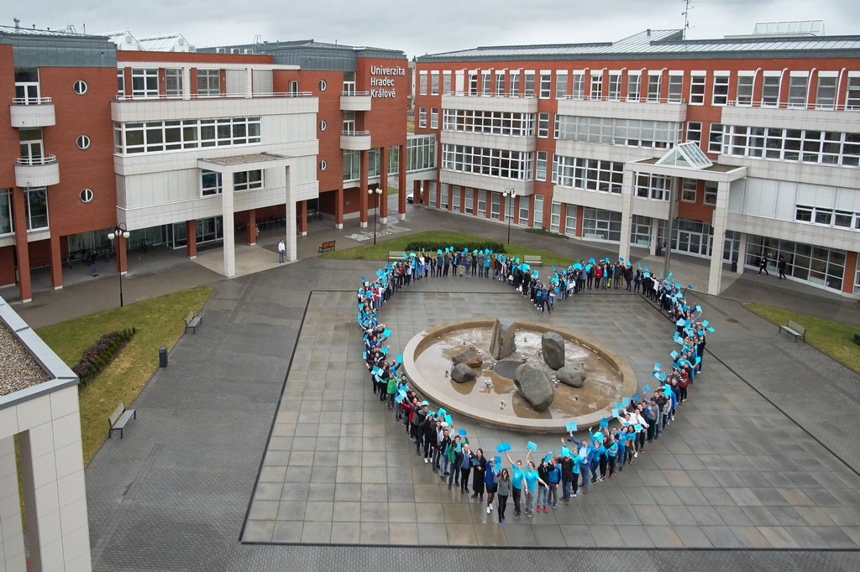
UHK & FIM
University of Hradec Králové
Education institution was founded in 1959
In 1992 it became/renamed in university
6,000 students
Public university
ECTS (European Credit Transfer System)
4 faculties
Dormitory for students
https://www.uhk.cz/en
Faculty of Informatics and Management (FIM)
FIM was founded in 1993 – 32nd birthdays this year!
1,600 students
Bachelor‘s, Master‘s and Doctoral degrees
Exchange students are from the whole world
Summer school "Czech It Out 2025"
Website , Short Fairy tale of FIM UHK
4

Slide 5



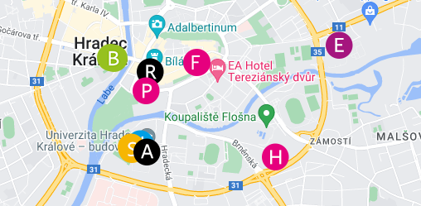

Other faculties

Slide 6
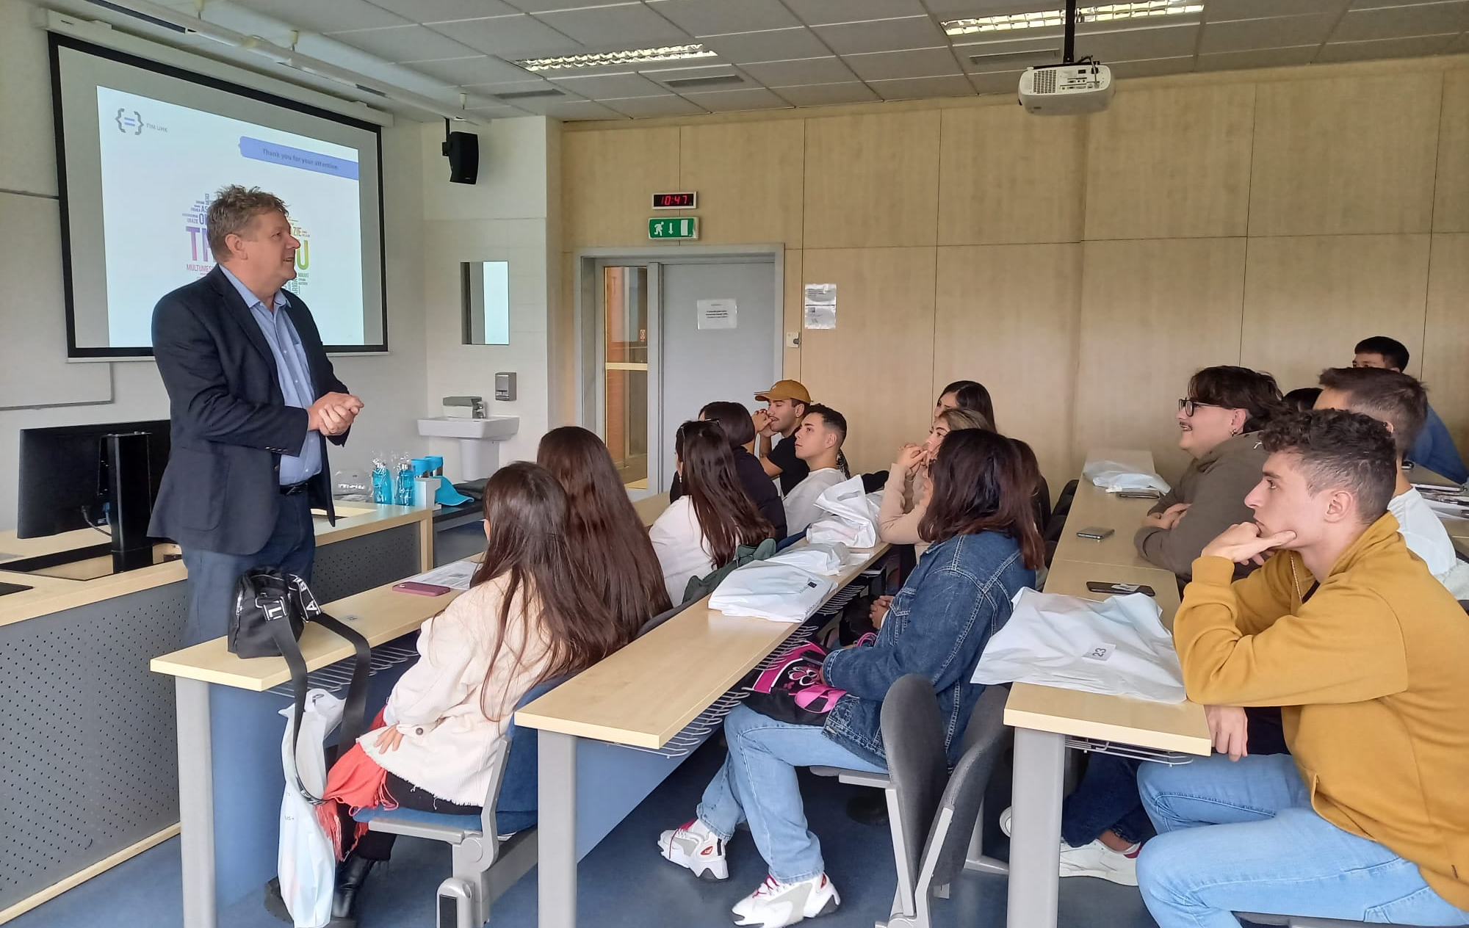
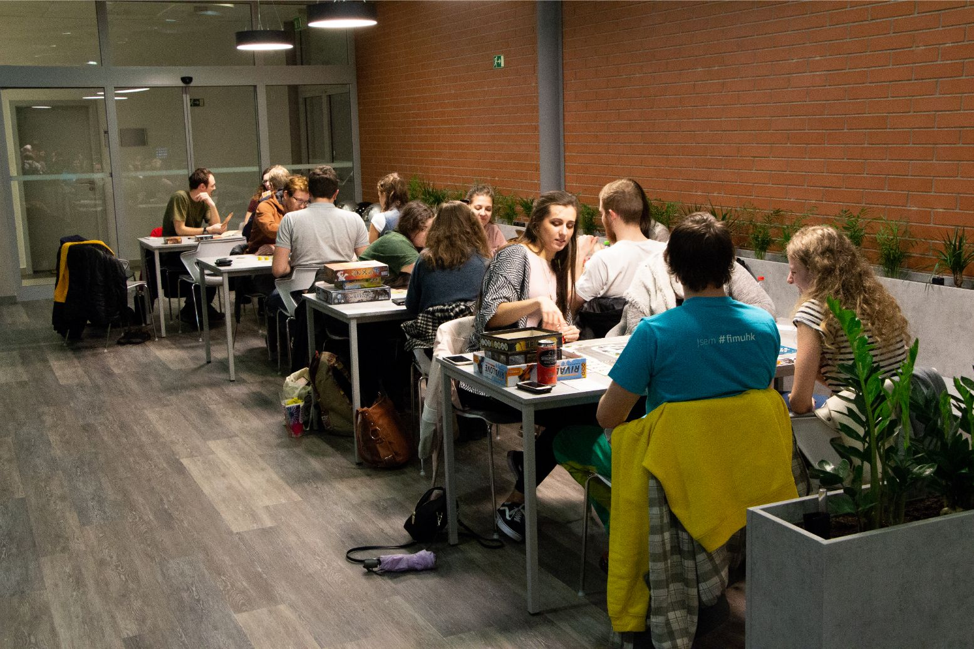
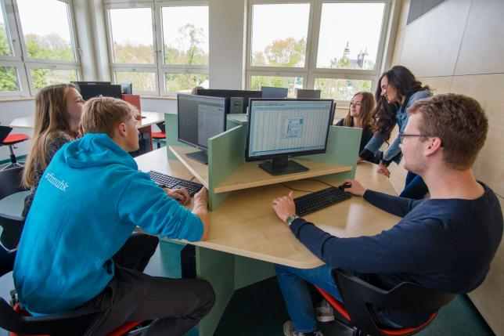
FIM - Study Programs - English
Full-time studies:
Bachelor Degree Programs
(duration of the program: 3 years)
Applied Informatics
Information Management
Master Degree Programs:
(duration of the program: 2 years)
Applied Informatics
Information Management
Economics and Management
Doctoral Degree Programs:
(duration of the program: 4 years)
Applied Informatics
Economics and Management
Systems Engineering and Informatics

Slide 7
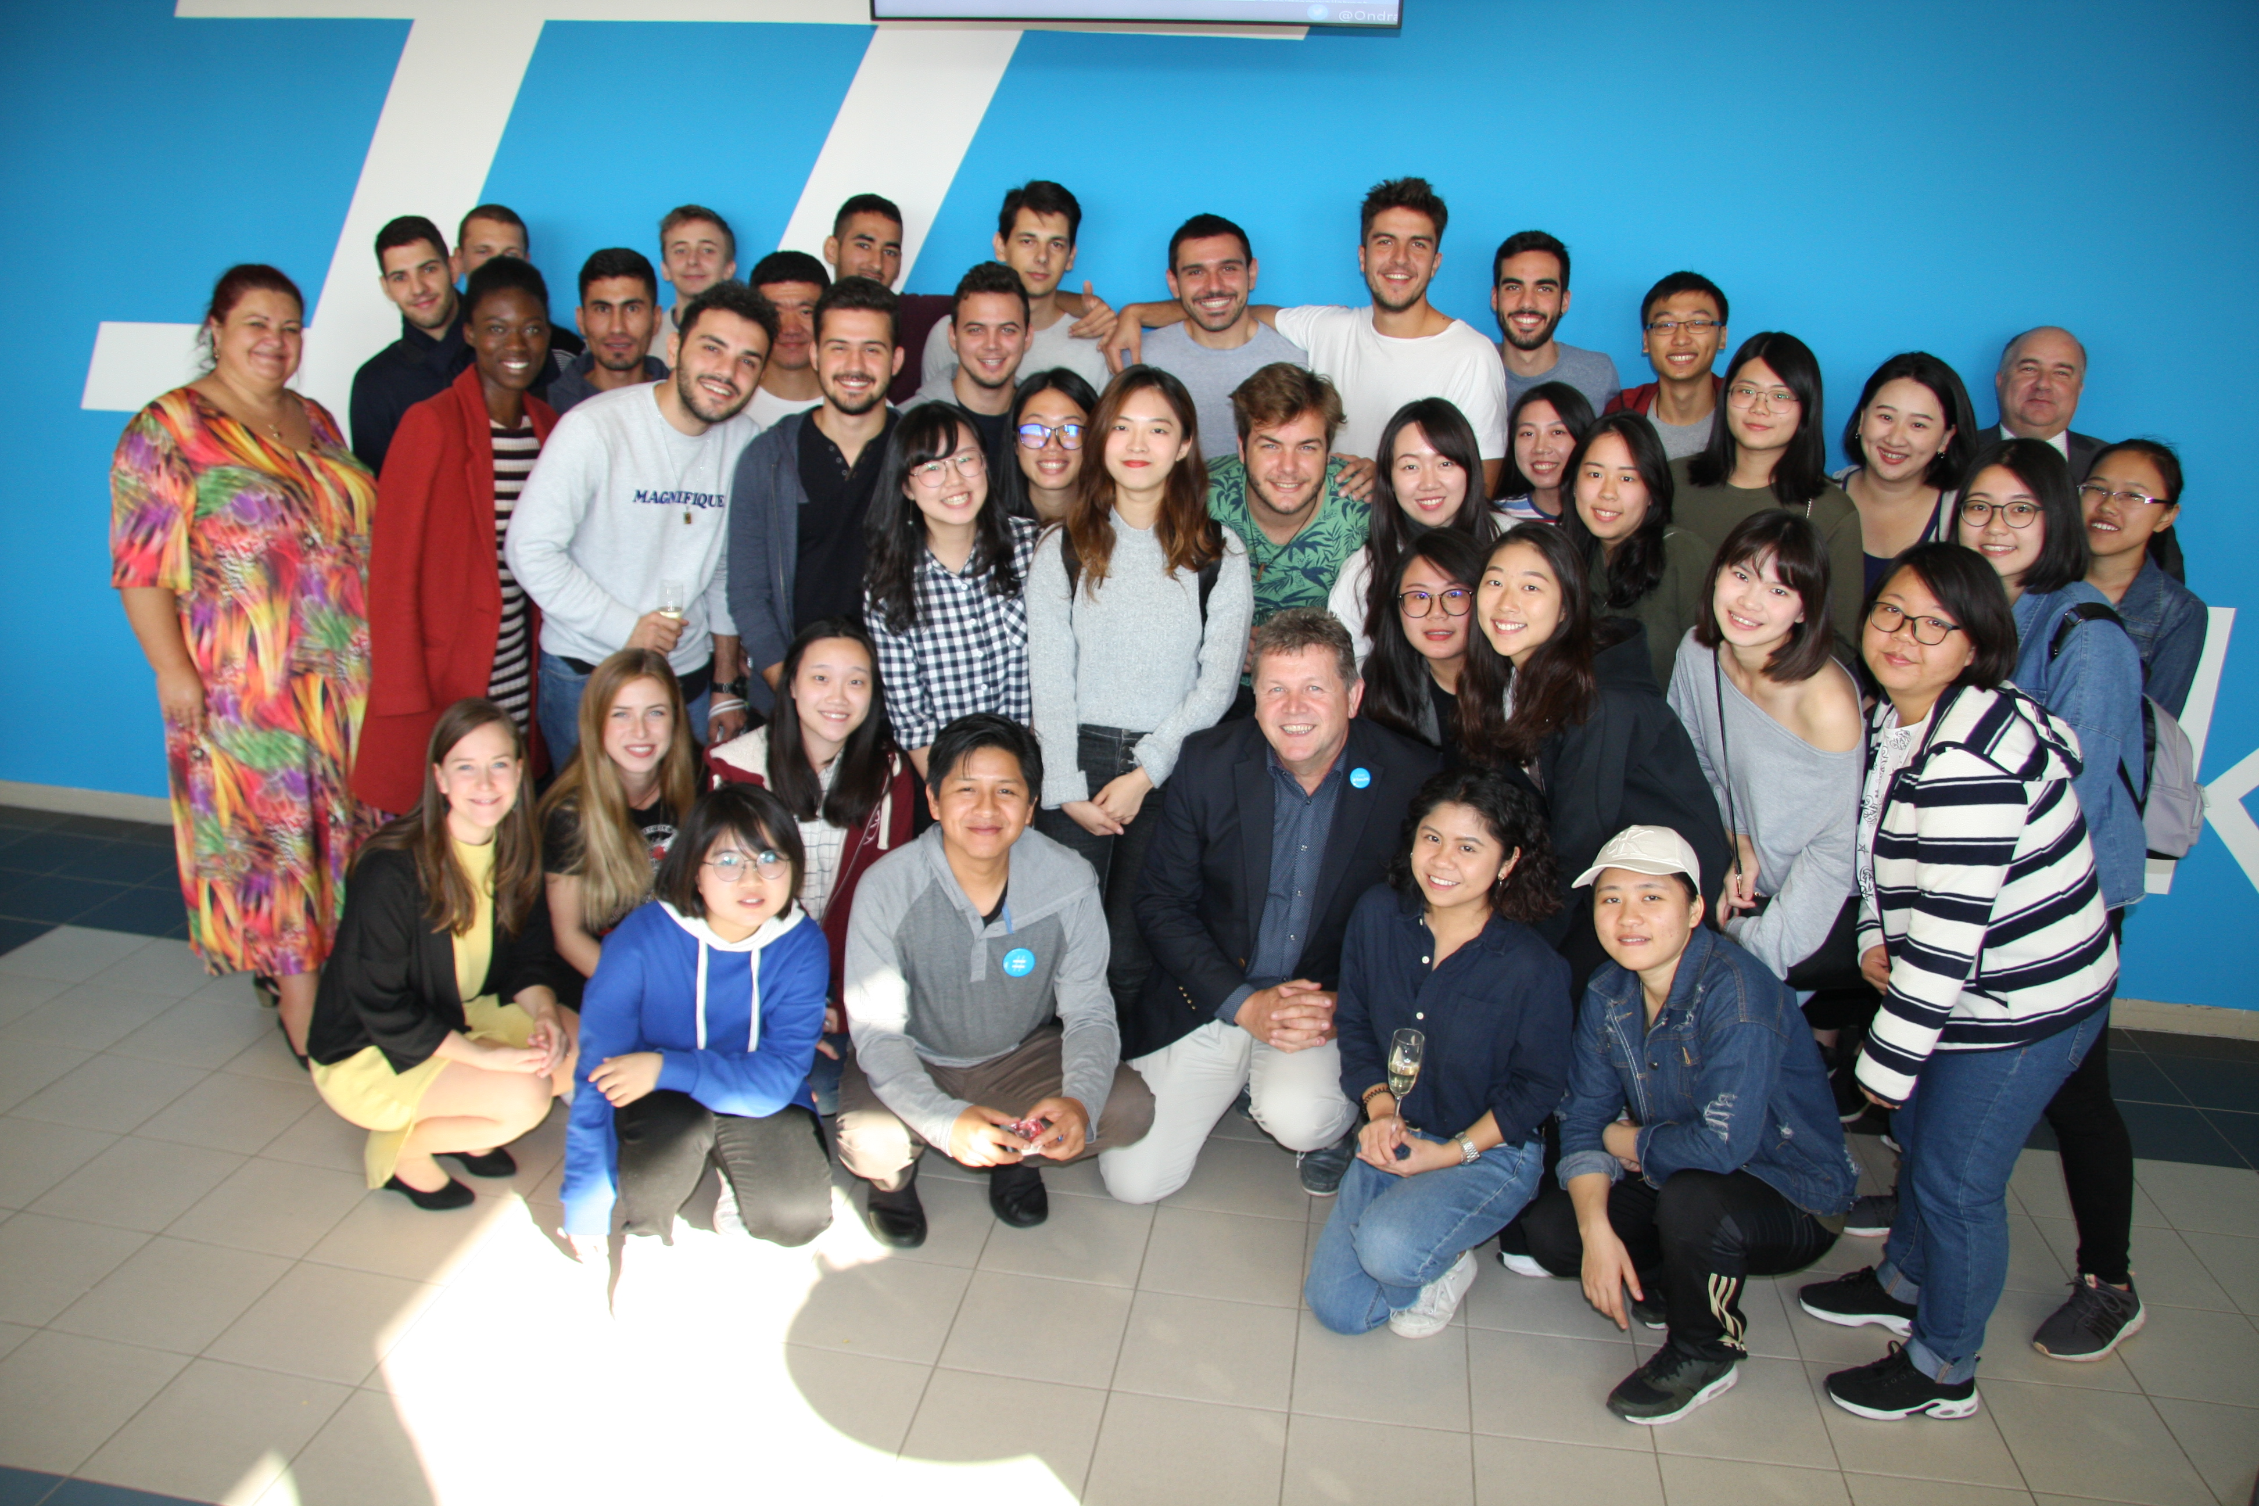
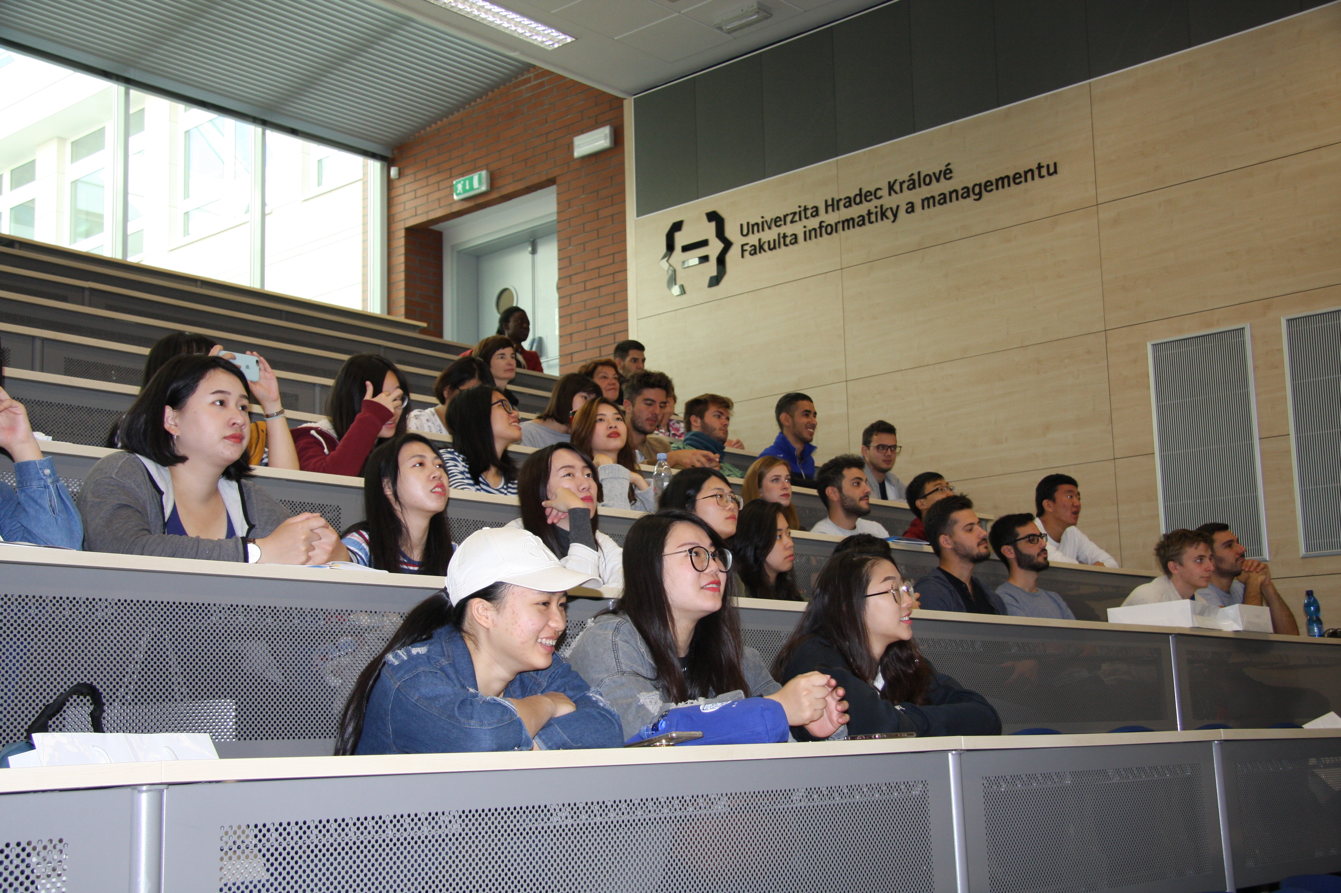
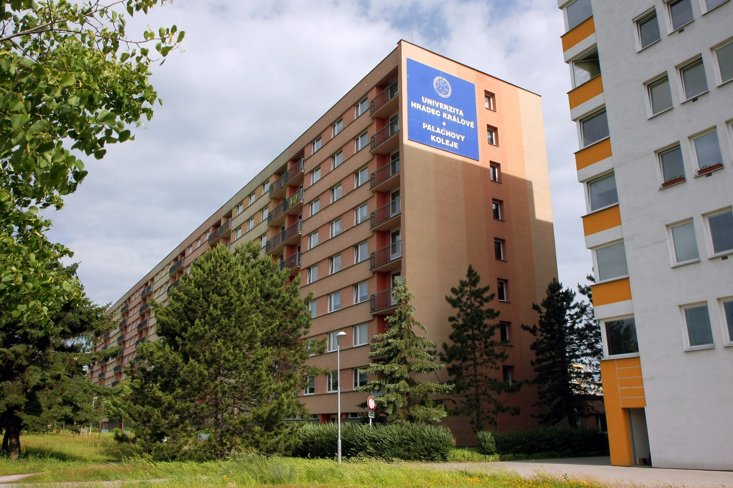
FIM - Mobilities
Mobilities:
Erasmus+ programs
Erasmus+ program for study, teaching, training or internships
Erasmus+ International Credit Mobility
Exchanges based on agreements about cooperation
Course Catalogue
On average 40 subjects available in English per semester
Students can take courses from other faculties (up to 25 % of credits only)
ISCED codes
0413 Management and Administration (includes Tourism, Languages)
0613 Software and applications development and analysis
0688 ICT (Information and Communication Technologies)
University Halls of Residence
25-30 minutes walk or take the city bus
Apartment has 2 bedrooms for 2 or 3 people
Kitchen & bathroom are shared by 4 or 6 students
Laundry, gym
EUR 170 EUR per month

Slide 8

Industrial Cooperation
8

Slide 9
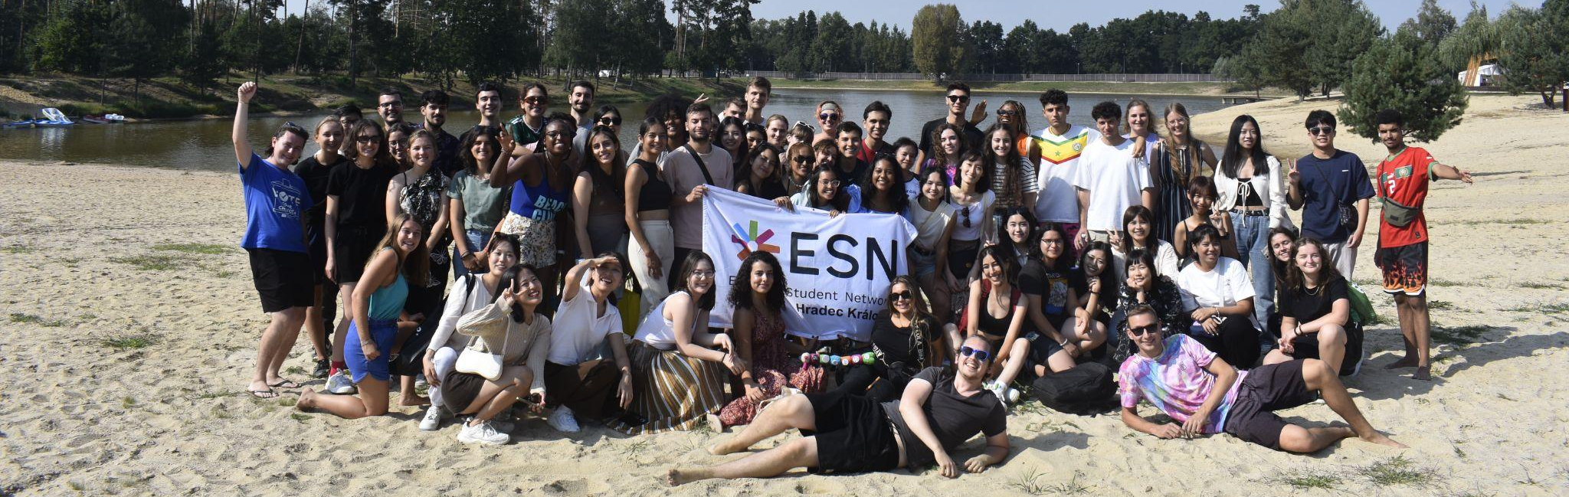
Erasmus Student Network - ESN
Erasmus Student Network
Non-profit international student organisation
Many activities are organized by ESN (events, evening programs, parties, trips, weekend activities)
Main goal of this organization is to help foreign students during their stay in Hradec Králové
https://www.esnhk.cz/
E-mail: info@esnhk.cz, Office phone: (+420) 493 332 216

Slide 10

University of Hradec Králové

