Slide 1


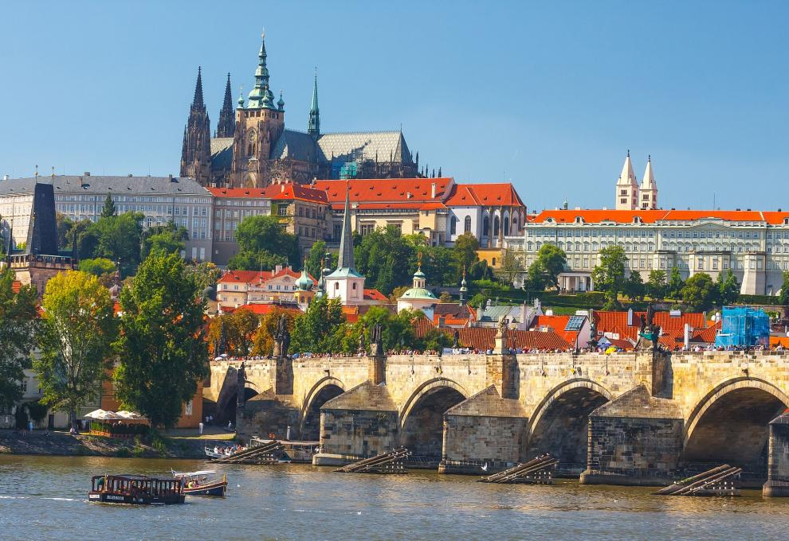
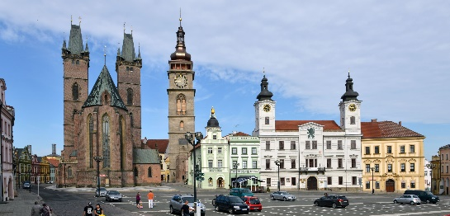
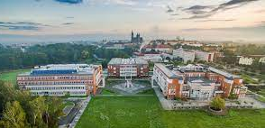
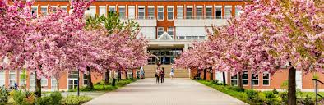
Welcome to the Czech Republic
Welcome to HRADEC KRÁLOVÉ
Welcome to the University of Hradec Králové

Slide 2
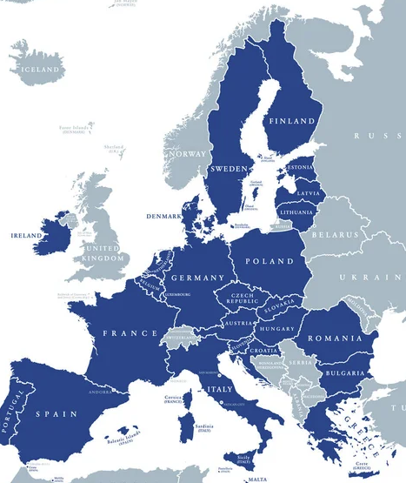

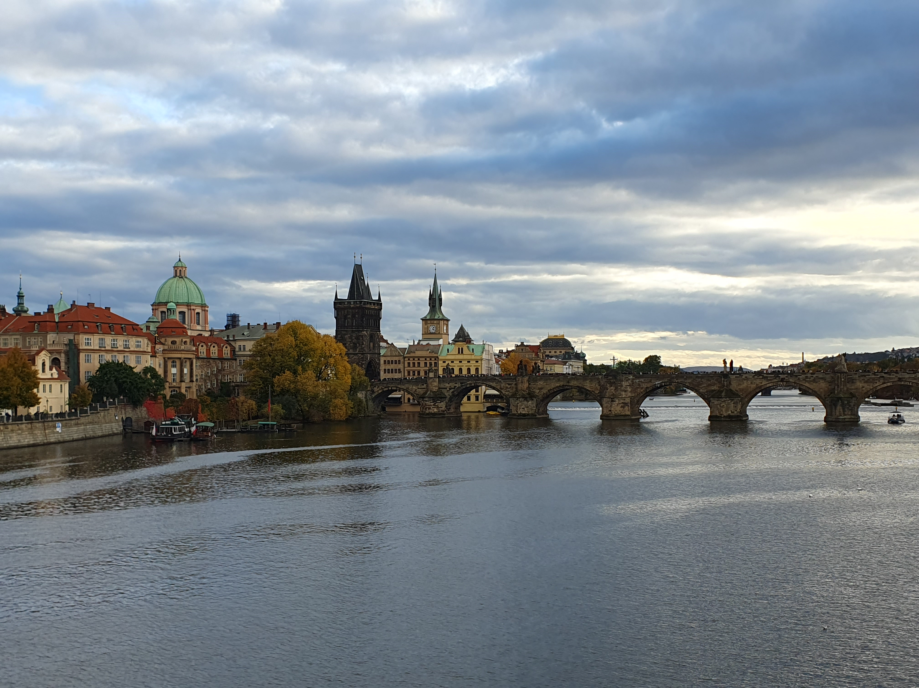

Czech Republic
Founded: 1.1.1993 (the Czech Republic)
28.10.1918 (Czechoslovakia)
Population: 10 millions
Area: 78,871 km²
Capital: Prague (1,000,000 citizens)
Official language: Czech
Currency: Czech crown
Political system: Unitary parliamentary republic
Well known companies:
Brewery Plzeňský Prazdroj
Škoda Auto a.s. – the largest car manufacturer in Czech
2

Slide 3
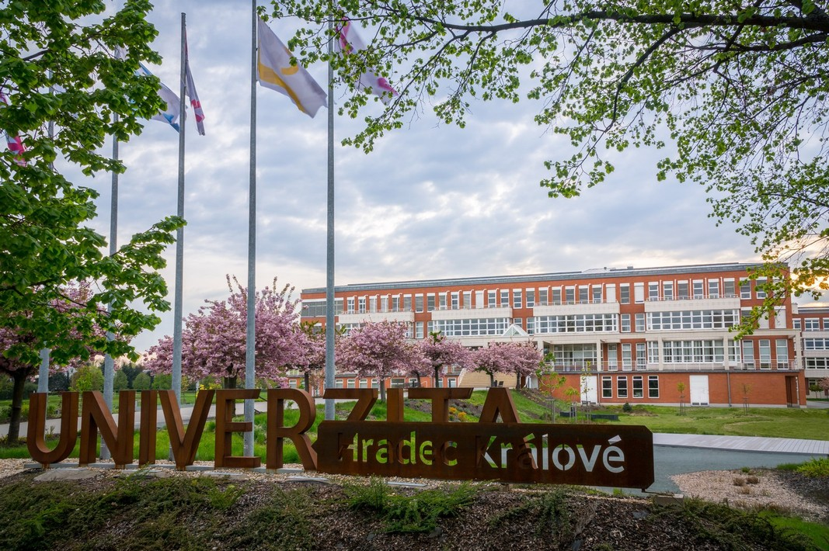
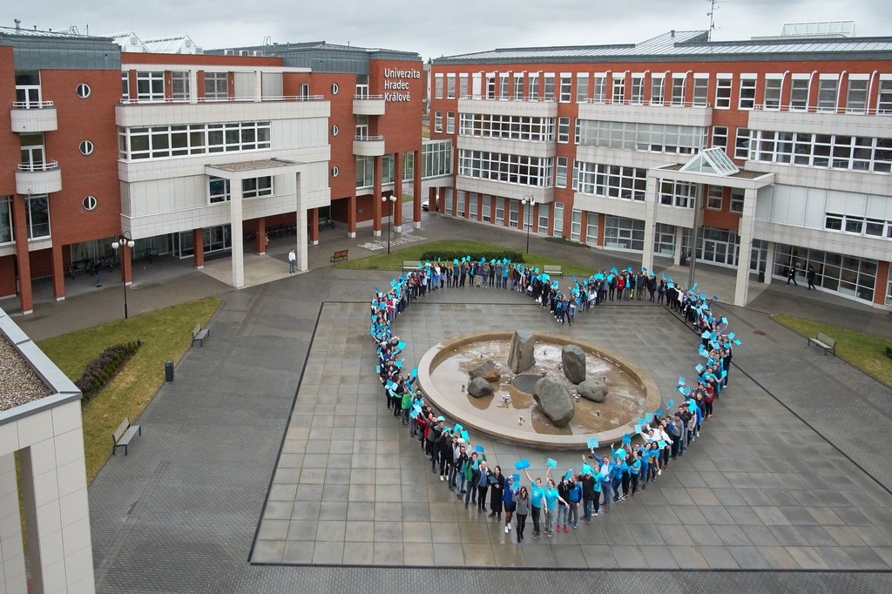
University of Hradec Králové
Education institution was founded in 1959
In 1992 it became/renamed in university
6,000 students
Public university
ECTS (European Credit Transfer System)
4 faculties
Dormitory for students
https://www.uhk.cz/en
UHK & FIM
Faculty of Informatics and Management (FIM)
FIM was founded in 1993 – 33rd birthday this year!
1,600 students
Bachelor´s, Master´s and Doctoral degree
Exchange students are from the whole world
Summer school „Czech It Out 2025“
Website
3

Slide 4
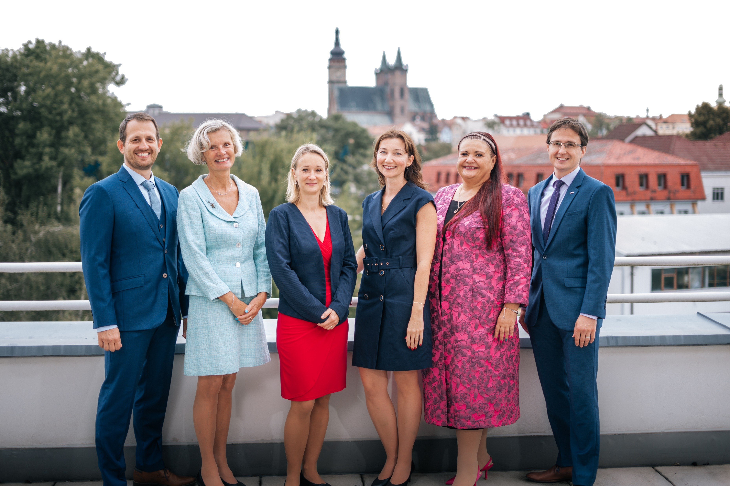




Management of the Faculty of Informatics and Management
Management of the Faculty of Informatics and Management
prof. Ing. Mgr. Petra Marešová, Ph.D., MBA
Dean
prof. RNDr. Petra Poulová, Ph.D.
Vice-Dean for Strategy and Development
prof. PhDr. Blanka Klímová, M.A., Ph.D.
Vice-Dean for International Relations
Ing. Jan Mačí, Ph.D.
Vice-Dean for Study Affairs
prof. Ing. Vladimír Bureš, Ph.D., MBA
Vice-Dean for Science and Research
Ing. Lenka Buchtová
executive secretary
Notes:
Druhý nejlepší ve výsledcích
Cílem nového vedení,…
A myslím si že mi k tomu pomůže mnohem více pohled zvenku (uvnitř mám…)
A čekávám pomoc v tom aby mě nasměrovali k tomu jak z fakulty udělat mezinárodně uznávanou fakultu – at už na základě doporučení které bude směřovat k inetrnacionalizici, vědě výzkumu, účasti v boardech,…
Je to taky trend úspěšných fakutl v česku,…že takvé boardy mají a používají je,..

Slide 5
Faculty of Informatics and Management
Who we are
The Faculty of Informatics and Management (FIM) at the University of Hradec Králové is a modern and dynamic educational and research institution. We combine IT, data analytics, economics, and management, with a focus on practical skills, innovation, and international cooperation. Our graduates are well-prepared for successful careers and contribute to enhancing the university’s reputation both nationally and internationally.
Vision
FIM aspires to be a top choice for talented students integrating computer science, management, and innovation. Through digital learning, interdisciplinary research, and industry partnerships, we shape the future—regionally and globally.
Notes:
Druhý nejlepší ve výsledcích
Cílem nového vedení,…
A myslím si že mi k tomu pomůže mnohem více pohled zvenku (uvnitř mám…)
A čekávám pomoc v tom aby mě nasměrovali k tomu jak z fakulty udělat mezinárodně uznávanou fakultu – at už na základě doporučení které bude směřovat k inetrnacionalizici, vědě výzkumu, účasti v boardech,…
Je to taky trend úspěšných fakutl v česku,…že takvé boardy mají a používají je,..

Slide 6
Organizational structure of the faculty
FACULTY MANAGEMENT
Department of Applied Linguistics
Department of Economics
Department of Information Technologies
Department of Informatics and Quantitative Methods
Department of Management
Department of Recreology and Tourism
Center for Academic-Industrial Cooperation
Center for Basic and Applied Research
Institute of Further Education (IFE FIM)
Institute of Modern Information Technologies
Founded: 1993
Number of study programs: 5 Bachelor‘s,
4 Master‘s,
3 PhD
Number of students: 1,589
Number of staff: 105

Slide 7
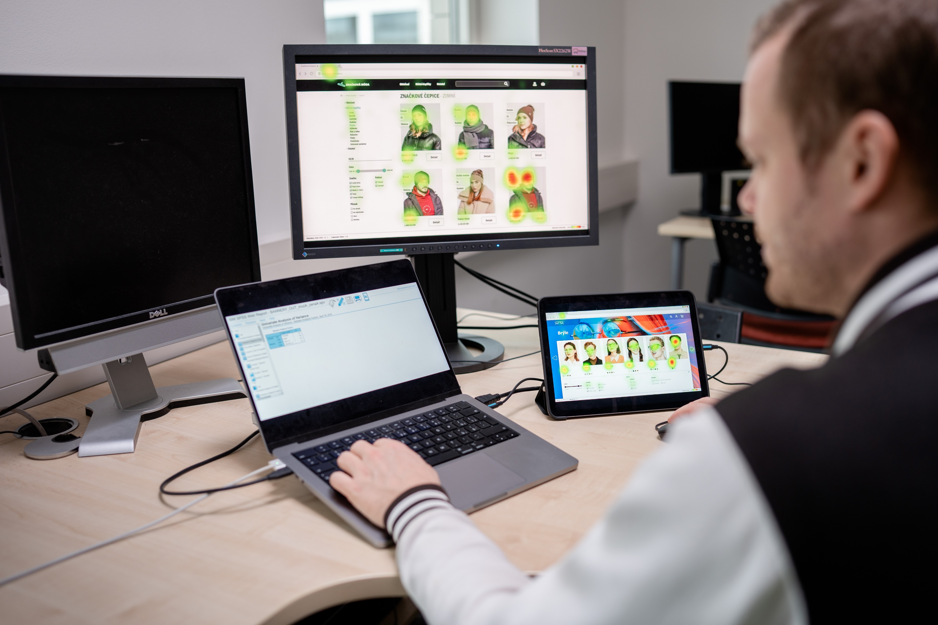


Research

Slide 8
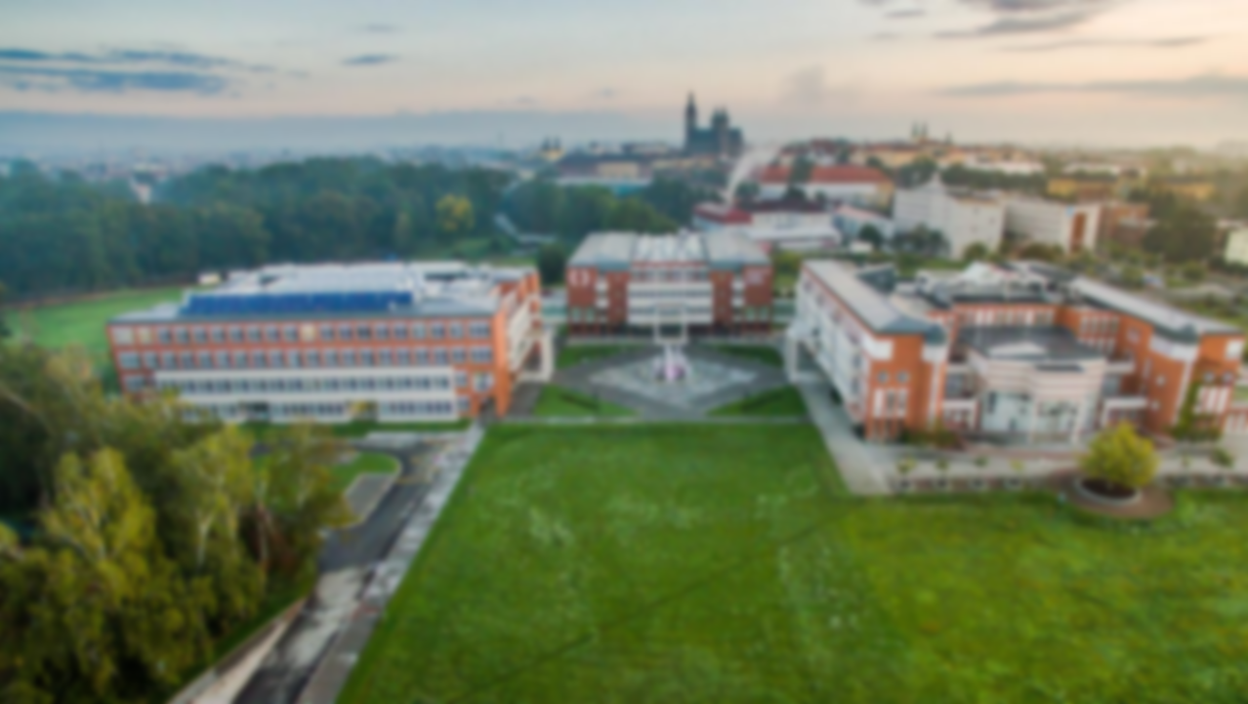





UHK/FIM rankings
UHK proves its high standard by passing strict criteria of prestigious international rankings such as QS or THE, it has also successfully qualified in a ranking devoted to sustainability and ecology – the UI Green Metric.
UHK Rankings | 2024 | 2025
THE WUR | 1201–1500 | 1001–1200
THE by subject: Education Studies | N/A | 601+
THE by subject: Computer Science | 601–800 | 601–1000
THE by subject: Physical Science | 1001+ | 801–1000
THE by subject: Life Sciences | 601–800 | 501–600
THE by subject: Arts & Humanities | N/A | 601+
THE Young Universities | 351–400 | N/A
QS WUR | 1001–1200 | 1001–1200
QS EECA/Europe | 403 | N/A
QS Eastern Europe | 41 | N/A
UI GREEN METRIC | 527 | N/A

Slide 9
Focus on Journals
Year | Web of Science |  | Scopus
 | Journals | Proceedings | Journals | Proceedings
2019 | 61 | 52 | 57 | 60
2020 | 83 | 31 | 71 | 36
2021 | 114 | 15 | 102 | 32
2022 | 109 | 9 | 88 | 16
2023 | 109 | 9 | 116 | 16
2024 | 103 | 3 | 119 | 21
2025* | 95 | 1 | 101 | 10
* December 2025 not included

Slide 10
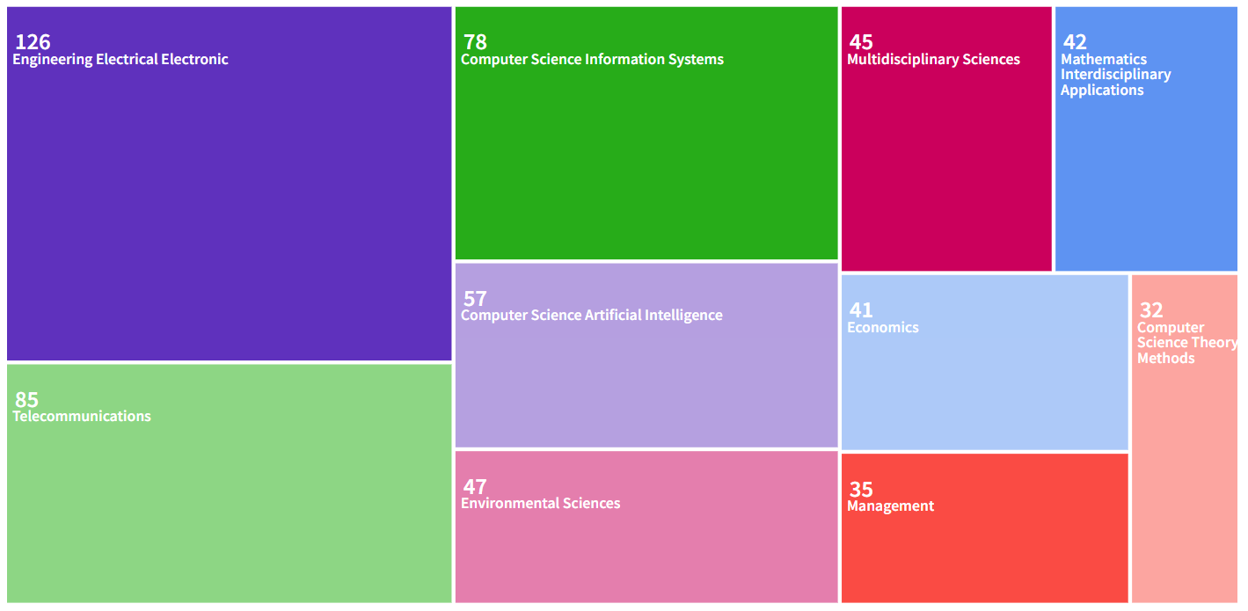
Research profile in Web of Science

Slide 11
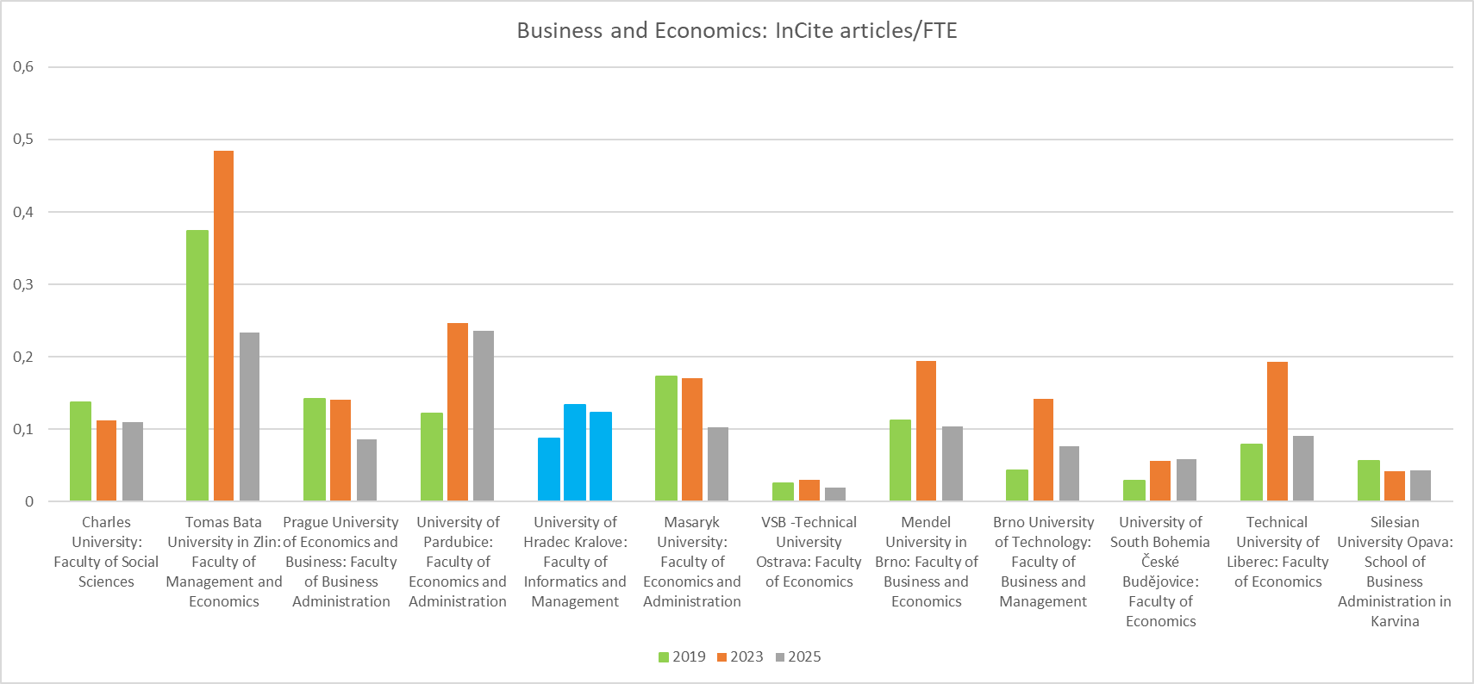
FORD 5.2 - Business and Economics: a comparison among faculties
InCite records, journals articles only
Related to FTE according to the Ministry of Education, Youth and Sports

Slide 12
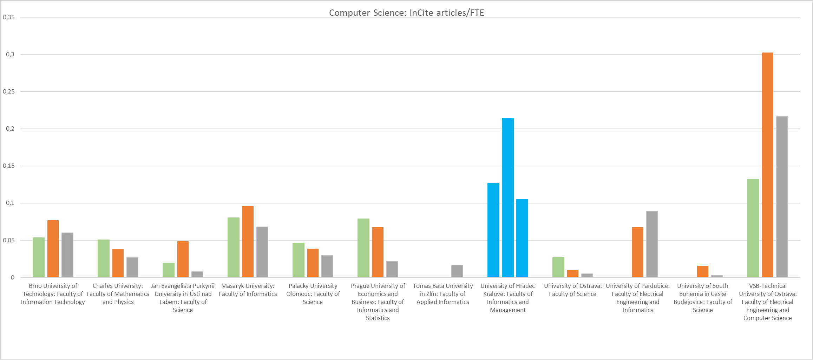
FORD 1.2 - Computer Science: a comparison among faculties
InCite records, journals articles only
Related to FTE according to the Ministry of Education, Youth and Sports

Slide 13
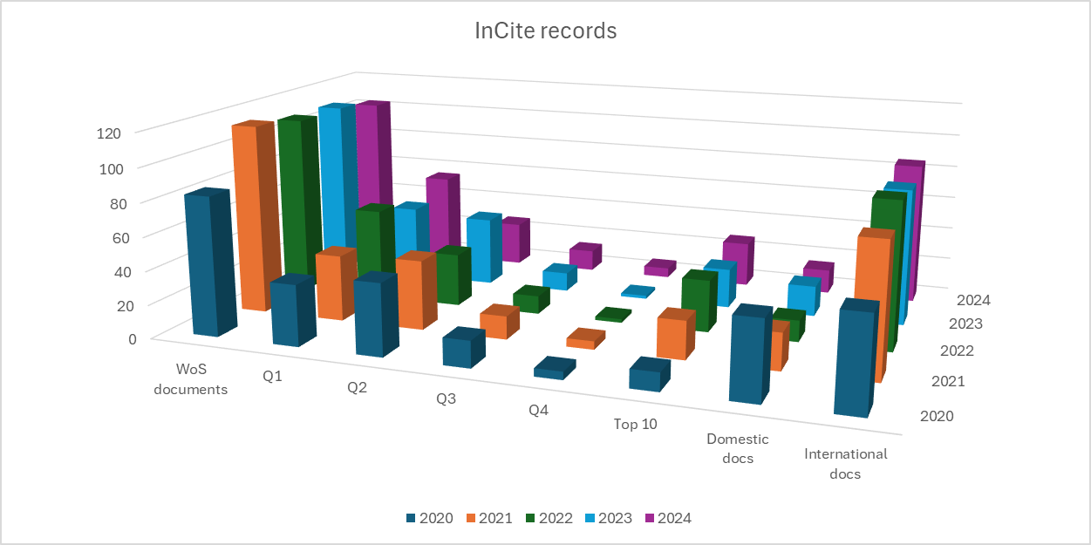
Qs and the Internationalization of Publications
Comparison of publications with respect to international authoring teams and quartile (source: Clarivate InCites)

Slide 14
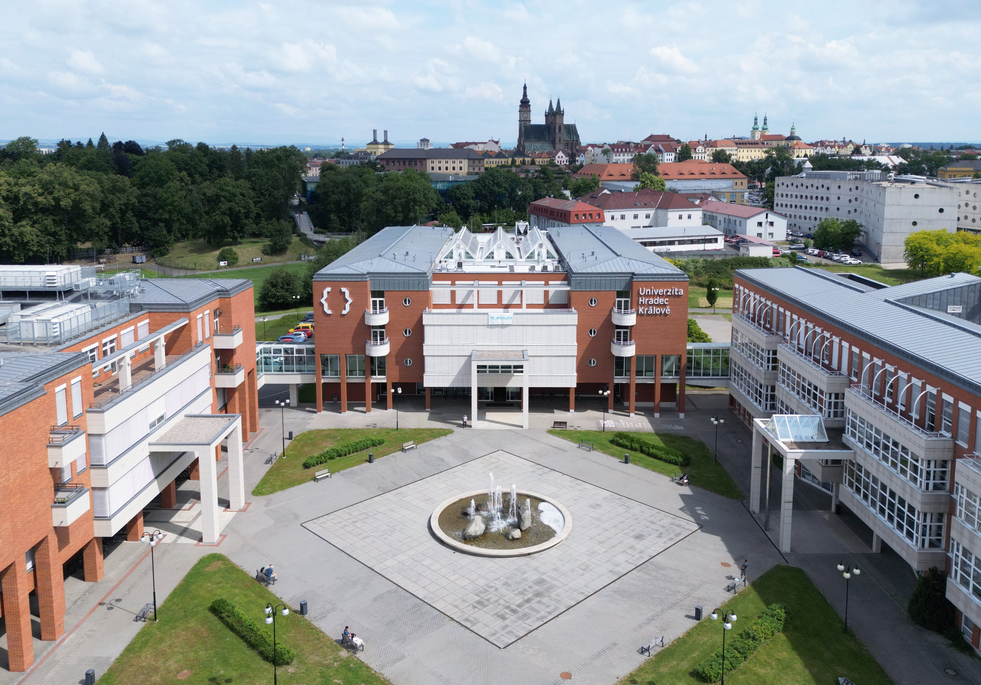

Research Activities and Projects University of Hradec Kralove, Faculty of Informatics and Management

Slide 15


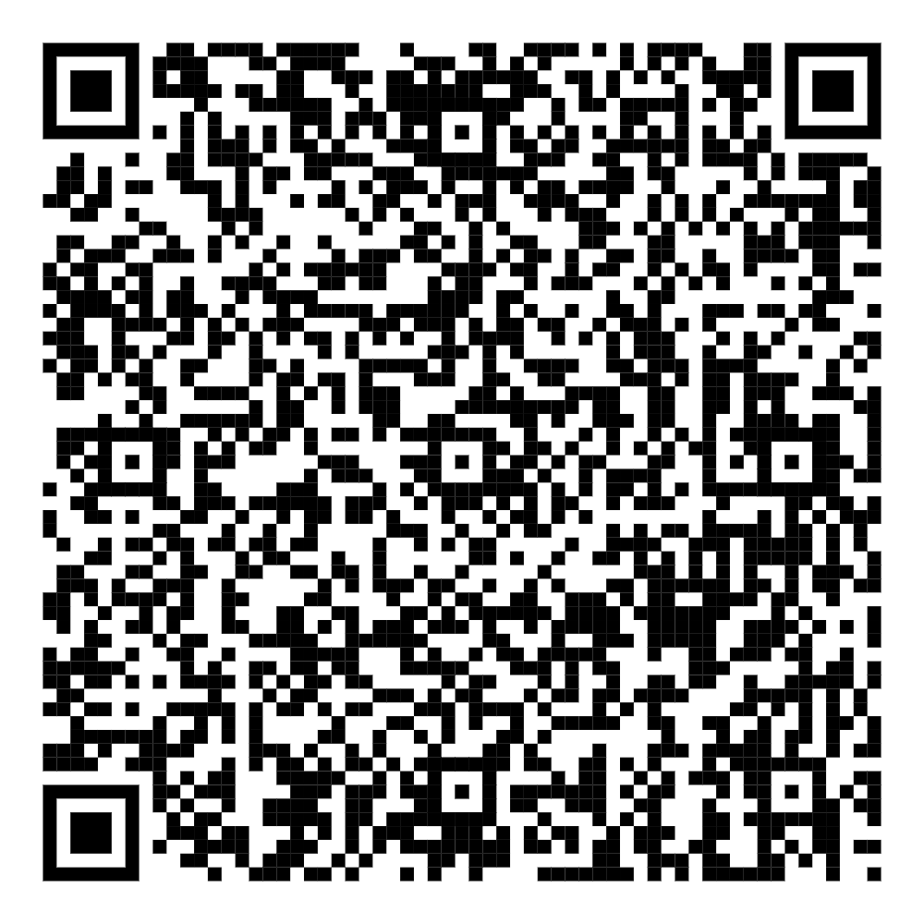
Department
of Information Technologies

Slide 16

Dept. of Information Technologies - Research Activities
CYBERSECURITY
Use of AI for expert system of asset identification and risk management
Artificial intelligence for Smart and Sustainable Urban Mobility
Securing IoT and resilient systems
The utilisation of social engineering as a means of enhancing resilience to cyber threats

Slide 17
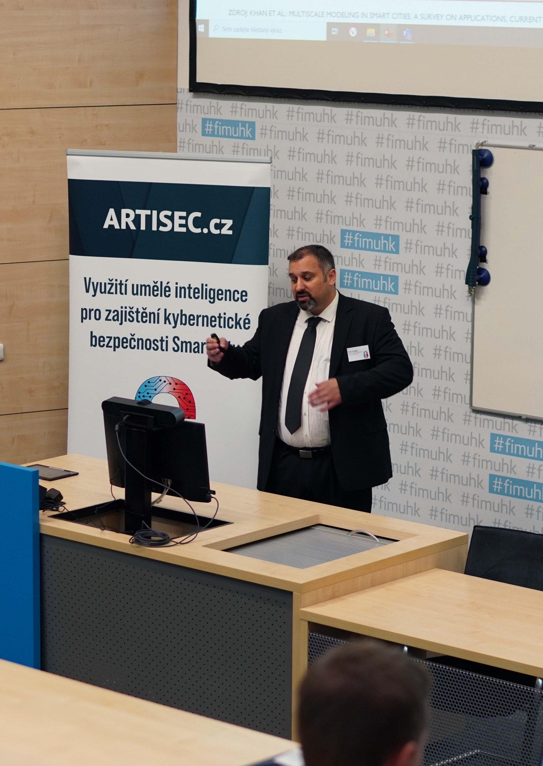
Dept. of Information Technologies - Project ARTISEC
Project Goal:
The ARTISEC project focuses on the use of artificial intelligence to ensure cyber security
Funding:
Technology Agency of the Czech Republic - The THÉTA 2 programme is aimed at supporting applied research and innovation in the energy sector
1,25 mil. EUR
Project duration: 2022 – 2025
Additional partners:
The Faculty of Electrical Engineering and Communication, Brno University of Technology
Self-Governing Region Hradec Kralove

Slide 18

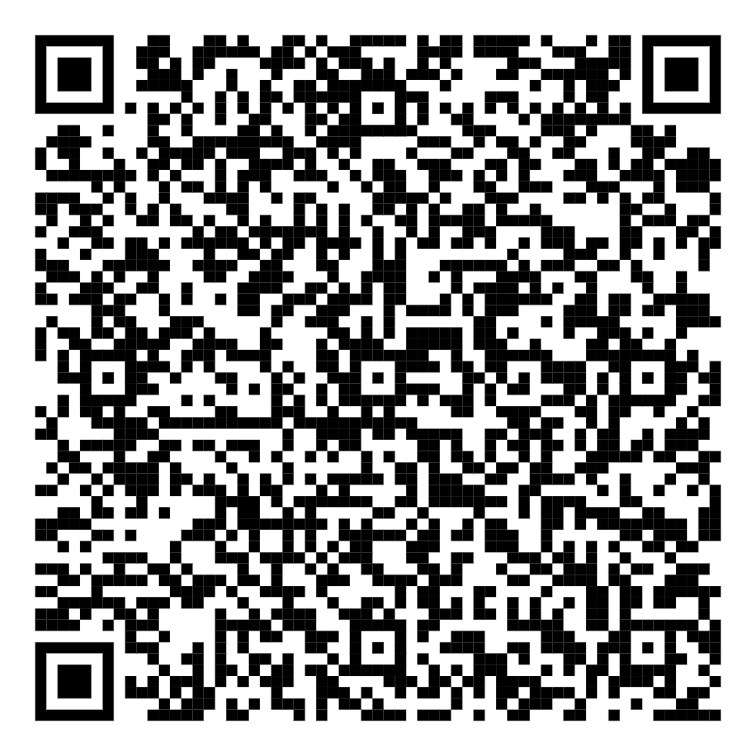
Department of Informatics
and Quantitative Methods

Slide 19

Dept. of Informatics and Quantitative Methods - Research
Algorithmization
Indoor Localization
Data Science, Data Processing and Analysis, Statistical and Mathematical Modelling
Application of AI

Slide 20
Dept. of Informatics and Quantitative Methods - Projects
Algorithmization
Web service application for Quartz Scheduler (DERS, spol. s r.o.)
Design of a paperless laboratory concept (VUOS a.s., EffiChem, spol. s r.o.)
Design and analysis of a hotel process simulator (VŠH, spol. s r.o.)
Design of an application for processing medical data from Capsule Endoscopy (FN HK)
Mobile application for CO2 sensor readings including visualization and sensor management via NFC (Protronix, spol. s r.o.), …
Data Science, Data Processing and Analysis, Statistical and Mathematical Modelling
Analysis of data related to water management (institutional project with the company Povodí Labe)
Analysis of data from the transport system of the city Pardubice and data describing the use of parking spaces in the city of Hradec Kralove (MPO project Smart Parking & Charging)
Analysis of data describing the habits and behaviour of elderly people (project with the Medical Faculty of Hradec Kralove and others)

Slide 21

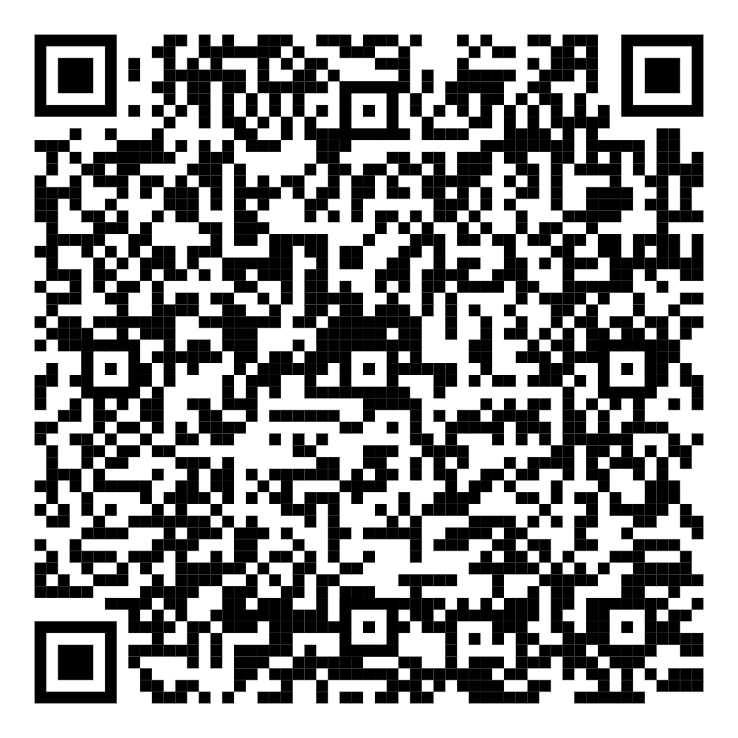
Department of Economics

Slide 22

Dept. of Economics - Research Activities
Application of decision-making methods and methods of dynamic simulation in the field of healthcare
Design of a dynamic model to evaluate the effectiveness of investment in the selected areas of research and development
Econometry and related models and indicators
Industry 4.0/Company 5.0

Slide 23
Dept. of Economics - Projects
Devising a Personalized Risk Stratification and Holistic Management for Prevention of Cognitive Impairment in Patients with different Cardiovascular Phenotypes: The Dorian Gray Project
Horizon Europe, main coordinator: Università degli Studi di Brescia (UNIBS)
Project duration: 2025 – 2029
Objective: Univeristy of Hradec Kralove in proposal: Generation of a Health Technology Assessment (HTA) report based on the results of an implementation clinical study in 4 clinical centres across Europe. HTA will explore legal, ethical, and social aspect as well and cost–effectiveness of the multidomain personalised intervention delivered through the ABCE (WP12). Outcome: implementation of the intervention in population with MCI.

Slide 24

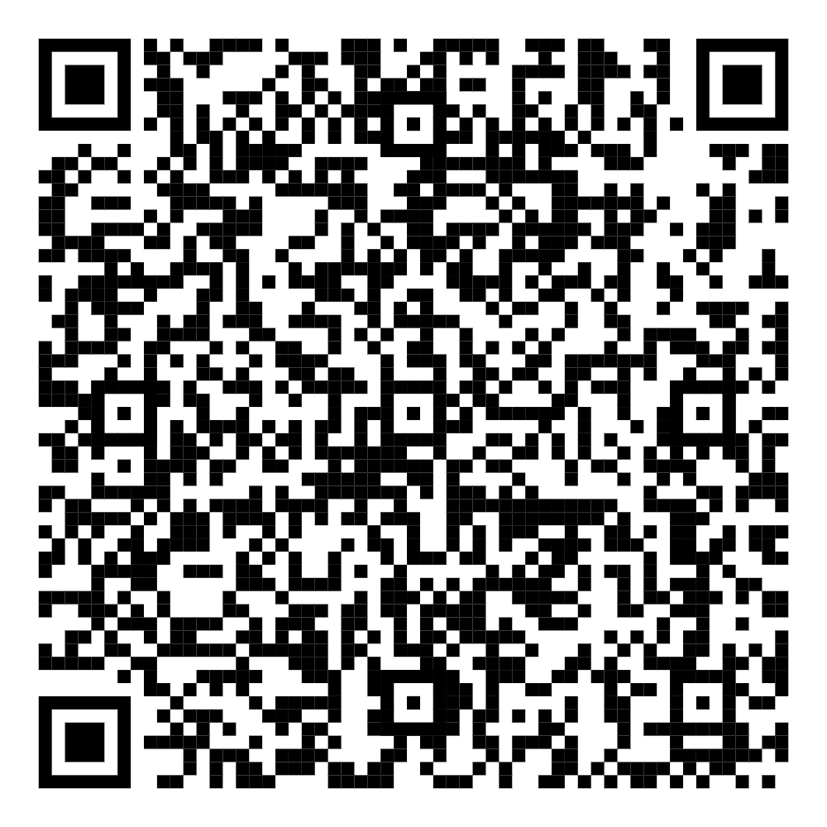
Department of Management

Slide 25
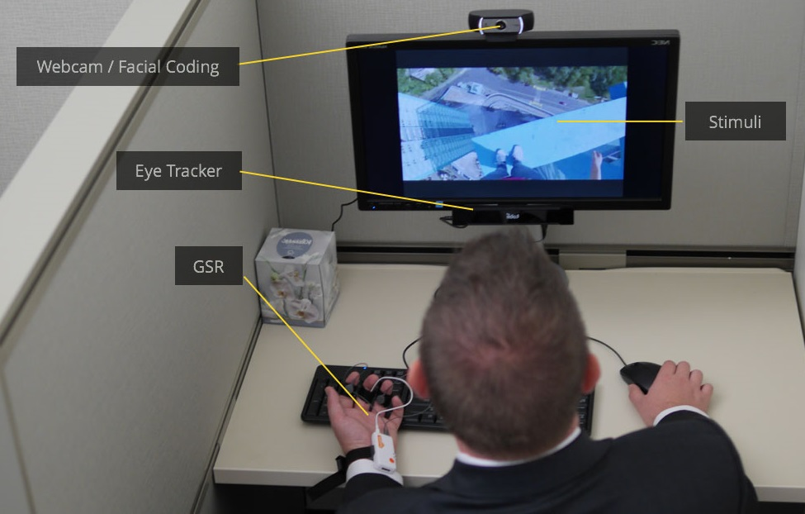
Dept. of Management – Research Activities
Audio-visual interaction: exploring the relationship between music and visual stimuli
Usability testing of websites and improving user experience (UX)
Analysis of eye movements and emotional facial expressions
Digital communication, innovative development , or digital communication on social networks or in the communication of multinational companies
The issue of innovation, or open innovation strategies, specifically in the area of human resource management strategy, referred to as the 'human side of open innovation‘

Slide 26
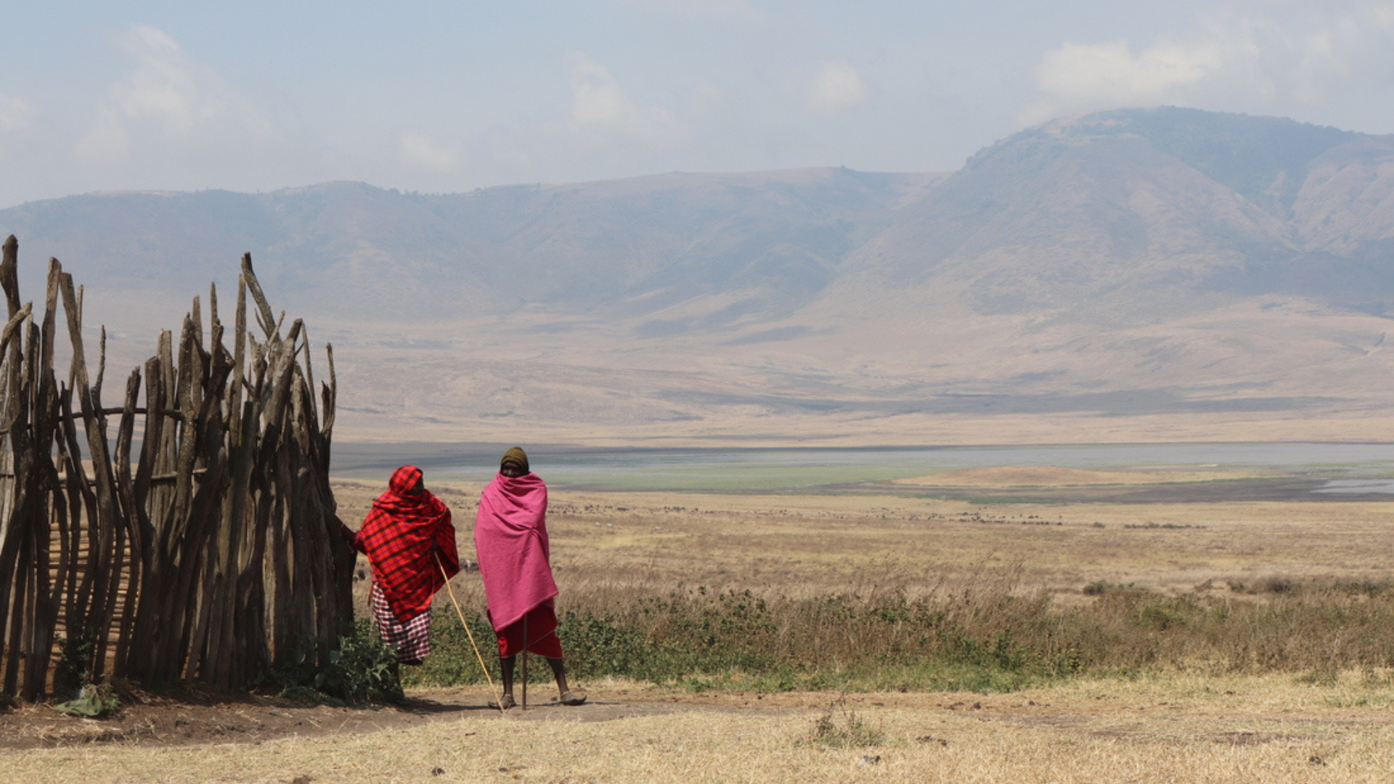
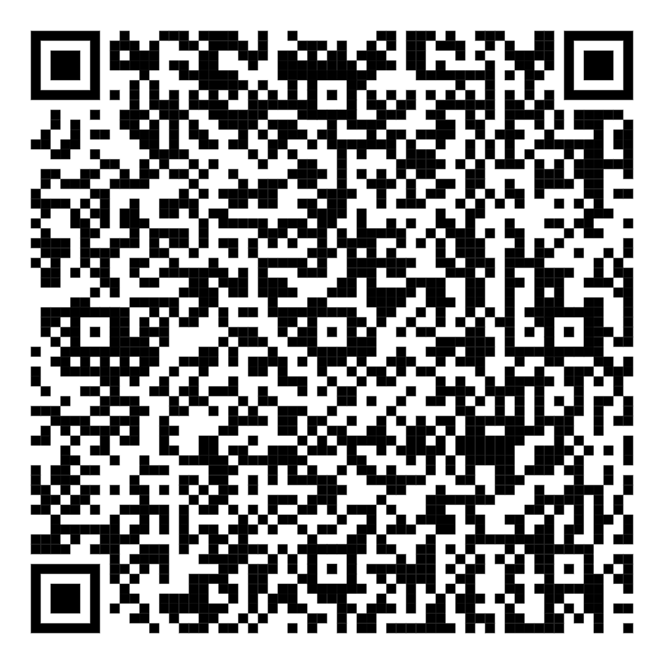
Department
of Recreology and Tourism

Slide 27
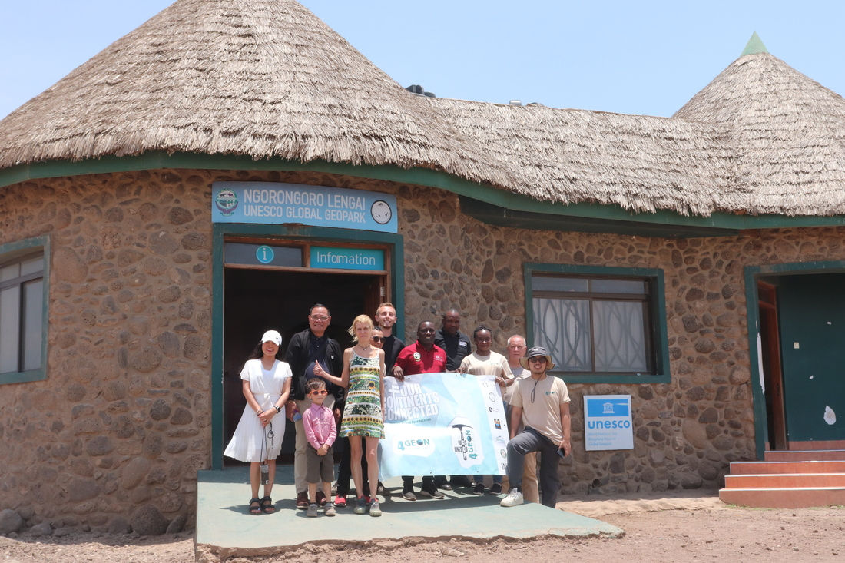
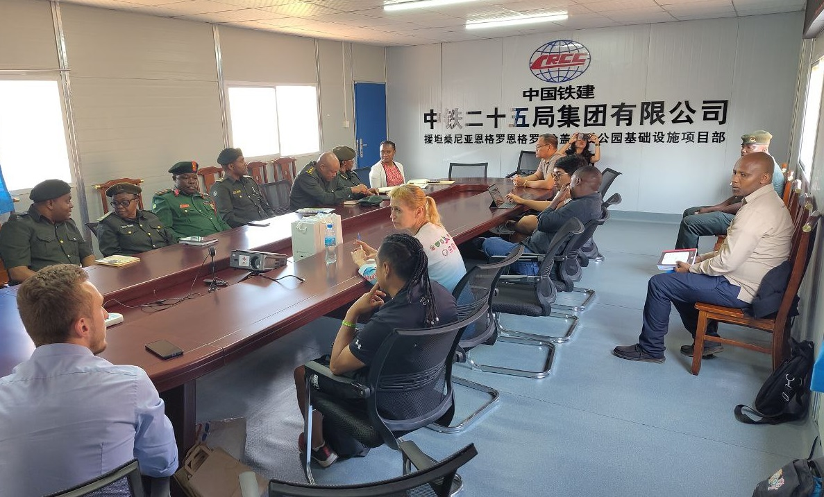
Dept. of Recreology and Tourism – Research Activities
Sustainable and Socially Responsible Tourism
Geotourism with emphasis on geointerpretation and geo-education
Social responsibility in tourism
Use of ICT, modelling and systems approach in tourism sustainability

Slide 28
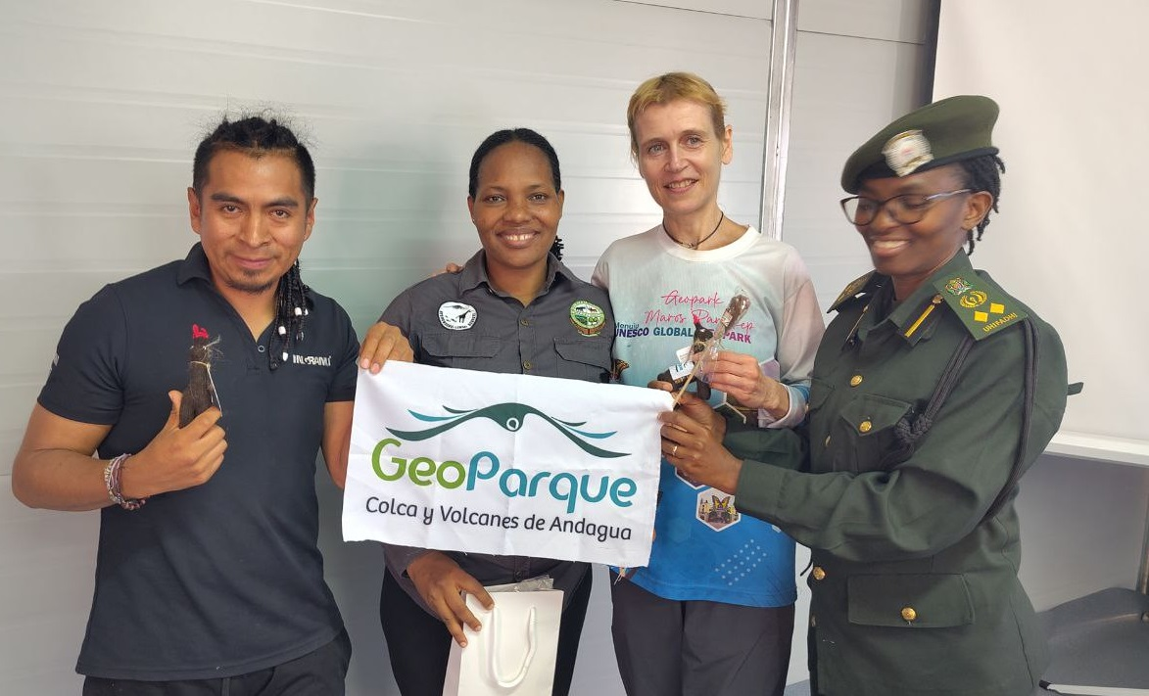
Dept. of Recreology and Tourism – Research Activities
4GEON
The IGCP-751 4GEON project supports geoscience knowledge transfer in geoparks
5 diverse geoparks connected by approach to ABC interpretation and community involvement
Participating goeparks
The Barrandian National Geopark
Rio Coco UNESCO UGGp
Colca y Volcanes de Andagua UGGp
Ngorongoro Lengai UGGp
Bohol Island UGGp

Slide 29

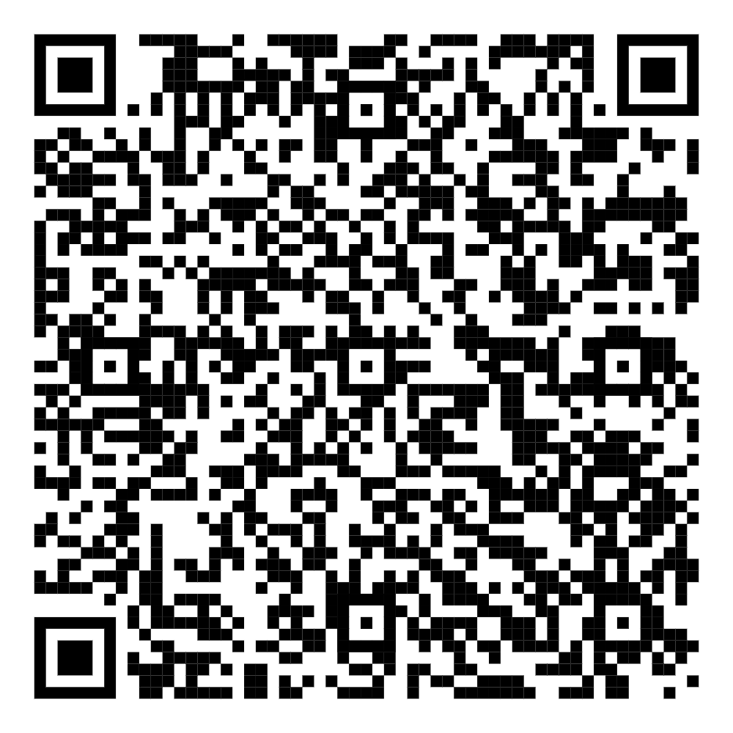
Department
of Applied Linguistics

Slide 30
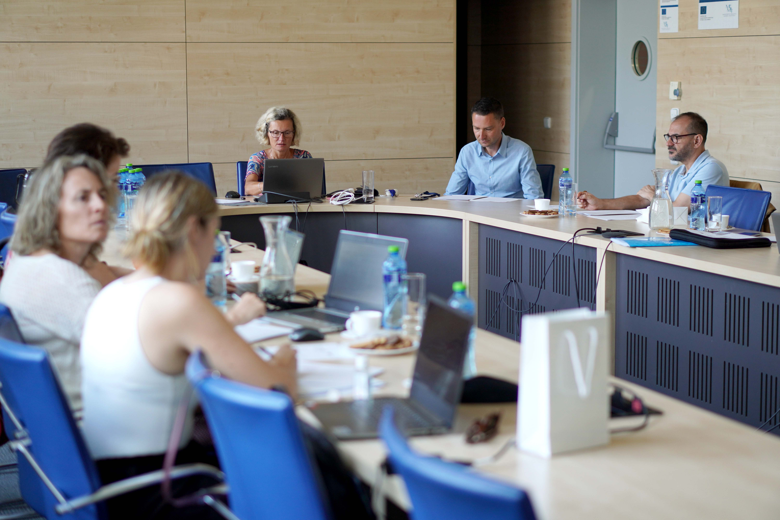
Dept. of Applied Linguistics
Approaches to foreign language teaching and learning
AI in higher education
Linguistic and ethical aspects of digital communication
Efficiency of digital tools for foreign language learning
Quality of Life of older generation in the context of digital education
Business digital communication and intercultural business communication

Slide 31
Dept. of Applied Linguistics - Projects
2023 – 24 Grant of the Fund for Bilateral Relations (reg, no. EHP-BFNU-OVNKM-4-257-01-2023)
Artificial Intelligence in Formal Foreign Language Education (UHK-NTNU)
2022 – 23 Grant of the Fund for Bilateral Relations (reg. no. EHP-BFNU-OVNKM-4-198-01-2022)
Usefulness of Emerging Technologies in Formal Foreign Language Education (UHK-NTNU) https://sites.google.com/view/web-bilateral-initiative
2020 - 24 - COST CA19102 - Language in the Human-Machine Era
2024 – 25 Accelerating Digital Transformation for Higher Education Institutions in Southeast Asia (DX.SEA) – (UHK, other European and Asian universities)

Slide 32


Study Programs

Slide 33
Study Programs
Study programs taught in English
Applied Informatics (B, M, D)
Information Management (B, M, D)
Economics and Management (B, M, D)
Other study programs taught in Czech
Management of Tourism (B)
Cybersecurity (B)
Data Science (M)

Slide 34


International Cooperation

Slide 35
Achievements in International Cooperation
A significant increase of the international pedagogical and research cooperation through:
memberships in MC of COST projects (9), KA2 projects, bilateral projects or Visegrad Funds
memberships in the program and organizing committees of international conferences
invited lectures at the international conferences
ERASMUS mobility academic and student exchanges
summer schools Czech It Out and BIPs
COST LITHME 4th Training School
international conferences

Slide 36
Other Internatioal Projects
Horizon Europe
2025 – 29 Dorian Gray „Digital twinning Of caRdiovascular and cognitIve heAlth: aN inteGrated pRevention strAtegy for healthier aGeing“
ERASMUS+ Cooperation Partnerships Projects
2024 – 27 AI4UNI
2023 – 26 MISS4Health - Micro-credentials in Soft Skills for Healthcare Professionals and Students
2023 – 25 Accelerating Digital Transformation for Higher Education Institutions in Southeast Asia (DX.SEA101083265)
2021 – 23 EducAGE - Improving Competences of Older People Caregivers towards Healthy Ageing through Digital Transformation
Bilateral Projects - Norwegian Funds
2023 – 24 Artificial Intelligence in Formal Foreign Language Education
2022 – 23 Usefulness of Emerging Technologies in Formal Foreign Language Education
Visegrad Funds
2023 – 24 Central European Urban Resilience Handbook for Best Practices

Slide 37
Internationalisation
 | 2019/20 | 2020/21 | 2021/22 | 2022/23 | 2023/24 | 2024/25
Number of incoming students | 186 | 141 | 189 | 235 | 219 | 272
Number of outgoing students | 81 | 29 | 80 | 66 | 67 | 108

Slide 38
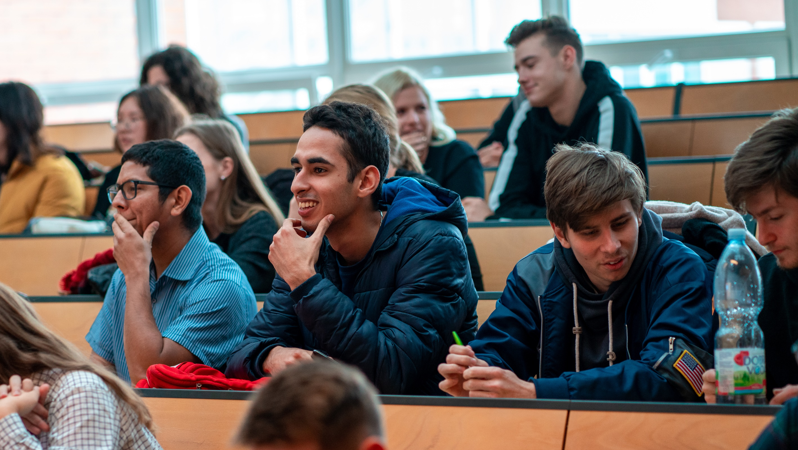
Summer School Czech It Out
2019 - 124
2021 – 24 (online)
2022 – 62
2023 – 38
2024 – 42
2025 - 120

Slide 39
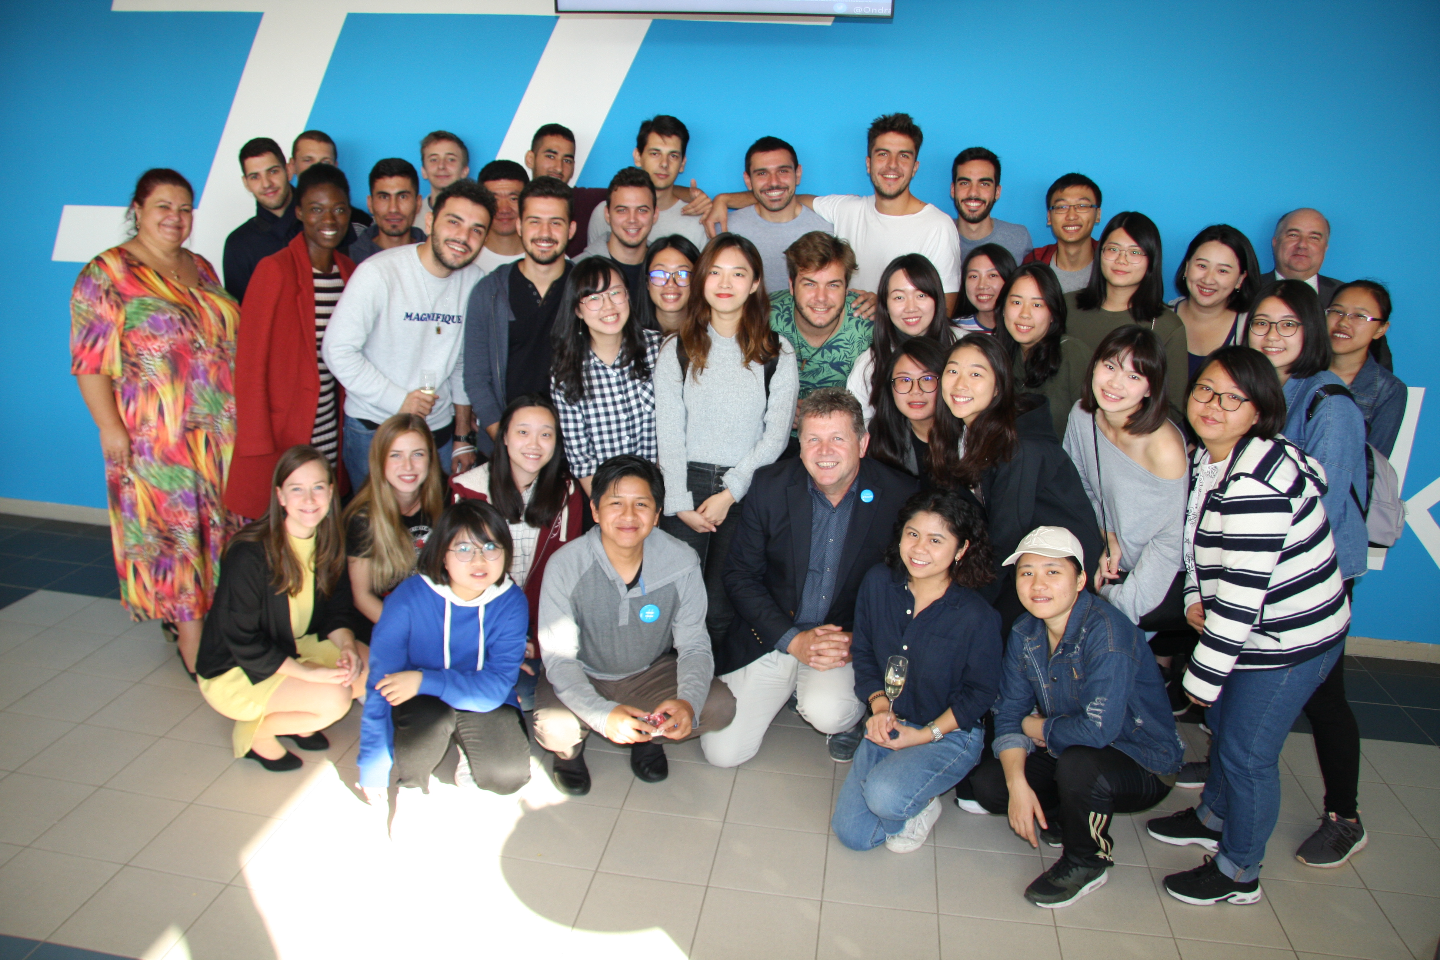
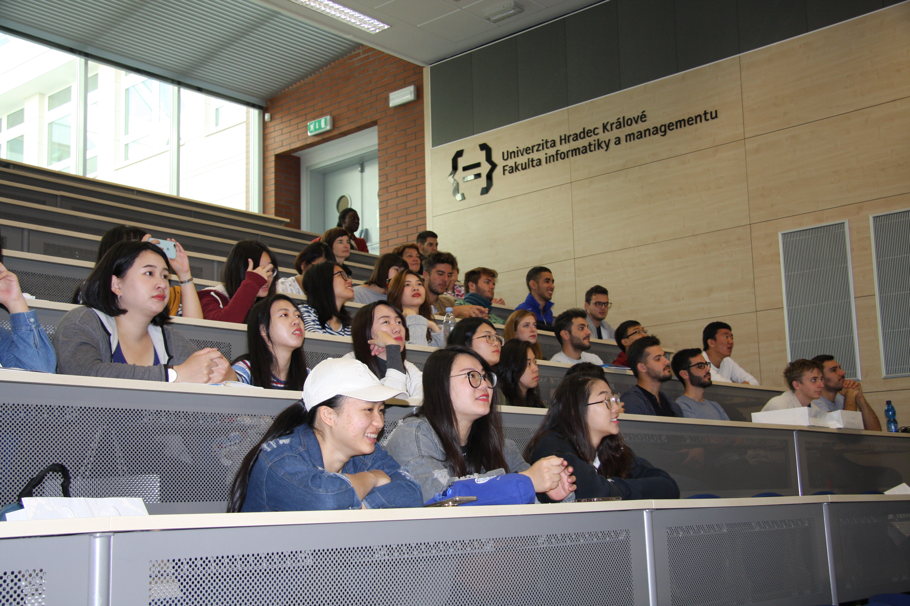
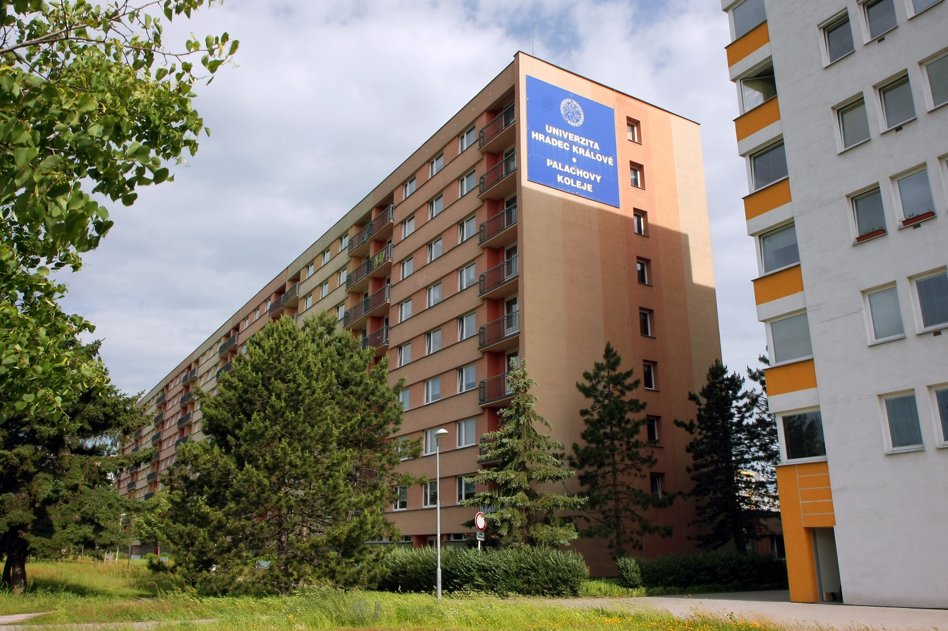
FIM - Mobilities
Mobilities:
Erasmus+ programs
Erasmus+ program for study, teaching, training or internships
Erasmus+ International Credit Mobility
Exchanges based on agreements about cooperation
Course Catalogue
On average 40 subjects available in English per semester
Students can take courses from other faculties (up to 25 % of credits only)
ISCED codes
0413 Management and Administration (includes Tourism, Languages)
0613 Software and applications development and analysis
0688 ICT (Information and Communication Technologies)
University Halls of Residence
25-30 minutes walk or take the city bus
Apartment has 2 bedrooms for 2 or 3 people
Kitchen & bathroom are shared by 4 or 6 students
Laundry, gym
EUR 170 EUR per month

Slide 40










































Achievements in Regional Cooperation
Collaboration with over 200 partner companies
R&D projects
invited lectures (more than 40 per year)
practical projects (approx. 60 per year)
supervision of final theses
20 partner schools
lectures, excursions, competitions
FIM UHK, CZECH REPUBLIC

Slide 41
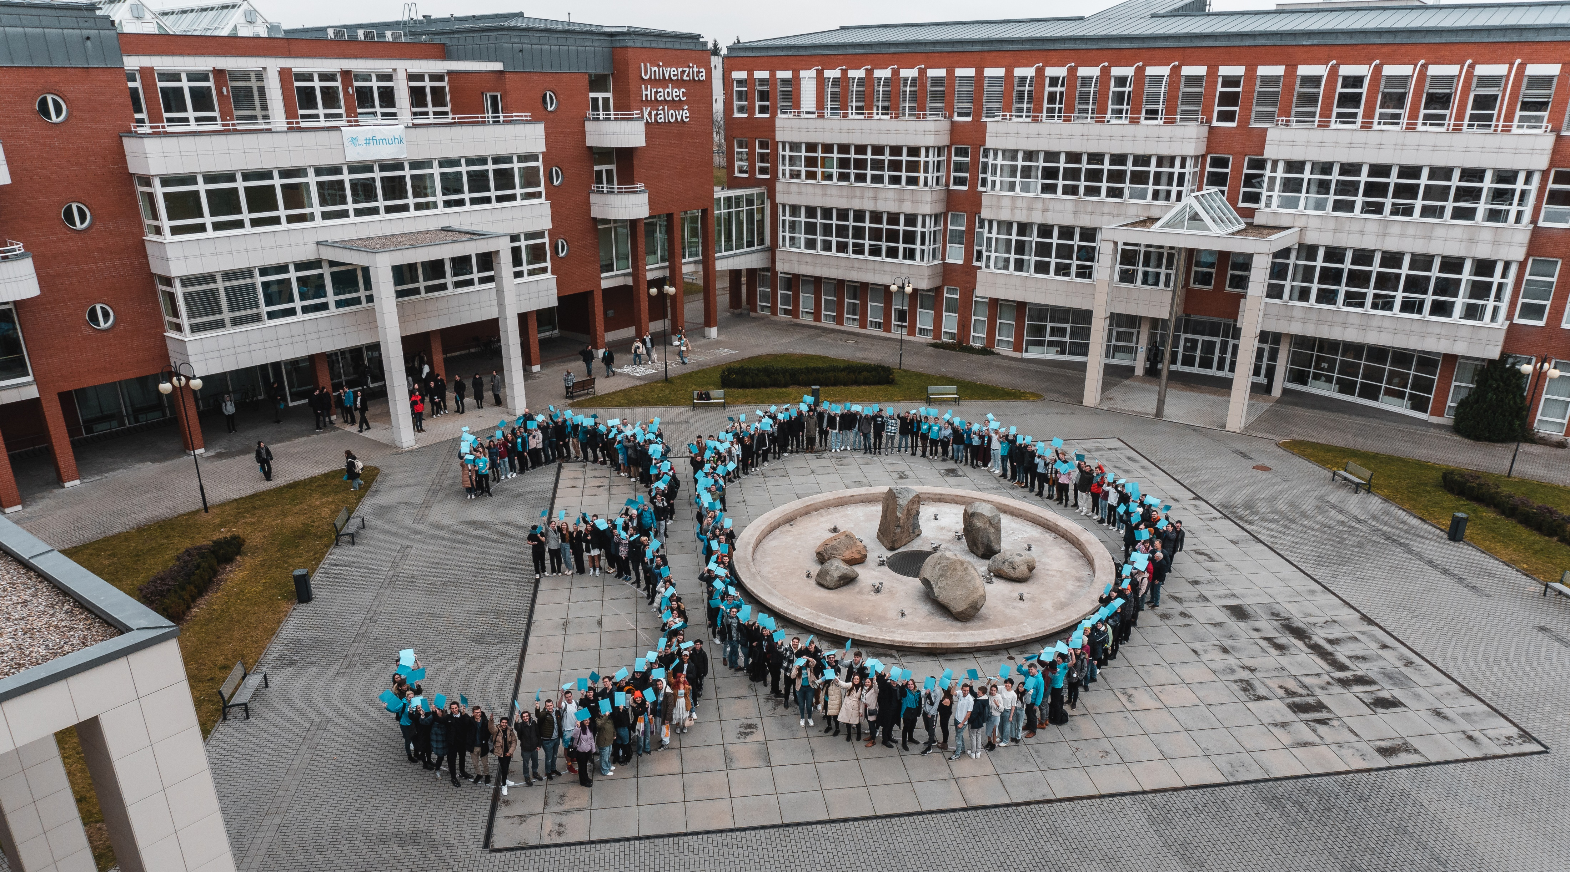



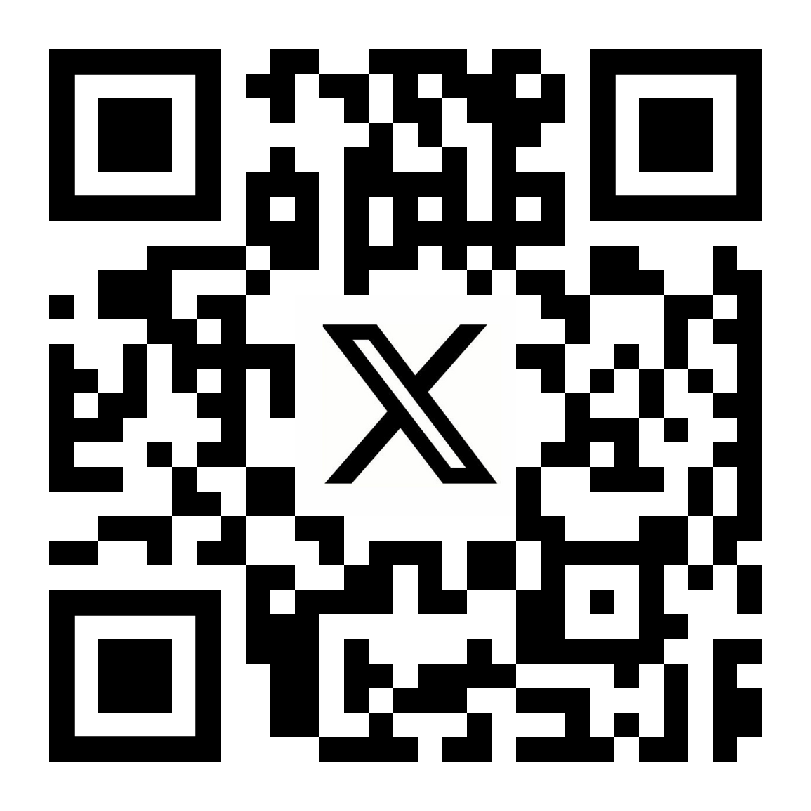
www.uhk.cz/en/fim

