Slide 1
The TOEFL ITP® Tests:
Expand Possibilities through English

Slide 2

Global trends show there are more people than ever studying English*.
Common Language
  ~20% of the population speak English
  ~1.5 billion English-language learners worldwide today.
Economic Value
  Emerging economies and developing countries increasingly recognize the economic value of producing large numbers of skilled graduates able to communicate in English
Internationalization
  Internationalization of education is having a strong impact on the need to learn English, which has increased the need for English Language Learning.
Expected growth
  The number of English learners around the world is only expected to grow.
*Source: https://www.babbel.com/en/magazine/how-many-people-speak-english-and-where-is-it-spoken/

Slide 3
Institutions, Teachers and Students have specific needs for English language assessments.
Institutions/Teachers Need
  Ability to measure students’ English language ability over time
  Data to make confident decisions about their students’ progress
  Flexibility to test when they need to test
Students Need
  More opportunities to prove themselves and expand their possibilities
  Short-term, non-degree and collaborative international programs and scholarship programs around the world

Slide 4
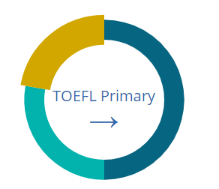
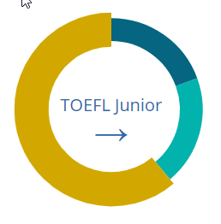
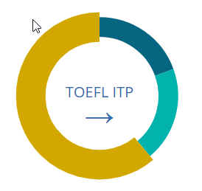
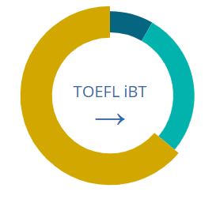

The TOEFL® Family of Assessments is backed by more than 55 years of research from world-renowned experts of assessment and linguistics.
All TOEFL® tests measure skills across 3 domains: academic, navigational and social/interpersonal.
These domains encompass the skills needed to learn and succeed in the classroom and on campus.
TOEFL Primary®
tests
TOEFL Junior®
tests
TOEFL ITP®
tests
TOEFL iBT®
test

Slide 5

The TOEFL ITP® tests are trusted by more than 2,500 institutions, in over 50 countries around the world.
University of Applied Sciences Dusseldorf, Germany
Handong Global University, Korea
Program in American Language Studies, Rutgers University, USA
Skema Business School, France
Good Hope School, Hong Kong
Ohio University, USA
Tohoku University, Japan
Kiang Wu Nursing School, Macau
University of Jordan, Jordan
Universidad De Monterrey, Mexico
Thai Nguyen University of Technology, Vietnam
Universidad de Cordoba, Colombia
Brawijaya University, Indonesia
ICPNA Cusco, Peru
Universidad de Chile, Chile

Slide 6
The TOEFL ITP® tests are trusted by more than 2,500 institutions, in over 50 countries around the world.
“The TOEFL ITP tests made our program more data-driven. Now we know a student’s ability instead of making subjective statements.”
-Peter Chang, Assistant Director, Program in American Language Studies, Rutgers University, USA
University of Applied Sciences Dusseldorf, Germany
Handong Global University, Korea
Program in American Language Studies, Rutgers University, USA
Skema Business School, France
Good Hope School, Hong Kong
Ohio University, USA
Tohoku University, Japan
Kiang Wu Nursing School, Macau
University of Jordan, Jordan
Universidad De Monterrey, Mexico
Thai Nguyen University of Technology, Vietnam
Universidad de Cordoba, Colombia
Brawijaya University, Indonesia
ICPNA Cusco, Peru
Universidad de Chile, Chile

Slide 7

The TOEFL ITP® Tests are MORE Than Just Tests!
They are a tool that…
Empowers the teacher and the institution providing data needed to make decisions
Helps institutions improve teaching effectiveness with confidence
Gives students more scholarship and admission opportunities
Notes:
1. Empowers the teacher and the institution
The TOEFL ITP Assessment Series brings decades of global experience in English-language measurement to your program and your classroom – giving teachers the data they need to make confident decisions. It effectively measures proficiency for English-language program placement, progress monitoring and exit. This series provides two testing levels and flexible administrations which allows teachers to test when they need to test.
2. Helps institutions improve teaching effectiveness with confidence
Trusted global English-language testing brand backed by 50+ years of research and assessment development experience, TOEFL ITP scores measure a student's true ability to actually communicate in English, using critical language skills needed in the classroom.
3. Gives students more opportunities
The TOEFL ITP Assessment Series is accepted by short-term non-degree and collaborative international programs and scholarship programs around the world, giving students more opportunities to prove themselves and expand their possibilities.

Slide 8
“I think the scores help us start the conversation, which leads us towards analyzing what we need to do for each student.”
- Fiona Hu, Instructor, Program in American Language Studies, Rutgers University, USA

Slide 9


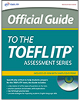
The TOEFL ITP® tests offer teachers, institutions and students the options needed to support their goals and objectives.
Institutions
Students
Placement in intensive English-language programs
Progress Monitoring in English-language programs
Exiting from English-language programs
Scholarship Programs
Admission to short-term, non-degree programs and collaborative international degree programs
Skill Building and Preparation for the TOEFL iBT® test

Slide 10
Overview of the TOEFL ITP® Assessment Series.
Tests
Teacher Resources
Student Resources
Level 1
Official Guide to the TOEFL ITP® Assessment Series
TOEFL ITP® Teacher Workshop
TOEFL® Connect Portal
Level 1 Practice Tests, Volume 1
Level 2 Practice Tests, Volume1
Test Taker Handbook
Level 2
Reporting/Certificates
Score Reports
Certificates
Confidence in English abilities of students to
open future opportunities

Slide 11



The TOEFL ITP® tests give educators the ability to assess students' proficiency in three different skills providing the data to make confident decisions along the way.
Listening Comprehension
Structure
and
Written Expression
Reading Comprehension
Measures the ability to recognize language appropriate for standard written English
Contains sentences that test knowledge of important structural and grammatical elements of standard written English
Measures the ability to understand both short and long conversations in English
Contains recorded material reflecting what a student might hear among students at an English-speaking college or university
Measures the ability to read and understand short passages at the university level
Contains reading passages with questions about the passages

Slide 12
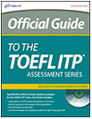
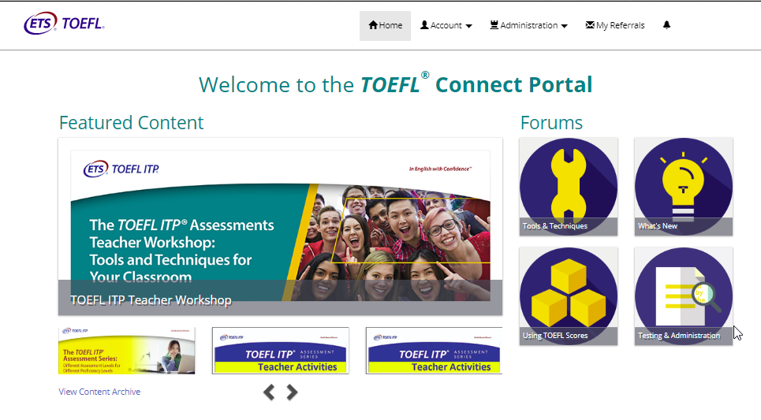
The TOEFL ITP® Assessment Series provides teachers and institutions with the tools and resources to enhance their programs.
Official Guide to the TOEFL ITP® Assessment Series
  A description of all the types of questions on the test
  Practice questions and answers with explanations
  Two full-length practice tests
  Useful strategies for improving academic English skills
  A CD-ROM for the Listening section (Mac® compatible)
Teacher Workshop
  One-day workshop
  Provides deeper understanding of test content, format, communication goals and skills assessment
  Features the Teacher Workshop Manual for the TOEFL ITP® Test, provides activities instructors can use in their classrooms
TOEFL® Connect Portal
  Communications portal
  Provides direct access to ETS, other English language educators, administrators and TOEFL ITP score users from around the world

Slide 13
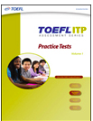


The TOEFL ITP® Assessment Series provides students with test preparation materials to help them succeed on the tests.
  Level 1 Practice Tests, Volume 1
    Two complete practice tests
    CD-ROM of the Listening passages
    Answer keys
    Scoring information
    Study tips and test taking strategies
  Level 2 Practice Tests, Volume 1
    One complete practice test
    CD-ROM of the Listening section
    Answer key
    Scoring information
    Study tips and test taking strategies
  Test Taker Handbook
    Information on what to do before the test
    What to expect on test day
    Getting ready for the test
    Score reporting
    Policies and guidelines

Slide 14
The TOEFL ITP® tests give teachers and institutions MORE flexibility and convenience.
Test throughout the year with multiple test forms
Test groups of any size
Set your own test dates and times
Measure progress using multiple test forms

Slide 15
The TOEFL ITP® tests provide teachers and institutions with flexibility and a strong foundation with which to measure their students’ English skills.
Available in paper and digital formats so you can select the testing option which best meets your schools needs
Offers two proficiency levels so you can administer the tests to all your students regardless of their English learning level
  Level 1 – Intermediate to advanced
  Level 2 – High beginner to intermediate
Level 1 evaluates skills in three areas (140 Questions|115 Minutes)
to obtain a comprehensive measurement of your students’
English ability
  Reading Comprehension (50 Questions|55 Minutes)
  Listening Comprehension (50 Questions|35 Minutes)
  Structure and Written Expression (40 Questions|25 Minutes)
Level 1 maps to the CEFR range A2-C1 to align to the global standard of measurement

Slide 16
The TOEFL ITP® tests provide teachers and institutions with flexibility and a strong foundation with which to measure their students’ English skills. (continued)
Level 2 evaluates skills in three areas (95 Questions|70 Minutes)
to obtain a comprehensive measurement of your students’
English ability
  Reading Comprehension (40 Questions|31 Minutes)
  Listening Comprehension (30 Questions|22 Minutes)
  Structure and Written Expression (25 Questions|17 Minutes)
Level 2 maps to the CEFR range A2-B1 to align to the global standard of measurement

Slide 17
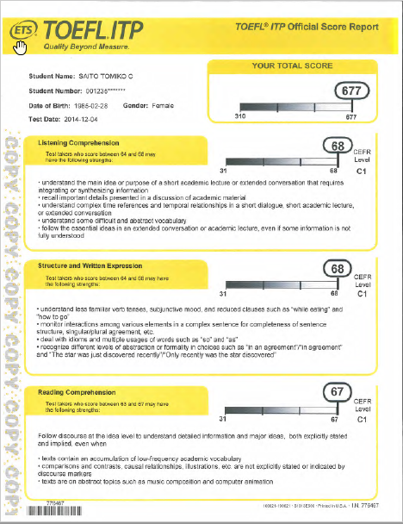
The TOEFL ITP® Tests provides detailed score reports to help better assess a student’s progress.
Students receive three section scores (with performance descriptors and CEFR score) and a total test score to clearly define performance
Score reports provide sub-score data so instructors can better evaluate student learning
Scores are provided as soon as 7 business days after receiving answer sheets so adjustments to curriculum can be made, as needed

Slide 18
“Students want to see how they’re doing. How they compare at an international level. The TOEFL ITP® test is a real motivator.”
- Alvaro Del Castillo, Director, Centro Boliviano Americano

Slide 19
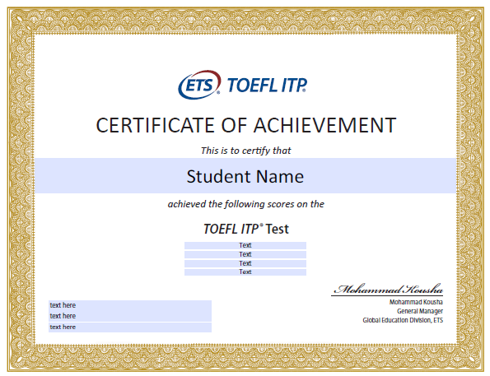
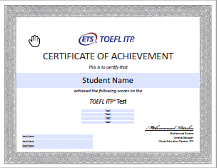
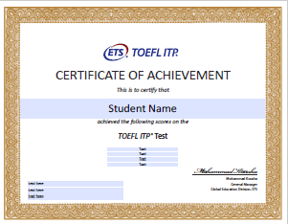
TOEFL ITP® Test certificates show proof of English language ability and instill confidence and motivation to pursue new opportunities.
Gold, Silver and Bronze Certificates awarded to test takers who achieve the required scores

Slide 20
“The only number, the only grade, the only tool that gives us the reality of a student in an international scenario is the TOEFL ITP® test.”
- Alvaro Del Castillo, Director, Centro Boliviano Americano

Slide 21
For more information on the
TOEFL ITP® tests, contact your Local
ETS Preferred Network (EPN) Office or visit: ets.org/toefl_itp

