Slide 1
Marzieh Baradaran
Supervisor: RNDr. Jiří Lipovský
Department of Physics
Email: marzieh.baradaran@uhk.cz

Slide 2
About
Education
• PhD in Theoretical Physics (2018)
• MSc in Theoretical Physics
• BSc in Physics
Work and research experience
Teaching Assistant, University of Guilan, Iran (2013 - 2015)
Teacher, University of Guilan, Iran (2015 - 2018)
Visiting PhD student (November 2016 - June 2017), Complutense University of Madrid, Spain
Postdoctoral fellow (April 2019 - April 2021), Czech Technical University in Prague, Czechia
Postdoctoral Researcher (May 2021 - Present), University of Hradec Králové

Slide 3
Research interests
Theoretical and mathematical physics; in particular:
Spectral properties of quantum graphs
Quasi-exactly solvable and integrable quantum systems
Exact solutions of relativistic and non-relativistic wave equations
Representation theory of Lie groups

Slide 4
Submitted papers, preprints, and ongoing research at UHK
Submitted paper
Kagome network with vertex coupling of a preferred orientation, Journal of Mathematical Physics, arXiv:2106.16019
Preprint
Magnetic ring chains with vertex coupling of a preferred orientation, arXiv:2201.01502
Ongoing research
Spectral properties of perturbed quantum graphs in the presence of different types of coupling conditions at the graph vertices.

Slide 5
Conferences and seminars
Conference
“Quasi-exactly solvable sytems: the Lie algebraic approach and the Bethe ansatz”
The fourth International Conference on Technology and Science-2021, November 18th , 2021, Turkey
Seminar
“Spectrum of a kagome network”
A microseminar organized by UHK, December 2nd , 2021

Slide 6
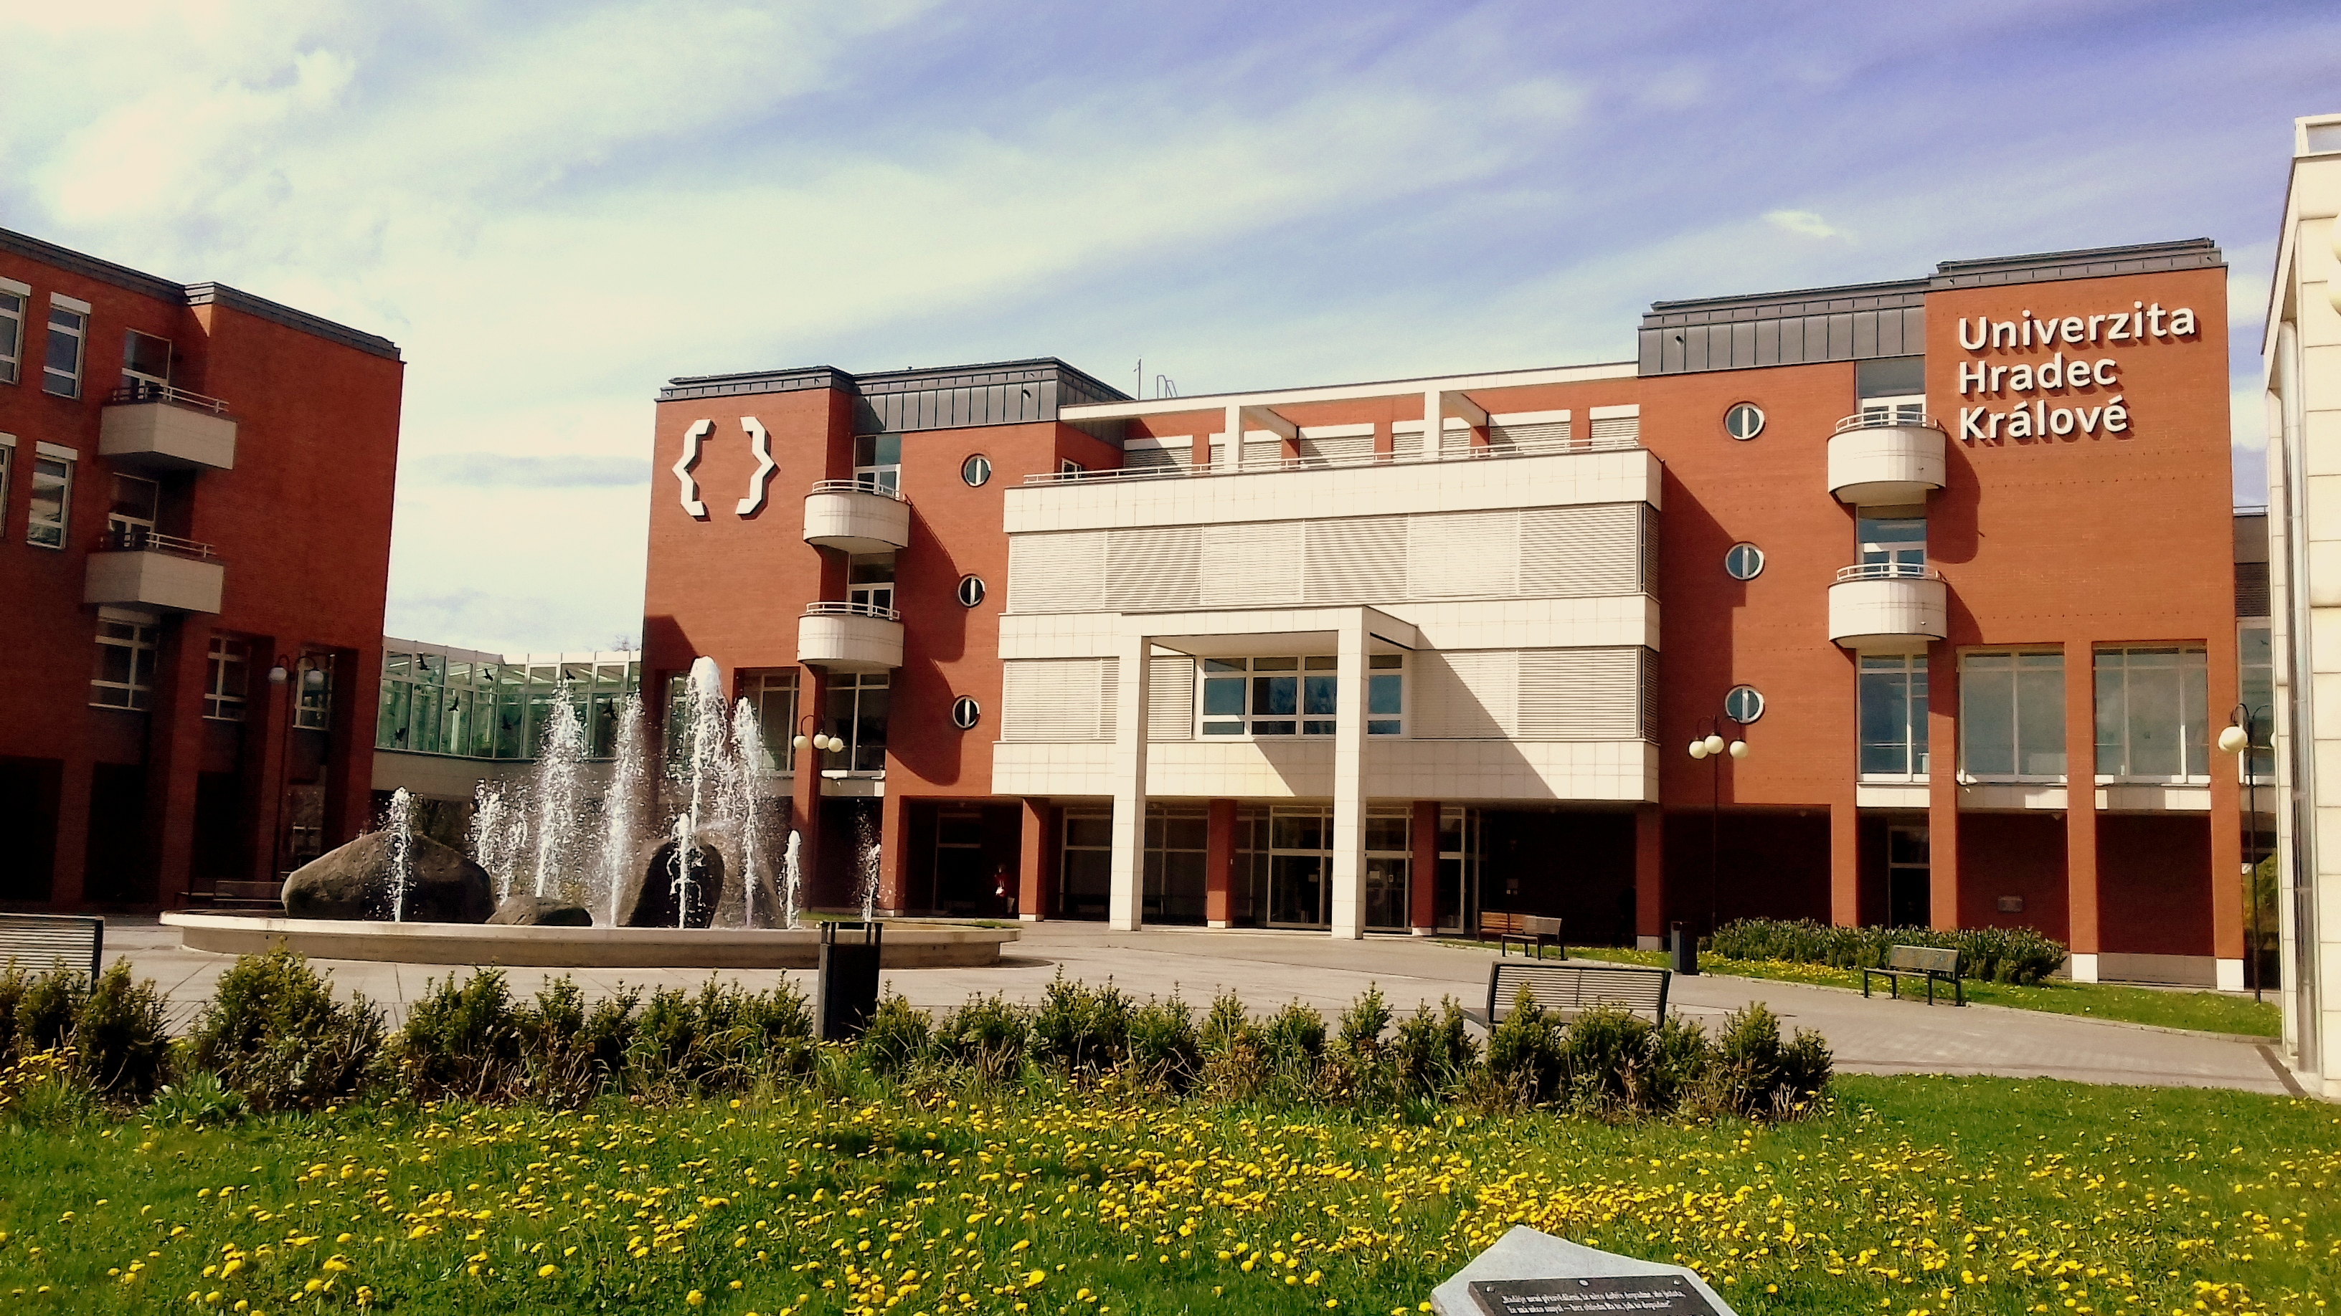
Thank you!

