Slide 1

RESEARCH ACTIVITIES
(January 17th, 2024)
Toshitaka Hayashi.
toshitaka.hayashi@uhk.cz
Supervisor: Richard Cimler, Ph.D.
Faculty of Science

Slide 2
Brief biography and research interests
Education:
  Ph.D. (Software and Information Science), Iwate Prefectural University, Japan, 2021.
Working experience:
  Postdoctoral researcher (October 2021-Present), University of Hradec Kralove
Research interest
  Machine learning with limited data.
The main research keywords:
  One-class Classification
  Self-supervised learning
Research project at UHK:
  Unseen data discovery using Ballistocardiogram (BCG) signals (-2023)
  One-class classification for time series data (2024-2026)

Slide 3
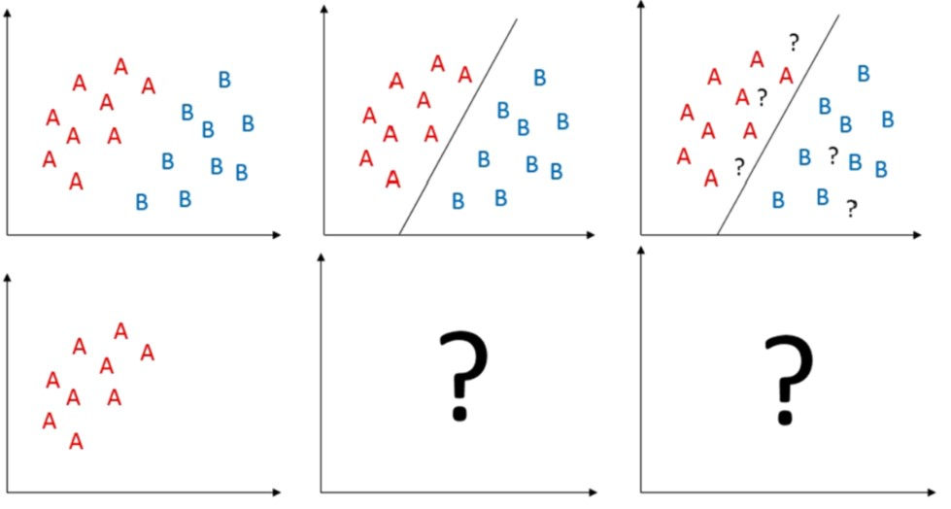
1st interest: One-class classification
Training data
Training stage
Testing stage
Supervised classification
One-class classification

Slide 4
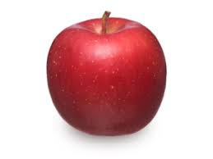

2nd interest: Self-supervised learning
Self-labeled dataset
One
0°
90°
180°
270°
Training
Rotation Prediction
model
Prediction is OK: One
Not OK: Other
Other

Slide 5
One-class classification for time series
Goal
  Develop OCC algorithms for time series data
Expected outputs are categorized into the following contents:
  Develop OCC algorithms with new hypotheses focused on specific symptoms, or individual difference between patients.
  Extending OCC algorithms for images into time series data.
  Extending time series OCC algorithms to other data types for obtaining different views.
  Application of OCC for biometric signals

Slide 6
Publication in UHK
Year | Paper title | Journal name
2022 | OCFSP: Self-supervised One-class Classification Approach Using Feature-slide Prediction Subtask for Feature Data | Soft Computing
2022 | OCSTN: One-class time-series classification approach using signal transformation network into a goal signal | Information Sciences
2023 | Classification of health deterioration by geometric invariants | Computer Methods and Programs in Biomedicine
2023 | Distance-based one-class time-series classification approach using local cluster balance | Expert Systems with Application
2023 | Image Entropy Equalization: a novel preprocessing technique for image recognition tasks | Information Sciences
2023 | Patient deterioration detection using one-class classification via cluster period estimation subtask | Information Sciences
2023 | Interpretable synthetic signals for explainable one-class time-series classification | Engineering Application of Artificial Intelligence

Slide 7
Conference papers
Conference paper | Conference information
Image Entropy Equalization for Autoencoder-Based One-Class Classification | SOMET 2022: 20-22 September 2022, Kitakyushu, Japan
Machine learning could be easier if all data were MNIST | SOMET 2023: 20-22 September 2023 Naples, Italy

Slide 8
On-going research
Topic
Developing OCC algorithms for specific symptoms
Deterioration detection via remaining life prediction subtask
One-class classification with local features in image
Pretrained model for time series data
Considering new pretext tasks for one-class classification

Slide 9
Thank you very much!
Email: toshitaka.hayashi@uhk.cz

